Slide 1


Slide 2
WebAdMIT and Configuration Portal Rewind
Reggie Ross / July 28, 2022 / 2:45 PM

Slide 3


Agenda
Release Notes process
Review updates to WebAdMIT (June 2021 to now)
Review updates to the Configuration Portal (June 2021 to now)
Review updates to the Universal Advisor Portal (June 2021 to now)

Slide 4

Reggie Ross
Training Strategist

Slide 5
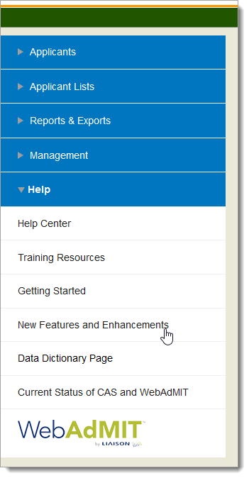
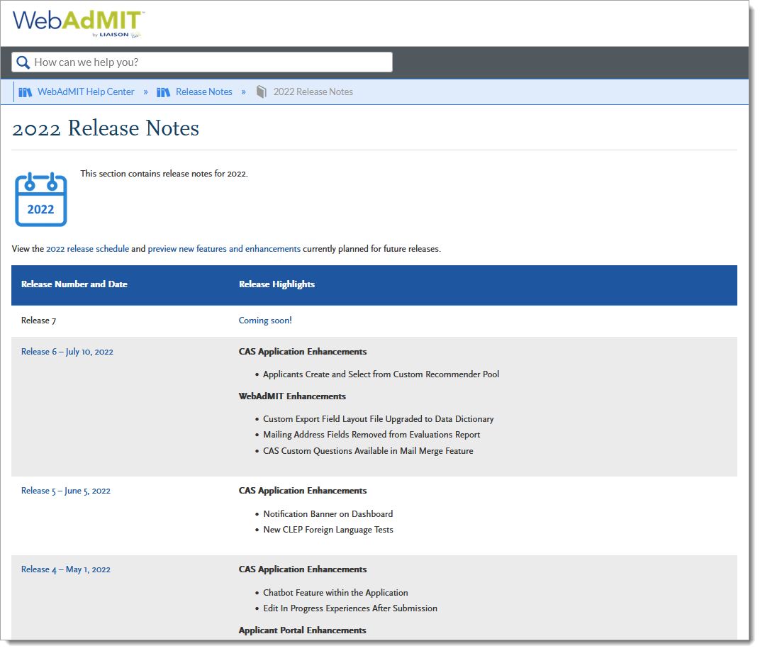
Release Notes Process

Slide 6
WebAdMIT Enhancements

Slide 7
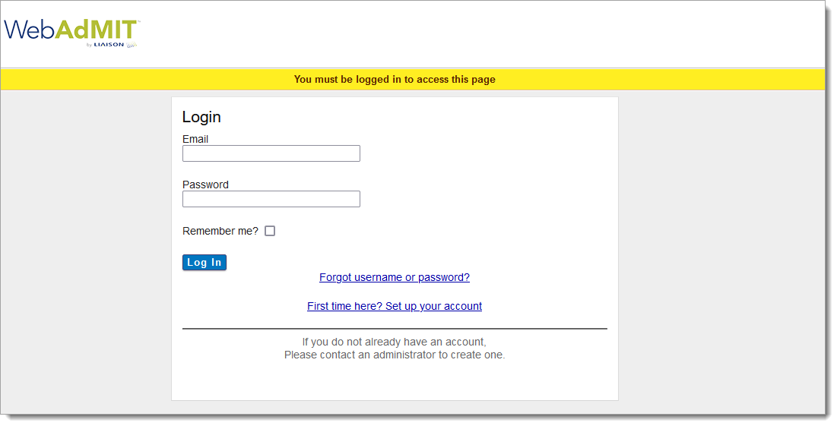
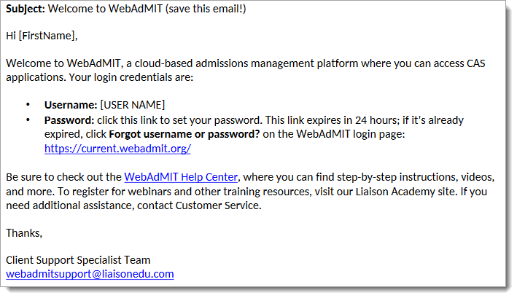
Account Creation & Password Reset Email Changes
Notes:
https://help.liaisonedu.com/Release_Notes/2022_Release_Notes/Release_01
The WebAdMIT new user and password reset email was separated into two emails and updated to better meet your needs.
The WebAdMIT new user email is sent when you create an account for an admissions user. It includes information about WebAdMIT, their login credentials, and a link to the WebAdMIT Help Center, where they can access all our help content, including step-by-step instructions, best practices, videos, and more.
The password reset email is sent when you request a new password. It includes your login credentials and a unique link to reset your password.

Slide 8
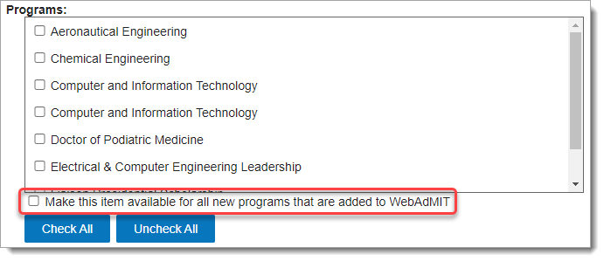
Automatically Activate Features for Programs Added Mid-Cycle
Notes:
https://help.liaisonedu.com/Release_Notes/2021_Release_Notes/Release_11
WebAdMIT now allows you to select if the following features are activated automatically for programs added mid-cycle through the Configuration Portal:
Admissions Users
Local Statuses
Custom Fields
Applicant Header
Note that:
You must select Make this item available for all new programs that are added to WebAdMIT for each user and template. This allows you to control the specific users and templates that have new programs automatically available to them.
After programs are automatically added, you can later edit the users and templates to remove the new programs.
This enhancement is especially useful if your CAS allows you to add programs mid-cycle through the Configuration Portal, as you won’t need to add your new programs to each user and template. For example, if you select Make this item available for all new programs that are added to WebAdMIT for your users and later create program D mid-cycle, then all your admissions users will automatically have program D added to their account once your program is approved.

Slide 9
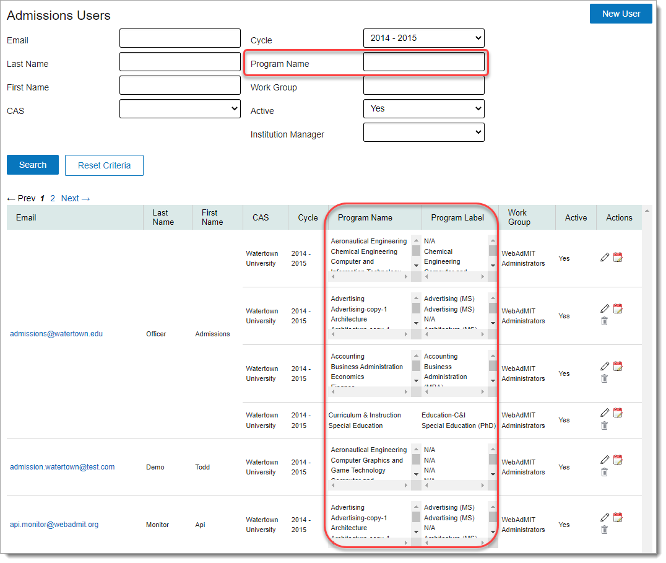
Program Search and Result Updates on the Admissions Users Page
Notes:
https://help.liaisonedu.com/Release_Notes/2021_Release_Notes/Release_11
On the Admissions Users page, the program data in the search results table was updated to include two columns: Program Name and Program Label (which corresponds with the WebAdMIT Label field in the Configuration Portal). The programs in these columns are sorted alphabetically.
Additionally, the Program search field on the Admissions Users page was updated to Program Name, to more clearly identify which program data you can search by. Previously, the Program search field would gather results from a program’s Program Label, and if one wasn’t available, its Program Name.

Slide 10
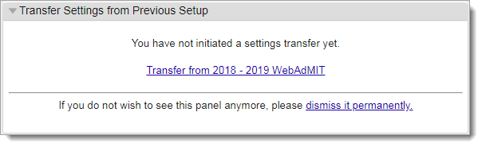
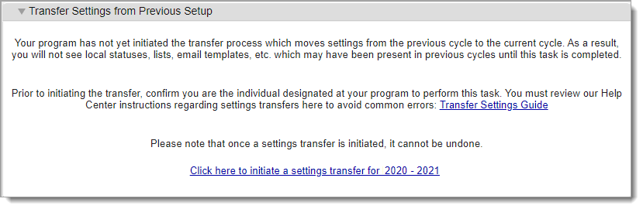
Transfer Settings Panel Updates
Notes:
https://help.liaisonedu.com/Release_Notes/2021_Release_Notes/Release_12
The Transfer Settings feature allows you to transfer templates you built in WebAdMIT from a previous cycle to a current cycle. With this enhancement, the option to dismiss the panel permanently was removed. This ensures that no one accidentally dismisses the panel, as dismissing it removed the panel from all users at the organization, including the users who manage this process at their organization. Additionally, the Transfer Settings panel has an updated message with clearer directions on what the feature is, how to use it, and a link to the Transfer Settings Guide.

Slide 11
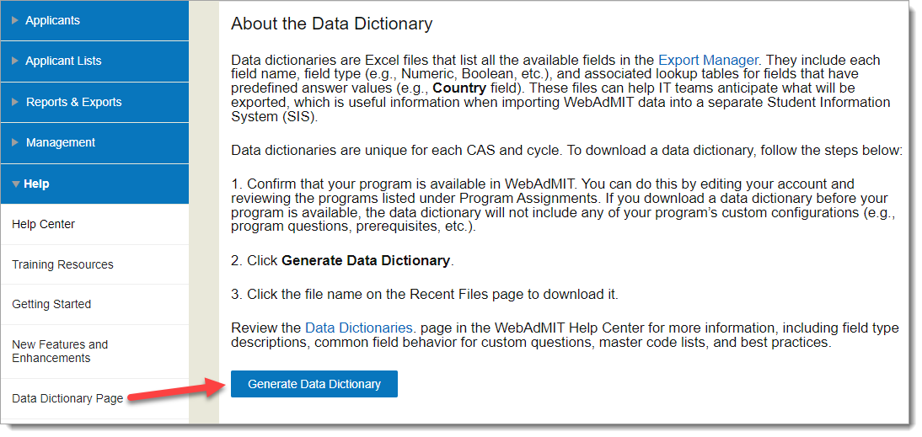
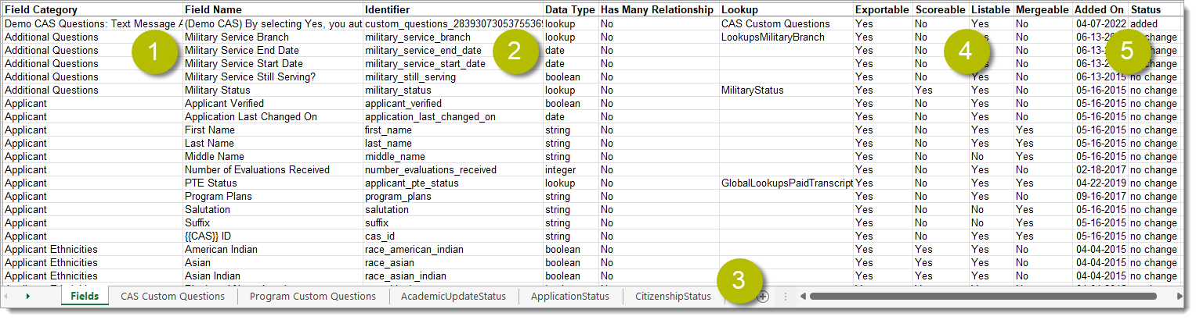
New WebAdMIT Data Dictionary
Notes:
https://help.liaisonedu.com/Release_Notes/2022_Release_Notes/Release_06
https://help.liaisonedu.com/Release_Notes/2021_Release_Notes/Release_11
Custom Export Field Layout File Upgraded to Data Dictionary
IPEDS Code Updates in Master College Code List
You can now initiate and download your CAS’s data dictionary (formerly Custom Export Field Layout file) under the Help panel in WebAdMIT. The data dictionary lists all the available fields in the Export Manager and Report Manager and includes each field name, field type (numeric, Boolean, etc.), and associated lookup tables.
Previously, Custom Export Field Layout files were produced by Liaison, accessible in the help center, and updated by Liaison at key points in the cycle. With this enhancement, you can click the Generate Data Dictionary button within WebAdMIT to automatically create and download a data dictionary. The upgraded data dictionary also contains additional fields, including organization-level and program-level questions you built in the Configuration Portal. Review the Data Dictionaries and Master Code Lists page for more information about these changes, as well as best practices and tips.
IPEDS codes for numerous colleges were added.
IPEDS is the Integrated Postsecondary Education Data System. It is a system of interrelated surveys conducted annually by the U.S. Department of Education's National Center for Education Statistics

Slide 12
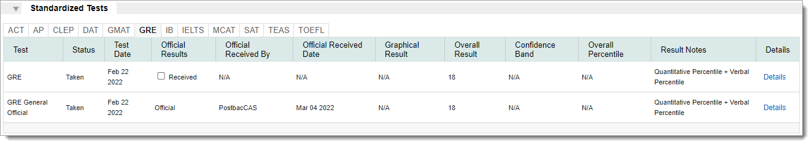
Standardized Test Updates
Notes:
https://help.liaisonedu.com/Release_Notes/2022_Release_Notes/Release_04
The Standardized Tests panel on the Applicant Details Page now has subpanels for each test type (e.g., GRE, TOEFL, MCAT, etc.) available in the CAS. If an applicant has both self-reported and official test scores for a specific test type, those will all be listed under the test type subpanel.
We’ve also standardized the field names of the standardized tests in the following format: (test name) Official (field name) (e.g., MCAT Official Test Date). You can view these updated field names in the List Manager, Export Manager, and Scoring. This enhancement allows you to more easily navigate test score fields

Slide 13

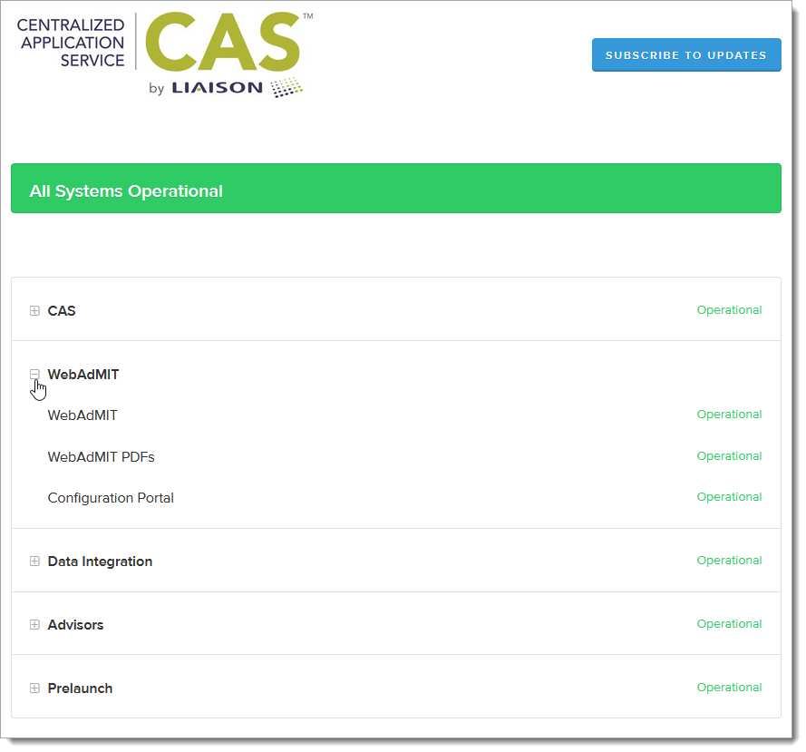
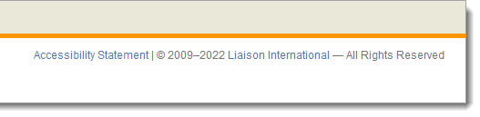
Status and Accessibility
Notes:
https://help.liaisonedu.com/Release_Notes/2021_Release_Notes/Release_05
https://help.liaisonedu.com/Release_Notes/2021_Release_Notes/Release_08
A Current Status of CAS and WebAdMIT link has been added to the Menu Bar, linking to https://status.liaisonedu.com/.
You can access Liaison’s Accessibility Statement in the footer of WebAdMIT. This page provides details about our 508 compliance and links to WebAdMIT’s VPAT.

Slide 14

Lookup Table Updates
Annual Fall 2021 Lookup Updates
Annual Spring 2022 Lookup Updates
Notes:
https://help.liaisonedu.com/Release_Notes/2021_Release_Notes/Release_08
https://help.liaisonedu.com/Release_Notes/2022_Release_Notes/Release_02
Many fields in the Applicant Portal contain predefined answer values that applicants can select. For example, the Country and County fields both have predefined answer values. These values are contained in shared “lookup tables.” With this release, the second of two semi-annual updates to these lookup tables has been implemented.

Slide 15
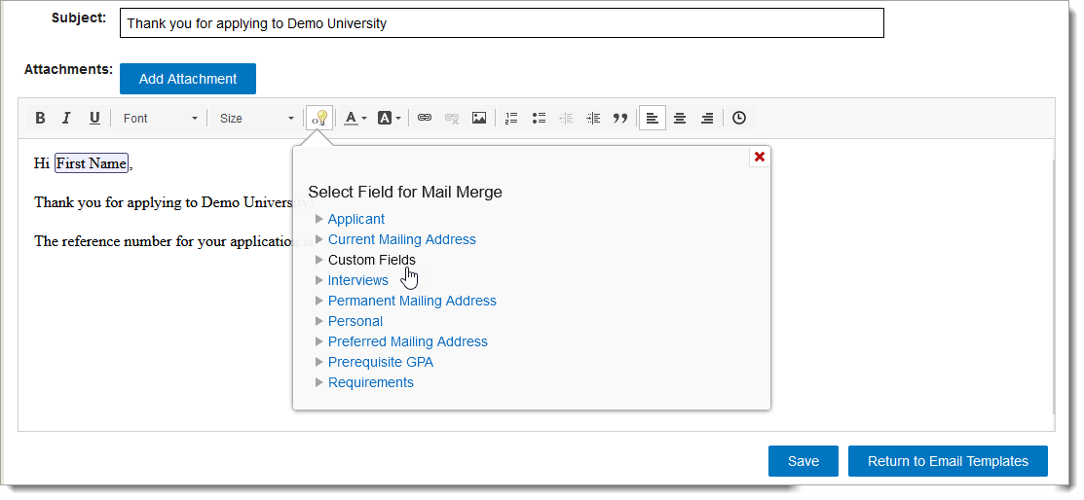
Email Template Mail Merge Updates
Notes:
https://help.liaisonedu.com/Release_Notes/2021_Release_Notes/Release_08
https://help.liaisonedu.com/Release_Notes/2022_Release_Notes/Release_06
When you create Custom Fields, you can include special characters in the label (i.e., name) field. Additionally, you can include Custom Fields labels as merge fields in the File Name Pattern field in the PDF Manager. Previously, if you used a Custom Field label containing a special character as a merge field, the PDF template would not save. This enhancement automatically removes special characters from the Custom Field merge field names on screen. The special characters will still be included in the file names for any PDF Manager jobs you run and download.
The Mail Merge options also now include CAS Custom Questions, so you can add those merge fields to include information your applicants provided to you in response to some of the Custom Questions that were asked on the application.

Slide 16
Export and Report Manager Updates
CAS Updates Field Selections
Kira Assessment URL Field in Export Manager
Text Authorization, Phone Type, and Notes Data Added to Partial View Applicant Exports
Custom Program Plans Question
Mailing Address Fields Removed from Evaluations Report
Notes:
https://help.liaisonedu.com/Release_Notes/2021_Release_Notes/Release_11
https://help.liaisonedu.com/Release_Notes/2021_Release_Notes/Release_06
https://help.liaisonedu.com/Release_Notes/2022_Release_Notes/Release_01
https://help.liaisonedu.com/Release_Notes/2022_Release_Notes/Release_02
https://help.liaisonedu.com/Release_Notes/2022_Release_Notes/Release_06

Slide 17
Fee Waiver Eligible Status Updated
Notes:
https://help.liaisonedu.com/Release_Notes/2021_Release_Notes/Release_07

Slide 18
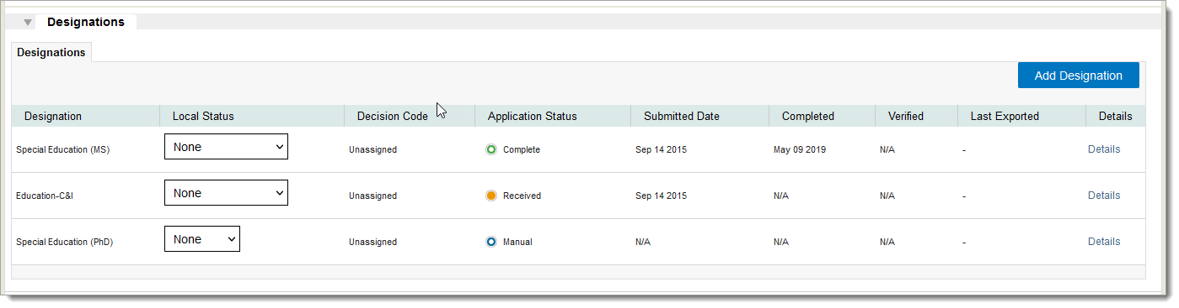
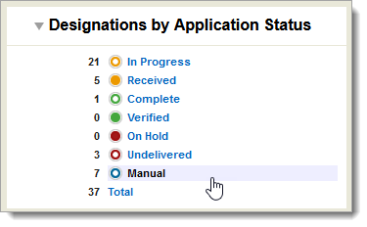
Manual Designation Updates
Notes:
https://help.liaisonedu.com/Release_Notes/2022_Release_Notes/Release_04
Some CASs offer the Manual Designations feature, which allows you to add additional designations, or programs, to an applicant. With this enhancement, the following items are now available in WebAdMIT:
Submitted Date
Completed Date
Program Added
Applicant Specific Deadline
Full application PDF for the Manual Designation
Note that if you previously added Manual Designations to applicants, these new items will appear once the applicant's data is retransmitted into WebAdMIT.

Slide 19
Configuration Portal Enhancements

Slide 20
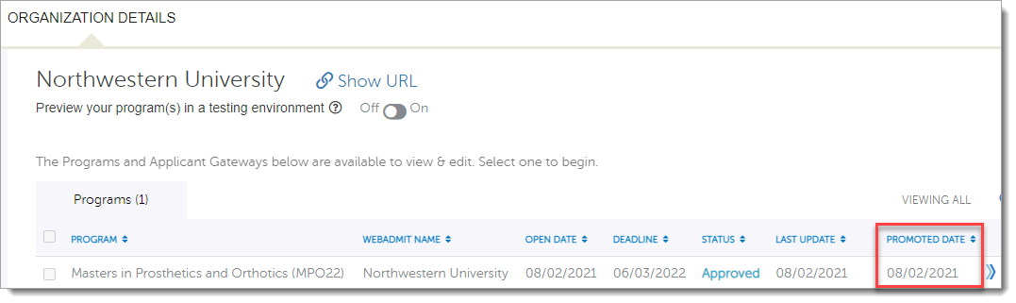
Single Program Promote Date
Notes:
https://help.liaisonedu.com/Release_Notes/2021_Release_Notes/Release_07
Once a program is ready to go live in the application, association-level users can promote that program from the prelaunch environment to the production (i.e., live) environment. A new Promoted Date column in the Organizations table now includes which date the program was promoted so that you can easily identify which programs were promoted.
Single Program Promote (SPP) allows association-level users to promote Approved programs from the Configuration Portal prelaunch environment to the production (i.e., live) environment. This reduces confusion because the prelaunch environment is exclusively used for creating and testing programs, while the production environment is exclusively for viewing and working with live programs. Additionally, Single Promote Promote maximizes efficiency because association-level users can promote programs on an as-needed basis throughout a cycle as programs are created or new organizations join a CAS.
Note that you may need to refresh your page after promoting a program to view the promoted date.

Slide 21
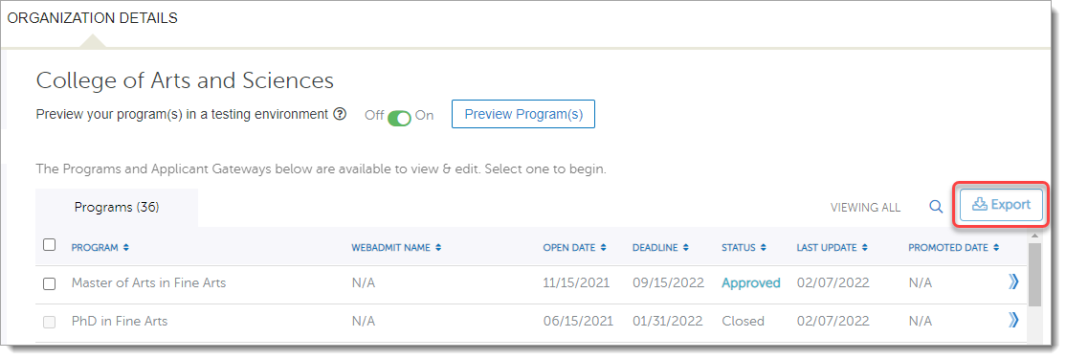
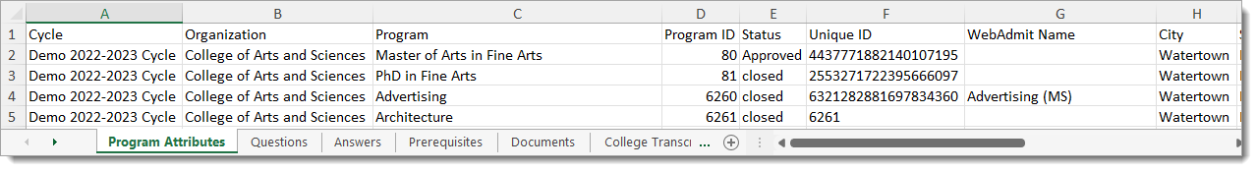
Export Program Configuration Data
Notes:
https://help.liaisonedu.com/Release_Notes/2022_Release_Notes/Release_01
You can export your programs’ configuration data using the Export button on the Organization Details page. The file includes worksheets for each of your configuration options; for example, if your CAS offers the Documents feature, a Documents worksheet will be listed with your programs' applicable data in it. Additionally, the file includes data for all programs, including those in the Draft, In Review, Approved, and Closed statuses. This enhancement allows you to review and manage program configurations in an easy-to-read format.

Slide 22
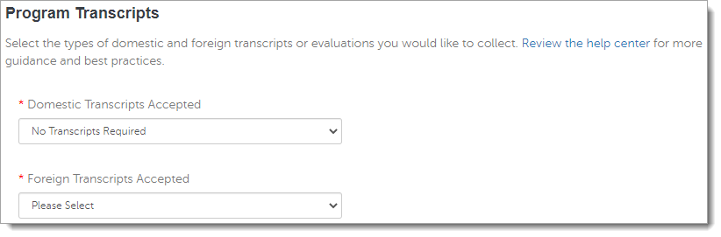
Programs Can Request Foreign Transcripts Separately from Domestic Transcripts
Notes:
https://help.liaisonedu.com/Release_Notes/2021_Release_Notes/Release_09
A new Foreign Transcripts Accepted section has been added to the Configuration Portal as a feature that can be turned on for program-level transcript requirements. This allows you to decide if you want to request foreign transcripts or foreign evaluations and, if so, what type.
With this change, applicants will see new options in the Applicant Portal for uploading or sending in their foreign transcripts and evaluations.
Additionally, WebAdMIT now identifies the document type under the Documents panel, Transcripts subpanel.

Slide 23
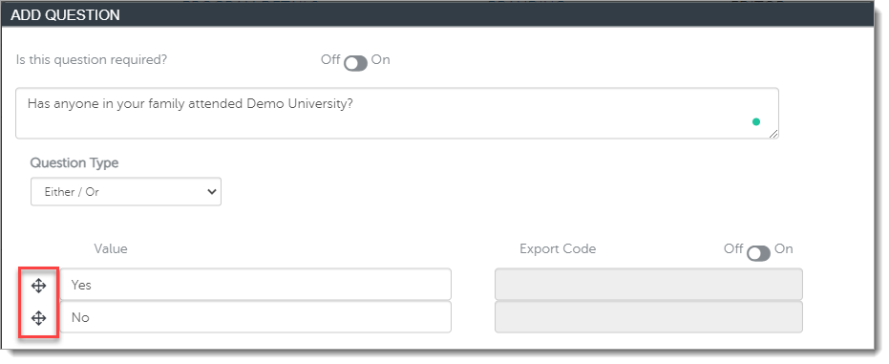
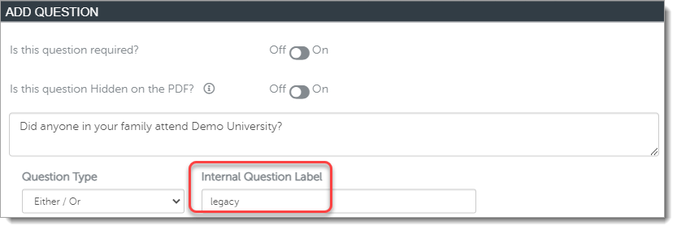
Question Workflow Updates
Notes:
https://help.liaisonedu.com/Release_Notes/2021_Release_Notes/Release_07
https://help.liaisonedu.com/Release_Notes/2021_Release_Notes/Release_08
Drag-and-Drop Reorder Functionality for Either/Or Questions
Ability to Customize Internal Question Labels for Custom Questions
The drag-and-drop reorder functionality is now available when reordering Either/Or question responses in the Configuration Portal; this is similar to the functionality for reordering Multiple Choice question answer options. This enhancement improves user experience, as you no longer need to enter answer options in the exact order you want them displayed in
You can now assign Internal Question Labels to the Custom Questions in the Program Materials section of the application. This enhancement allows those questions to have a name that remains the same for each cycle, which is helpful for data integration (e.g., "legacy"). It also allows you to add more descriptive field names.

Slide 24
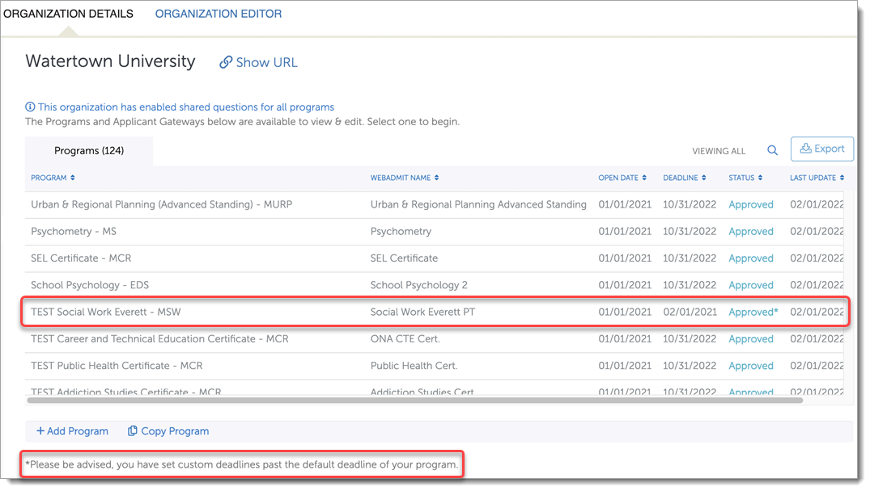
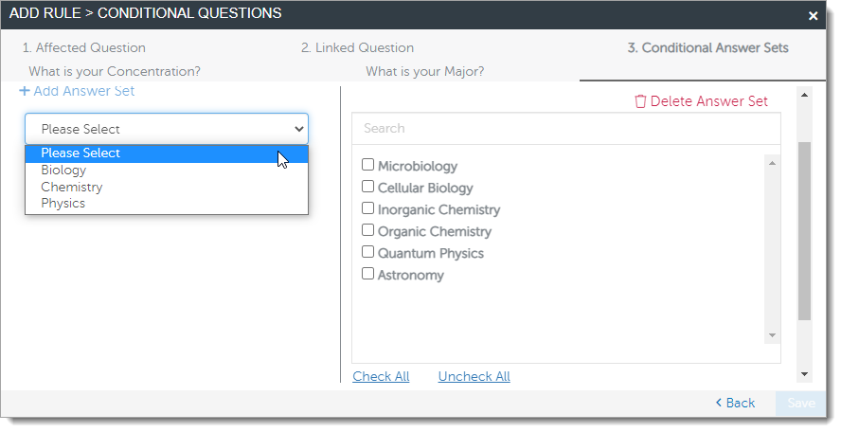
Question Rule Workflow Updates
Notes:
https://help.liaisonedu.com/Release_Notes/2021_Release_Notes/Release_11
https://help.liaisonedu.com/Release_Notes/2022_Release_Notes/Release_01
https://help.liaisonedu.com/Release_Notes/2022_Release_Notes/Release_01
Conditional Answer Options Question Rule Workflow Improved: The Conditional Answer Options Question Rule has several improvements, including adding:
A search field for answer values.
The ability to batch check and uncheck answer values.
Apply Organization-level Questions to Change Deadline and Change Fee Question Rules: If your program uses organization-level questions, you can use them when configuring the Change Deadline and Change Fee Question Rules. This enhancement allows you to manage program deadlines and fees for any of your program-specific questions.
Program Status Reflects Change Deadline Question Rule Configuration: The Change Deadline Question Rule allows you to set multiple deadlines based on an applicant’s response to a program-specific or Extended Profile question. If your program’s default deadline has passed but the alternate deadline is still open, then your program’s status on the Organization Details page will be listed as Approved* with a note that select applicants can still submit to your program. Once all deadlines have passed, then your program’s status will be listed as Closed.
Previously, once your program’s default deadline passed, your program’s status was listed as Closed, even if applicants could still apply to your program through meeting your alternate deadline criteria. This enhancement improves clarity for program statuses.

Slide 25
Universal Advisor Portal Enhancements

Slide 26
New Universal Advisor Portal Account Request Form
Updated Advisor Reports (biannual update)
Notes:
https://help.liaisonedu.com/Release_Notes/2021_Release_Notes/Release_07
https://help.liaisonedu.com/Release_Notes/2021_Release_Notes/Release_11

Slide 27
Reference Guides

Slide 28
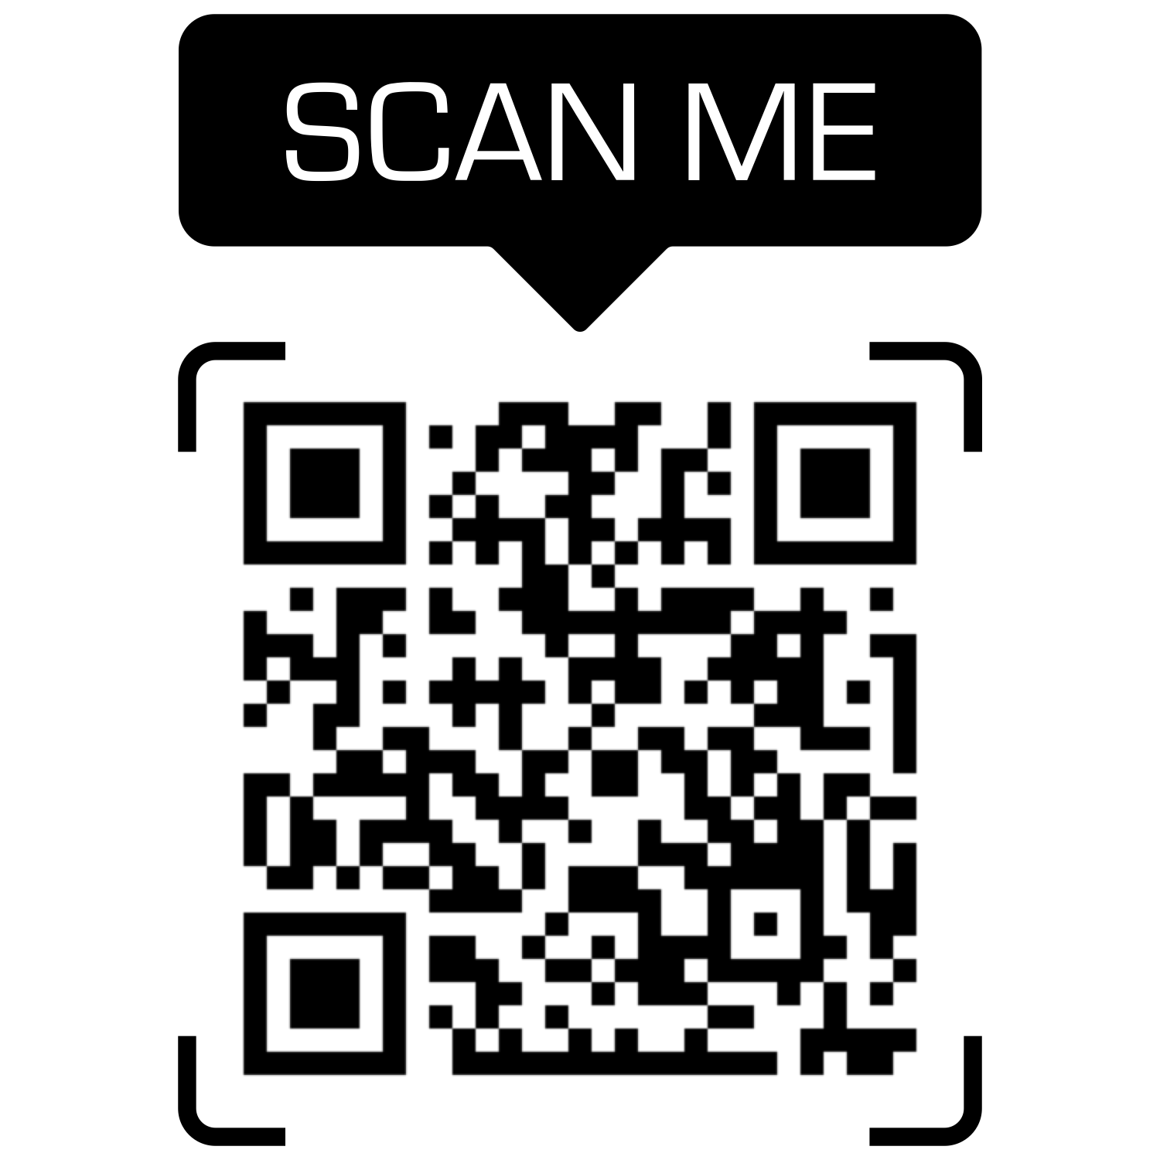
Reference Guides
Notes:
https://help.liaisonedu.com/Release_Notes/2021_Release_Notes/Release_05
https://help.liaisonedu.com/Release_Notes/2021_Release_Notes/Release_06
https://help.liaisonedu.com/Release_Notes/2021_Release_Notes/Release_09
https://help.liaisonedu.com/Release_Notes/2021_Release_Notes/Release_11
https://help.liaisonedu.com/Release_Notes/2022_Release_Notes/Release_02
https://help.liaisonedu.com/Release_Notes/2022_Release_Notes/Release_05

Slide 29
Q & A

Slide 30
Thank You
Reggie Ross
Liaison
training@liaisonedu.com

