Slide 1


Slide 2
The Great Resignation:
A Roundtable Discussion
Robert Ruiz | Vice President, Strategic Enrollment, Liaison
David Poole | Research Director, EngineeringCAS, Liaison
2:45 p.m. – 3:30 p.m.

Slide 3
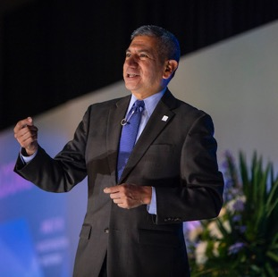

Panelists
Robert Ruiz
David Poole
Vice President,
Strategic Enrollment
Research Director

Slide 4

Simply Stated…

Slide 5
What is the Great Resignation?
The term “Great Resignation was coined by Anthony Klotz, a professor of management at Mays Business School at Texas A & M, in May 2001

Slide 6
Why the resignations?
1. Retirement – workers are retiring in greater numbers
2. Relocation – not happening in large numbers despite openings in other communities
3. Reconsidering – work-life balance and care role
4. Reshuffling – localized switches among industries rather than exiting the labor market
5. Reluctance – don’t want to return to in-person jobs

Slide 7
Group Discussion

Slide 8
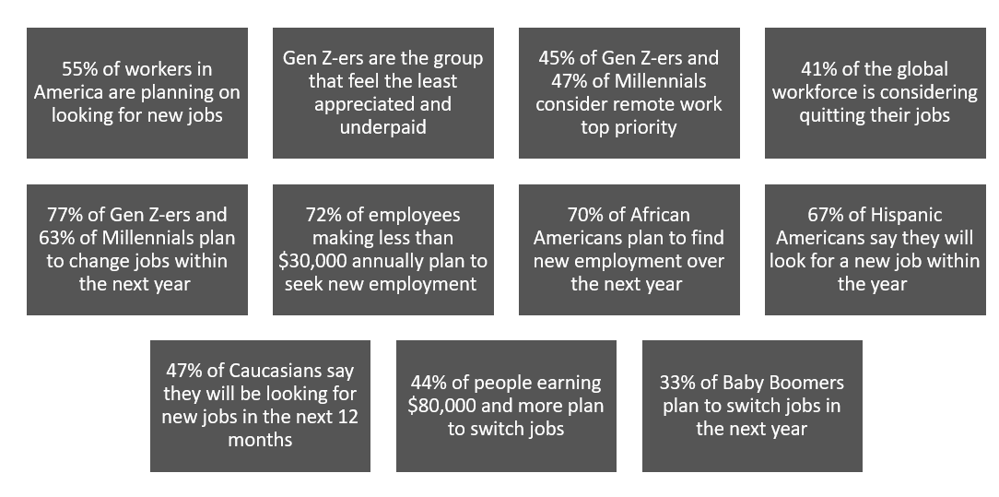
Who is resigning?

Slide 9
Group Discussion

Slide 10
What impact on higher ed?
Over 80%
of Student Affairs survey respondents said burnout and low salaries could lead people to leave, according to the National Association of Student Personnel Administrators (NASPA)
Inside Higher Ed’s 2022 Survey of College and University Chief Academic Officers,
19% of provosts say faculty members are leaving at significantly higher rates than in the past.
More than 50%
of higher education professionals in a recent survey indicated they were likely to look for other employment within the next 12 months (College and University Professional Association for Human Resources)

Slide 11
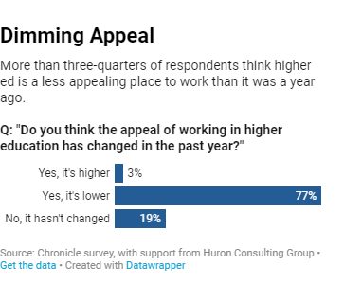
What impact on higher ed?

Slide 12
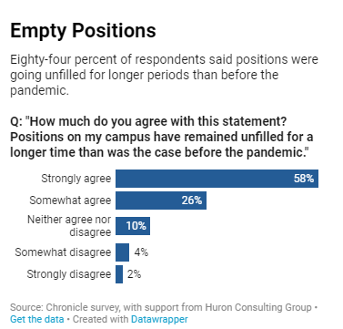
What impact on higher ed?

Slide 13
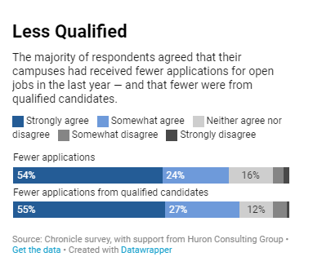
What impact on higher ed?

Slide 14
What can we do?
Notes:
Flexible work options
Address burnout
Focus on organizational health
Offer skill building opportunities/professional development
Refocus on skill sets really needed for a position
Partner with industry to fill the gap (LIAISON for Higher Education)

Slide 15
Thank You
Robert Ruiz
Vice President for Strategic Enrollment
Liaison International
rruiz@liaisonedu.com
David Poole
Research Director EngineeringCAS
Liaison International
dpoole@liaisonedu.com

