Slide 1


Slide 2
Using Lightning Components & Dynamic Forms in Custom Page Layouts

Slide 3


Presenter
Melanie Schwartz
Service Enablement Manager
Notes:
My name is Melanie Schwartz and I am the Service Enablement Manager with TargetX. I’ve been with the company since 2015, and have over 15 years of experience working in and with higher education.

Slide 4


Objectives
Reduce/Eliminate Record Types
Reduce Clicks
Highlight Frequently Used Information
Segment Info by Function/Criteria
Streamline Page Layout
Notes:
My hope is that you will walk away today with the tools needed to improve your page layouts and ultimately user adoption.
*read objectives*​
By the end of the session you should have some ideas of how to reduce some of the complexity that you may have currently configured (or inherited) in your Salesforce org, and that you can start prioritizing the info you need and de-prioritizing the info you and your end users don’t need.​

Slide 5
Agenda
Compact & Search Layouts
Rich Text Components
Related List Components
Quick Actions & Global Actions
Utilizing Tabs
Dynamic Forms
Notes:
These are the topics we are going to cover today. Everything that I’m going to show you is “native” Salesforce functionality, meaning nothing is in TargetX packages or specific to TargetX, so there is no additional purchase or configuration required to turn on any of these features, other than making sure you are using Lightning. ​I have a lot I want to show you…

Slide 6
Compact & Search Layouts
Notes:
Let’s start with a few things you can update without modifying the layouts you already have in place.​

Slide 7
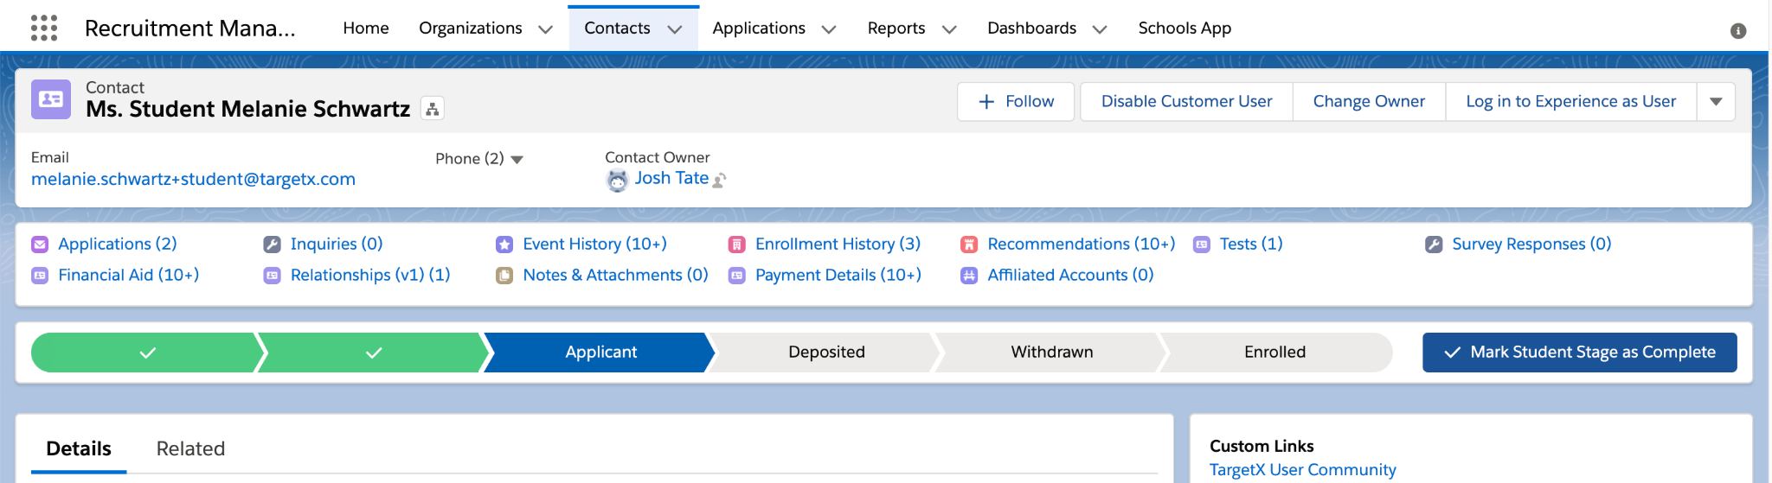
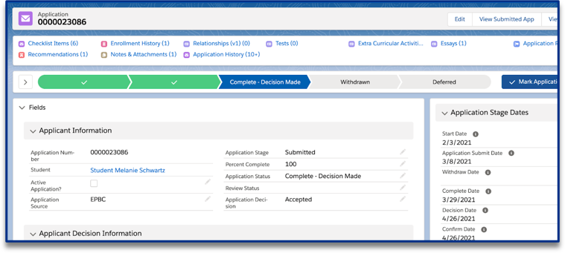
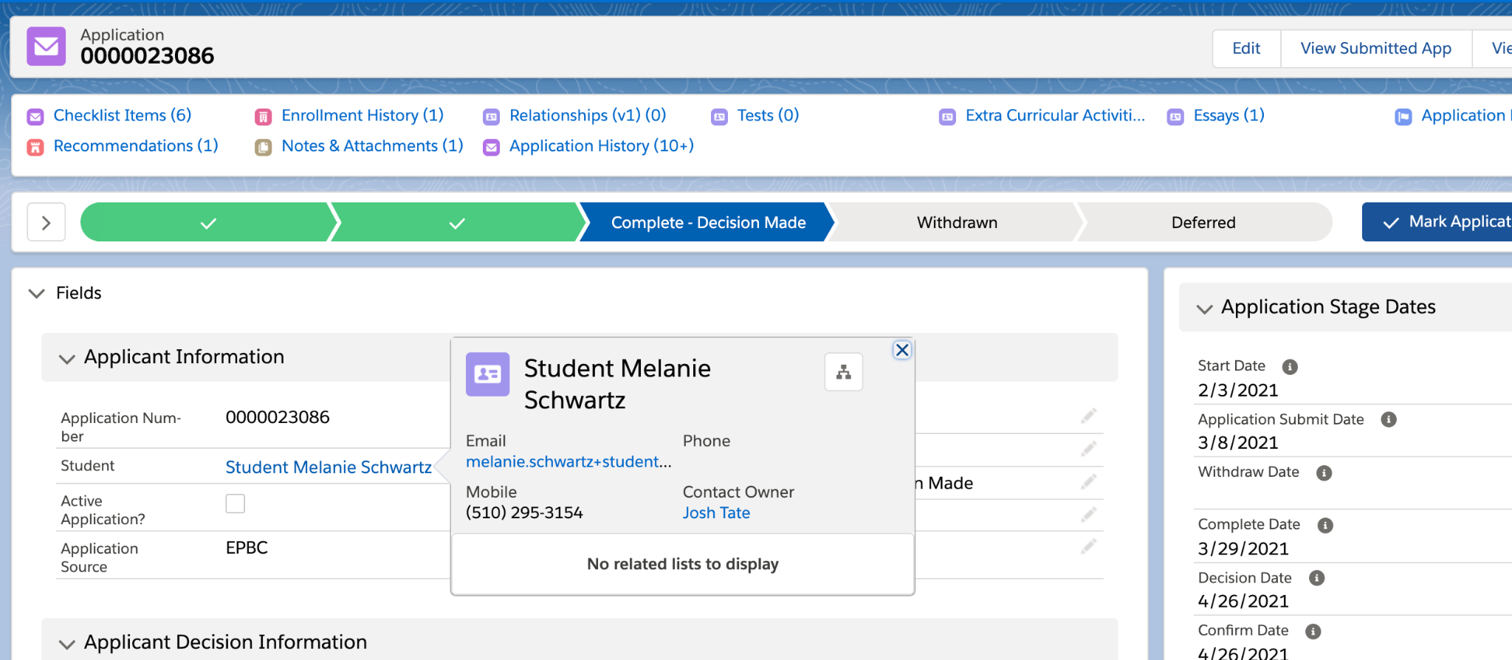
Compact Layouts
Notes:
Compact Layouts are a feature that you can update today without diving into an overhaul of your current page layouts. ​
​
Compact Layouts are viewable in two locations - at the top of the page layout of the object that they represent AND any related page layout where there is a lookup field to that object. ​
​
In this example I’m looking a the top of a Contact record and, in addition to the full name, I see the Email, Phone and Contact Owner information about this particular student. ​
​
* When I navigate to one of this student’s application records, I can find the Contact lookup field - here it’s called Student and it’s blue like a hyperlink - when I hover over it ​
​
* a pop-out is revealed that shows the same detail as my Contact compact layout. Email, Phone and Contact Owner​
​
Compact Layouts are considered essential by Salesforce if you have mobile users.​
​
I have a few more examples of where this could be used.

Slide 8
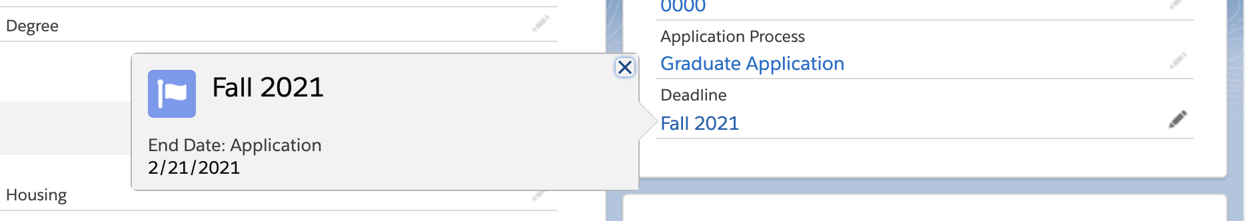
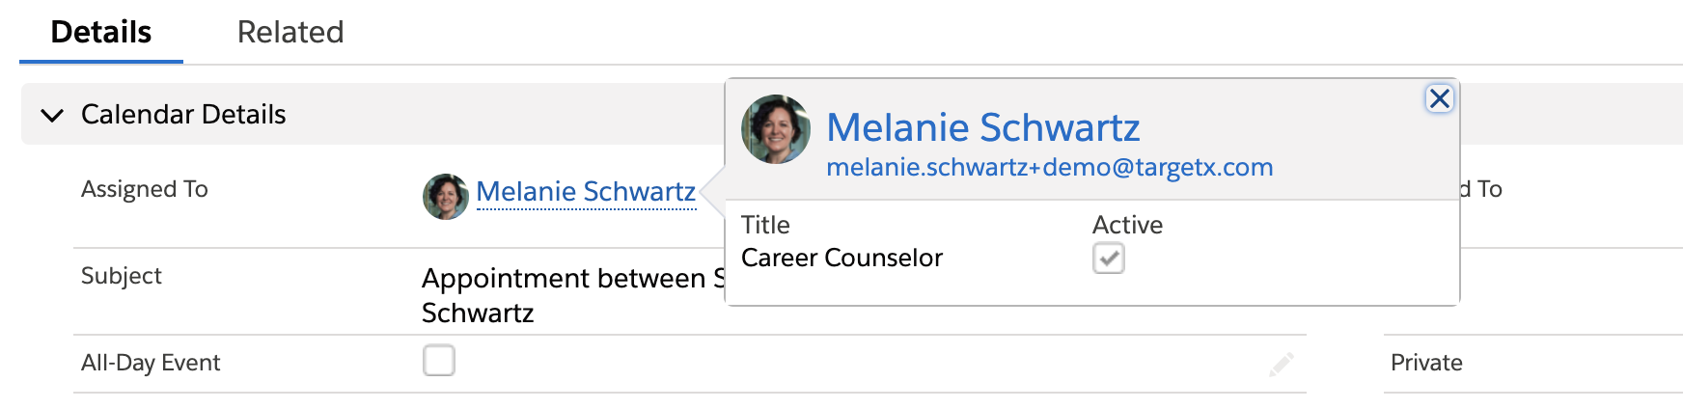
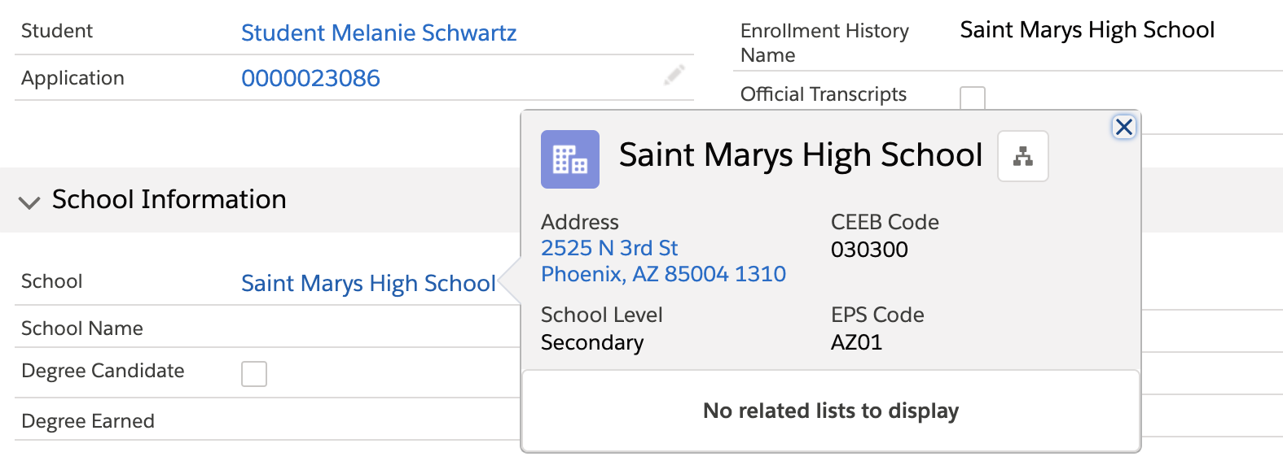
Compact Layouts
Notes:
* Imagine you’re on the phone with an applicant and need to find the deadline date of their application - hover on the Deadline field to reveal the Period Deadline End Date​
​
* You can easily find contact information about another Salesforce user who might have been the creator or last modifier of a record...maybe they are the assignee of a task or an event...or perhaps the student’s admissions counselor or primary academic advisor – anywhere you see a User Lookup you can see the User compact layout with helpful information​
​
* Finally, there might be an instance where you have received a transcript in the office and want to confirm that the institution named on a student’s Enrollment History record matches the document - hover on the school name to reveal business address, ceeb and eps codes ​
​
Where else could this be useful?
...now let’s shift to search layouts...​

Slide 9
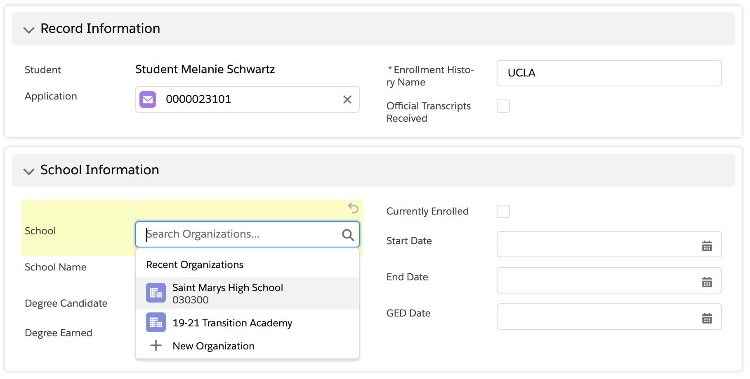
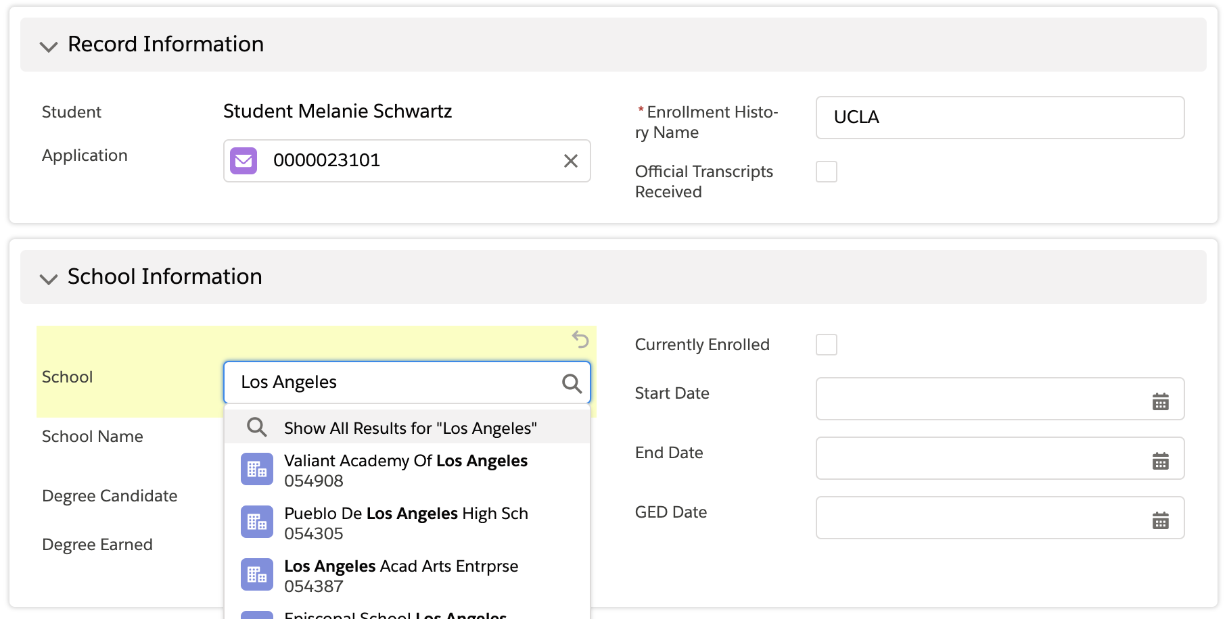
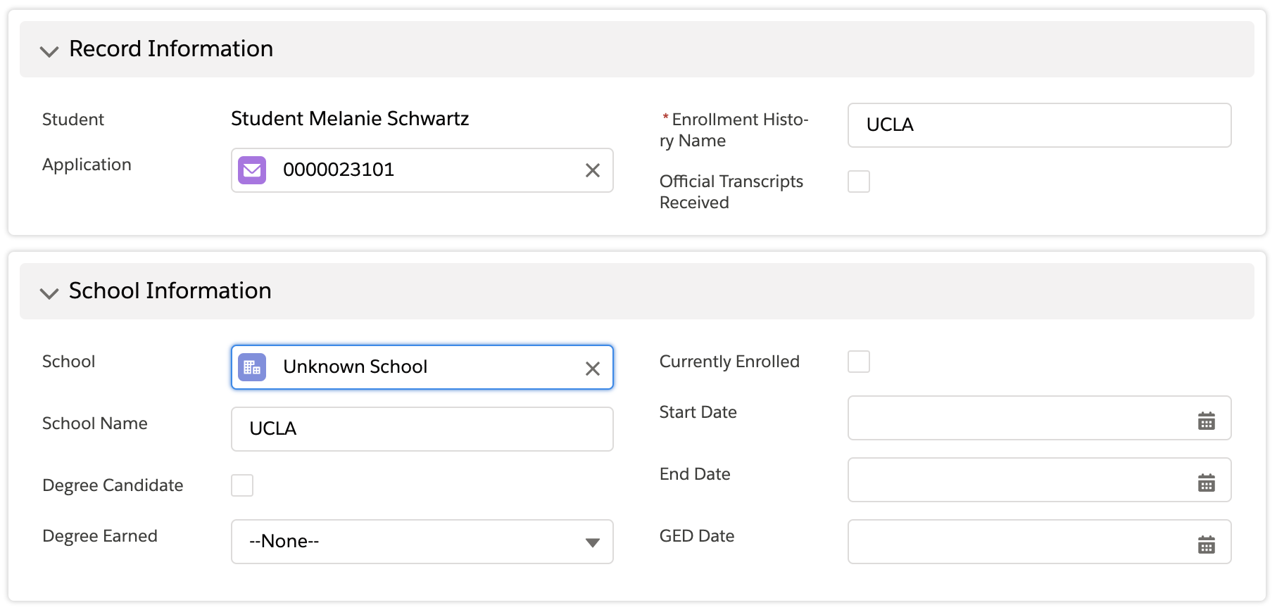
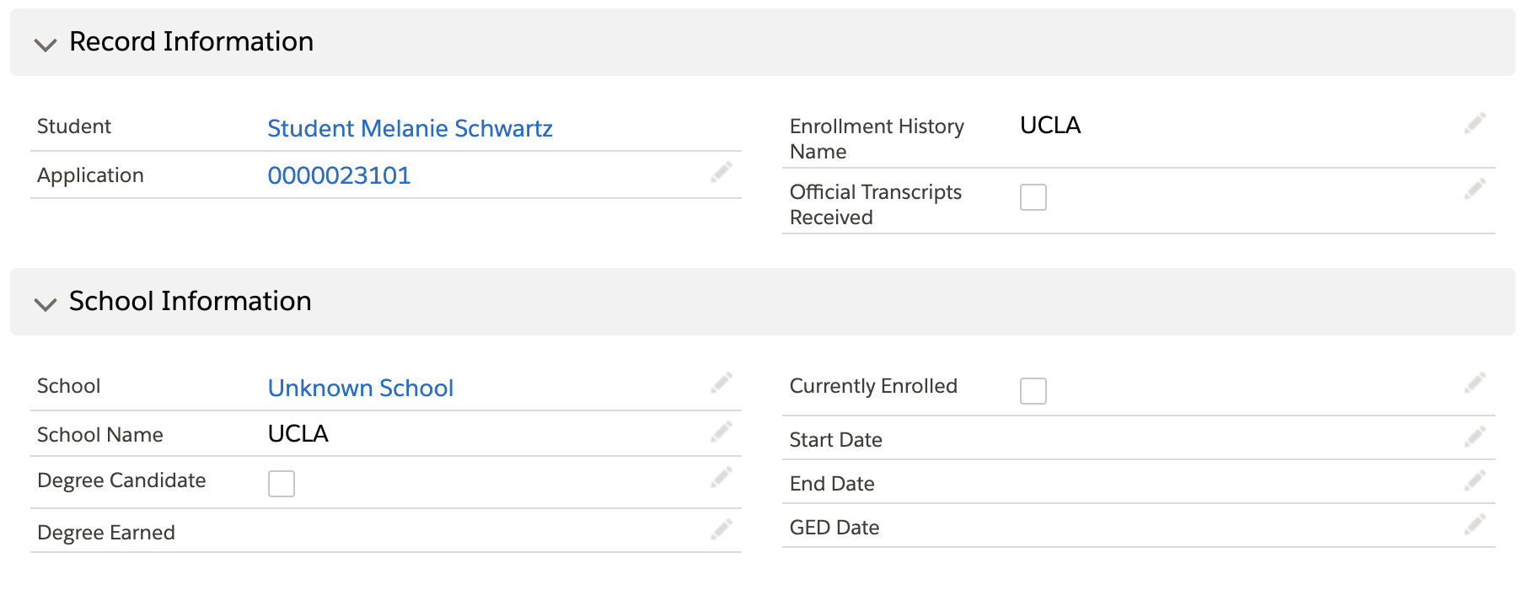
Search Layouts
Notes:
Search Layouts are another feature that you can update today without impacting existing page layouts and immediately improving a user’s experience.​
​
Search Layouts dictate how the results are displayed when you make a selection in a lookup field.​
​
Let’s go to an Enrollment History record that was assigned to Unknown School.​
​
* I see that my student reported the value of “UCLA” in the application, but that value does not exist on my Accounts table, which is why it assigned the record to Unknown School.​
​
*I’ll edit the School lookup field, clearing the Unknown School value.​
​
*by default this will show “Recent records”​
​
*so I am going to search for “Los Angeles” and click Enter​

Slide 10
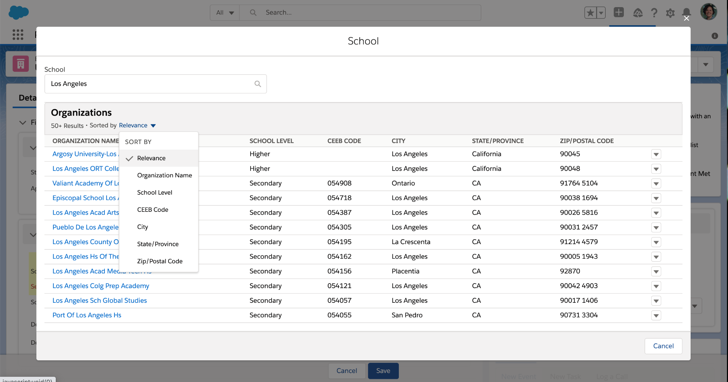
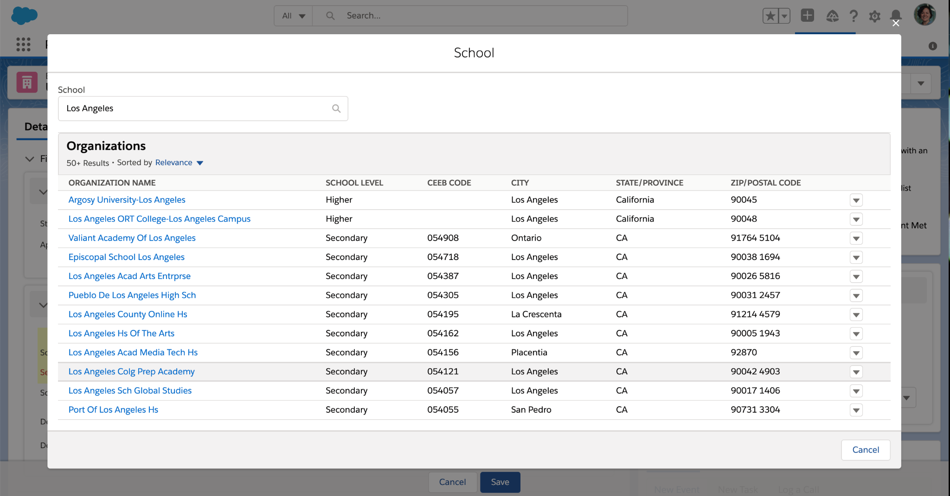
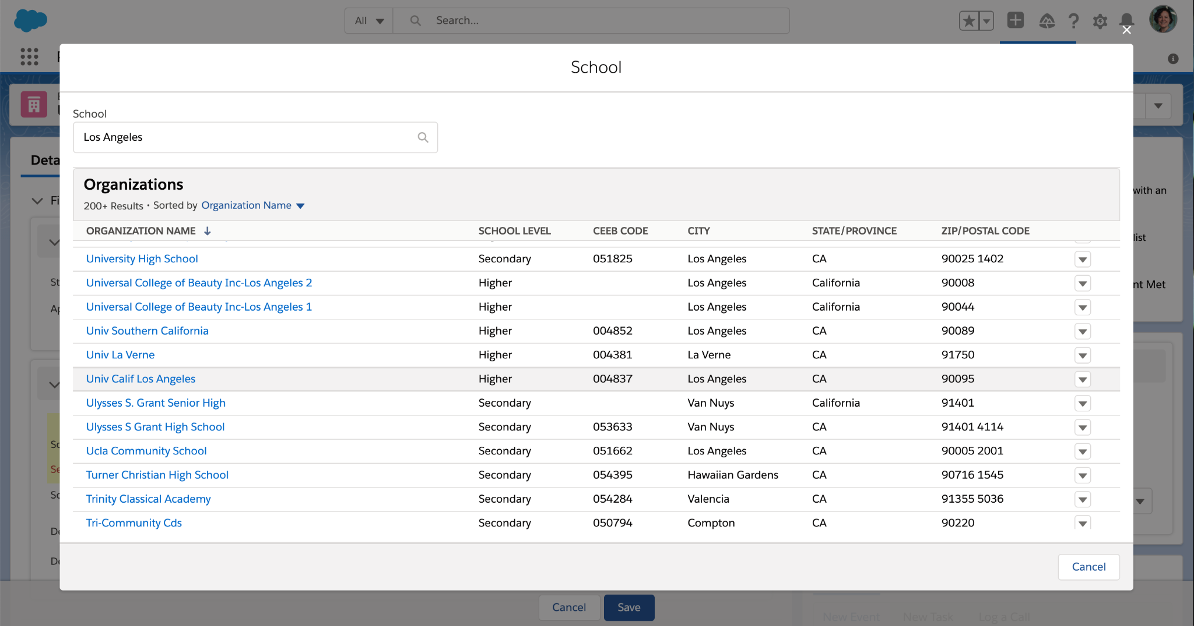
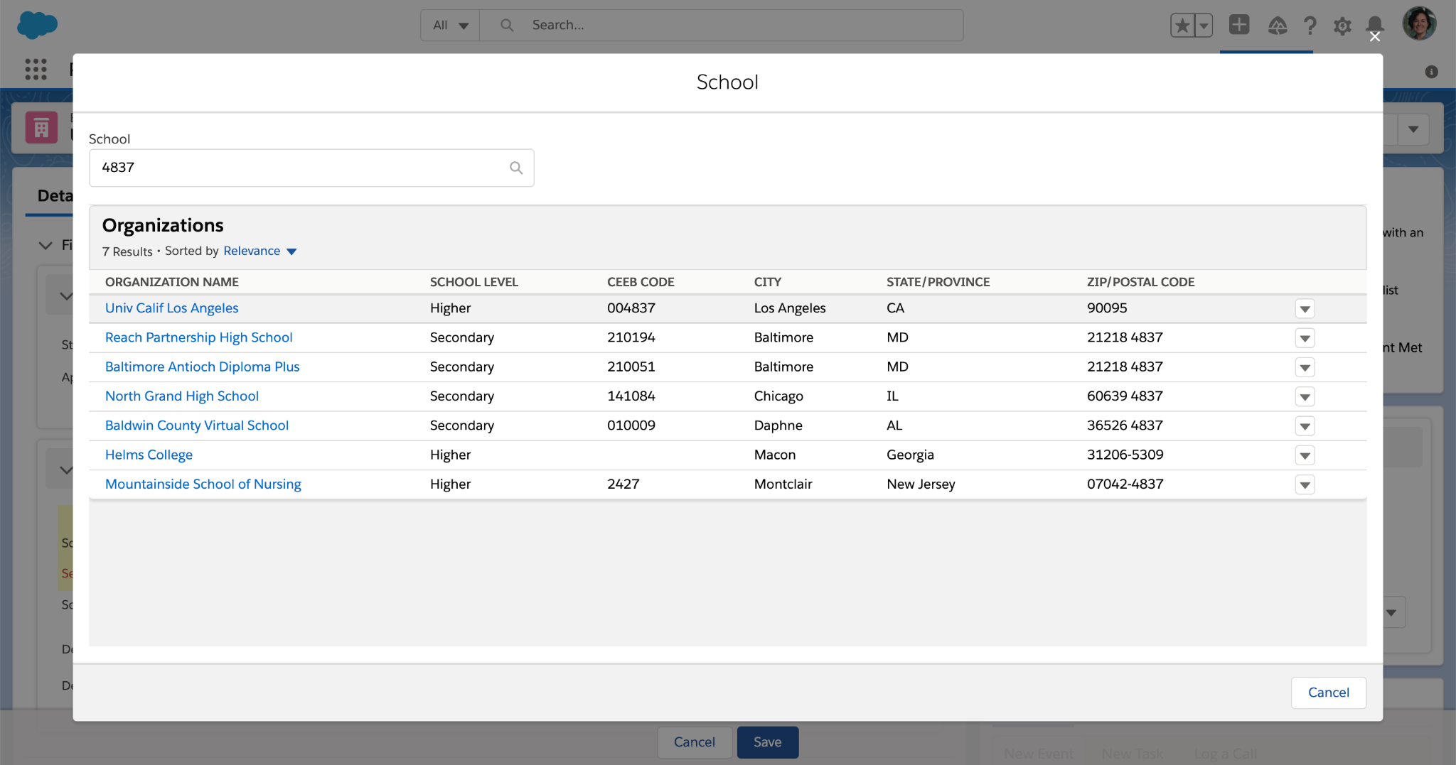
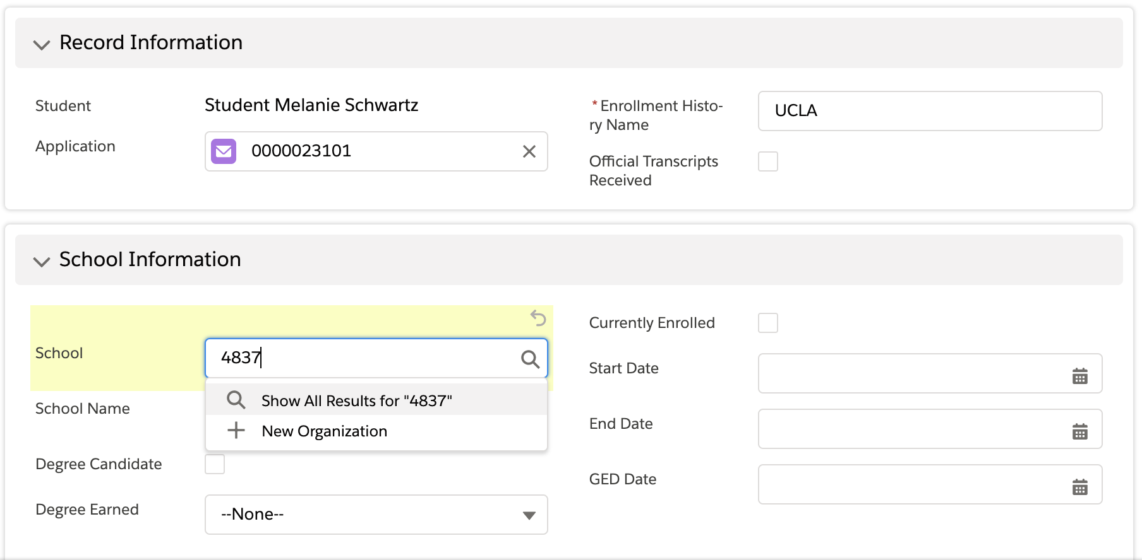
Search Layouts
Notes:
this pulls up a search box that allows me to * sort the results
I can search the list * and select the correct UCLA account record.
*Alternatively, I could have search by CEEB code on the Enrollment History record, clicking the
* “Show All Results” option.
The results screen would look like this * a mix of ceeb and zip code values for 4837
Updating your Search layout is what will allow you to select the columns displayed in the search results which match the relevance dropdown.

Slide 11
Lightning App Builder:
Rich Text & Related Lists
Notes:
Now let’s move into the Lightning App Builder and explore some of the components that are available on both Standard and Custom objects...starting with Rich Text and Related Lists​
​
​

Slide 12
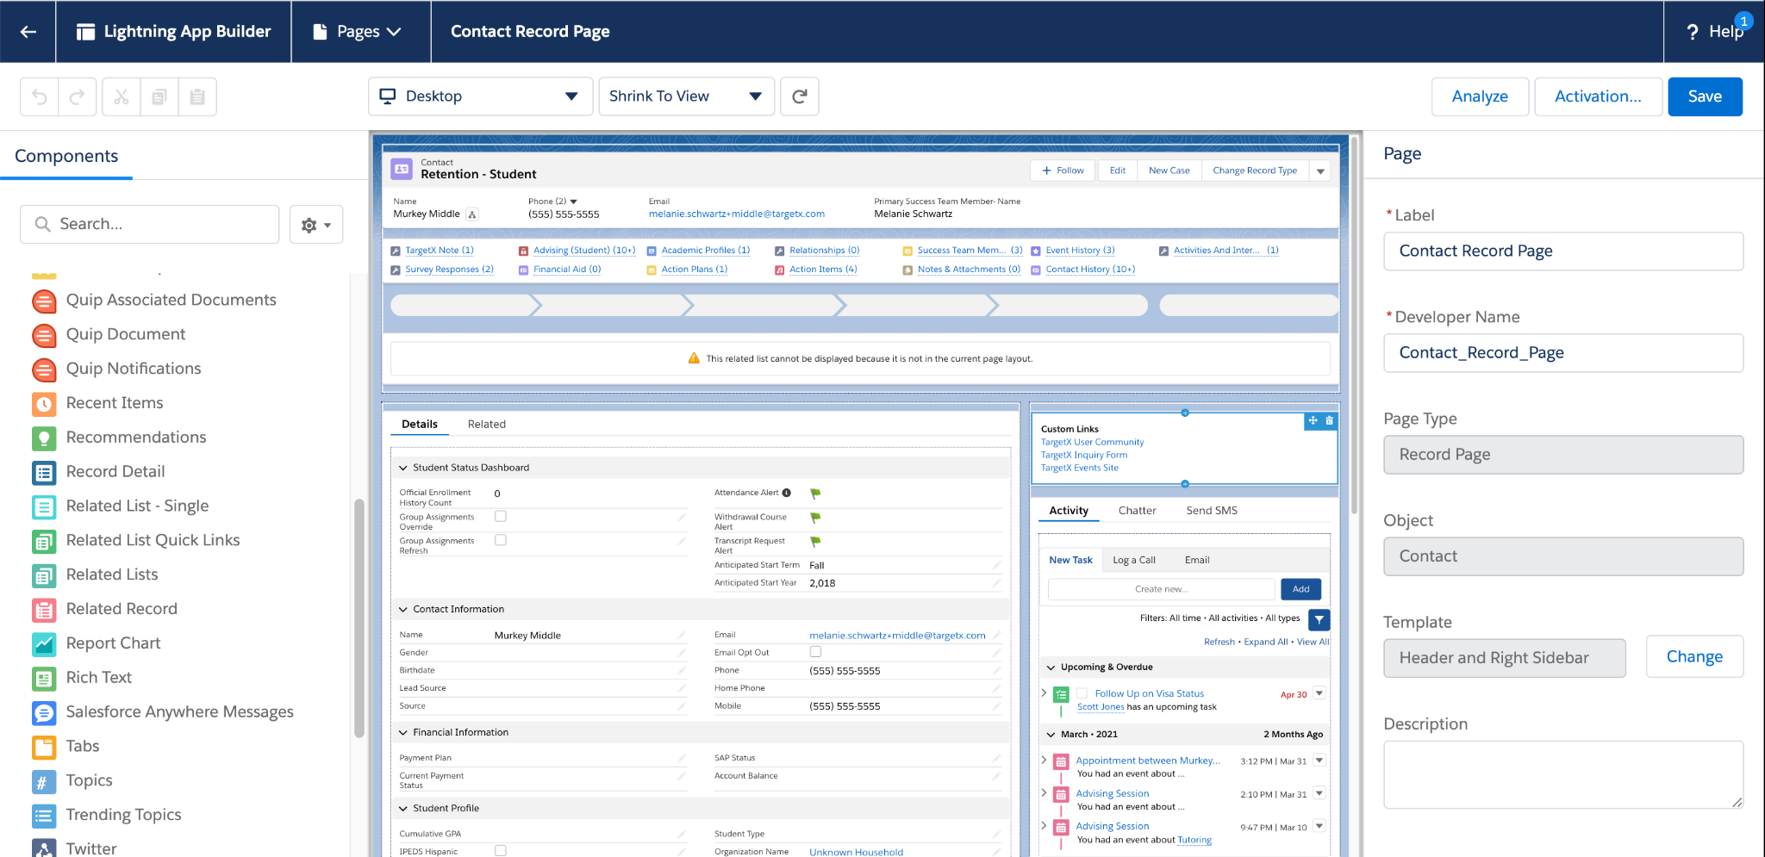
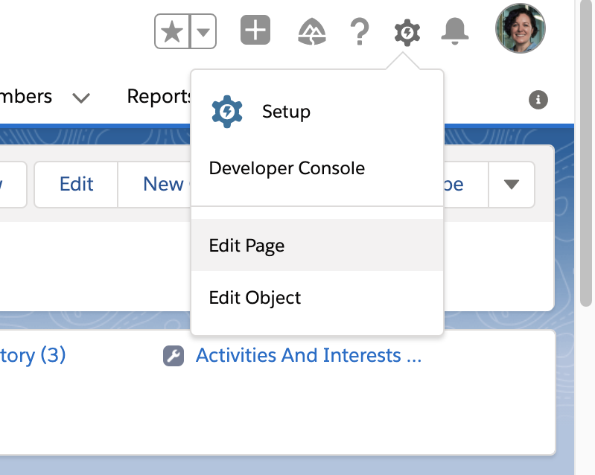
Lightning App Builder
Notes:
To access the Lightning App Builder, click on the gear in the top right corner and select Edit Page​
​
* This will open the Lightning App Builder where you will see Components on the left, your page in the center and the Properties Pane on the right where you can change things like labels and visibility.​
​
* we are going to start by focusing on Rich Text and Related List Quick Links​

Slide 13
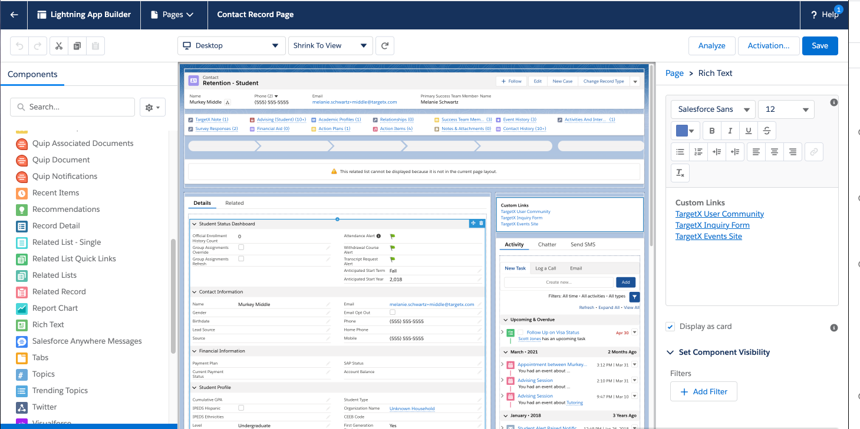
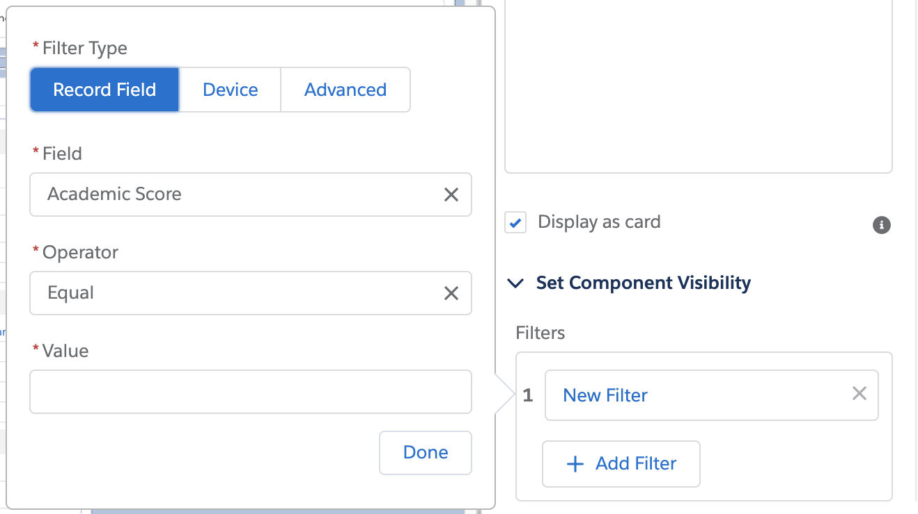
Rich Text
Notes:
Rich Text is a component that can be added to your Home page or the detail page of any object. ​
​
*Just drag and drop the component onto the page and it will open a ​
​
*WYSIWYG in the Properties pane. This is what could replace the Custom Links component you used in Classic. Honestly this is better than Custom Links because it can be use for far more than just links and you can make it * conditional​
​
When I click Add Filter * I can set conditions based on record details, the device being used to view the information, or even user criteria. You can also do combinations of criteria.​
​
Conditional criteria can be used to dictate visibility of any component, section or field in the Lightning App Builder.​ You can even make buttons conditional with this tool.

Slide 14
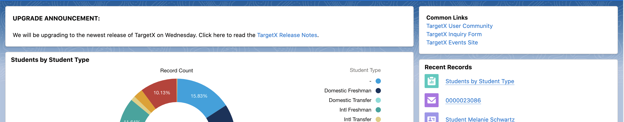
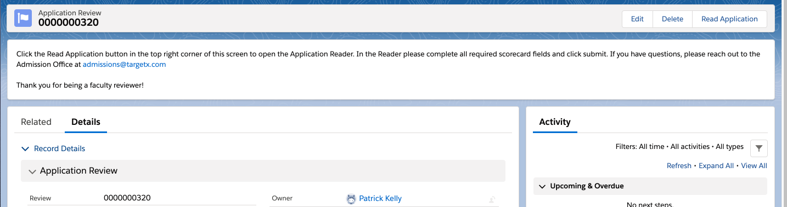
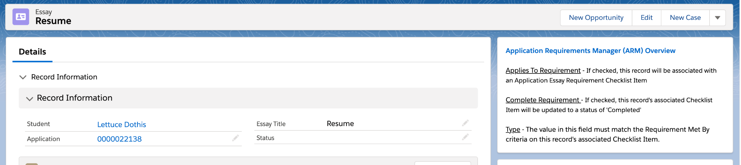
Rich Text
Notes:
In addition to your new Home Page “Common Links”... you could be adding ​
​
*General Announcements (like when you will be upgrading your TargetX packages)​
​
* consider giving instructions to faculty reviewers who will be using the TargetX App Review tool..​
​
* or offer definitions for terms used in TargetX tools, or links to the TargetX User Community for more information​
Has anyone added rich text on their layouts?
​
...now let’s shift to related lists...​

Slide 15
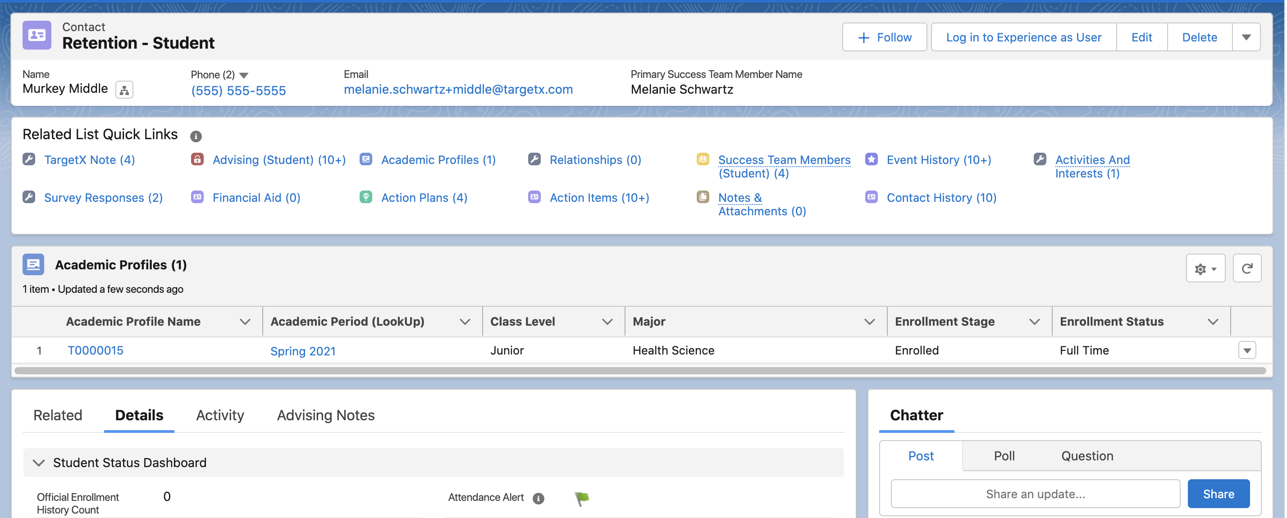
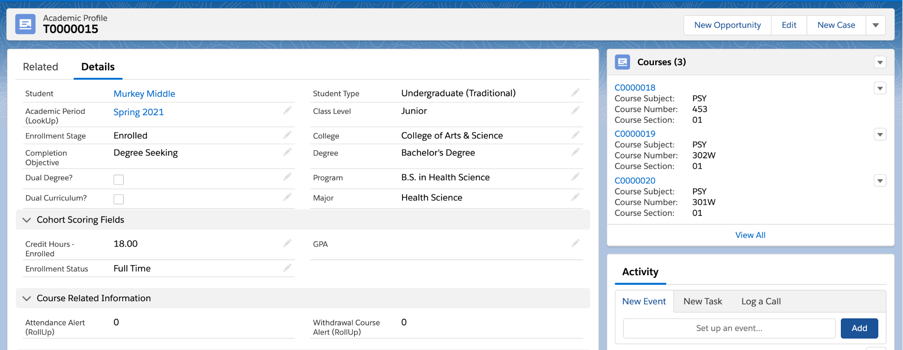
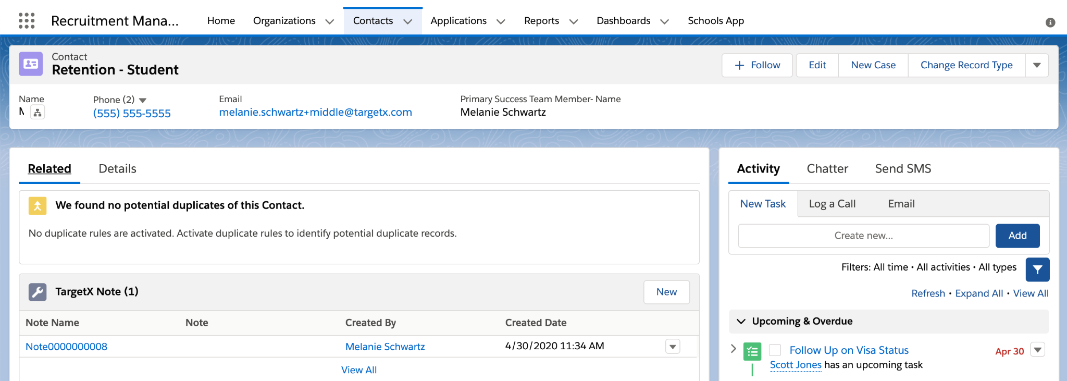
Related Lists
Notes:
Related lists are a place where we also saw changes with a shift from Classic to Lightning. You might remember that in Classic related lists are at the bottom of the page layout.
With Lightning, records come with two tabs, Related and Details, and the Related tab is usually the default. So now instead of scrolling, you will need to switch over to the details tab to see your fields and then toggle back to the Related tab to find the related records. But can transform this into this! *
* we’ve made Details the default tab
* we’ve added the beloved Related List Quick Links to the top so you can see if there are related records AND
* we’ve called out an important Single Related List - in this example we are showing Academic Advisors some key data points from a current students registration records. You could spotlight any single related list. Maybe you want to quickly see all the Inquiries or Enrollment Histories related to a student.
You can also add related lists as a side panel, like this * In this example we see Courses on the side panel of an Academic Profile record

Slide 16
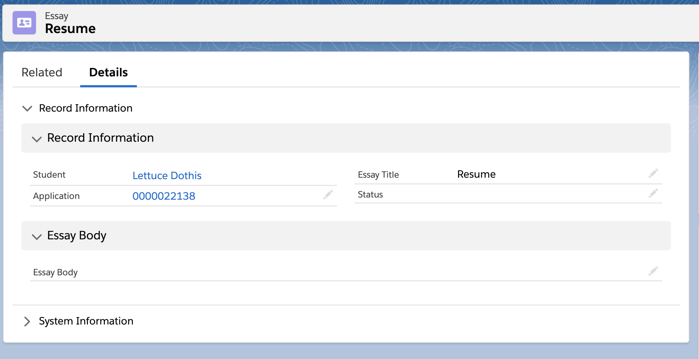
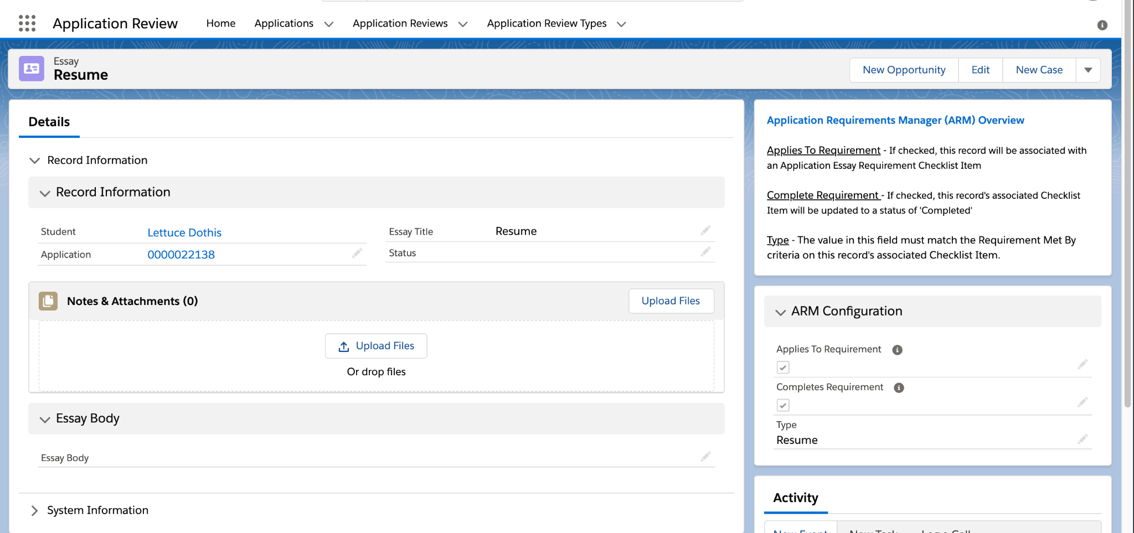
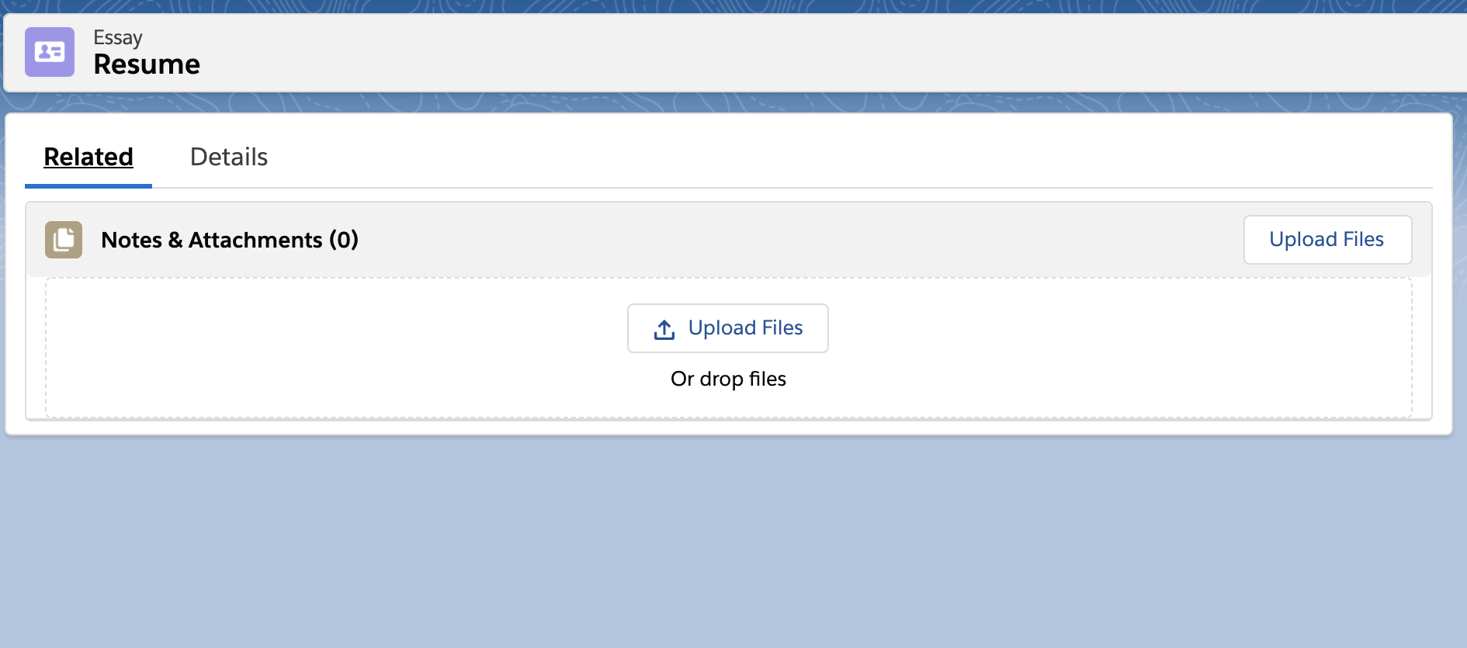
Related Lists
Notes:
Another great use case for the single related lists component is for any objects that have only one related list - some good TargetX examples are any objects where you are collecting attachments - Enrollment History, Tests, Recommendations or like I’m showing here, Essays.
It’s an extra click * to toggle over to the Related tab just to see if there is a resume attached.
Instead, we can remove the Related tab entirely and show that one related list on the Details screen like this *

Slide 17
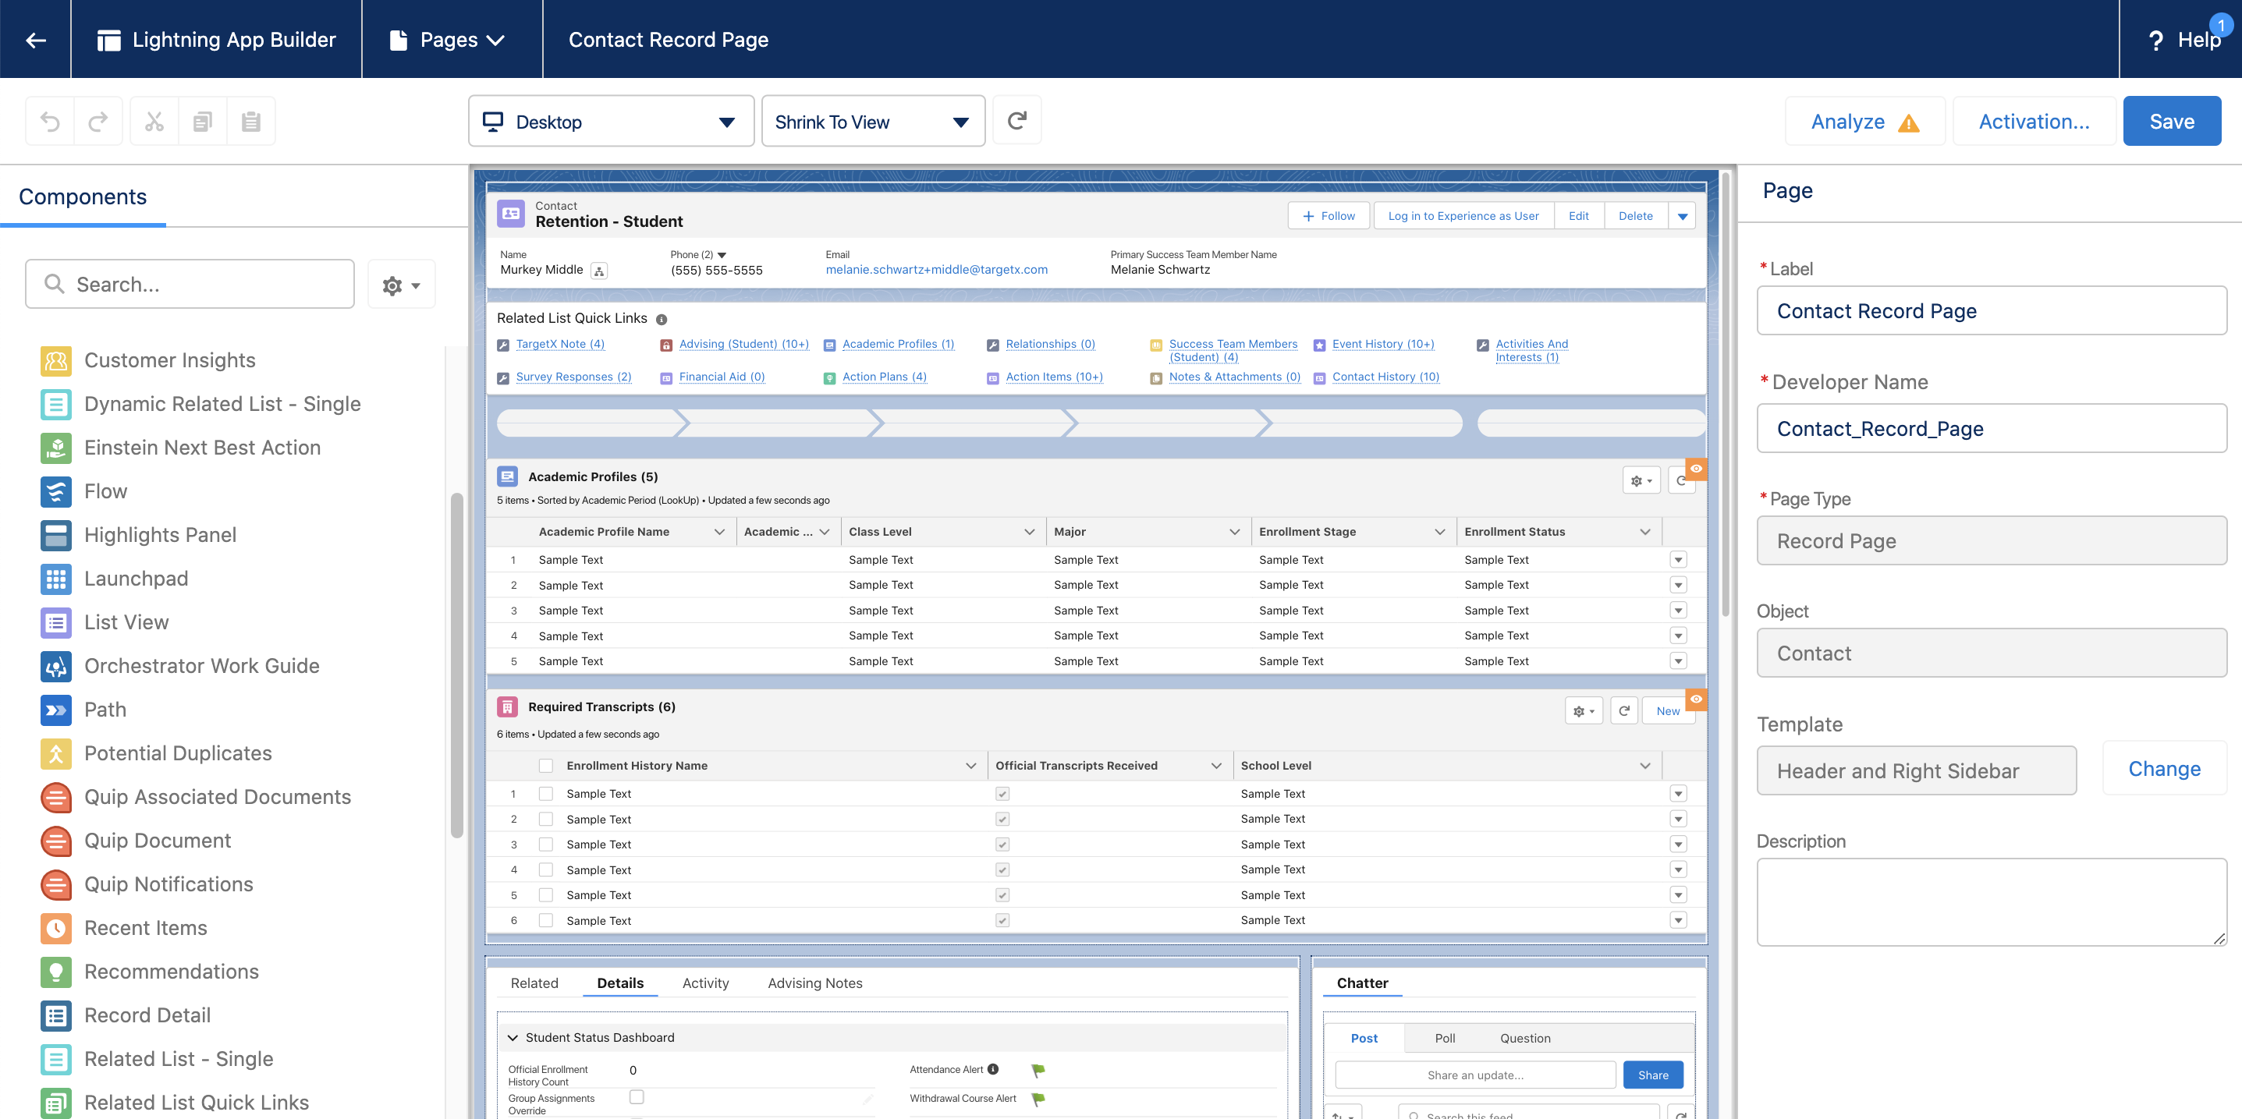
Related Lists
Notes:
The Related List – Single, and Dynamic Related List components can be found here. They are also easy to drag and drop anywhere on the page and can be conditionally visible.
So what is a Dynamic Related List?*

Slide 18
Dynamic Related Lists
Allows you to create a filtered related lists with configured fields, order and customizable actions.
A related list can be added multiple times on the same page
A maximum of 30 records can be displayed
Only allows for AND logic, not OR
Desktop Only
Notes:
A Dynamic Related List is a lightning component that allows you to create a filtered list view of a related object, rather than ALL records related. Even if you don’t want to filter a related list, you might choose to upgrade to this component to leverage the ability to customize the number of records or actions displayed.
I have a couple of examples where this might be useful.

Slide 19
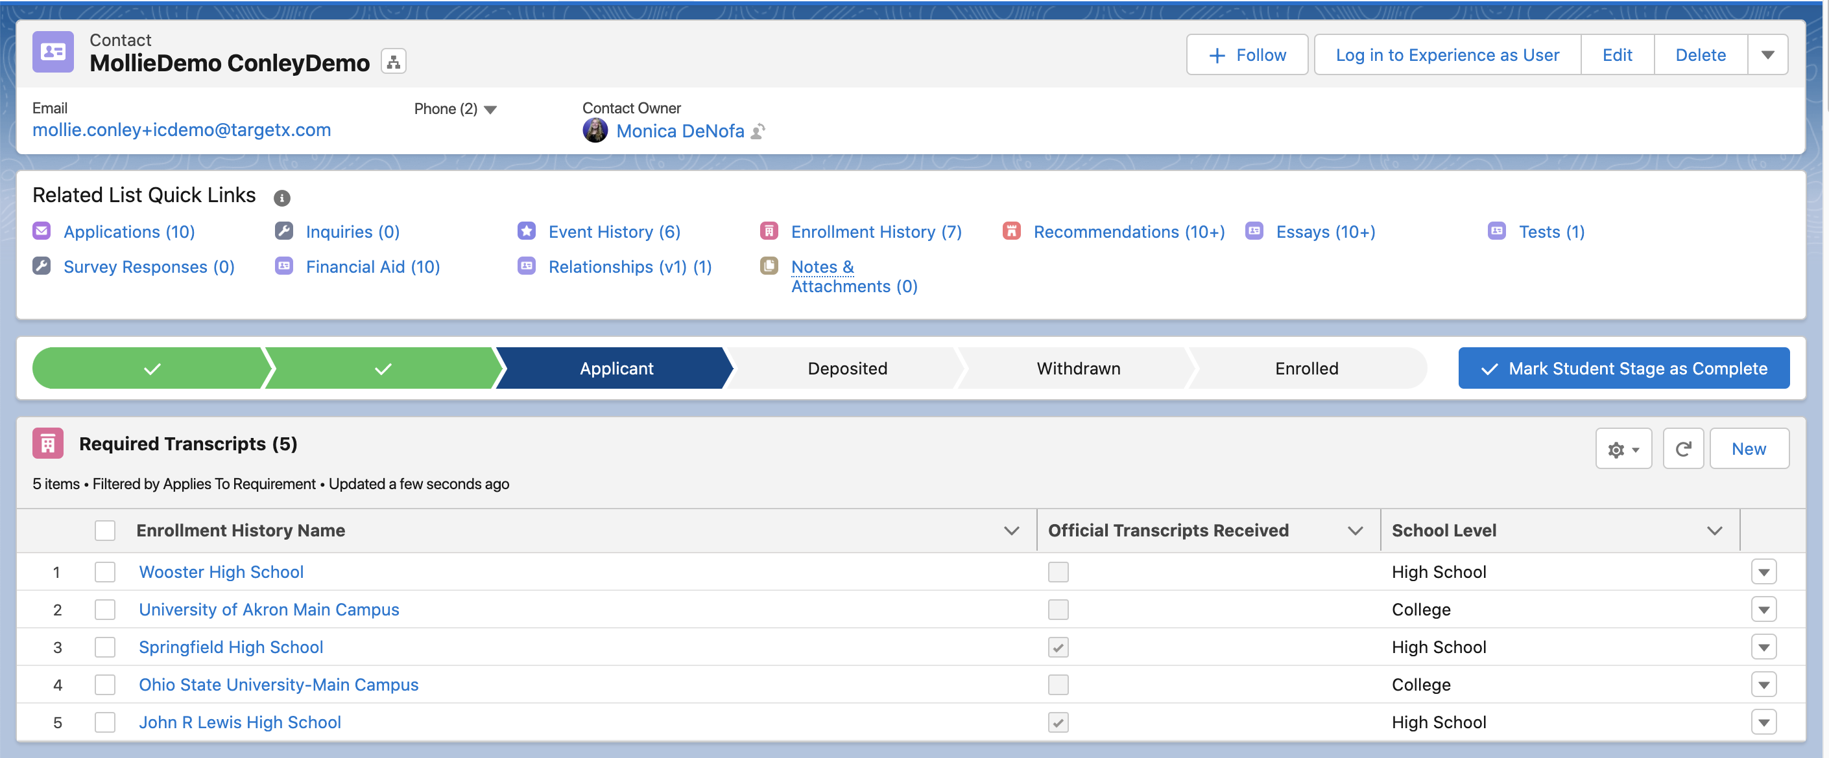
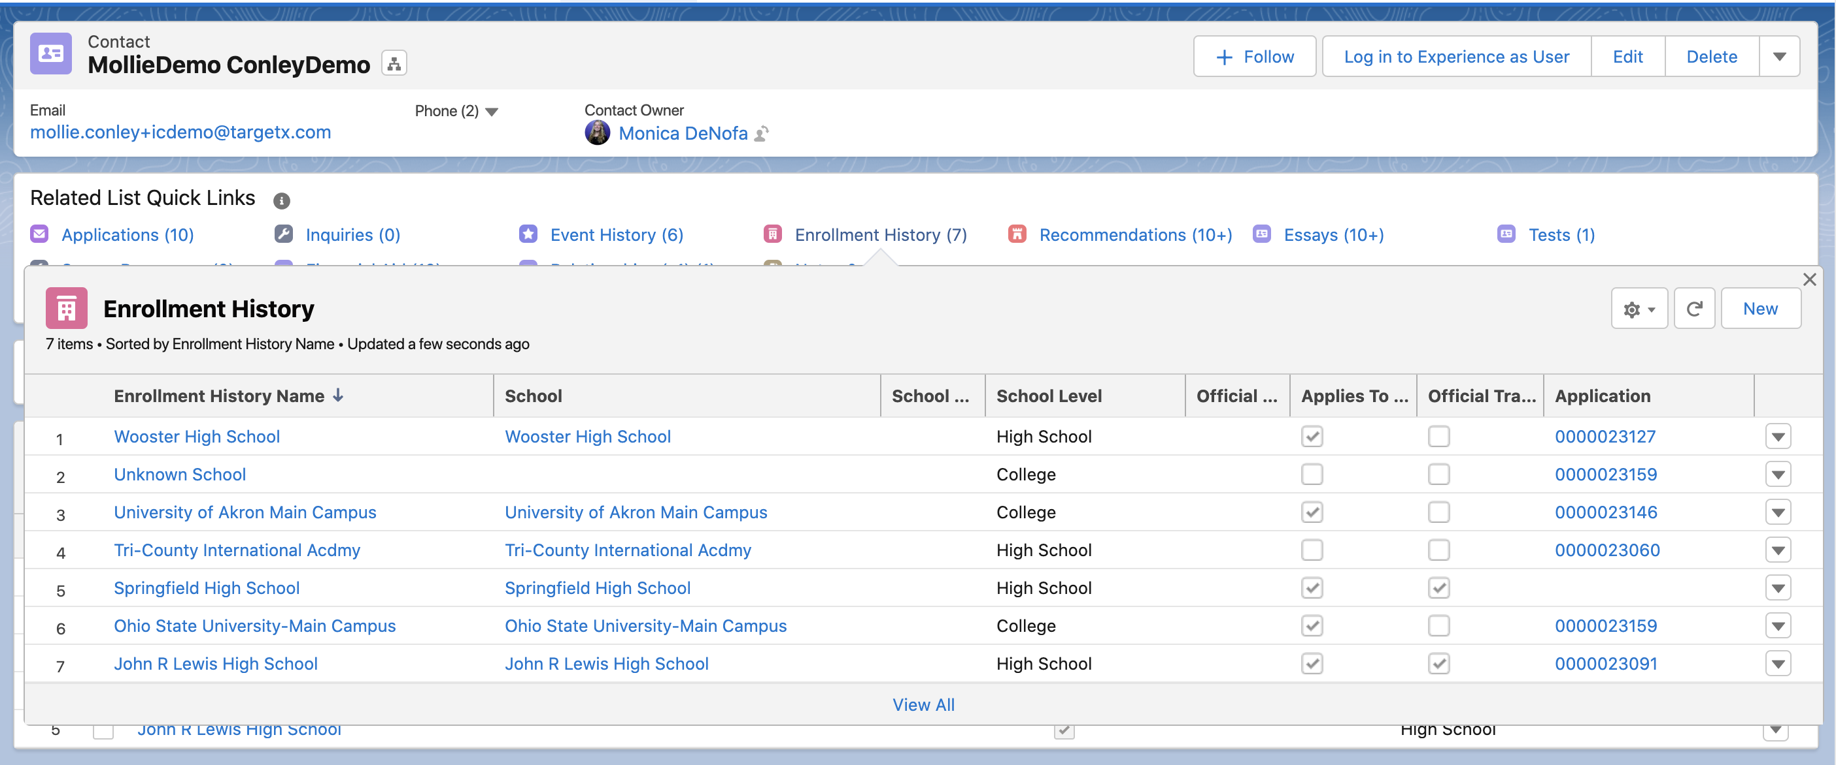
Dynamic Related Lists
Notes:
Here you can see that I have an Enrollment History related list in my quick links, * showing 7 records. These records could have been created by an ACT Import, self reported in the Online application, etc.
*When I hover we can see the details of those 7 records. Notice that this view has 8 columns, and also that two of these records do not have applies to requirement checked, so they are not visible to the student in their checklist items.
*I’ve added a dynamic related list using the Enrollment History object at the * top of my Contact page layout, but on this one I’m filtering to only show me records where “Applies to Requirement” is checked, implying that these are the 5 schools that we are expecting transcripts from.
You’ll notice this related list has fewer columns, has a * custom label of “Required Transcripts”, and has a * New button so you could create a new enrollment history record here or from the standard related list view.

Slide 20
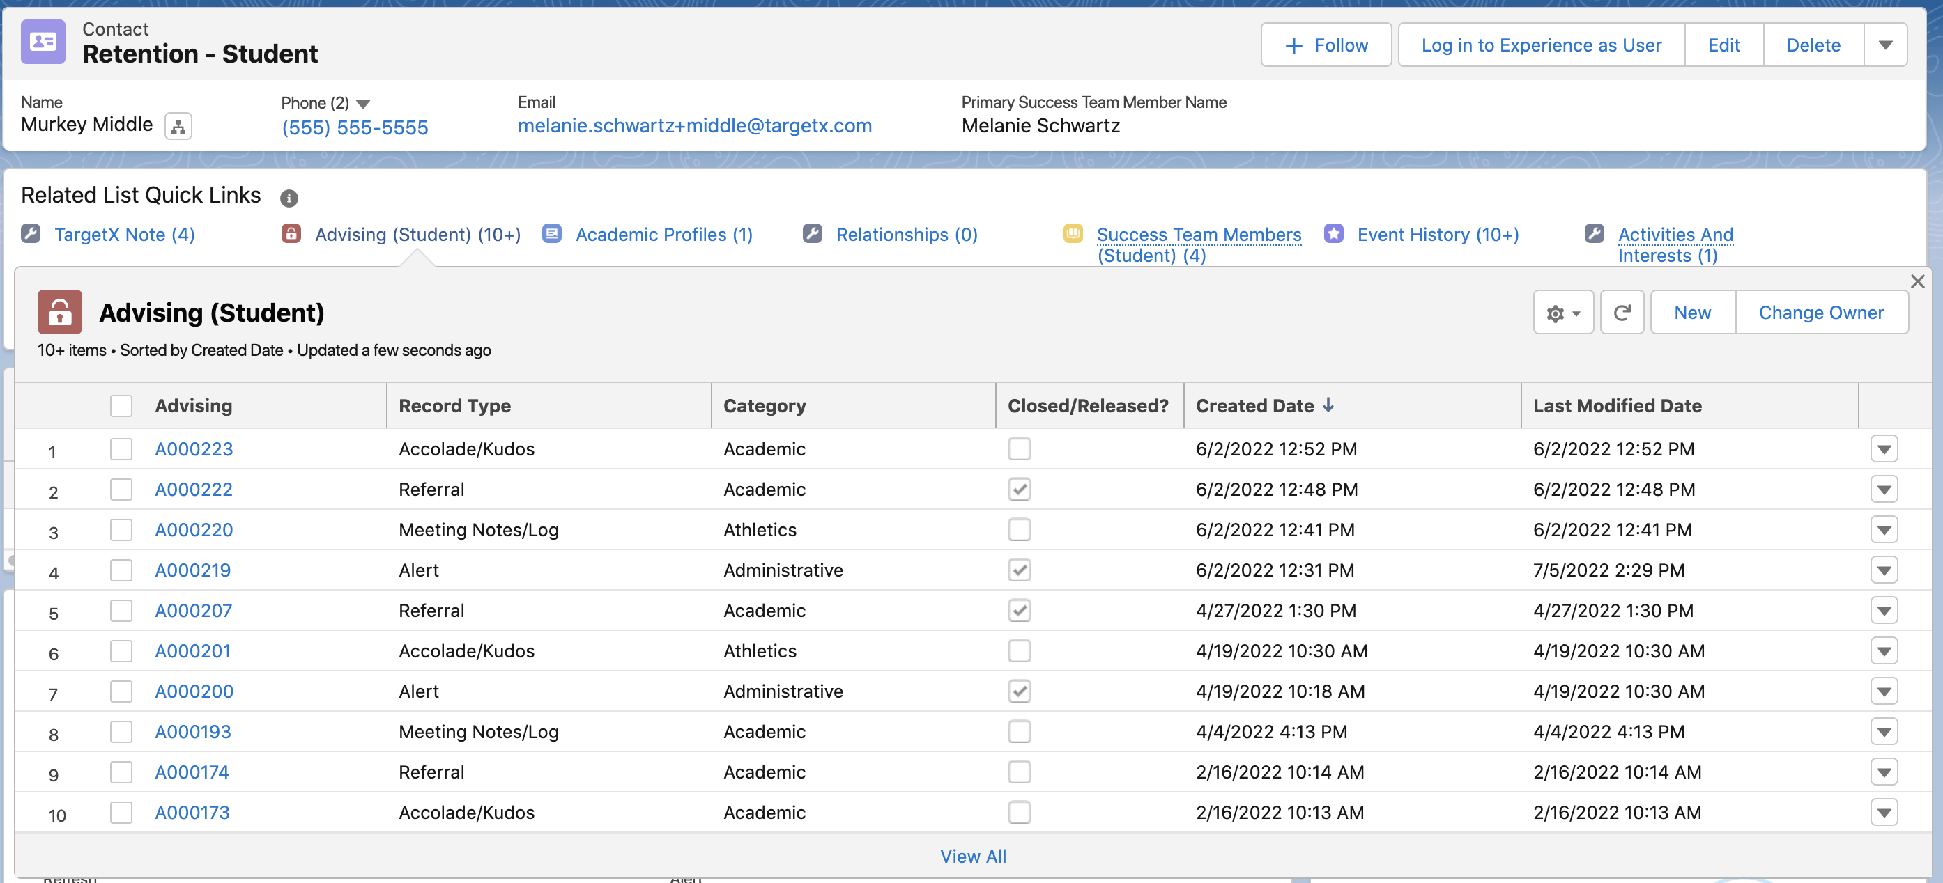
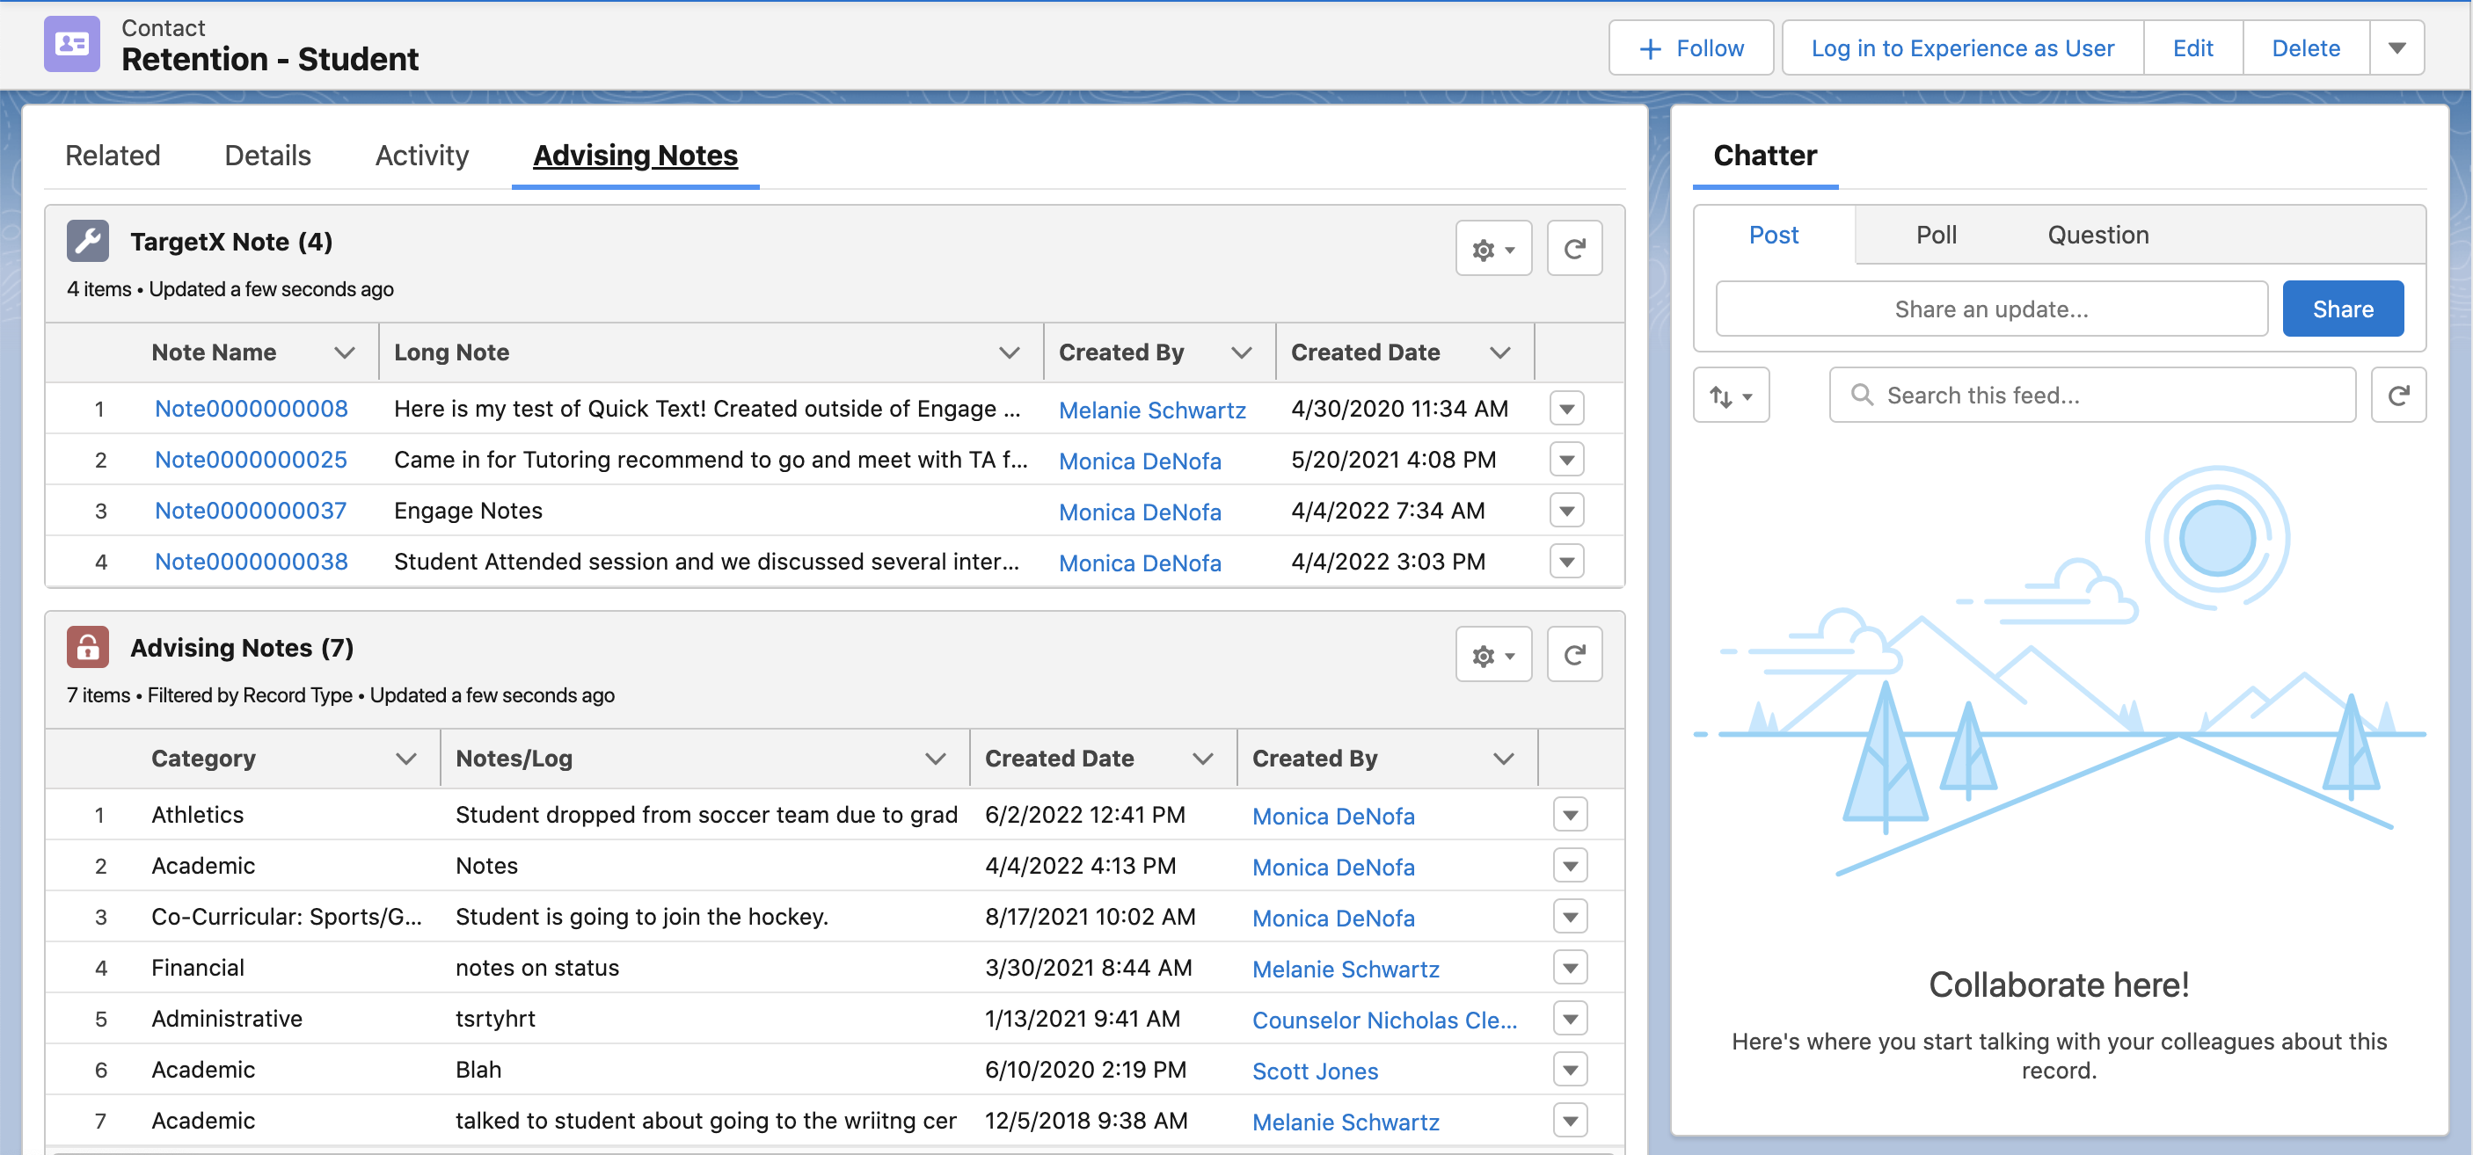
Dynamic Related Lists
Notes:
Filtering on record type is another use case for this tool. For those of you using Retention you are familiar with the Advising object and that it has 5 record types. On any given Contact record, we would see a mix of all Advising records, which is also what you would typically view in the Student Success Center.
*On this view I've created a * custom tab called Advising Notes where I am organizing both my Engage Notes and my Advising Notes made in the SSC. I could have applied a custom label * here in TargetX Notes and I have applied filtering here * to show me only Notes type of Advising records. It’s also worth noting that I have remove the New button from both related lists so that Advisors are forced to use the tools – Engage or Student Success Center – to make new records.
Where else might you spotlight a single related list or configure a dynamic related list?

Slide 21
Lightning App Builder:
Quick Actions & Global Actions
Notes:
Related Lists aren’t the only thing you can spotlight with a special component... what about viewing related records or making a new record?

Slide 22
What’s the Difference?
Related Lists – this component is used to display a list of records that have a Lookup or Master-Detail relationship to the record that is currently viewed.
Related Records – this component can be used to display the details of a single related record, including the details of a parent record on the Lightning page. This feature also allows for inline editing on the displayed record.
Notes:
As we’ve just discussed, related lists are showing us records that have a relationship to the record we are currently viewing. We use related lists all the time to see things like Applications, Enrollment Histories, Academic Profiles and Advising records that are related to our Students. ​
​
Whether a standard or dynamic related list, in all cases you are still required to click through to the desired record to make changes. ​
​
The Related records component, lets you bring details from another object onto the record you are currently viewing. You can even edit that other related record! ​
​
So where would this be useful?.... What if you are looking at a prospective student’s application record and you need to be able to correct their name or other contact information? That might look like this...​

Slide 23
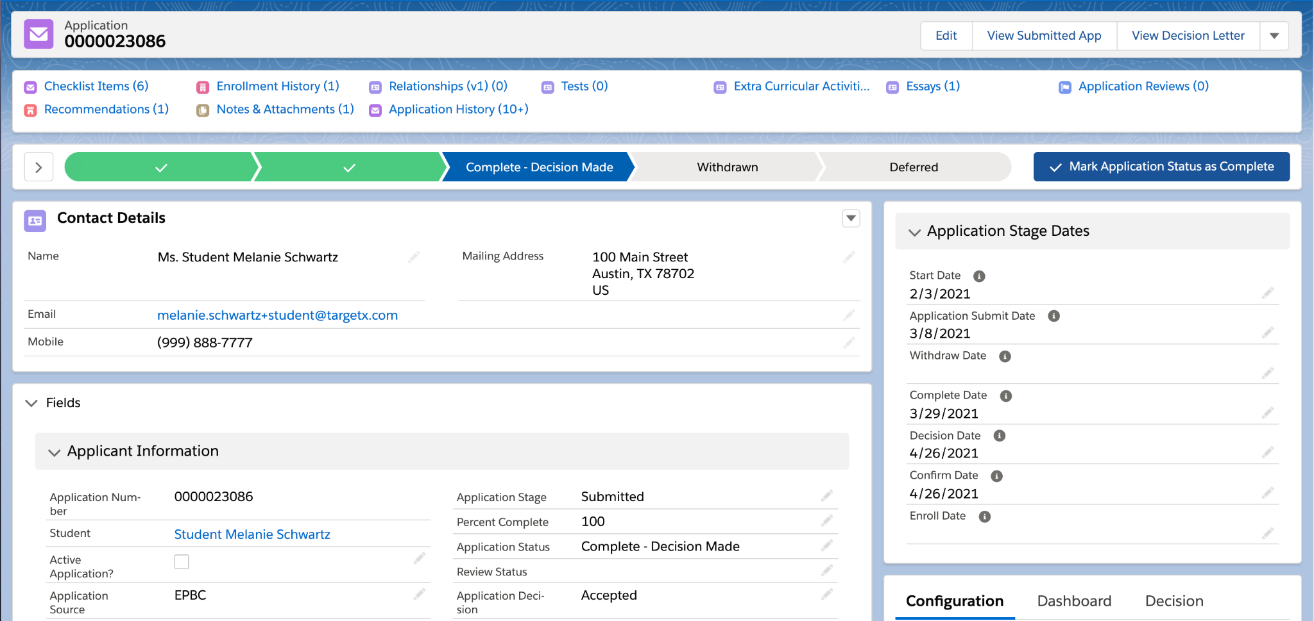
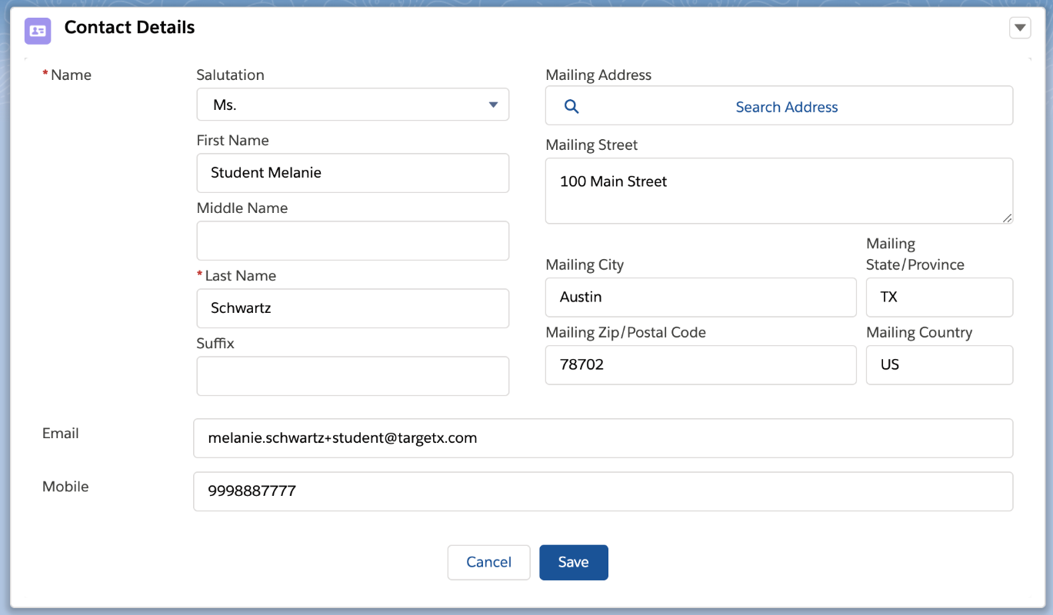
Related Records
Notes:
Here I’ve used a Quick Action to create a view of a set of fields from my related Contact record. This is different from the Compact Layout I showed earlier, because here when I edit this application record *, it allows me to edit those viewable Contact fields directly … FROM the application.
Quick Actions are created on the object that you want to see the summarized view of...so for this example, I made a custom Quick Action on the Contact and then added that Contact Quick Action to my Application layout.

Slide 24
Quick Actions vs Global Actions
Quick Actions
This is an object-specific action, which means that the record containing the action/button must be linked to the actionable related record.
Global Actions
This action allows you to created records on objects that may not have a relationship to the record that is the starting point for the action.
Notes:
Creating a custom Contact Quick Action is what allowed us to show the editable fields from the related Contact record. Salesforce now delivers a number of standard Quick Actions on Standard objects, but you cannot customize the fields on those, that’s why we saw two when we went to select our Quick Action. I recommend creating a custom one to meet your needs.​
​
Global Actions are a little bit different. I would use a Global Action if I wanted to create a record that may not be related to the record that I’m currently viewing. Global Actions are added as buttons in the Highlights Panel, and can be customized to show only fields you need, and make them required to ensure that you get exactly what you need. You might add a Create Account Action on an Enrollment History record. Or a Create Advising Action from the Academic Profile or Action Item record.

Slide 25
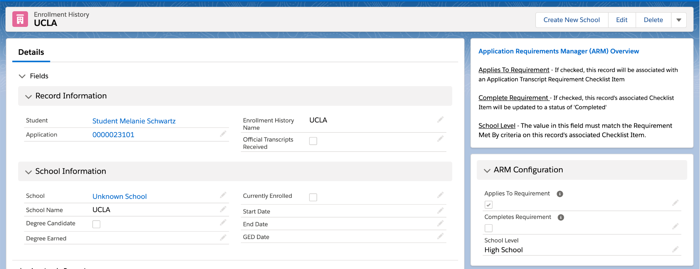
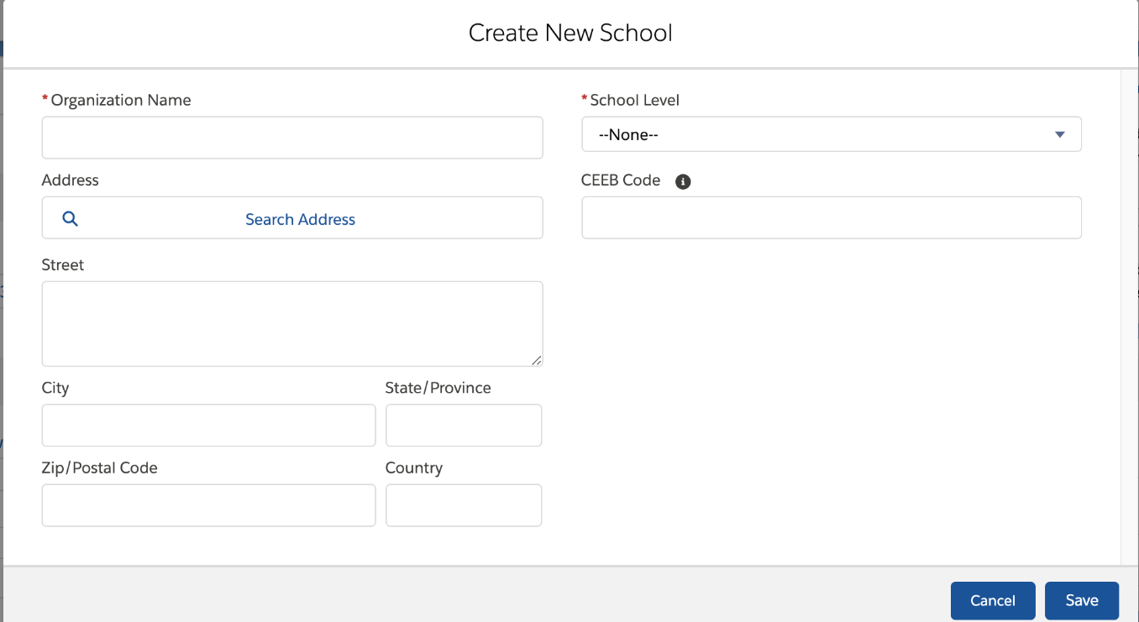
Global Actions
Notes:
Let’s go back to my Unknown School Enrollment History record. After using my new Search Layout, I still can’t find the school that the student provided. I have a * “Create New School” button in the Highlights Panel that I can use to create a new record.​
​
When clicked * it opens a pop out with exactly the fields I need to create a new Account record.​
​
These buttons are another feature that can have conditional visibility applied.

Slide 26
Lightning App Builder:
Dynamic Forms
Notes:
The last Lightning Builder feature I want to introduce today is Dynamic Forms

Slide 27
What are Dynamic Forms?
With Dynamic Forms you’ll be able to:
Place fields anywhere on the layout, not just the traditional Details page
Use visibility rules to make fields and components appear or disappear based on criteria
Eliminate the need for maintenance of multiple page layouts
Notes:
So what are Dynamic Forms? This feature was made generally available for custom objects in the Salesforce Winter ‘21 release. This allows you to be much more flexible and creative with your field placement. ​
​
If you have created record types solely for the purpose of having different page layouts for different kinds of records (for example Grad vs Undergraduate or Domestic vs International applicants) or you’ve created different profiles for that same purpose, then this the feature is for you! ​
​
I’m going to walk you through a number of examples that I’ve implemented on the TargetX Application object to show how you might use this feature...​

Slide 28
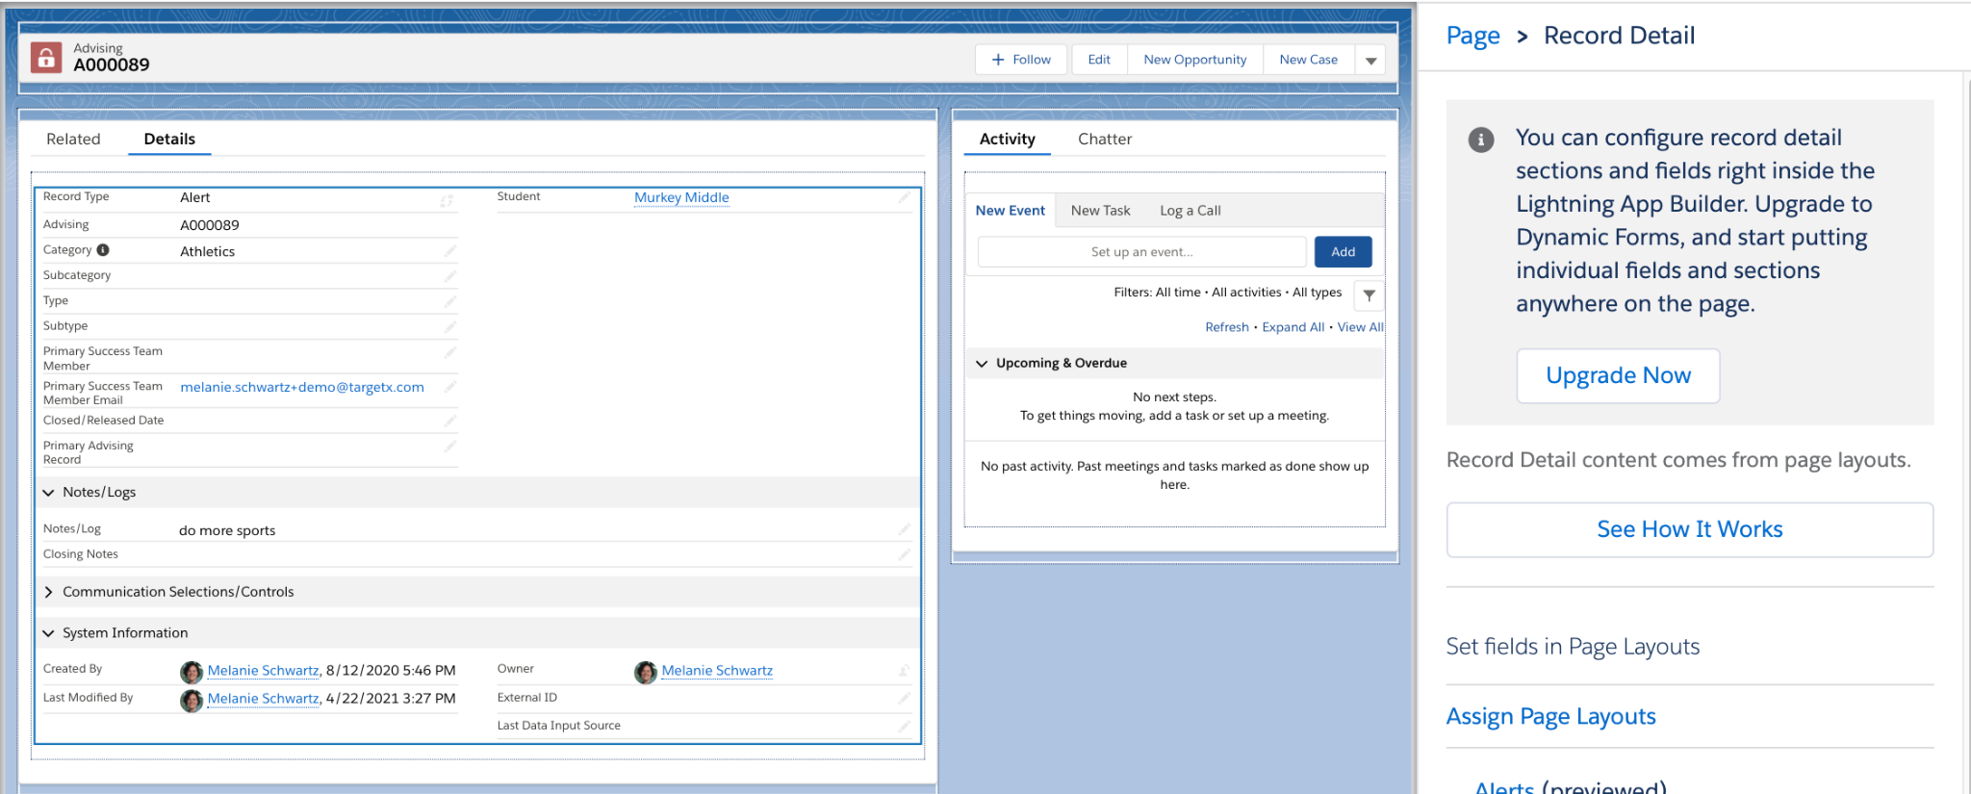
Dynamic Forms
Notes:
The first time you select the Record Detail from the Lightning App Builder page of a custom object, you will be asked if you want to upgrade the details section of the layout. Selecting Upgrade Now will automatically convert your existing details sections to a Dynamic Form configuration. From there you can make additional modifications.​

Slide 29
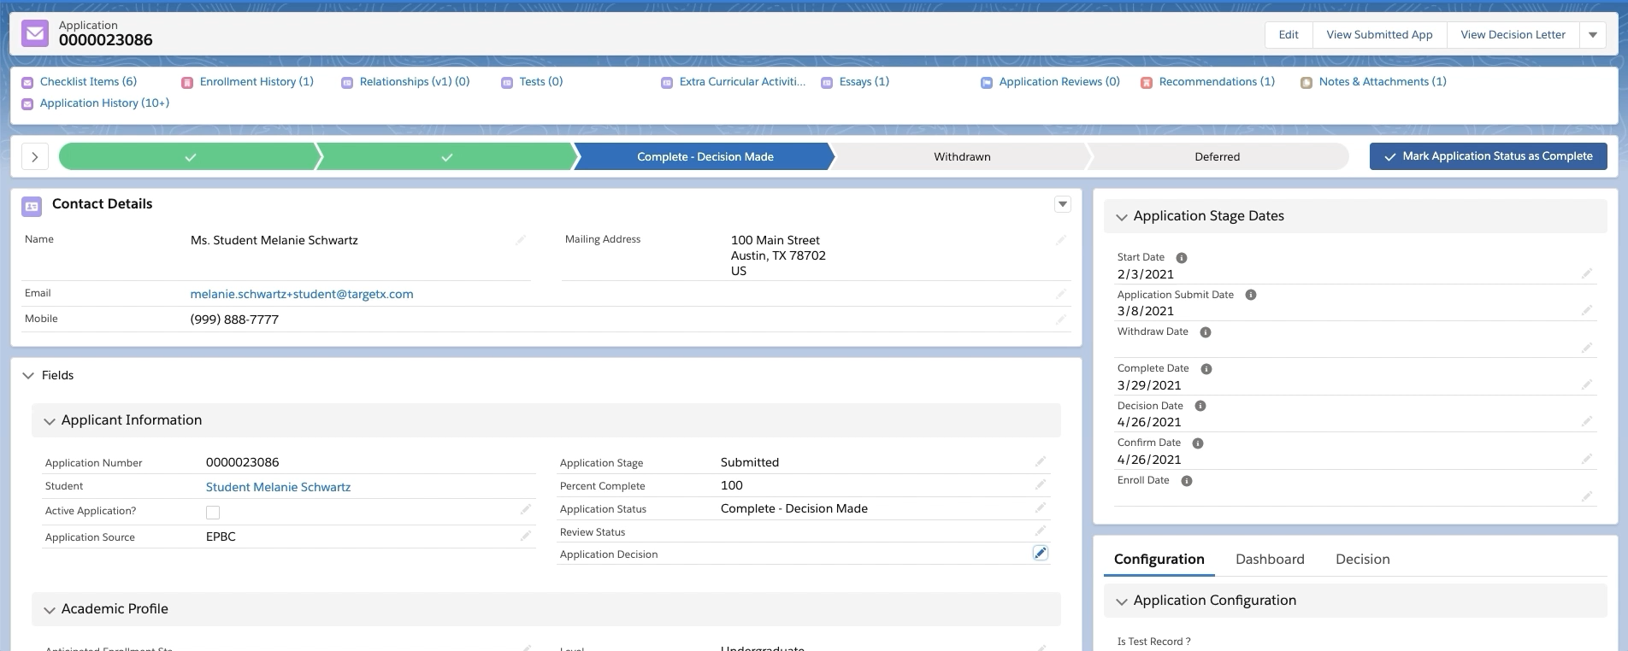
Dynamic Forms
Notes:
<PRESS PLAY> As I mentioned, I’m going to stick with the TargetX Application object to show some page layout modifications that can be done with the features we have covered today, including dynamic forms​

Slide 30
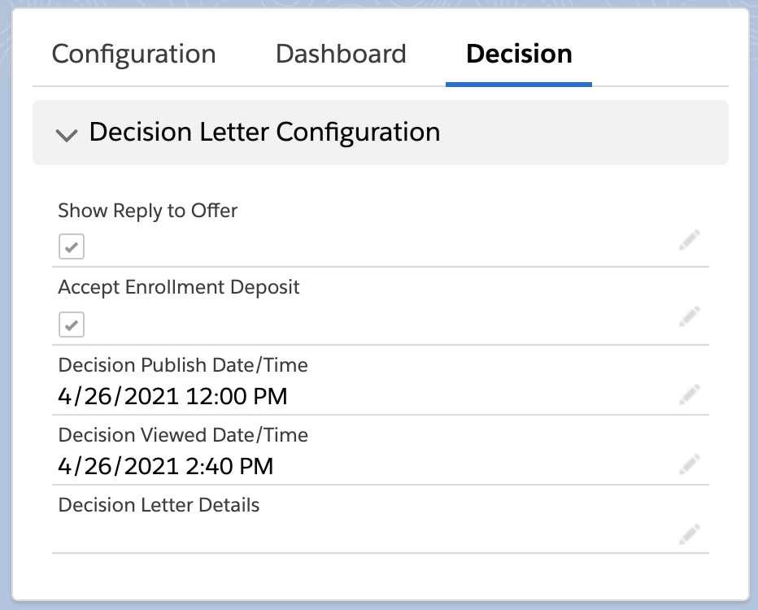
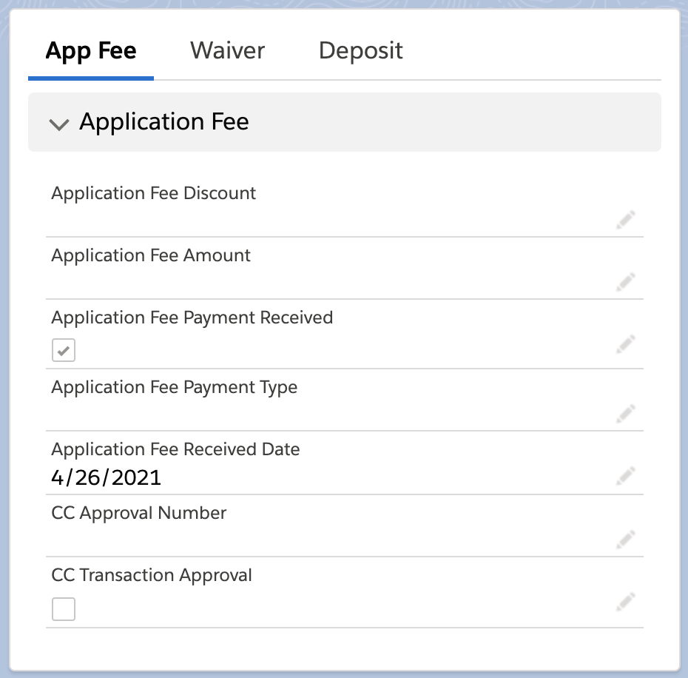
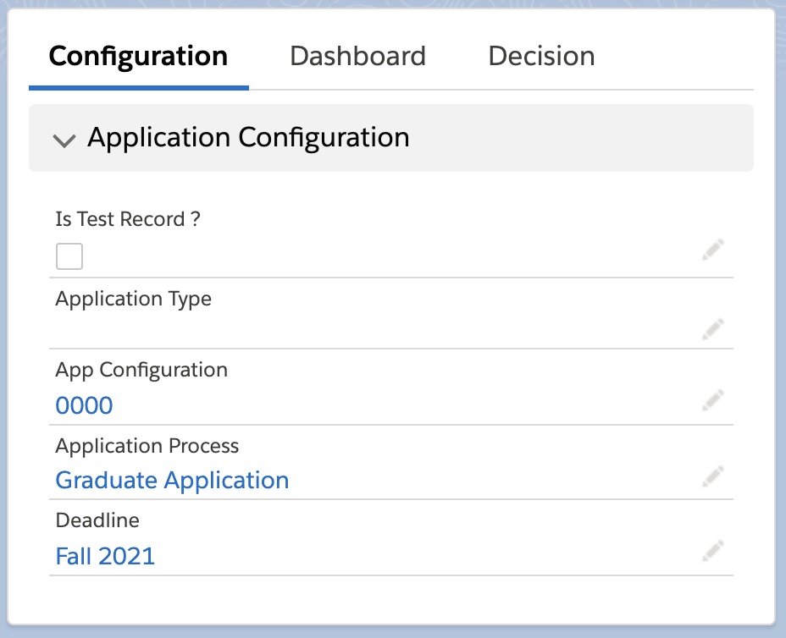
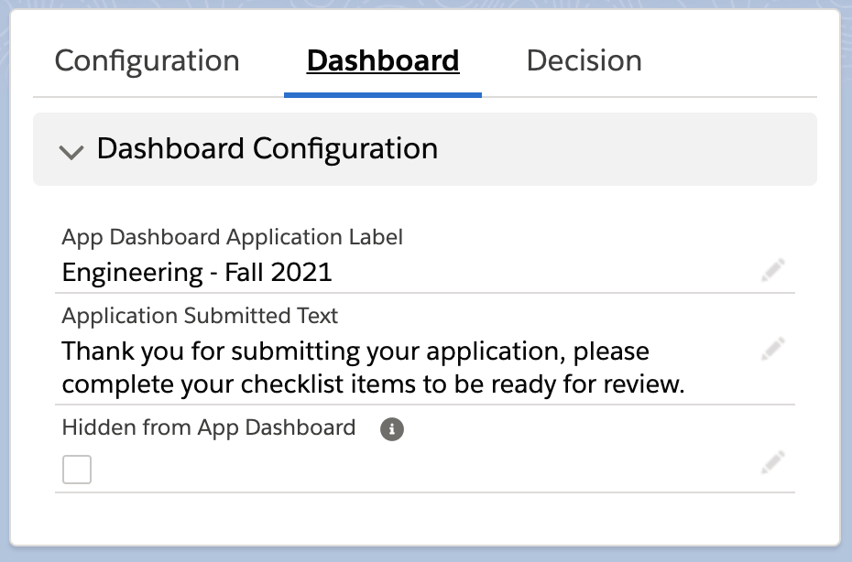
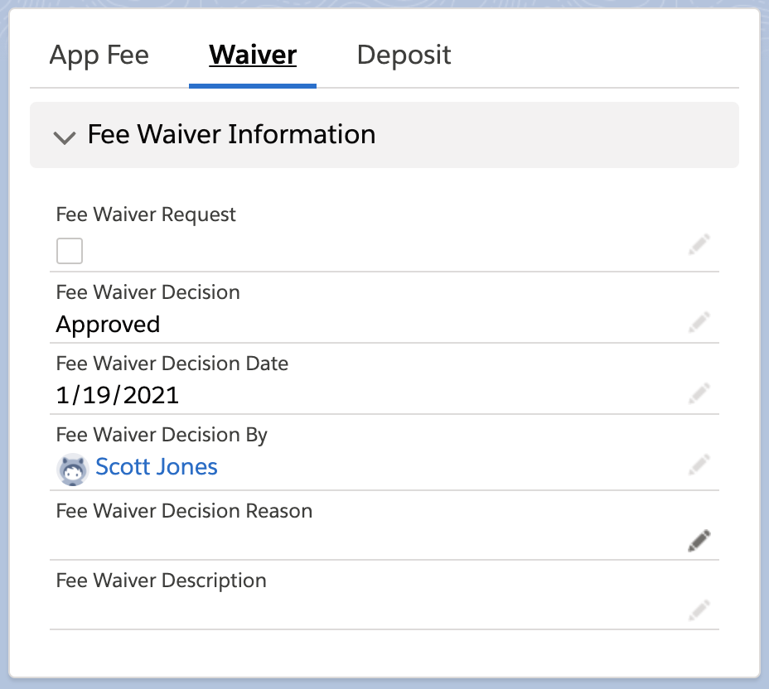
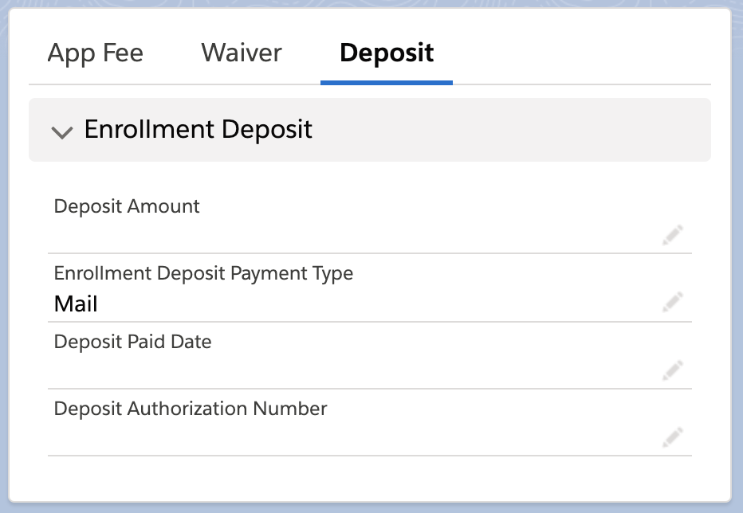
Dynamic Forms
Notes:
When I started using Dynamic Forms, I wanted to isolate what I consider “configuration fields” to the side, away from the content of the application.
I created new blocks with multiple tabs to achieve this.
My first block contains sections related to the Application configuration,*Applicant Dashboard and *Decision Letters
Another block has Fee related sections including *Application Fees, *Application Waivers, and *Enrollment Deposit information
You could go a step further by not just isolating these fields on the layout, but also making the blocks conditionally visible to a select set of users based on profile or role.

Slide 31
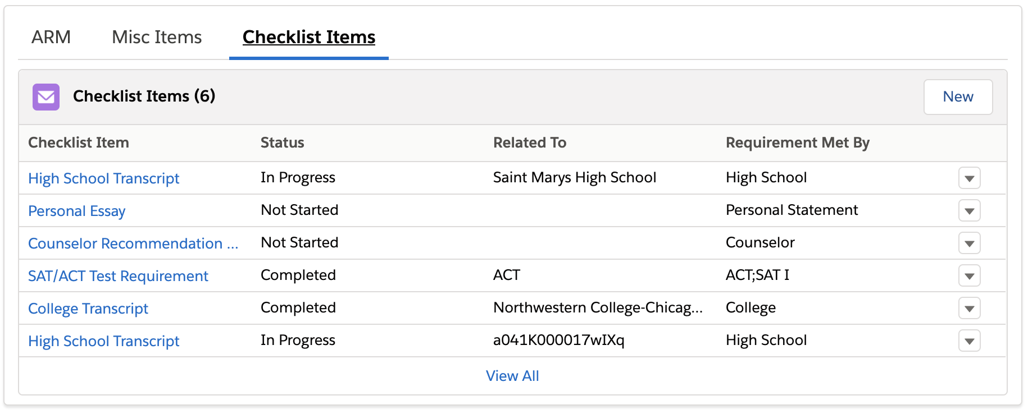
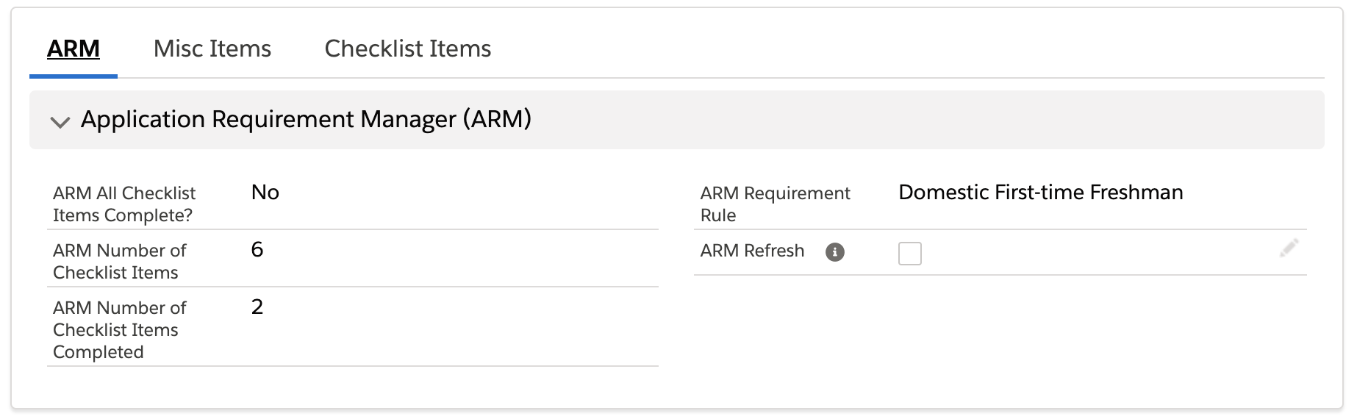
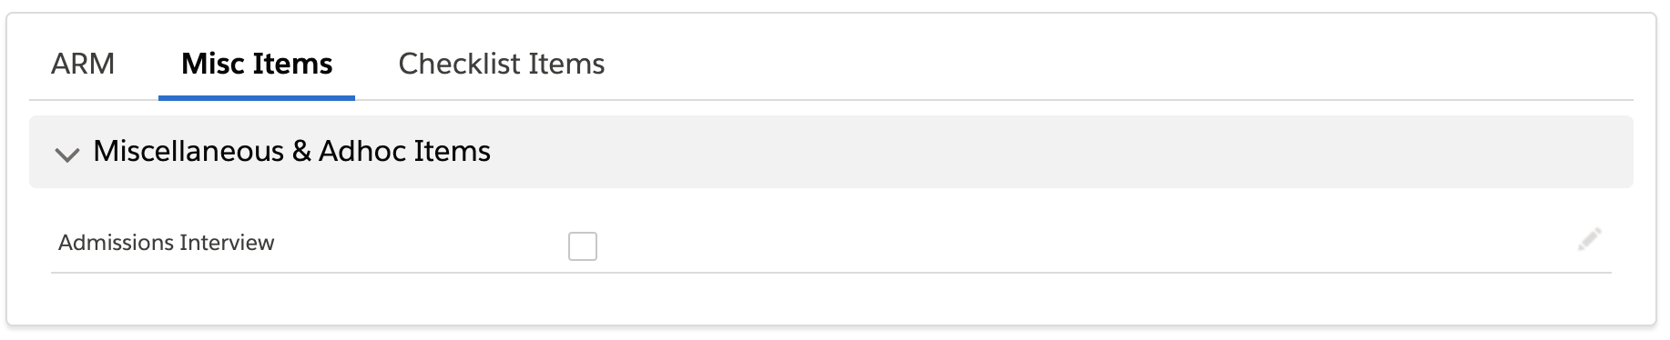
Dynamic Forms
Notes:
In the center of my Application layout, I created a multi tab section to bring together all of my checklist items related pieces – the configuration fields,
* any miscellaneous checkboxes, and finally the
* checklist items related list - now I can easily toggle between these to see if the correct items are populating based on the rule without having to scroll to the top of the page or toggle to another screen.

Slide 32
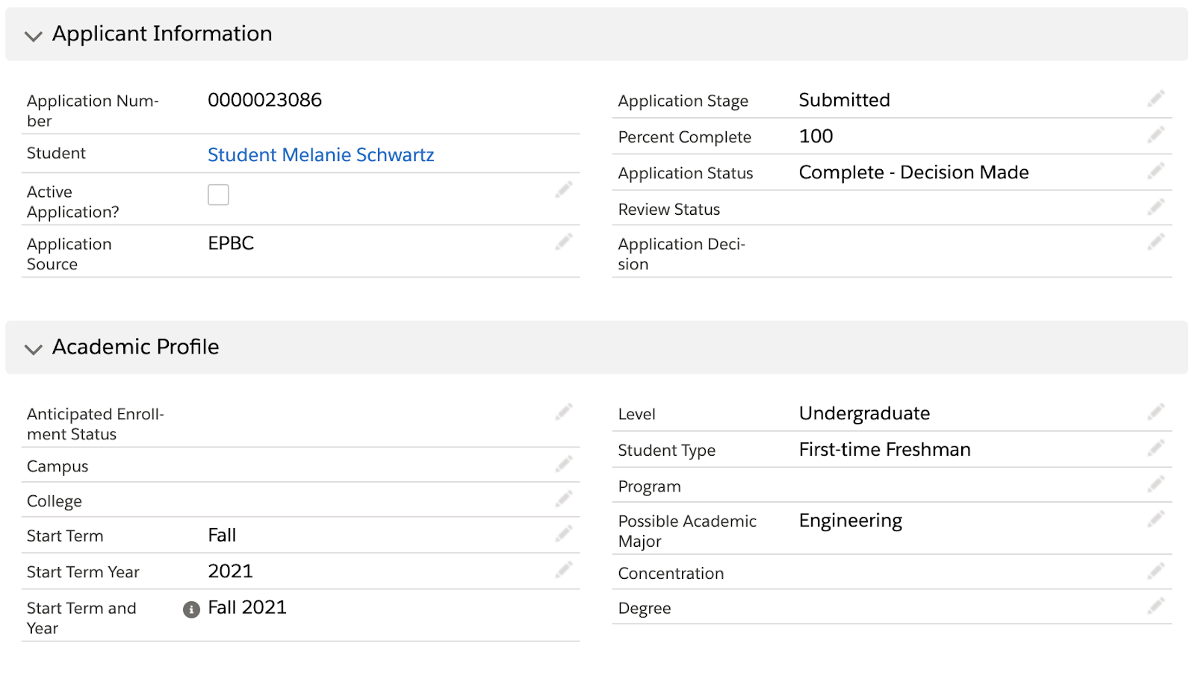
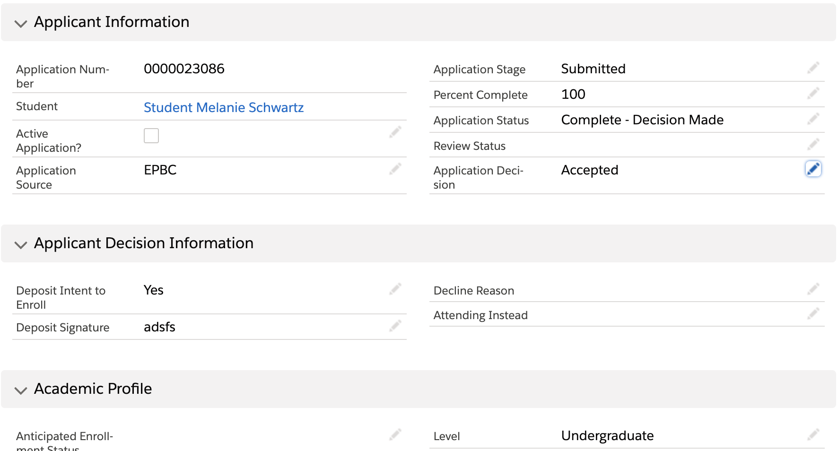
Dynamic Forms
Notes:
Finally, I want to show how not only fields, but entire sections can be conditional.
Here i’ve designed a section that is dependent on the * value in the Application decision field. The applicant’s * intent to enroll and deposit information is only revealed if they’ve been accepted by the institution.
On the Application object, you could also use this functionality to hide or display sections of fields that might be related to Honors Applications, fields that are only answered by certain program applicants, or a block of Residency questions that might only show if someone identifies as being a resident of your state.
This functionality could easily extend to other objects - Perhaps you ask different questions of parents than of non-parent relationship records or different Recommendation Rating fields for different kind of recommenders
Anywhere that you currently have large blocks of field that may never be populated, consider putting those fields in a separate section and making it conditionally visible.
As I’ve mentioned Dynamic Forms is currently only available for custom objects, but that includes most of your TargetX functionality, with the exception of Contacts and Accounts. Currently Salesforce is exploring expanding this functionality to Standard objects but no general release date is available.

Slide 33

Dynamic Forms
Notes:
Here are some other examples of page layouts I have updated using the various features I’ve discussed today..
*Recommendation page layout - here i’ve used *rich text and * dynamic forms to make these sections

Slide 34

Dynamic Forms
Notes:
Application Forms page layout - here i’ve used *rich text , *compact layouts, and * dynamic forms to make conditional sections
This a reusable card, but when I select an Application Type* or Master Form..

Slide 35

Dynamic Forms
Notes:
We now see
*a multitab section for fee and deposit configurations, and
*different fields related to setting the org wide email and adding the custom verification and submission text - which are all features that only work when set on an application type, not a reusable form.

Slide 36
Resources
Break Up Your Record Details with Dynamic Forms (Salesforce Help)
Lightning App Builder (Salesforce Trailhead)
Lightning Experience Customization (Salesforce Trailhead)
Salesforce Dynamic Forms – Overview & Deep Dive Tutorial (Salesforce Ben)
Customize Compact Layouts (Salesforce Trailhead)
Notes:
I know that I’ve only briefly showed some of the mechanics of how to do these things today, so I have included a list of resources that you can access to get more guided training and information.​

Slide 37
Resources
Customize Layout for Search Results (Salesforce Help)
Object-Specific versus Global Actions (Salesforce Developer Documentation)
Create Object-Specific Quick Actions (Salesforce Trailhead)
Ultimate Guide to Dynamic Related Lists (Salesforce Ben)
How to Show a Set of Fields in Lightning Experiences without Code (Salesforce Diaries)
Notes:
I hope that this webinar has helped you start to think about how these features might be useful in your TargetX CRM.

Slide 38
Q & A

Slide 39
Thank You
Melanie Schwartz, MA
Liaison International
mschwartz@liaisonedu.com

