Slide 1
Tapping Into the Trifecta
George Wolf | Vice President for Enrollment Management, Siena Heights University
Scott Mallen | President, EMP Division, Liaison

Slide 2
Agenda
Current challenges effecting marketing today
Emerging solutions
EDU Specific Marketing Challenges
3 keys to successful Enrollment Marketing
The “Trifecta” in Action

Slide 3
Top Marketing Challenges
Marketing issues impacting EDU and beyond

Slide 4
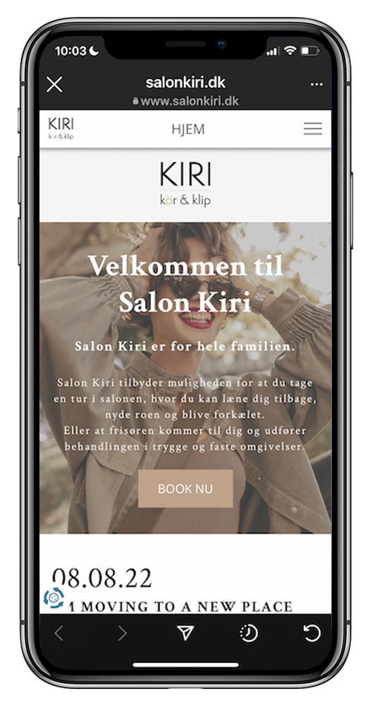
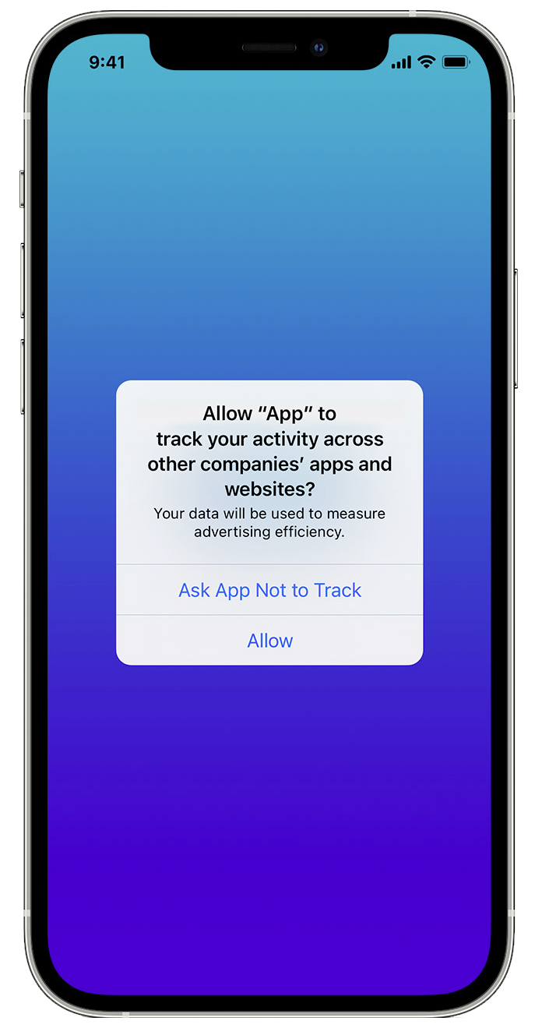
A new “privacy-first” world
GDPR & CCPA
Must demonstrate that they have received valid consent to store and process personal information.
Eliminates dependence on behavioral data collection
No more implied consent to gather data
Cookies
Firefox and Safari block tracking cookies
Chrome blocking cookies in 2023
Apple’s tracking privacy protection
Apps need your permission when they track you across apps/websites owned by other companies.

Slide 5
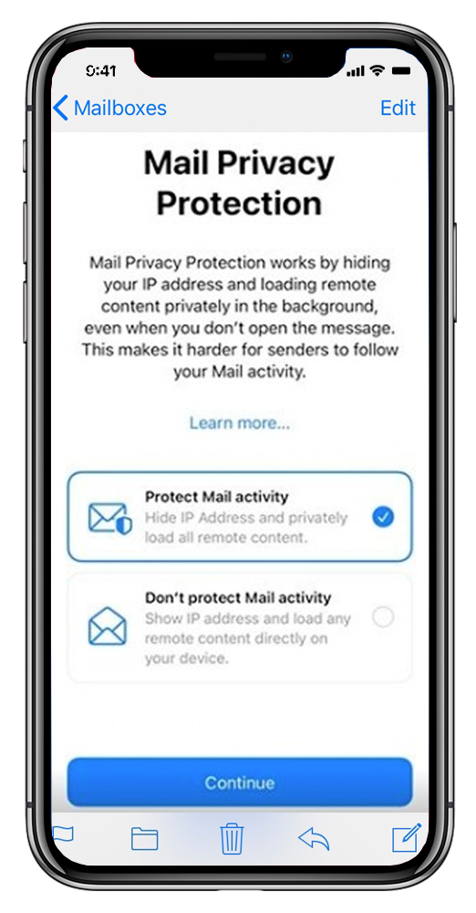
Email Privacy changes
Apple’s Mail Privacy Protection
Individual user data (like location, time opened, etc.) from Mail users are no longer available to email marketers
Open rates are increasing, but are no longer reliable
Click-to-open rates are decreasing, but are also unreliable
Open rate-powered email features have become less reliable
Goggles push to end spam
100+ engineers work on email deliverability
End goal: you get only get email you want - End spam

Slide 6
The Digital Clutter
too many Ads
Americans are exposed to around 4,000 to 10,000 advertisements each day
Email overload
188,000,000 Emails are sent every minute.
We live in an ever-growing stream of information that’s available at our fingertips. This has led to an ever-increasing problem of content overload
https://www.redcrowmarketing.com/2015/09/10/many-ads-see-one-day/

Slide 7
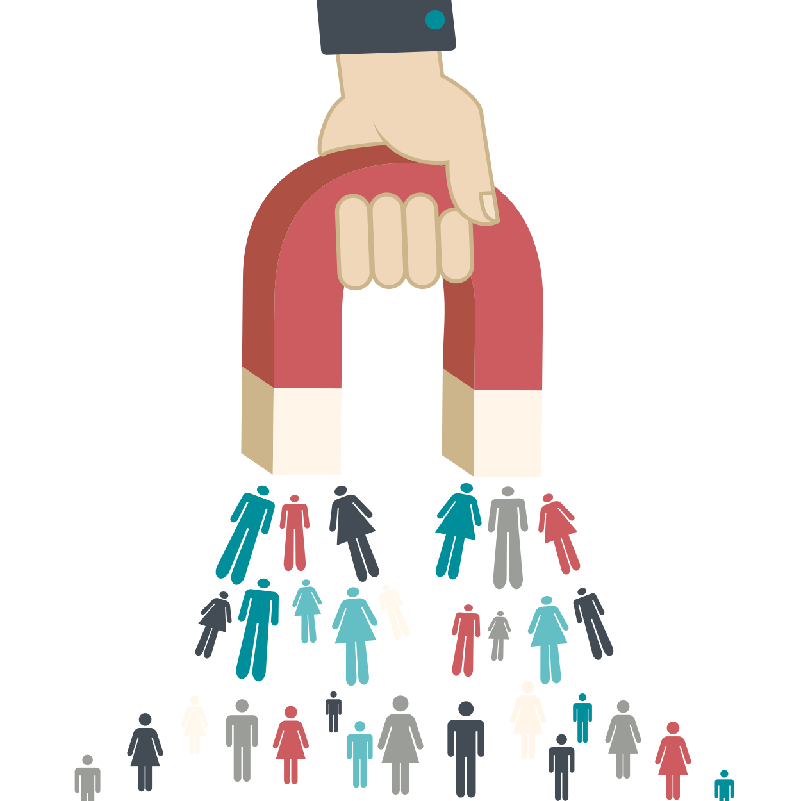
Rising New customer acquisition Cost
In the last five years, customer acquisition costs have increased by as much as
60%
key factors:
The introduction of iOS 14.5
The demise of third-party cookies
Increased consumer privacy legislation such as CCPA & GDPR

Slide 8
Overcoming these Challenges
Focus on Inbound marketing
First-person data
Inbound marketing

Slide 9
Overcoming these Challenges
Focus on Inbound marketing
First-person data
Predictive modeling
Identify what a prospect wants before they know it
Predictive modeling

Slide 10
Overcoming these Challenges
Focus on Inbound marketing
First-person data
Predictive modeling
Identify what a prospect wants before they know it
Hyper-personalized marketing
Talk to prospects as individuals
Hyper-personalized marketing

Slide 11
Overcoming these Challenges
Focus on Inbound marketing
First-person data
Mobile Marketing
Email
Snapchat
Texting
Facebook
Predictive modeling
Identify what a prospect wants before they know it
Twitter
Personalized Microsites
Events
Hyper-personalized marketing
Talk to prospects as individuals
Digital Marketing
Variable Print
Prospect
Omni-channel communications
Leverage different connected channels with the same brand/message
Rep Interactions
Instagram
Pinterest
Youtube
Omni-channel communications

Slide 12
Overcoming these Challenges
No Need to Fly marketing campaign
Focus on Inbound marketing
First-person data
Predictive modeling
Identify what an prospect wants before they know it
Hyper-personalized marketing
Talk to prospects as individuals
Omni-channel communications
Leverage different connected channels with the same brand/message
results: +850% click through rate & 24% increase in sales revenue

Slide 13
EDU Specific Marketing Challenges
A changing landscape
Test optional: changing the top of the funnel
Demographic cliff
Hyper-competition
Inflation/ budget efficiency pressures
See all the challenges above
Less inquiries = more pressure on yield
No simple answer anymore
Re-brand again
Go to more fairs
Add more emails
Go big in digital

Slide 14
The Trifecta!
3 keys to successful enrollment marketing

Slide 15
Forward looking marketing strategy
Strategic plan for the entire Enrollment funnel
Actionable Plan
Allocate more resources as the funnel narrows
SEARCH PLUS
INQUIRED
EVENT
PRE-APP
ACCEPTED
ENROLLED
OTHOT Prescriptive Analysis
LIAISON
INTELLIGENT
NAMES
CRM?SIS
Data flows
automatically both ways
Upperclass
& UNDERCLASS
Focus on student journey
What do your students have to say, put yourself in their shoes
Nurture don’t mean hitting them in the face!
OR
Personalized Microsite
Personalized Microsite
Personalized Microsite
Personalized Microsite
Personalized Microsite
TARGETED
NURTURE
Parent & Student
DRIVE TO
APPLY
Parent & Student
EVENT
PROMOTION
APPLICATION
NURTURE
ACCEPT
CONF
VAR
ACCEPT VIDEO
Financial
Aid
DRIVE TO ENROLL
NURTURE:
PARENT
YIELD
FINAL PUSH
INTELLIGENT PRINT
Email
INTELLIGENT PRINT
INTELLIGENT PRINT
INTELLIGENT PRINT
INTELLIGENT PRINT
INTELLIGENT PRINT
INTELLIGENT PRINT
INTELLIGENT PRINT
INTELLIGENT PRINT
INTELLIGENT PRINT
INTELLIGENT PRINT
3-D ITEM & INTELLIGENT PRINT
Targeted Digital
dynamic form-fills
omni-channel communications
Growing case for print
Importance of Rep engagement
OTHER SOURCES
WEBSITE INQUIRIES
DIGITAL
MARKETING
OTHER LISTS
Maximize Your first-person data
Focus on people have consented for you to make contact and engage
COLLEGE FAIRS
STEALTH
LEADS

Slide 16
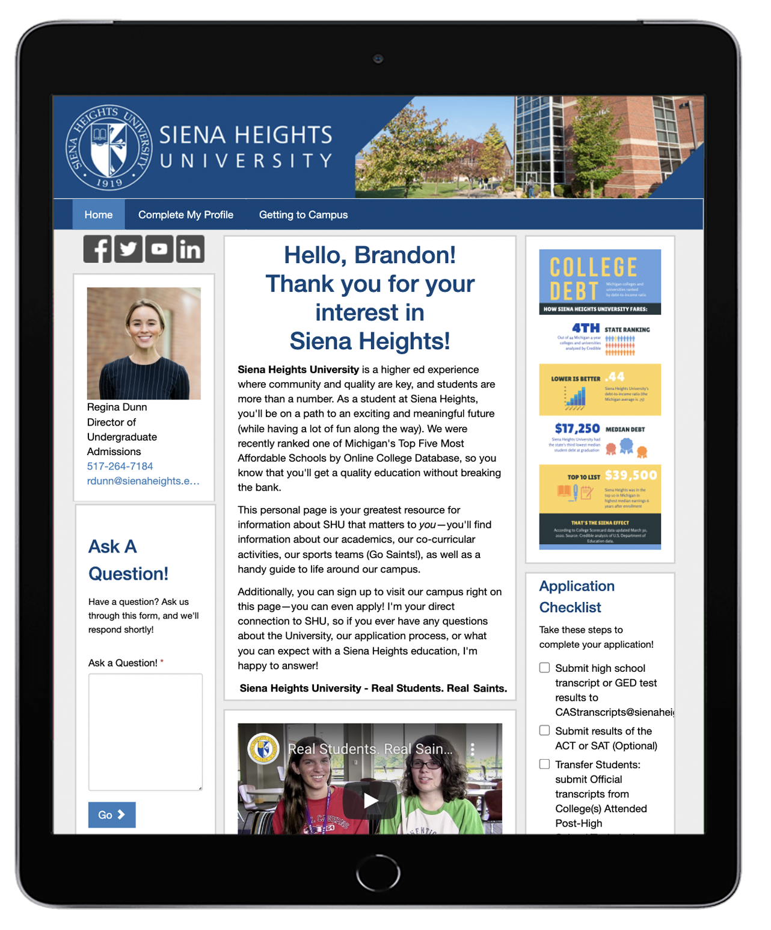
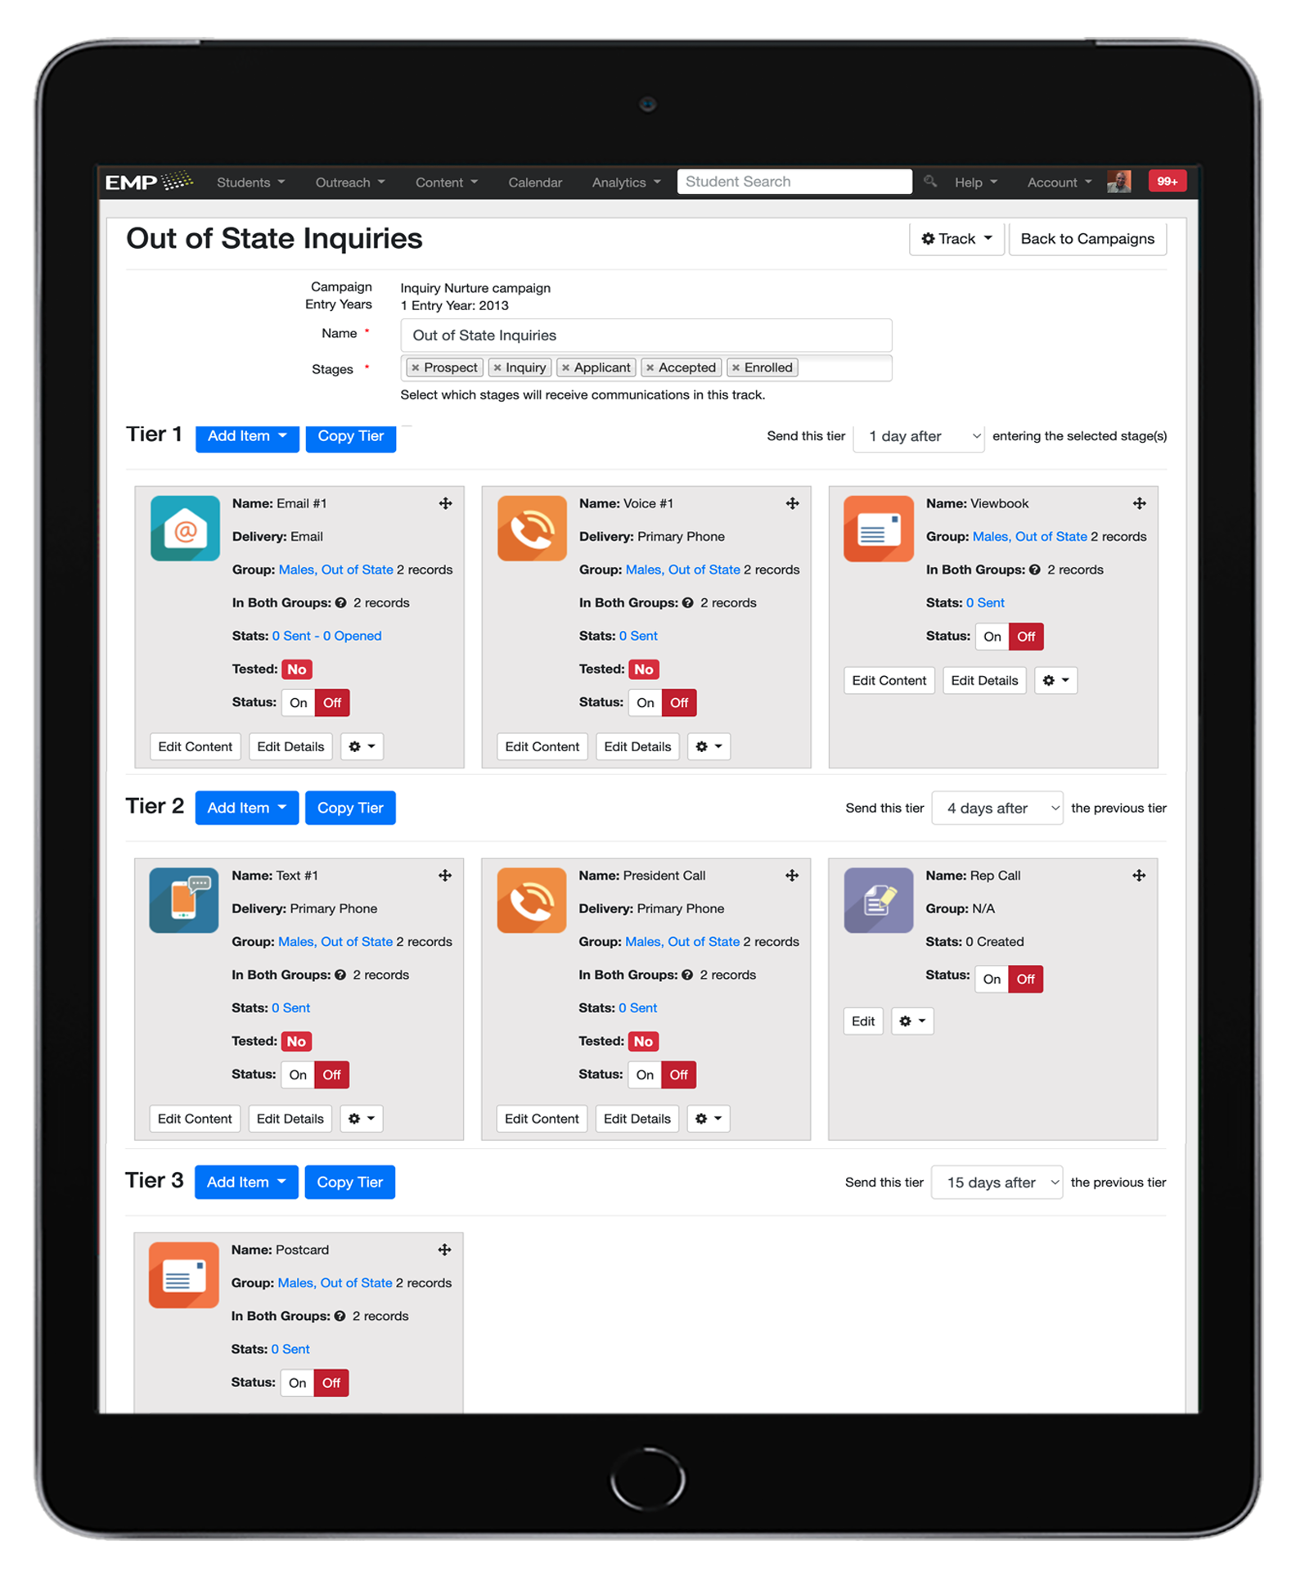
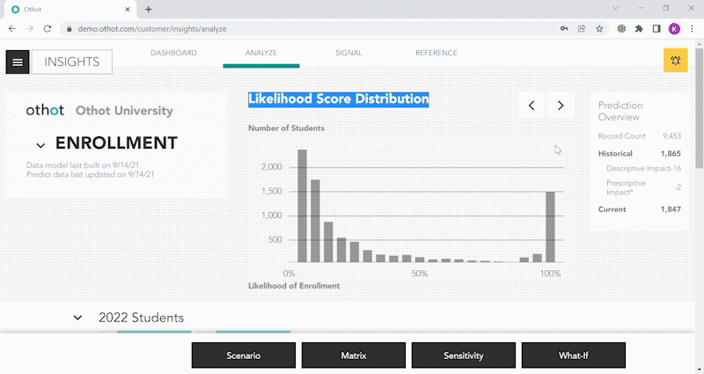
Strong Marketing Technology
The need for Automation
Immediate Response
Real-time Updates
Onmi-channel campaigns management
Channels are connected (QR Codes/personalized landing pages)
track all Interactions
real-time Campaign Updates
predictive modeling/Analytics
Know that an inquiry wants before they do
Build your Hyper-personalization campaigns off of your prediction
Analysis both Micro and Macro

Slide 17
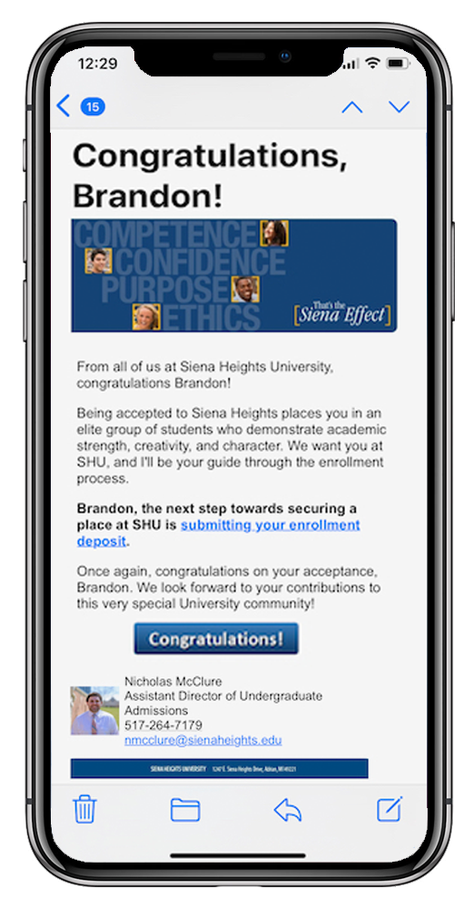
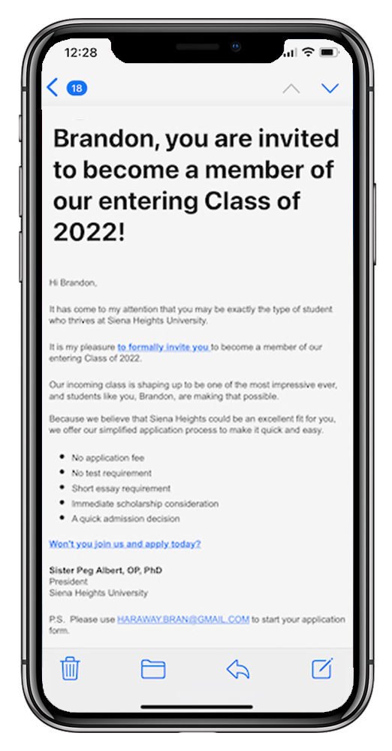
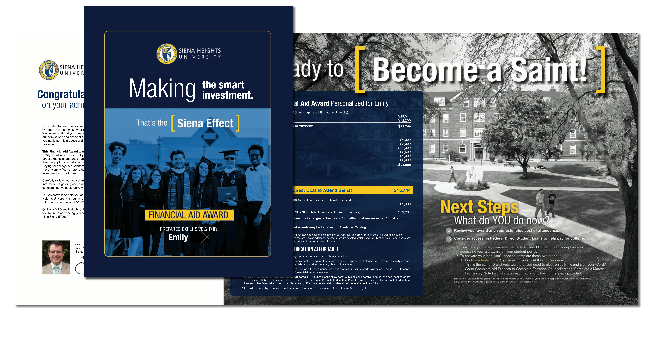
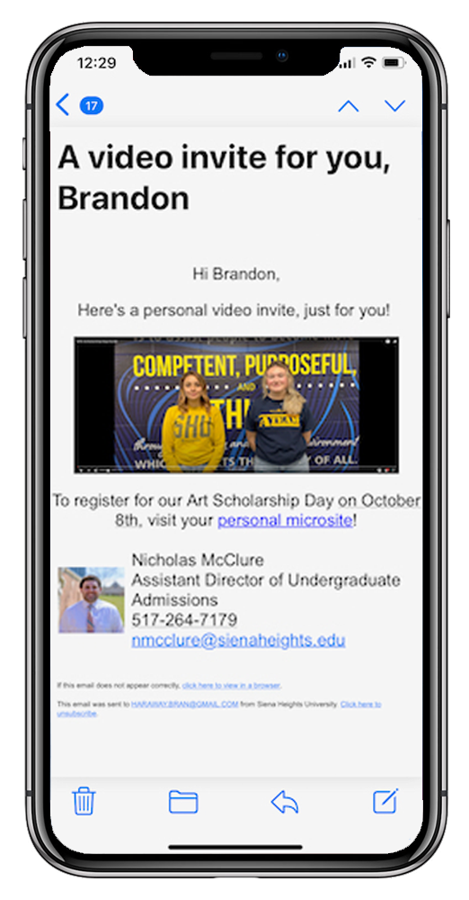
Creative built for one
Hyper-personalization
Content build for one
Position & brand across all channels
Meet Them Where They Live
Leverage Video Communications
Use A Mobile-First Strategy
Ensure Your Tech Design Is Superior
Making them feel wanted
Sell The End Game (tell a story)
Focus On Customer Experiences

Slide 18
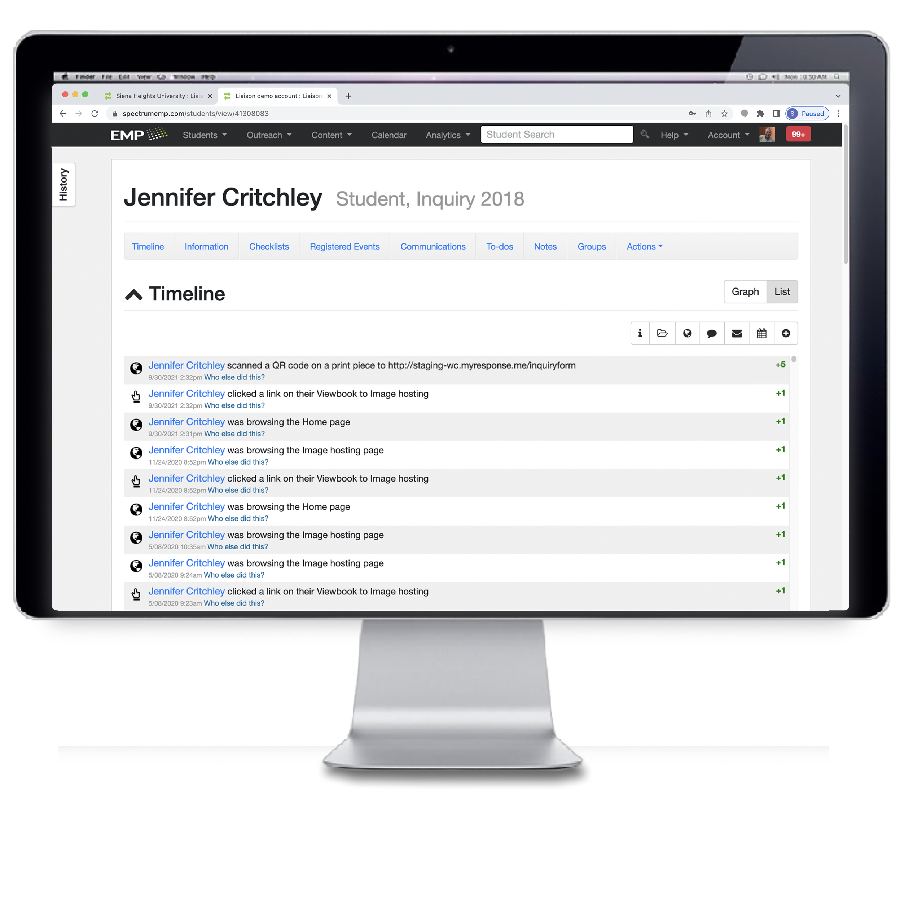
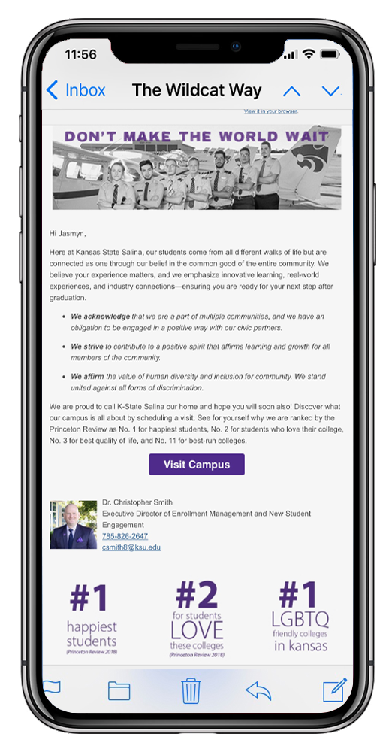
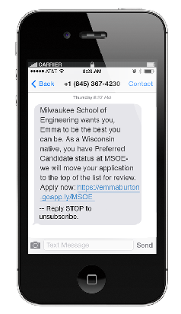
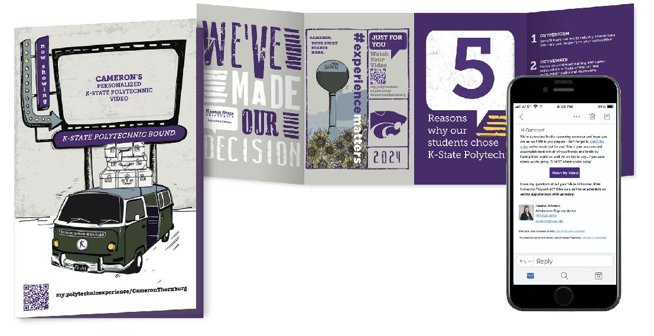
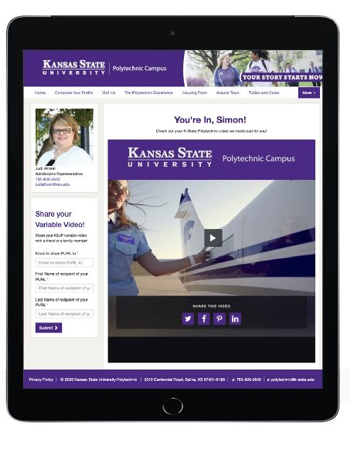
The “Trifecta” in Action
intelligent QR codes
Connect var print to digital
Hyper-personalized
Tracked Interactions
Interaction can trigger other campaigns
Validates print

Slide 19
The Trifecta!
Take Aways
Embrace technology. Use a marketing platform, Predictive Modeling!
Be strategic as well as tactical.
Develop strategies for the full recruitment funnel.
Actionable based Strategy
Speak to your audience in their channel and about their priorities.
Sustain ongoing and timely communication. Nurture, nurture and nurture some more (but don’t hit them in the face).
Data, analytics and reporting is paramount.
Look to your own experiences for new strategies or creative ideas.

Slide 20
Q & A

Slide 21
Thank You
George Wolf
Vice President for Enrollment Management
Siena Heights University
gwolf@sienaheights.edu
Scott Mallen
President, EMP Division
Liaison
smallen@liaisonedu.com

