Slide 1


Slide 2
Roadmap: TargetX, Admissions by Liaison and SlideRoom
Kevin Butts and Edmund O’Neill
July 28, 2:45 - 3:30 p.m. ET

Slide 3




Panelists
Kevin Butts
Edmund O’Neill
Vice President of Product Management, Student Lifecycle
Senior Director, Product Management

Slide 4



Agenda
TargetX Roadmap
Admissions by Liaison Demo
SlideRoom Roadmap

Slide 5


Slide 6
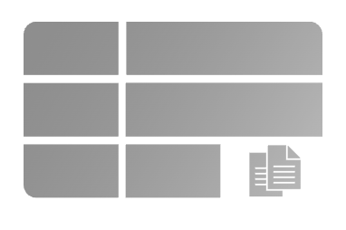

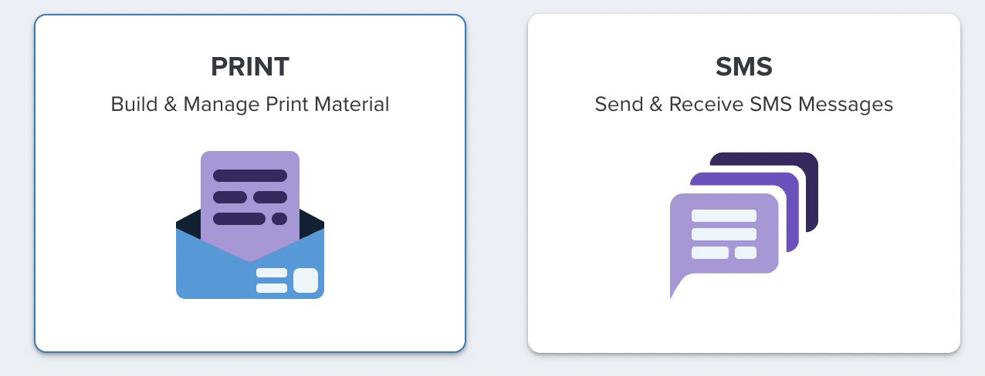
‘21-’22 Highlights
Recruitment & Retention
Communication Tools
Continued focus on Client-reported issues
✅
Notes:
Here are some highlights of our previous 12 months of releases:
We helped you reduce your reliance on third-party tools, by re-launching Tx Forms
We helped you better organize your campaigns and other data with Folders for your email campaigns
We iterated on our SMS and Print tools, with more to come this year
We launched a view for students to better schedule appointments with specific staff members
We responded to your feedback by closing over 70 issues reported directly by you and your colleagues
That was a brief look back. Now, let’s look forward at what the next year holds.

Slide 7
The 22-23 Roadmap Theme
Firm Up Our Foundation
We want to make your life easier and we want to grow the TargetX community.
Make it easier to use other Liaison products, and reduce your reliance on third-party products
Iterate on and modernize existing features, like Forms and Appt Scheduler
Make TargetX and Salesforce Work Better Together, so you can take full advantage of your CRM
Notes:
In the next 12 months, we want to focus on 1 theme for TargetX: Firm Up Our Foundation. We want to make your life easier, and we want to grow the TargetX community.
There are three tentpoles, three major parts, to this strategy. [read numbers]
YargetX plays nicely with SF - enhanced domains, Shield, (past) package updates, EDA, Flow Planner (future). Customers keep telling me that they want to be able to use SF features in conjunction with TX features, so my hope is this line speaks to that concern...and says "we are 100% built on the Salesforce platform" clea

Slide 8



TargetX Roadmap: 2022 - 2023: Make It Easier to Use Liaison Products
Available Now*
Coming This Year
CAS
Iterations & Lessons Learned
EMP
Enhanced Sync
Othot
Retention Prescriptions
Notes:
Right now, we’ve launched some key things that help you use other Liaison products, and reduce your reliance on third parties: the 22-23 common app and other standard imports are ready, we have a sync with our Enrollment Marketing Platform and Centralized Application Service, and we’re importing academic prescriptions from our machine intelligence solution, Othot.
Over the next year, we’ll be improving these syncs: bringing CAS’s lessons learned into the TargetX admissions application, opening up two-way syncing with EMP, and surfacing Othot prescriptions inside our Retention suite.Phenomena

Slide 9
TargetX Roadmap: 2022 - 2023:
TargetX Features & Functionality
2022
Q3
2022
Q4
2023
1H
Prefilled Forms
Forms
Contact Child Objects; Multi-select Lists
File Uploads; Inquiry Templates
Question Formatting Options
Communication Tools
SMS Email Notifications
Email Dynamic & Reusable Content
Print Conditional Content
Email Conditional Operators
SMS Scheduled Send
Engage Admin Permission Redux
Event Calendar Sync Solution
Unified Appointment Experience
Retention
Appointment Scheduler: New Modalities
Engage Meeting Notifications for Advisors

Slide 10
TargetX Roadmap: 2022 - 2023:
Make TargetX and Salesforce Work Better Together
July - September
October - December
2023: Q1 + Q2
Enhanced Domains
SF Shield
Improved Package Updates
Communication Flow Planner (SMS + Print)

Slide 11
I’d love to chat with you if you have feedback!
eoneill@liaisonedu.com

Slide 12
Admissions by Liaison
With CAS (Eng, Bus, Grad)
Available 7/1
Notes:
Today, I’m excited to introduce you to an exciting new best practice, Total Enrollment, Liaison’s commitment to helping higher education institutions achieve positive outcomes—from application through graduation – and beyond.
For the first time, Liaison has brought together the individual strengths of its award-winning brands and the connections with software and services across higher education, to create an Inquiry-to-Alumni solution that will forever eliminate the need for cobbled-together solutions from disparate companies that don’t work together.
More importantly, it puts the student experience first – making sure they have access to the right tools to learn about your institution, schedule a campus visit, fill out the application, communicate back-and-forth with your teams, and even gain support from faculty/staff if they’re struggling in a course.
Total Enrollment is an ecosystem designed to support you and your students – no matter the application, CRM or communication tools you’re using.

Slide 13
What is Admissions by Liaison
Help your faculty chairs stay on track with:
  Dashboards to track funnels and application reading
  Easy App reading and feedback forms for faculty
  Easy to use tools for Emailing and texting applicants
Automate Student communications on a budget:
  Automatically trigger emails to drive application completions
  All of your email, SMS, and Voice messaging is included
  Manage student form collection through the student portal
Get everything done without having to schedule time with IT
  Built in CAS integration
  Easily manage your own contact records
  Simple export wizard to pass records to your SIS
  Intuitive user management
A CRM that makes your life easier

Slide 14

Built around ease of use
Key Features
  Native CAS support
  Application reader
  Email/SMS/Voice Campaigns
  Form builder
  Decision Letters
  Workflows and assignment
  Dashboards and Reporting
Ideal customers
  Grad Programs
  Small Liberal Arts
Built around extensibility
Key Features
  Email and SMS communication tools
  Online Application
  Application Reader
  Dashboards and Reporting
  Appointment Scheduling
  Event Management
Ideal Customers
  Community Colleges
  Public Universities
Liaison CRM offerings
Notes:
Sasha

Slide 15
Admissions by Liaison
Demo

Slide 16
Admissions for CAS (Eng, Bus, Grad)
Admissions for CRM
Offered as full CRM solution as of 10/1
Target Audience
  Undergrad Programs bundled with Total Enrollment
Standard option for Bus, Grad, Eng CAS customers as of 7/1
Target Audience
  Grad Program Admissions

Slide 17
Roadmap - Calendar Year 2022/2023
Admissions by Liaison
Q3
Q4
Q1
Q2
*Key Theme
Events
Interview Scheduling
Configure staff appointment slots
CRM
Contact Stages & Workflow
Bring contacts into parity with Applications to track funnel stages
Contact DB Mgmt
Search on meta data, Dedup services, enhanced permissions,
Federated Data
Search and view contact and application data across orgs
Communications
Activity Filtering
Build drip campaigns based on previous interactions
Team Inbox
Manage 1:1 communications with students across channels
Appointment sched
Let students schedule appointments with staff
Anonymous User Tracking
Track stealth viewers
Student Portal
Forms
Applicants check in to events, submit forms/docs and payments

Slide 19
Portfolio Review and Marketing Automation
Our powerful Enrollment Marketing software, EMP, built exclusively for higher education, allows you to create, manage, and analyze omnichannel marketing campaigns that are:
Immediate
Relevant
Automated
Trackable
SlideRoom, the #1 application tool to view what your applicants make, do, and create such as art, research papers, 3D models, etc . We’re used by everyone, including the Ivy League, the best art schools, major scientific research facilities, and NASA.

Slide 20
Q & A

Slide 21
Thank You

