Slide 1


Slide 2
Staffing for Success:
Using Effective Onboarding to Build Culture
Stephen Taylor / 7.28.22 / 1:45

Slide 3


Agenda
Speaker Intro
Understanding Onboarding as Culture
Foundations of Onboarding
Onboarding in Practice
Discussion

Slide 4

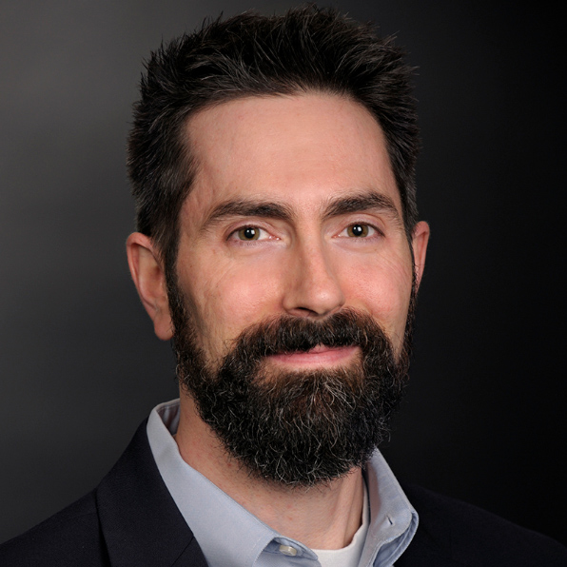
Research Director, BusinessCAS
15 years working with colleges & universities
Primary Field: Graduate Business
Primary Focus: Enrollment, Leadership in Higher Ed
4
©2020 Proprietary and Confidential

Slide 5

Culture and Onboarding
On building culture
The Iceberg Metaphor: Behaviors & EVERYTHING ELSE
Why onboarding?

Slide 6

Foundations of Onboarding
Adventures in Transition
Defining Onboarding

Slide 7
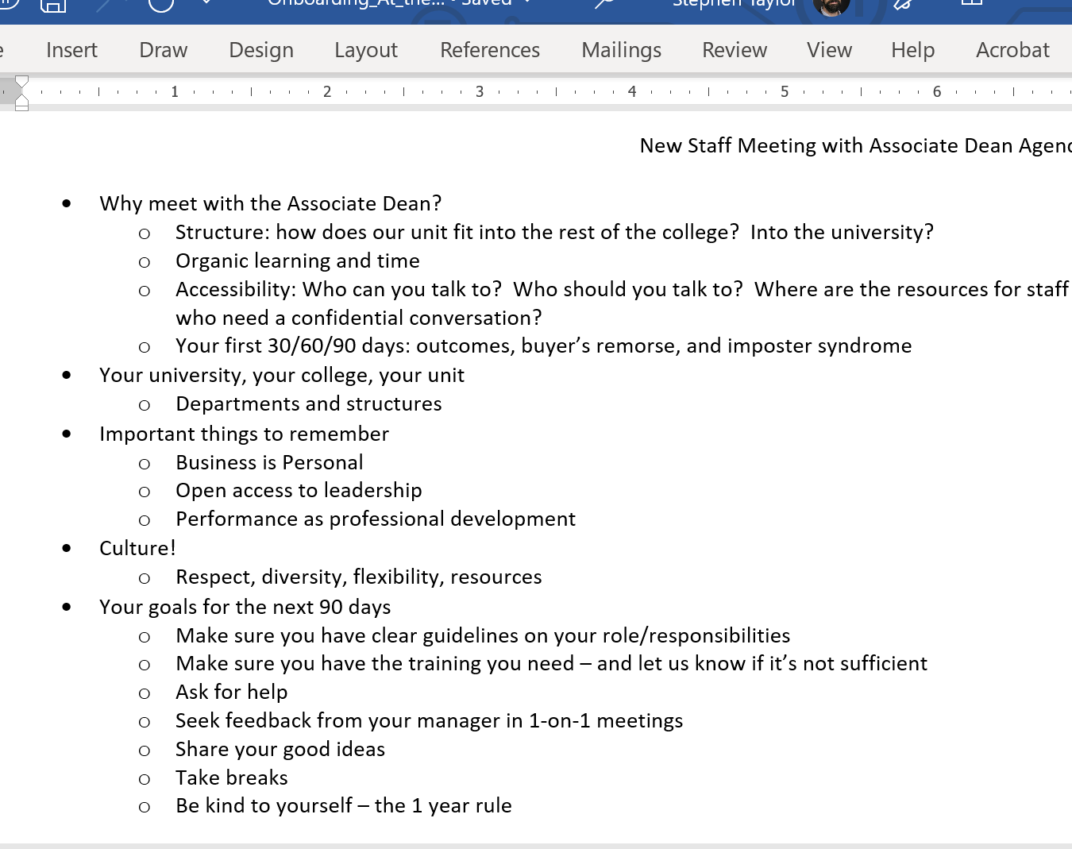
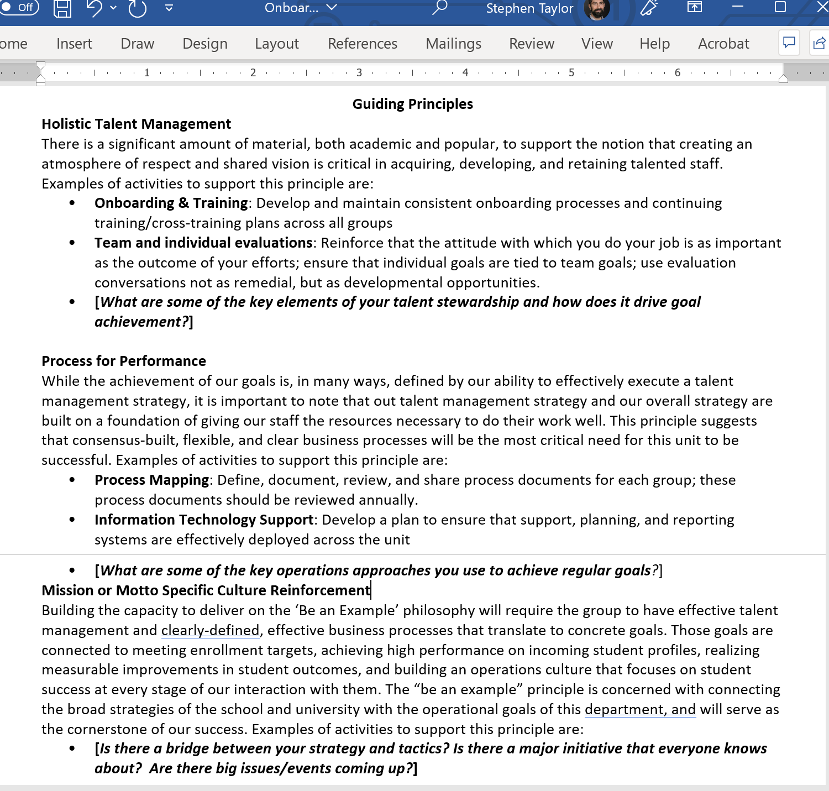
Onboarding in Practice

Slide 8
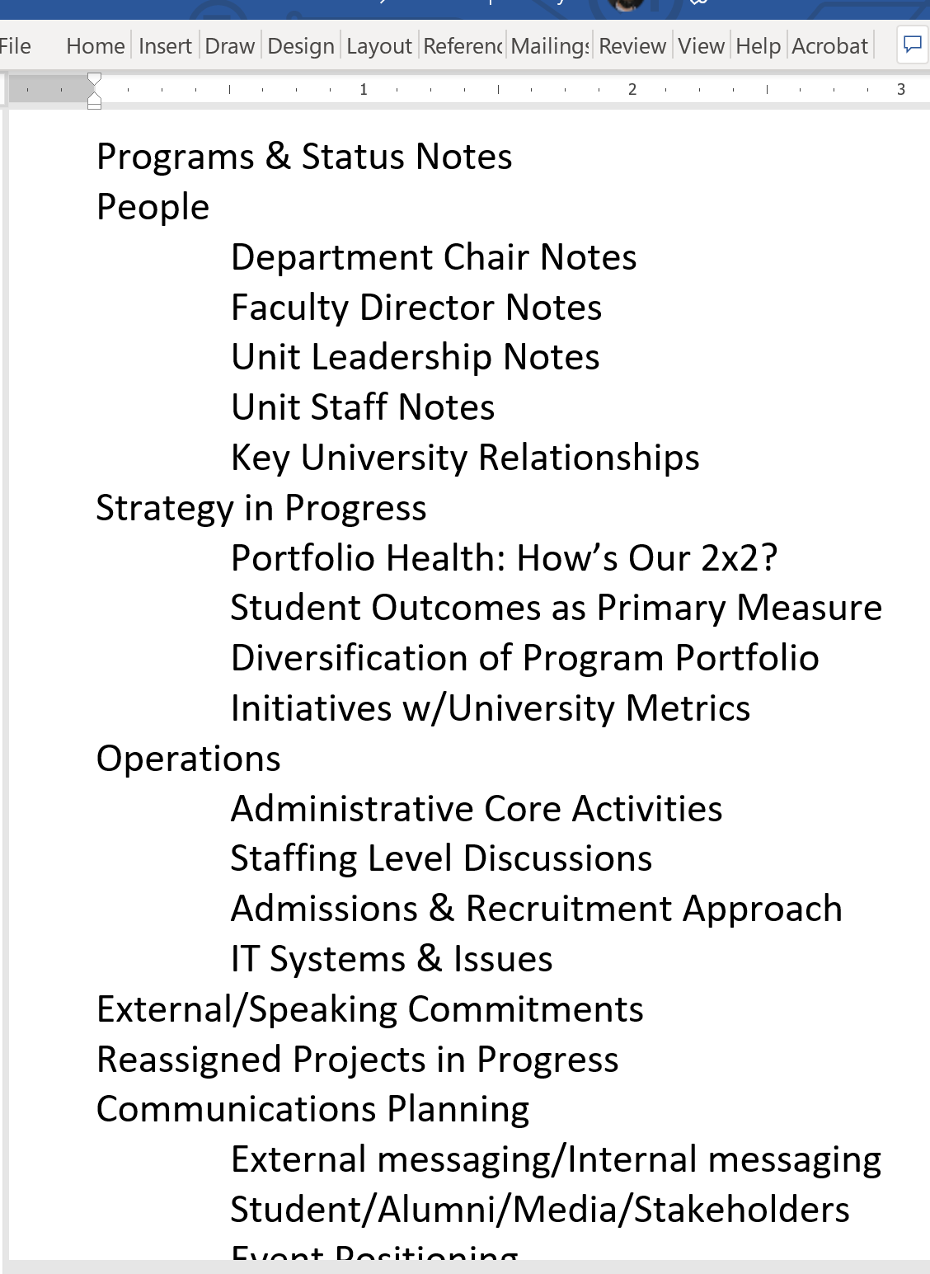
Topical Overview & Saying Goodbye
Topics to Include
A basic welcome message
College structure, team structure, key leadership
College Overview (for those coming from external)
Mission/Vision and How they Matter
The basics on history, faculty, students, alumni
Major awards, key taglines, brand identity
Campus, Facilities, and Centers
Programs, Departments, Student
Costs and Financial Aid
Committees and Governance
Dean
Scanning the Environment: understanding our field
Your Role – details on specific tasks and responsibilities
Dept leaders and staff to meet with
First 3 Months – Focus Areas and Deliverables
Off-Ramping Plans

Slide 9
Discussion

Slide 10
Thank You
Stephen Taylor
staylor@liaisonedu.com

