Slide 1


Slide 2
Seeing the Forest Through the Trees: Building Your Solutions Ecosystem
Jay Murray, AVP Enrollment Management – Western Connecticut State University
Sasha Peterson, Chief Innovation Officer – Liaison International

Slide 3
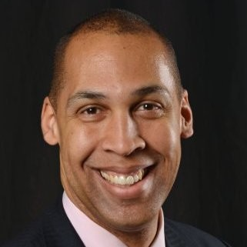


Your speakers
Jay Murray
Sasha Peterson
AVP, Enrollment Management
Chief Innovation Officer

Slide 4


Agenda
Our Stories
WCSU’s Enrollment Tech Journey
Total Enrollment Workshops
Lessons Learned
Q&A

Slide 5
Our stories

Slide 6
Western Connecticut State University
Founded - 1903
Part of CSCU state system
Enrollment – 4172 Undergraduate, 630 Graduate
Key programs
  Ancell School of Business
  Macricostas School of Arts & Sciences
  School of Professional Studies
  School of Visual and Performing Arts

Slide 7
The Liaison Story
Pioneered CAS in 1990
Today run 40+ platforms including Transfer App with CAO
Acquired Spectrum EMP in 2015
Acquired TargetX in 2020
Acquired Othot in April 2021
Introduced Total Enrollment in September 2021

Slide 8
The Total Enrollment Journey
A multi-year project!

Slide 9
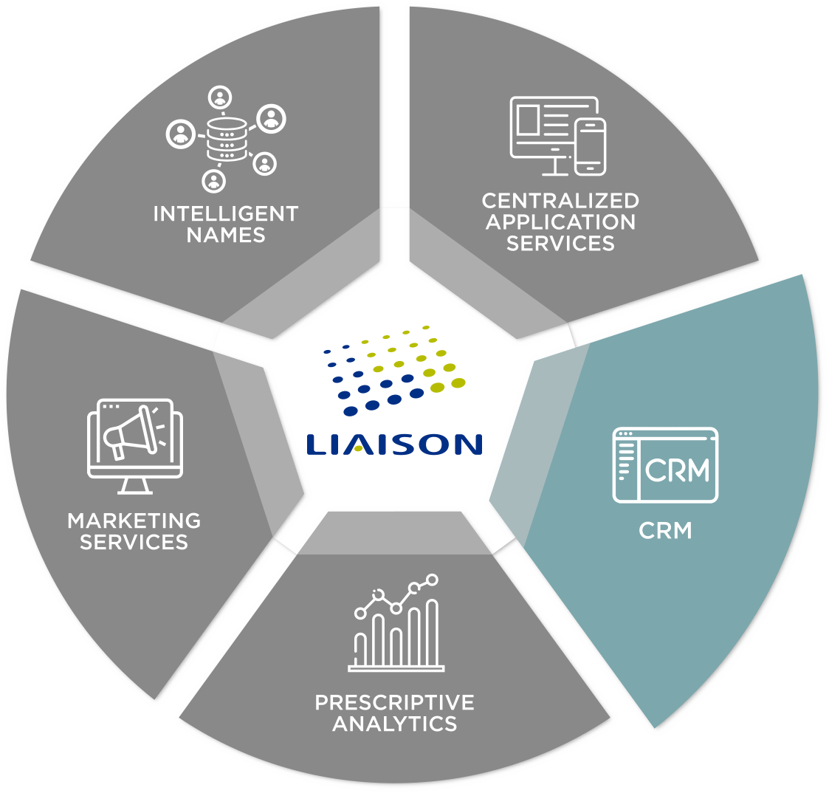
WCSU’s Total Enrollment Journey
The needs:
Centralized “source of truth” for data
Automated marketing
Dynamic application
The solution:
TargetX Recruitment CRM

Slide 10
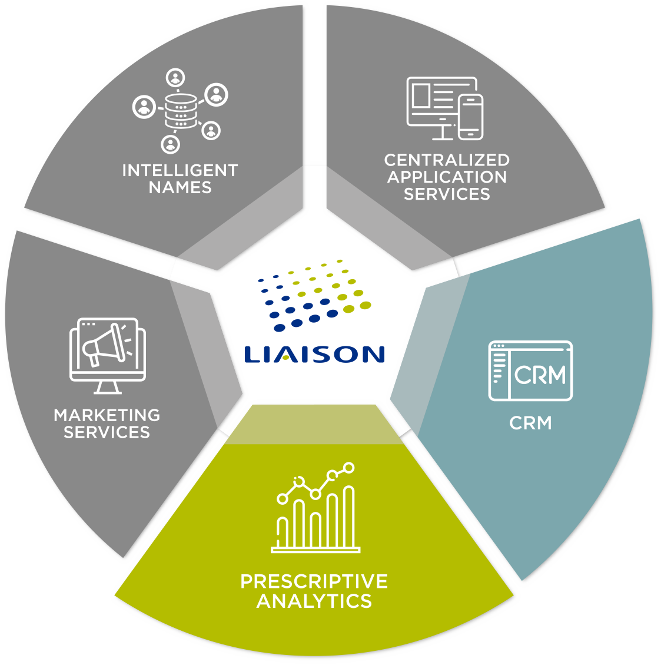
WCSU’s Total Enrollment Journey
The needs:
Help prioritizing resource allocation
Guidance on most effective “next step”
The solution:
Othot Prescriptive Analytics

Slide 11
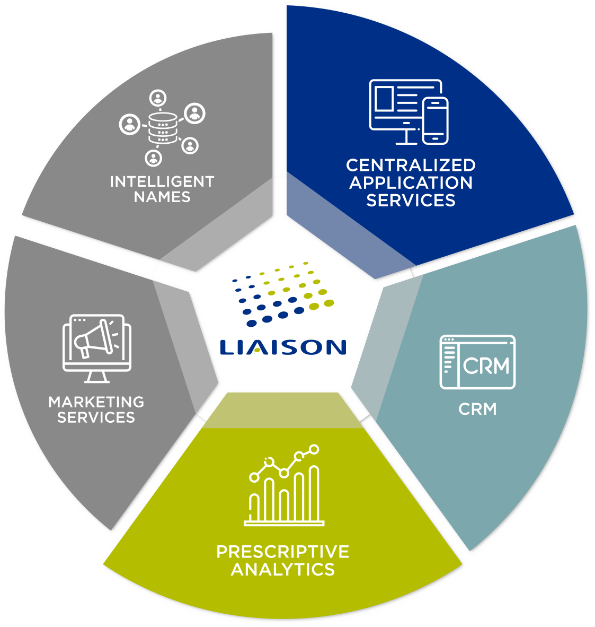
WCSU’s Total Enrollment Journey
The needs:
Increase efficiency of diverse graduate application
Increase application volume from marketplace
The solution:
NursingCAS by Liaison
BusinessCAS by Liaison
GradCAS by Liaison

Slide 12
The Total Enrollment Perspective
An ecosystem approach

Slide 13
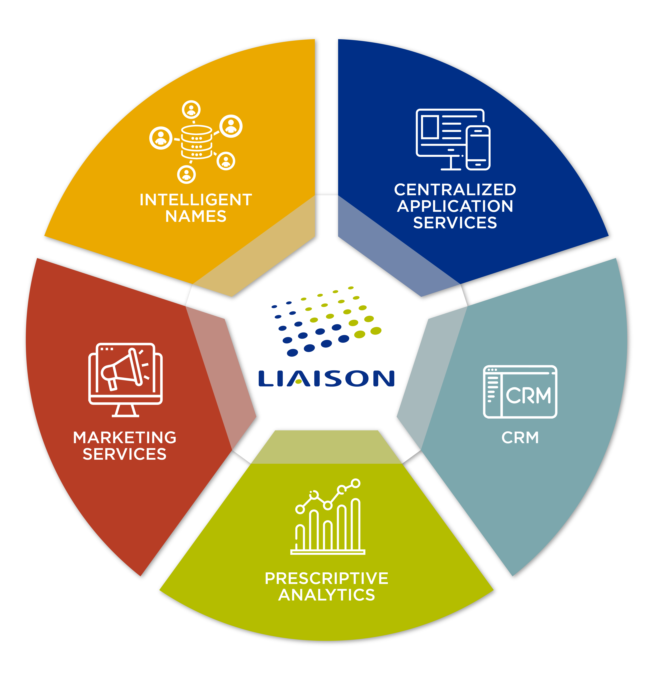
Robust ecosystem of enrollment solutions
Comprehensive view of your unique challenges
Outcomes focused
Leveraging what is working for you
13
©2020 Proprietary and Confidential

Slide 14
The Total Enrollment Workshop
Agenda
1. Educational Market Trends
A review of key headlines and trends presented by Liaison to the campus
2. Campus Strategic Plan
Discussion and alignment of key priorities centered around the current campus strategic plan
3. Secret Shopping Reveal
Presentation of findings from secret shopping
4. Total Enrollment Overview
Standard slide-deck depicting Total Enrollment by Liaison. If emphasis areas are already known there will be extra focus on those
5. Funnel Review
Map each funnel stage to key systems on campus (SIS, CRM, search vendor, etc.) and then assess efficacy with admin lens and student lens
6. Real time assessment
Review of findings and alignment of next steps framed around Liaison solutions
A partnership approach begins with understanding your unique needs
Day-long workshop focused on campus priorities
Expert staffing
Collaborative road-map design

Slide 15
WCSU Lessons Learned
“You don’t always need to know what you are doing, but you need to give some thought as to where you want to go.” -
Have a CRM implementation leadership team
Don’t try to do everything at once
Don’t be afraid to ask for help
Do you want once a day or real time data integration?
Training, training, training
Celebrate your victories, even the little ones

Slide 16
Q & A

Slide 17

Thank You
Jay Murray
AVP, Enrollment Management
Sasha Peterson
Chief Innovation Officer

