Slide 1


Slide 2
Secrets from Our Shoppers:
How the Inquiry Experience Informs Application Outcomes
July 28, 2022

Slide 3


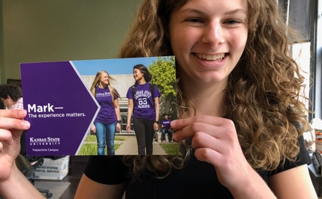
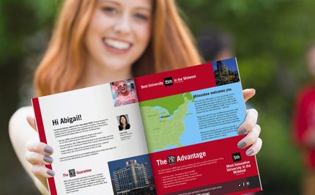

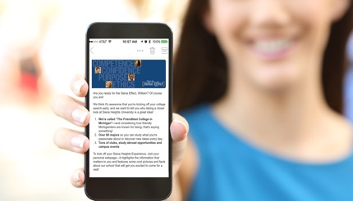
Today’s Agenda
Introductions
Secret Shopping
Four Lessons Learned from the Inquiry Response Project
Questions and Discussions
?
Feel free to ask questions!

Slide 4



Speakers
﻿Robert Ruiz
Suzanne Sharp Ed.D.
Vice President for Enrollment Management
Executive Director,
Enrollment Strategy

Slide 5
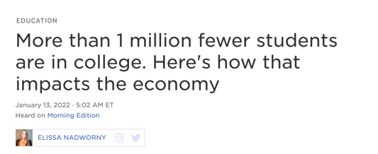
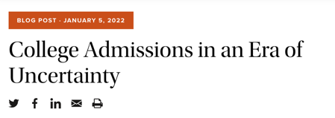
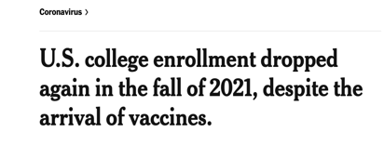
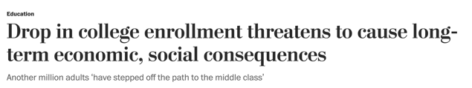
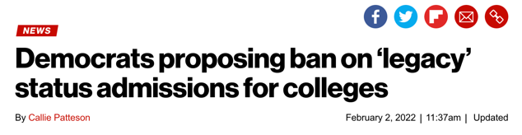

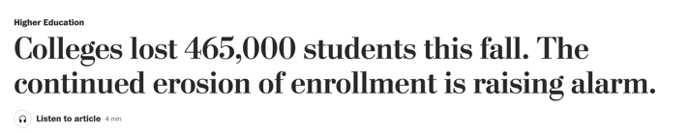
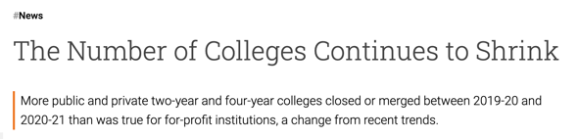
Enrollment Challenges

Slide 6

The Inquiry Response Project
What we did:
Visited web pages for 361 schools
  Mix of public, private, large, and small
  Sites visited in October and others in February of 2022
Searched for inquiry forms/ways to indicate interest as a high school senior seeking entrance in Fall 2022
Submitted inquiry forms and logged date and time
Tracked responses from each school:
  Emails - date, time, level of personalization, number sent
  Print pieces - date received, level of personalization, type
  Phone calls/text messages - date and type
All results were compiled four weeks from respective date of inquiry

Slide 7
#1
Four Lessons in Successful Communication
Be available.

Slide 8
How Easy is it to Request Information?
34.9%
of schools had an inquiry form on their home page.
17.53%
either did not have a form, or we never found it.
60%
40%
20%
0

Slide 9
Did the school have at least one social media link on their home page?
5.9%
of schools did not show social media.
What a student said about this.

Slide 10
APPLY NOW
VISIT US
85%
Had an APPLY NOW button on their home page.
76%
Had a VISIT button on their home page.

Slide 11


Make a Good First Impression
First impressions we experienced:
Pay attention to your response page. What happens when a student submits the form?
44%
of schools have this type of response:

Slide 12
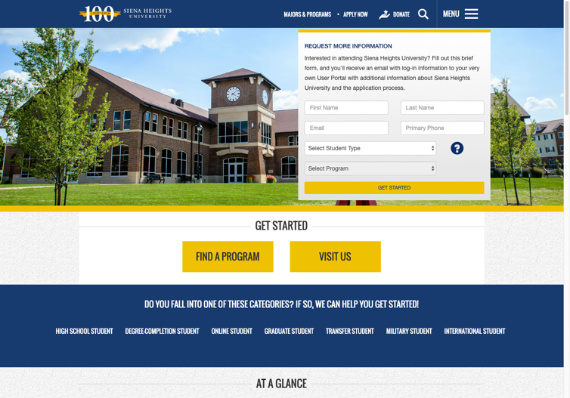
Be Available
Have a link on your home page for students to indicate interest!

Slide 13
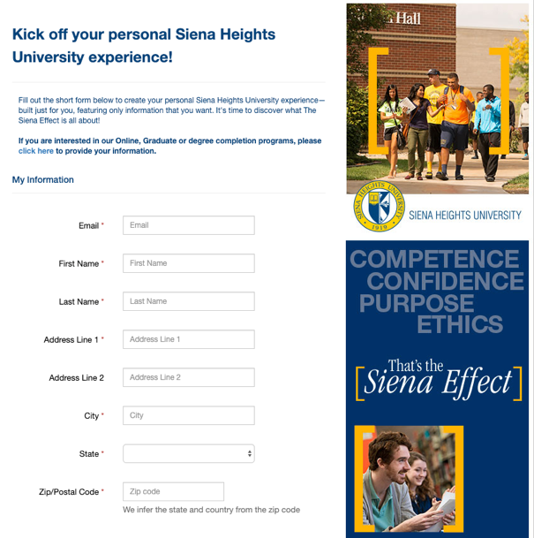
Make it Easy
Have a branded, quick and easy form fill.

Slide 14
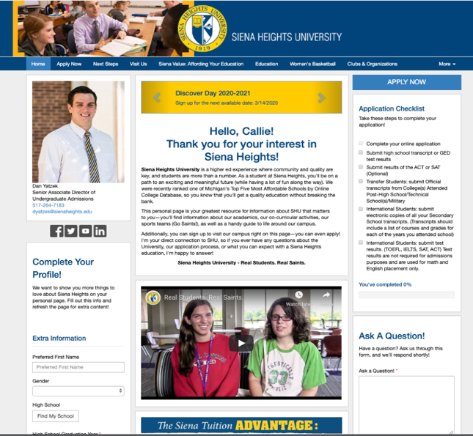


Which Impression Do You Prefer?

Slide 15
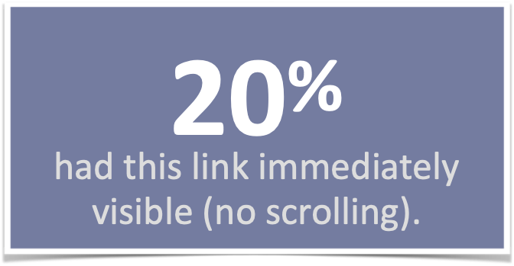
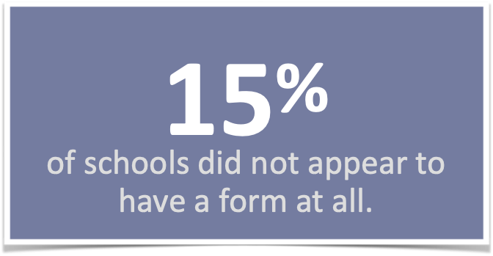
GRADUATE DATA Can Students Find What They Need?
Only 32% of schools had a request information link on their home page.
(67% of schools had an application link on their home page.)

Slide 16
Data from previous GRADUATE projects

Slide 17


#2
Four Lessons in Successful Communication
Be fast.
How do you feel when Amazon says your order will ship in five days, not two?

Slide 18

Be Fast…Be First!
61%
of students enroll at the institution that
contacts them first.*
* 2019 study by Wiley University Services and Aslanian Market Research

Slide 19
Types of First Response
Be Fast…Be First!
42 Schools had an IMMEDIATE response with a full variable PURL.
Others usually emailed as the first contact.

Slide 20
The Non-Response
Some schools did not respond to a submitted form within 4 weeks.
Can you guess how many?
40

Slide 21
Graduate data on response time
6%
of schools had an immediate response (PURL or microsite)
47%
of schools responded within an hour

Slide 22
#3
Four Lessons in Successful Communication
Be relevant
80% of consumers are more likely to make a purchase from a brand that provides personalized experiences.
- Epsilon
https://www.forbes.com/sites/blakemorgan/2020/02/18/50-stats-showing-the-power-of-personalization/?sh=3fa79acf2a94

Slide 23
Personalization of First Response
16.34%
used name and another relevant factor in their first response.

Slide 24
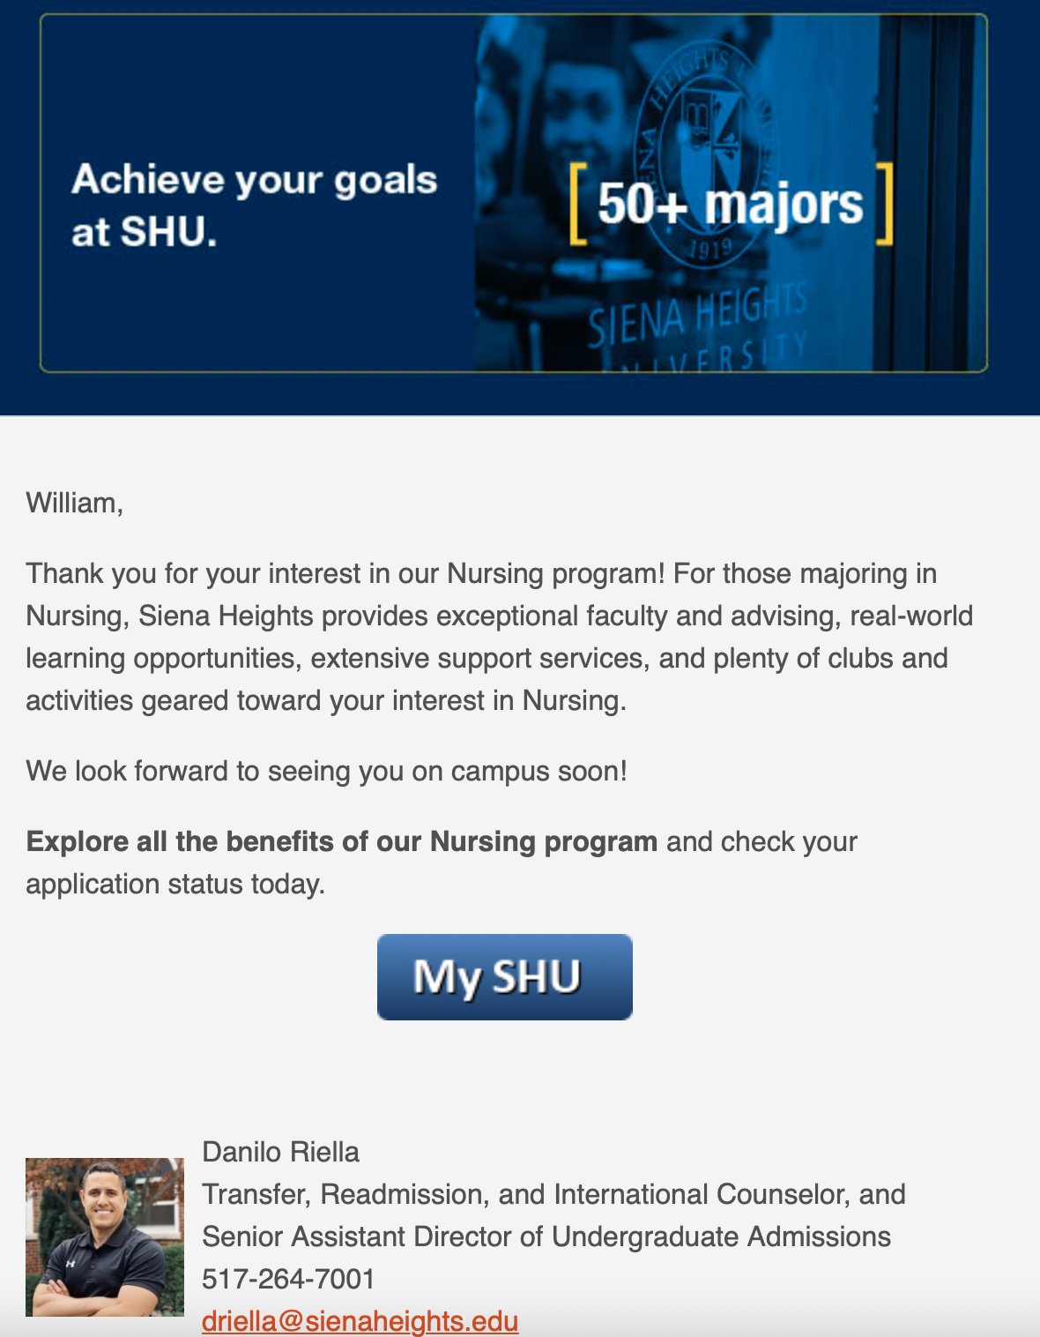
Example of Relevancy (and Consistency!)

Slide 25
#4
Four Lessons in Successful Communication
Use multiple channels.
Consumers typically respond after receiving messages from six channels
Messages are more likely to reach long-term memory if repeated across multiple channels
https://www.olsenmetrix.com/multi-channel-marketing-delivers-better-roi
https://www.salesgenie.com/multi-channel-marketing-campaigns/

Slide 26
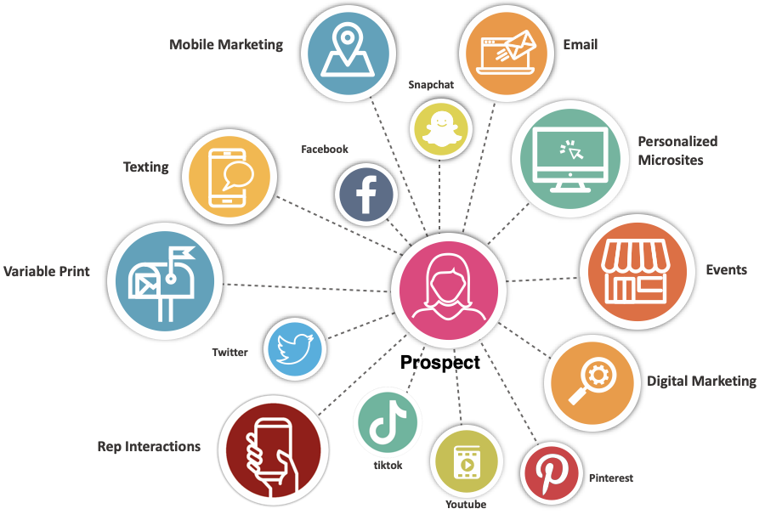
True Omni-Channel Marketing
It’s not just one email, it’s a combination of all interactions
(By the way, 23 schools sent one email. And nothing else.)

Slide 27
Use Multiple Channels
What channels are schools using for outreach?
Only 39 schools used three channels or more.

Slide 28


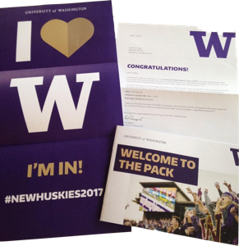
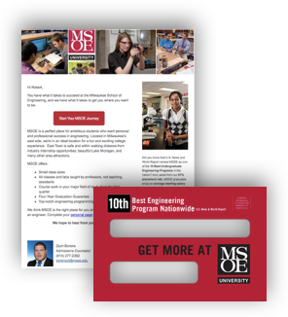

Who is Using Print?
20.5% of schools sent print within four weeks of an inquiry form submission.
Postcards and large envelopes of materials were the most common print pieces we received.
Most were completely generic, followed by use of name only.
An Adobe study indicates a 12% increase in response when print is included versus email only.
Source: http://mailingsystemstechnology.com/article-3980-mail-making-the-most-of-multi-channel.html

Slide 29
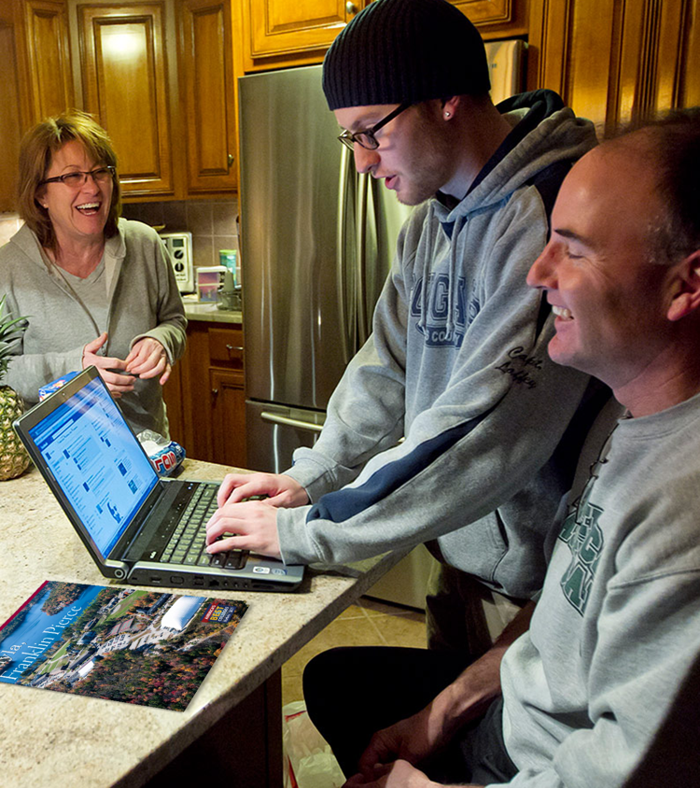
Why use Print?
More than
2/3
of parents are still highly involved with their child’s college search process.
-Eduventures

Slide 30
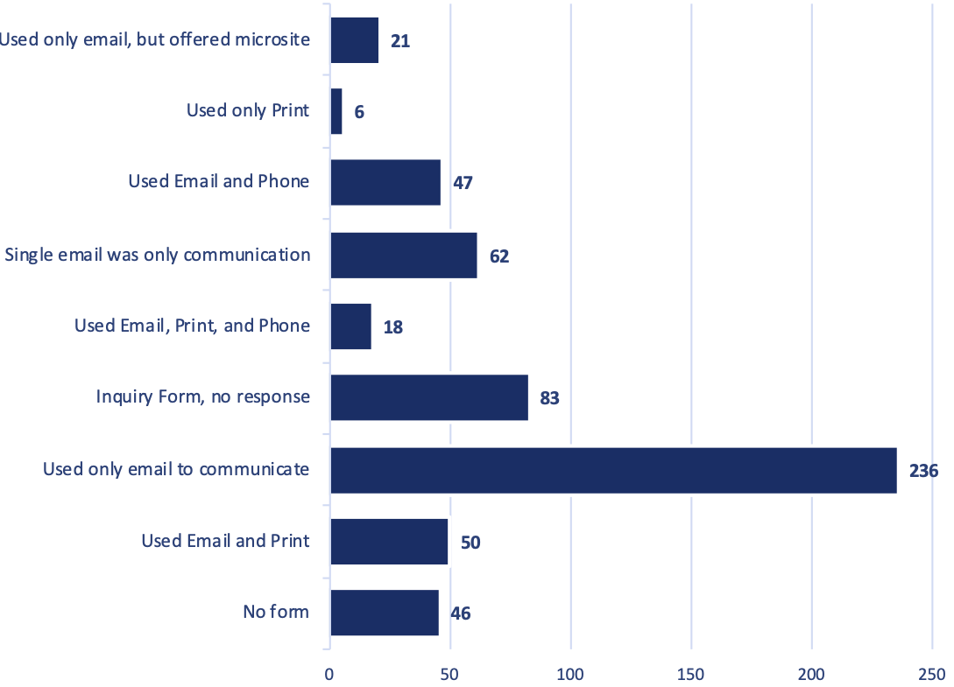
GRADUATE DATA Use Multiple Channels
Common channel combinations.
Only 5% of schools used
3 channels.

Slide 31
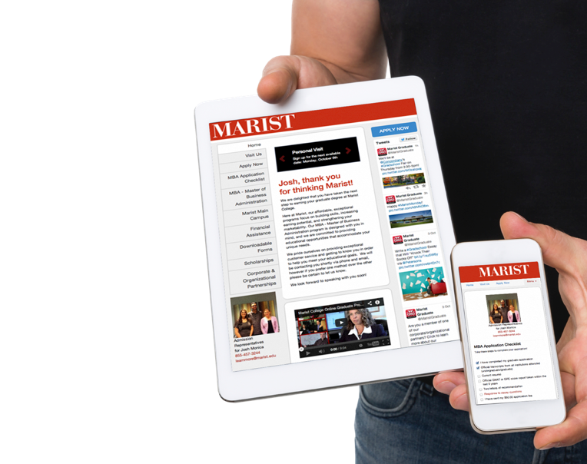
Be Sure You Stack Up
  Be available.
  Be fast. Be the first to respond.
  Be relevant. Make your response stand out.
  Use multiple channels to engage with today’s market.

Slide 32
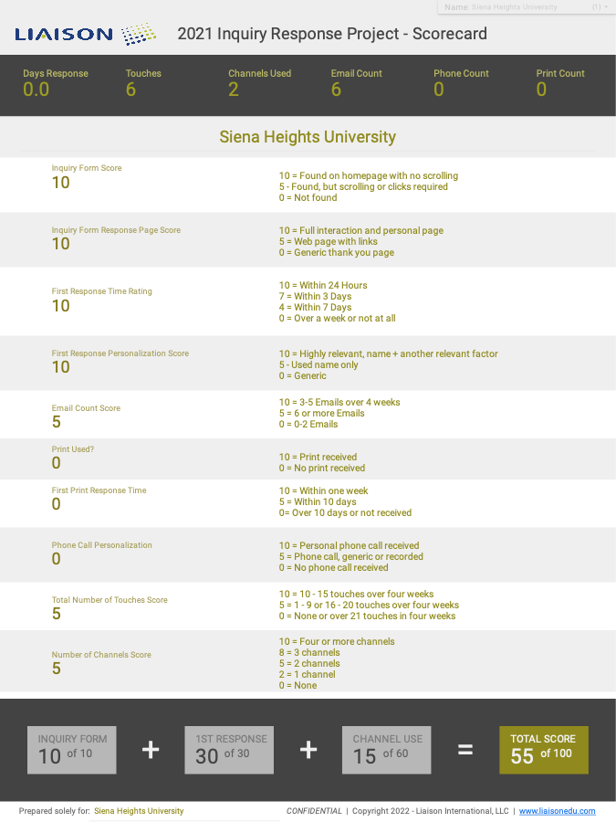
Where Do You Stack Up?
School Name
Average Score:
35
We are happy to meet with any school to go over their scorecard.

Slide 33
See How Enrollment Marketing Should Work!
marketsmarter.liaisonedu.com
Thank you
Robert Ruiz
Vice President for
Enrollment Management
rruiz@liaisonedu.com
Suzanne Sharp, Ed.D.
Executive Director,
Enrollment Strategy
ssharp@liaisonedu.com

