Slide 1


Slide 2
Search & Deliver: Finding and Guiding Adult Learners Back to Campus
July 28, 2022

Slide 3




Speakers
Erin O’Brien
﻿Andy Hannah
Chief Enrollment and Marketing Officer
President

Slide 4
Challenges
STEALTH
INQUIRIES
Top of the funnel
APPLICANTS
PAID SEARCH
ADMITS
SOCIAL AND INBOUND MARKETING
COMMITS
MATRICULANT
TEST ﻿TAKERS
RETURNING STUDENTS
GRADUATES
ALUMNI
DONORS

Slide 5
Marketing: Things to Think About
DIGITAL
SOCIAL
INBOUND

Slide 6

Enrollment Metamorphosis:
The Evolution of Inclusivity
Inclusivity
Shift from exclusivity to inclusivity in Higher Education

Slide 7
The Intelligent Funnel

Slide 8


The Intelligent Funnel
Top of funnel contacts
Enrolled Students

Slide 9

Top of the Funnel Disruption
Higher Engagement
Deeper Relationships
Propensity for Behavior
Higher Likelihood to Enroll
Increase in Apps

Slide 10

Custom
curation
High
propensity
A customizable, cost-effective advanced analytics solution…
…to start building relationships with the best adults for your institution
Segment:
Match your marketing needs
Integrates with all Liaison Solutions
Notes:
Product Description Summary
Should be easy to follow with the words on the slides

Slide 11
Intelligent Names: Targeting the Segments and Individual
US Adult Population
Adult Learner Candidates
Client Relationship Pool
High Likelihood Candidates for Client Institution
(with Othot)
Focused on Individualism
Driven by “living analytics”
Notes:
The Othot National Datafile contains 285 million individuals within the contiguous 48 states of the Untied States defined as the US adult population.
From there, based on large sample survey results, we matched those results with the database through machine learning to intensity score individuals for their intensity to enroll. The scores identify the graduate school and adult learner candidates, based on a propensity scale to pursue higher education. Tailored to your [client] need, we segment the population on location, certain demographic identification, and program structure in order to find candidates with the highest likelihood of attending your institution.
The created segments include addresses, household information, telephone numbers, and emails.

Slide 12

Conceptual Construct
1
2
3
4
(x)
Variables to Drive Segmentation
Propensity Score by Individual
Select
Geographic Region
Notes:
We isolate specific geographic regions based on prior enrollment trends. Then individual characteristics such as ethnicity, gender, age and etc., can be selected to further segment the candidate pool to meet requirements. Finally we assemble the segments analyze with individuals with the highest propensity scores.

Slide 13
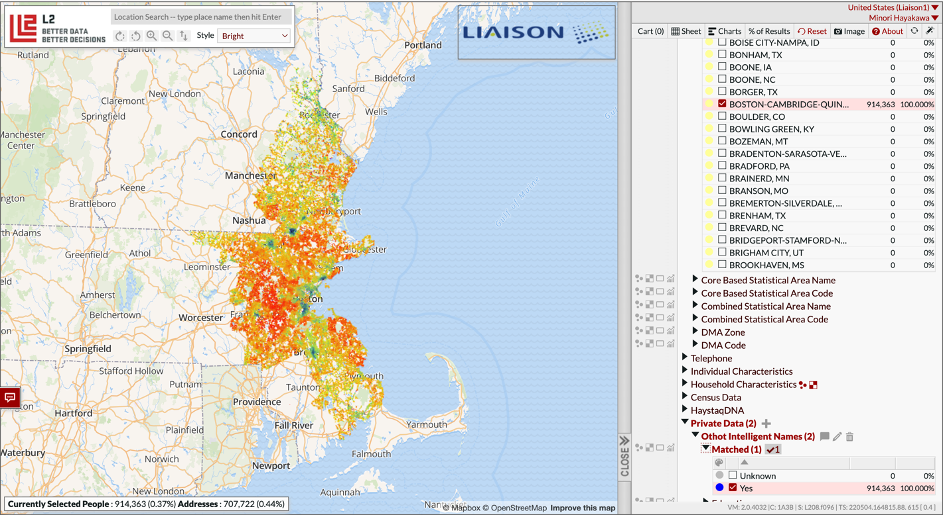
1. Pick a geography and the models will calculate the total number of individuals that were scored by the models
Notes:
This is the L2 interface that the client will be using the segment their search.
Demo – follow the dialog presented in the text box

Slide 14
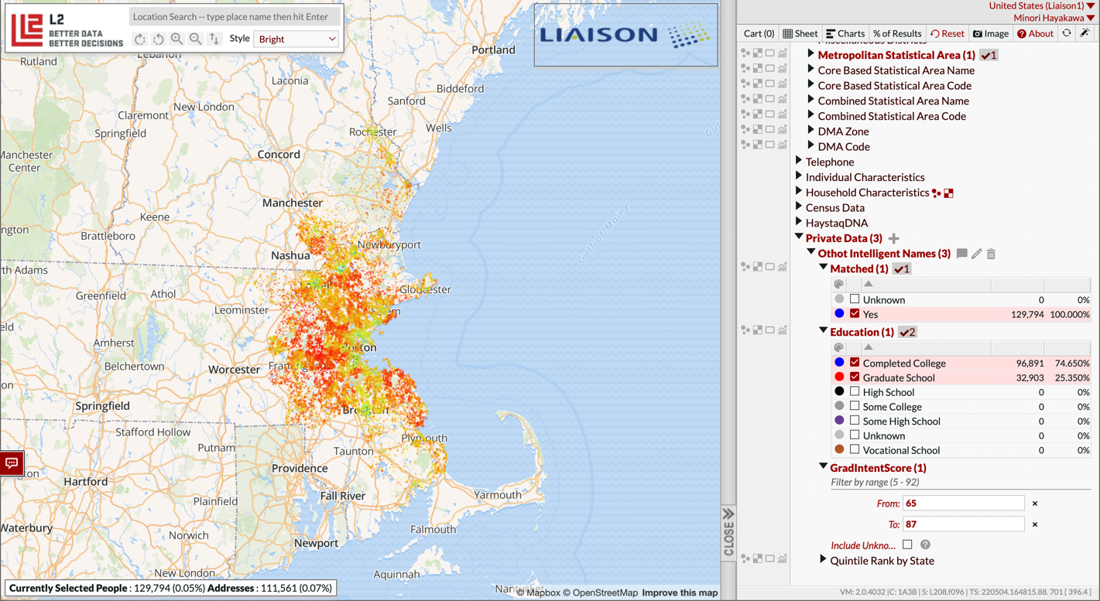
2. Narrow the geography, start to segment population (degree in this case) and filter by propensity score
Notes:
Demo – follow the dialog presented in the text box

Slide 15
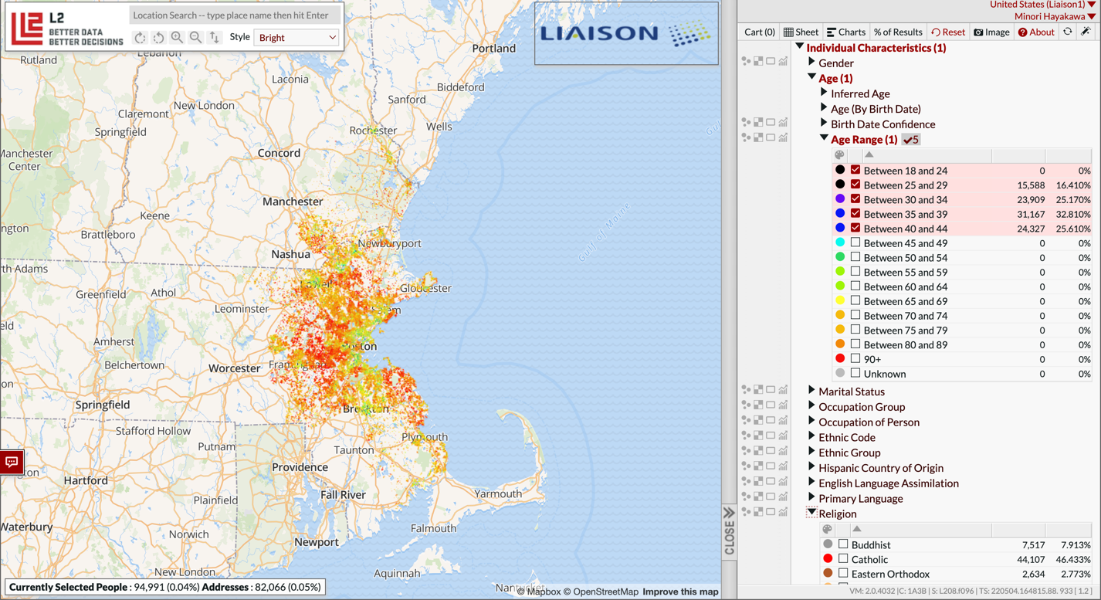
3. Further segment population (age in this case) and filter by desired variables
Notes:
Demo – follow the dialog presented in the text box

Slide 16
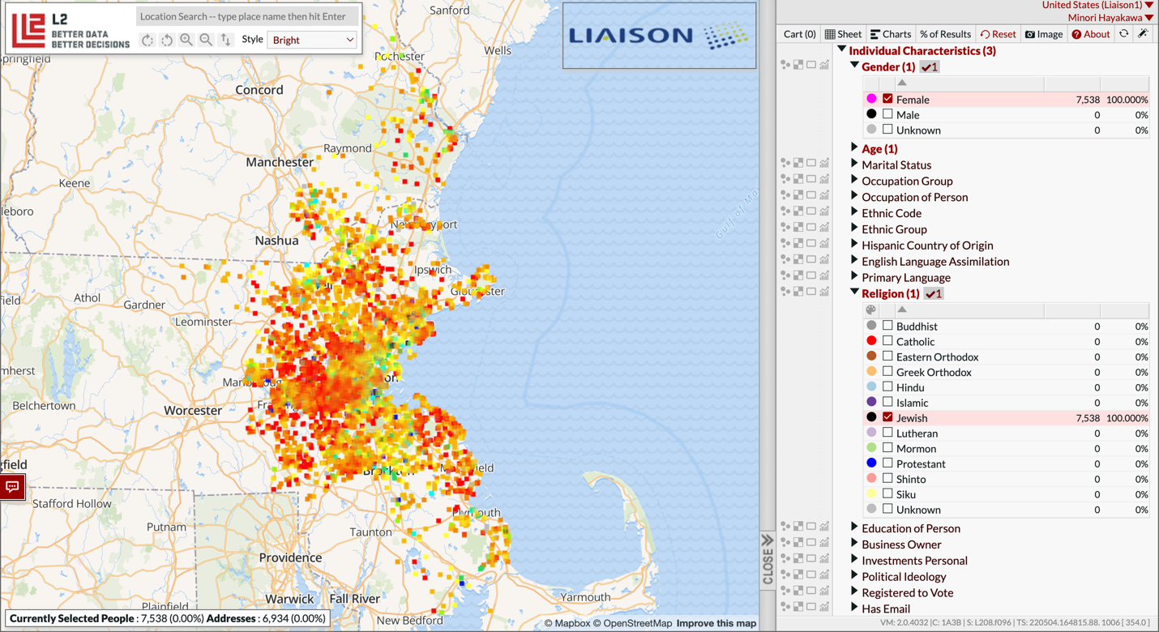
4. Further segment population (age in this case) and filter by desired variables (Gender and Religion here)

Slide 17


What happens next?
School selects names
They receive:
  Email addresses
  Mailing address for direct mail/loading into social media platform
  Can work with L2 for social media campaigns (will be additional cost)
  Cell phone number for text campaign (no additional cost)
Work with EMP to develop marketing campaigns (case-by-case)
Notes:
After you define your segment(s), they will receive email addresses, cell phone numbers, and mailing address for direct marketing and engagement.
Furthermore, we can work with L2 for social media campaigns at an additional cost, expanding ways for prospects to hear from you.
EMP will also guide you to develop a marketing campaign that is uniquely defined for you.

Slide 18
Q & A

Slide 19


Thank You
Erin O’Brien
Chief Enrollment and Marketing Officer
Andy Hannah
President

Slide 20
Differentiation
Personalization
Increased yields
Engagement
Expected 2-5x improvement in other domains
Direct and indirect engagement options
Value Enhancement
CAS, TargetX, CRM, Othot Prescriptive Analytics
Increased ROI
Shape of class
Targeted, custom segmentation
EMP to develop marketing portfolio
Liaison-Othot has more proprietary insights about graduate and professional students than any other organization in the world.
                As a result, our models are more powerful than other solutions in the market.

