Slide 1


Slide 2
Meeting the Needs of a Modern Application Experience:
The Liaison CAS & WebAdMIT Roadmap
Mike Margitich – VP, CAS Products

Slide 3

Presenter
Mike Margitich
VP, CAS Products

Slide 4


Agenda
What are CAS & WebAdMIT?
2021-2022 Feature Highlights
2022-2023 Roadmap Overview
Spotlight: A Mobile-First UX
Q & A

Slide 5
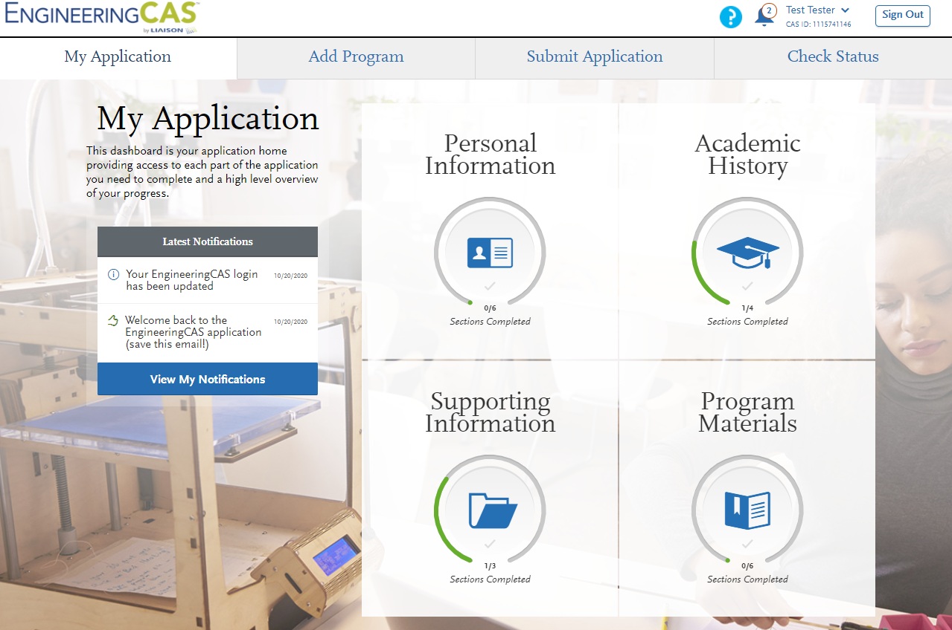
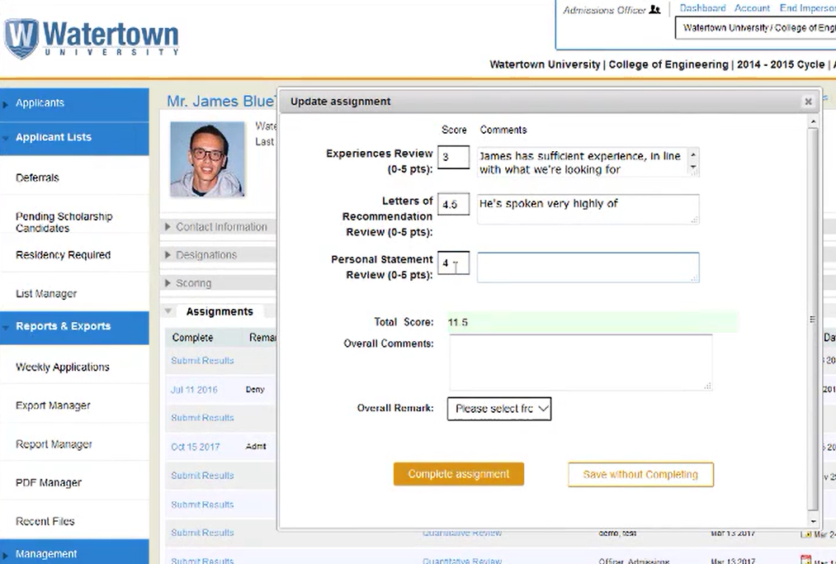
What are CAS & WebAdMIT?

Slide 6
The Power of a Centralized Application Service
Community
  Our concept brings professions and their schools together to optimize the application & enrollment experience
  Once a Centralized Application Service is established for a discipline, everyone unites around a common “marketplace” to streamline the process for applicants
Modern Technology
  Join a CAS and receive state of the art admissions management software and unparalleled applicant UX
  Cloud-based platforms ensure business continuity for schools and all facets of their admissions processing
Time-Saving Services
  Run a paperless admissions office and let us handle the collection and digitization of application materials
  Leverage our dedicated customer support for your applicants and focus your staff on higher-level activities
Partnership
  Liaison has been trusted by 100s of universities and millions of applicants over nearly a quarter century of CAS
  CAS concept has proven its value in nearly 40 different professional disciplines – this model & partnership works

Slide 7
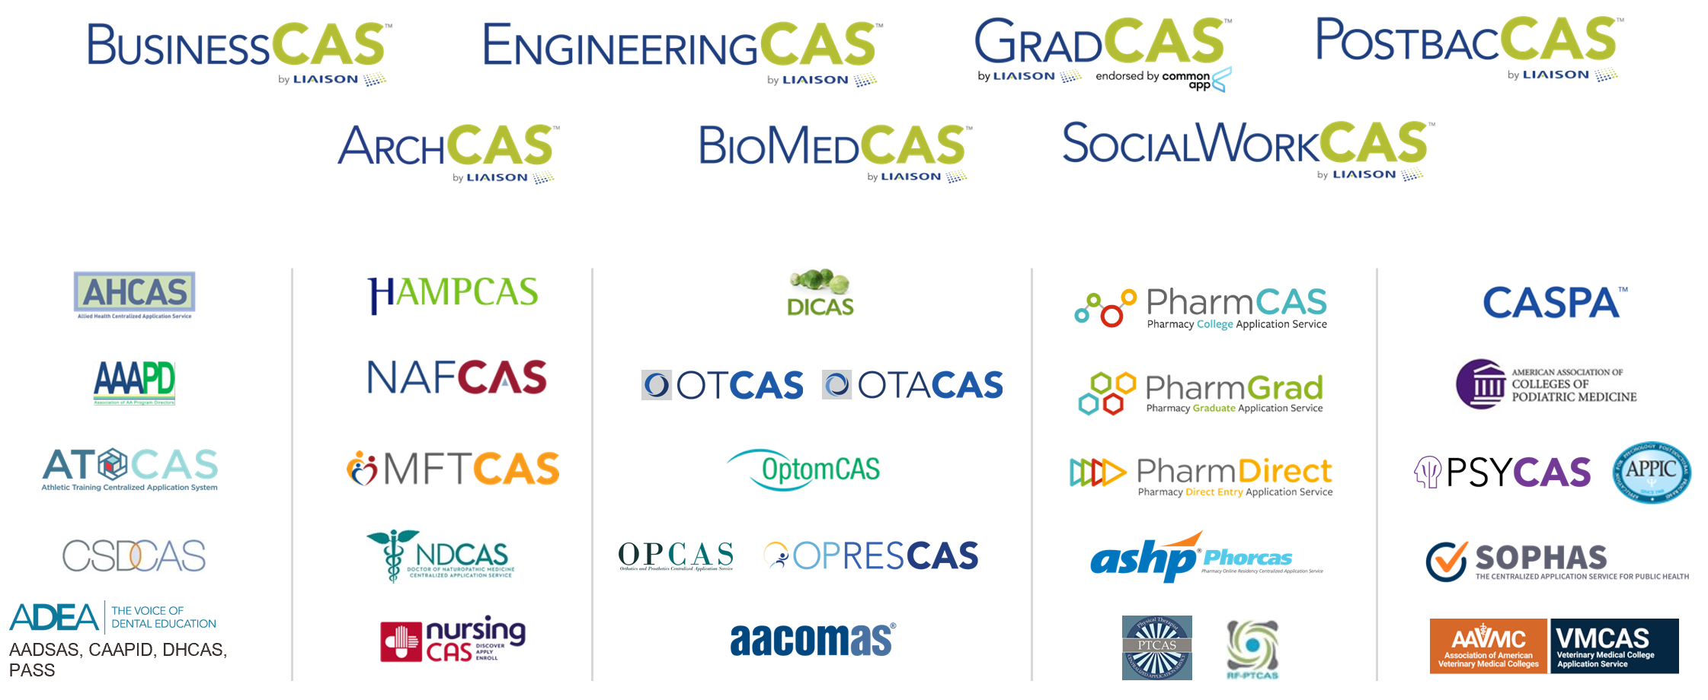
Our CAS Landscape

Slide 8
2021-2022 Selected
Feature Highlights

Slide 9
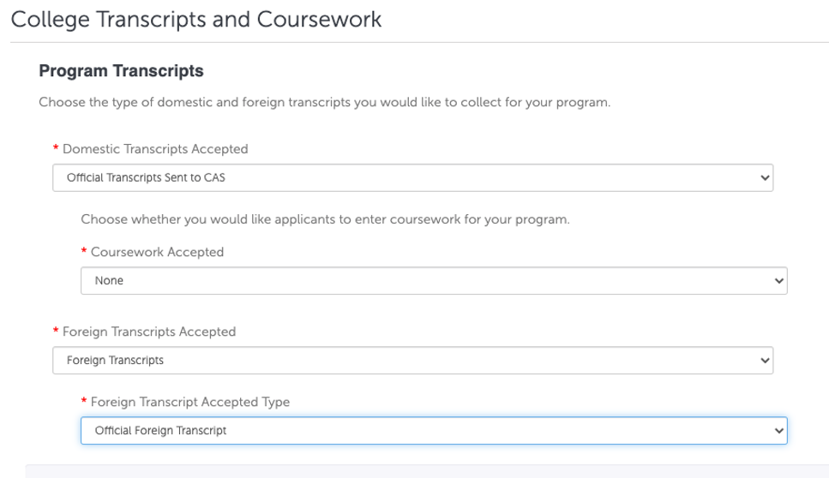
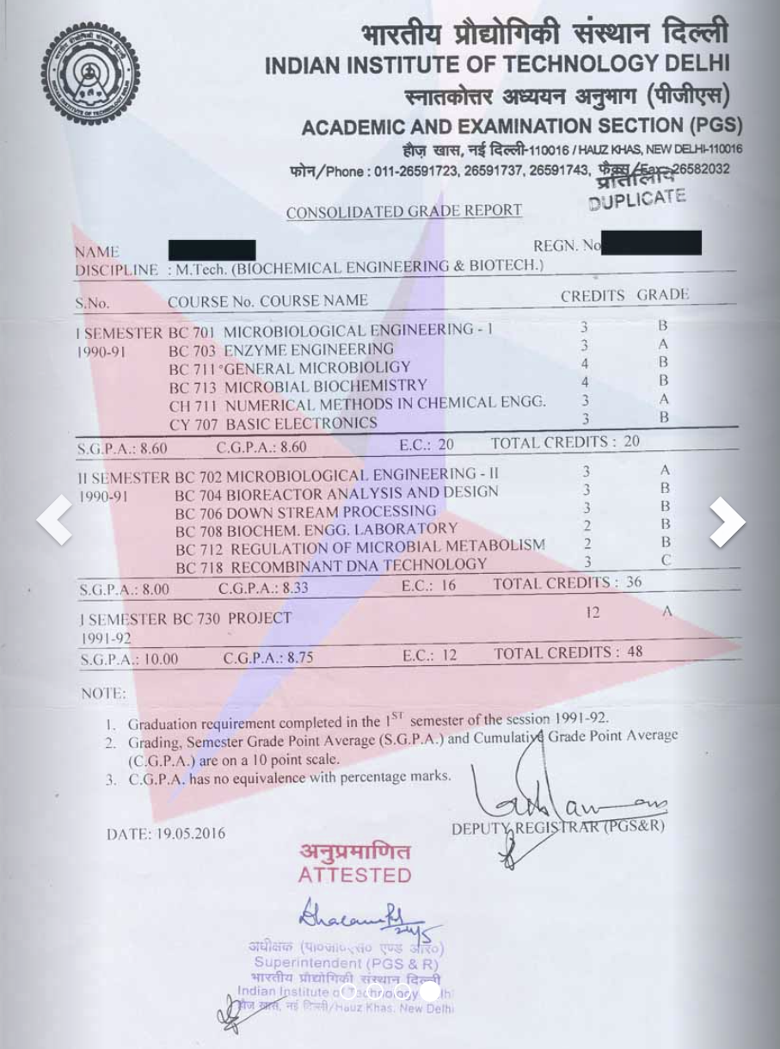
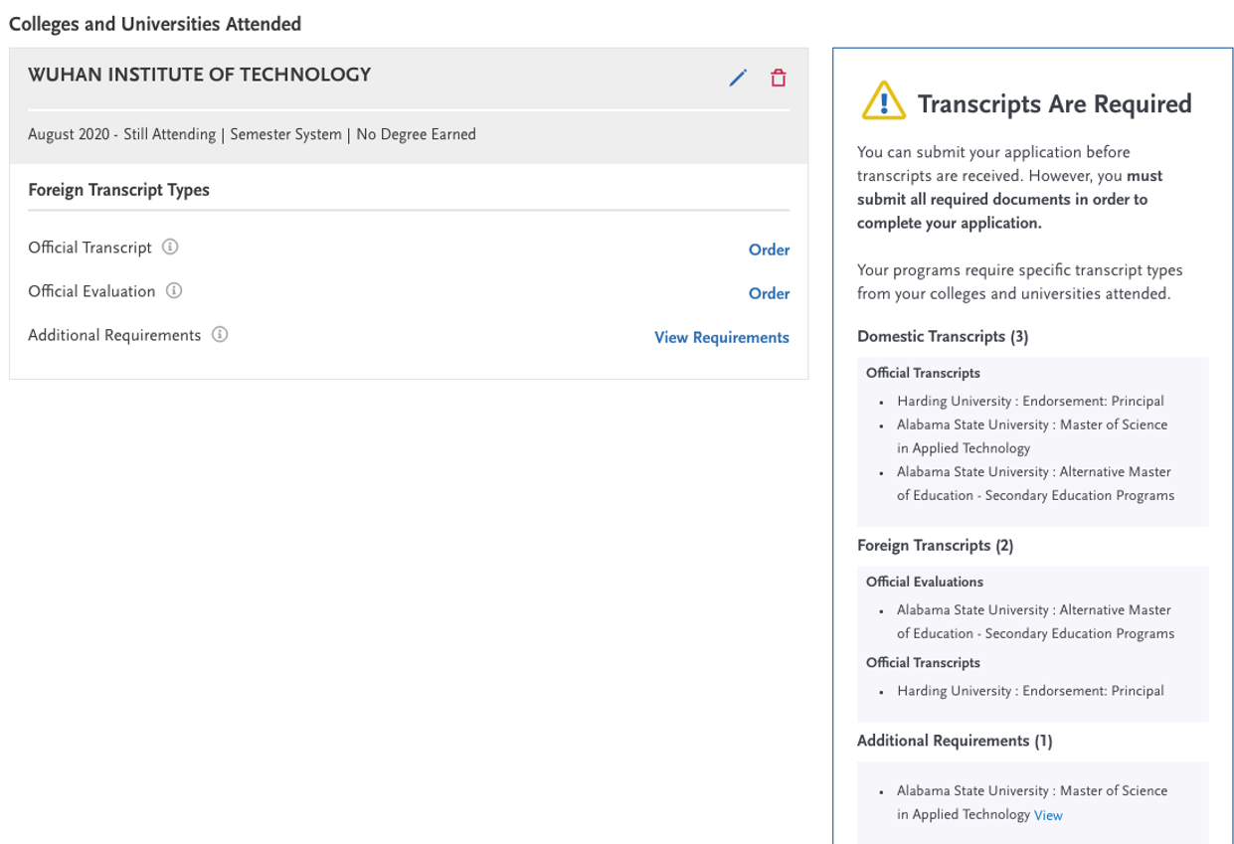
Expanded International Document Support

Slide 10
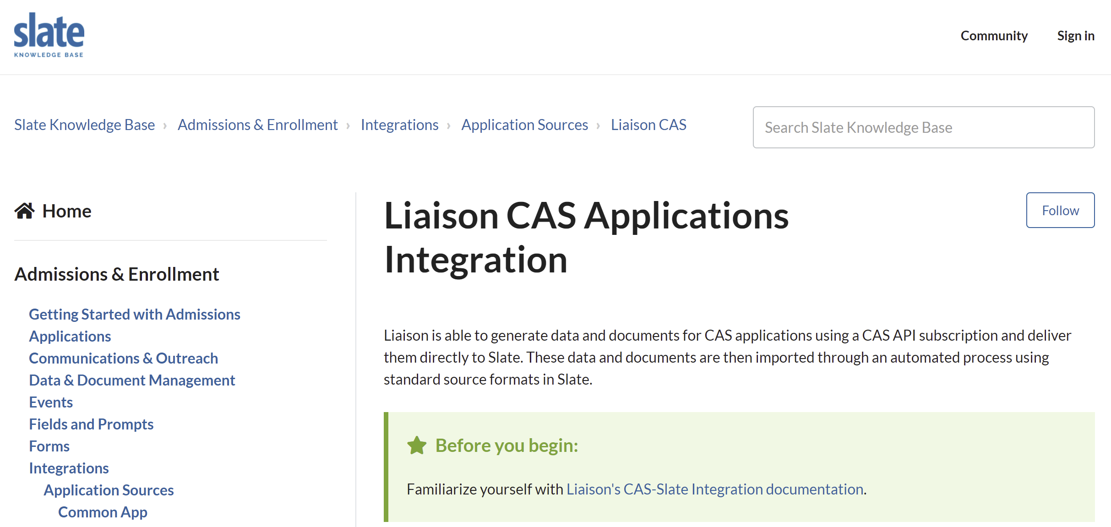

Standard CAS - Slate Integration

Slide 11
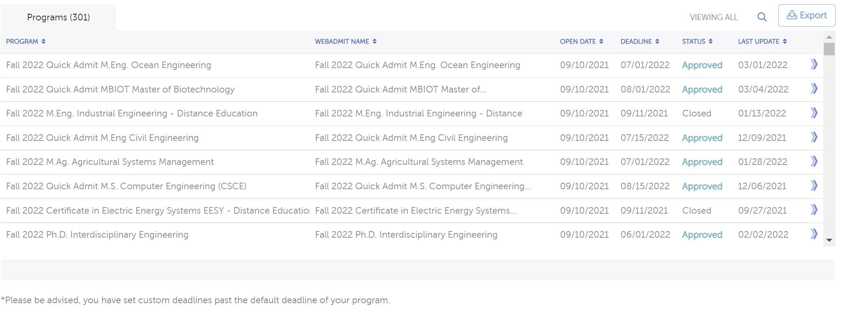
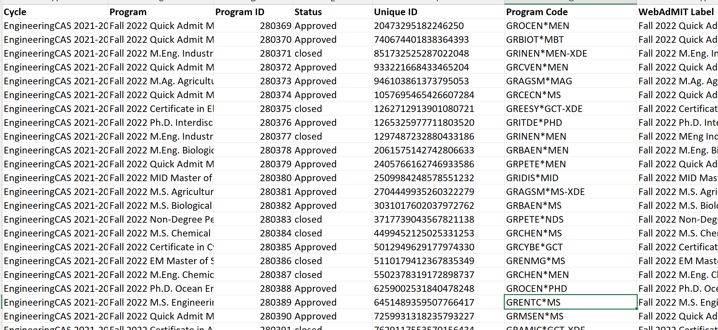
Push-Button Configuration Reports

Slide 12
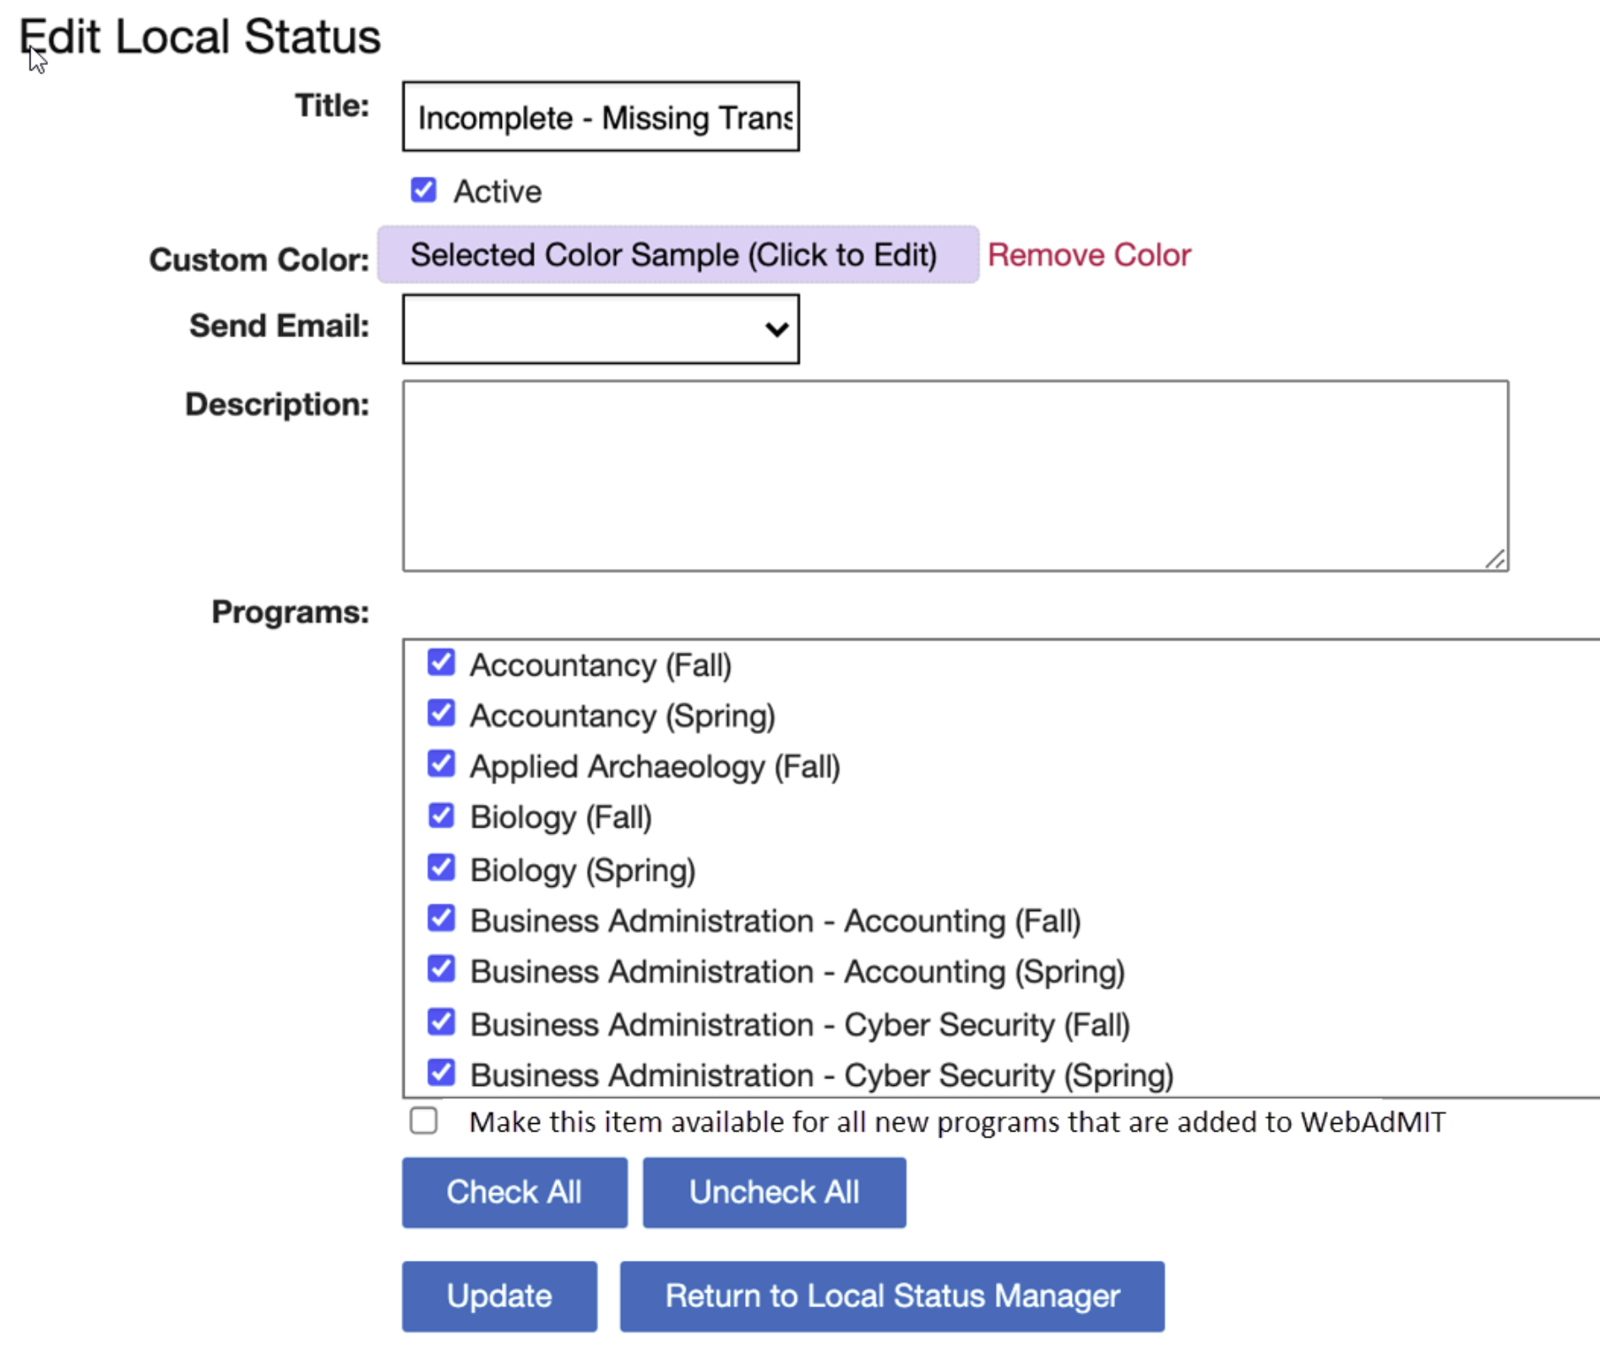
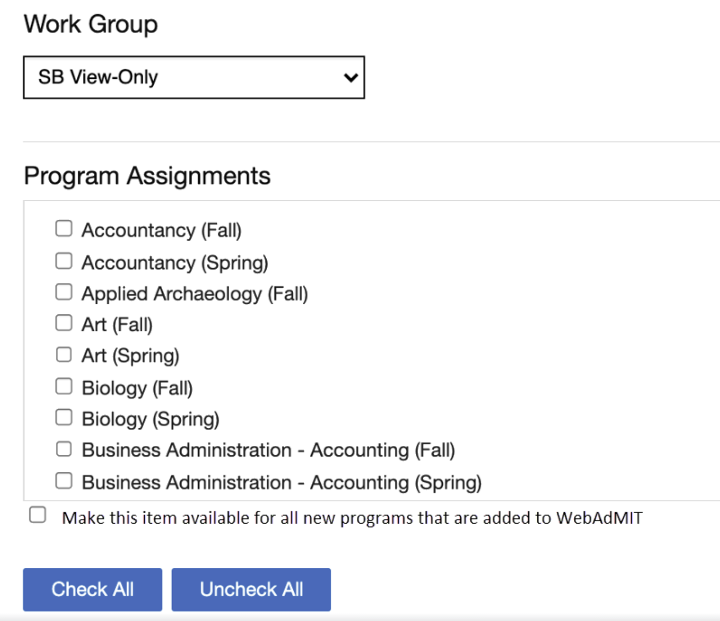
Automated Permissioning in WebAdMIT
Users
Local Statuses
Custom Fields
Applicant Header

Slide 13
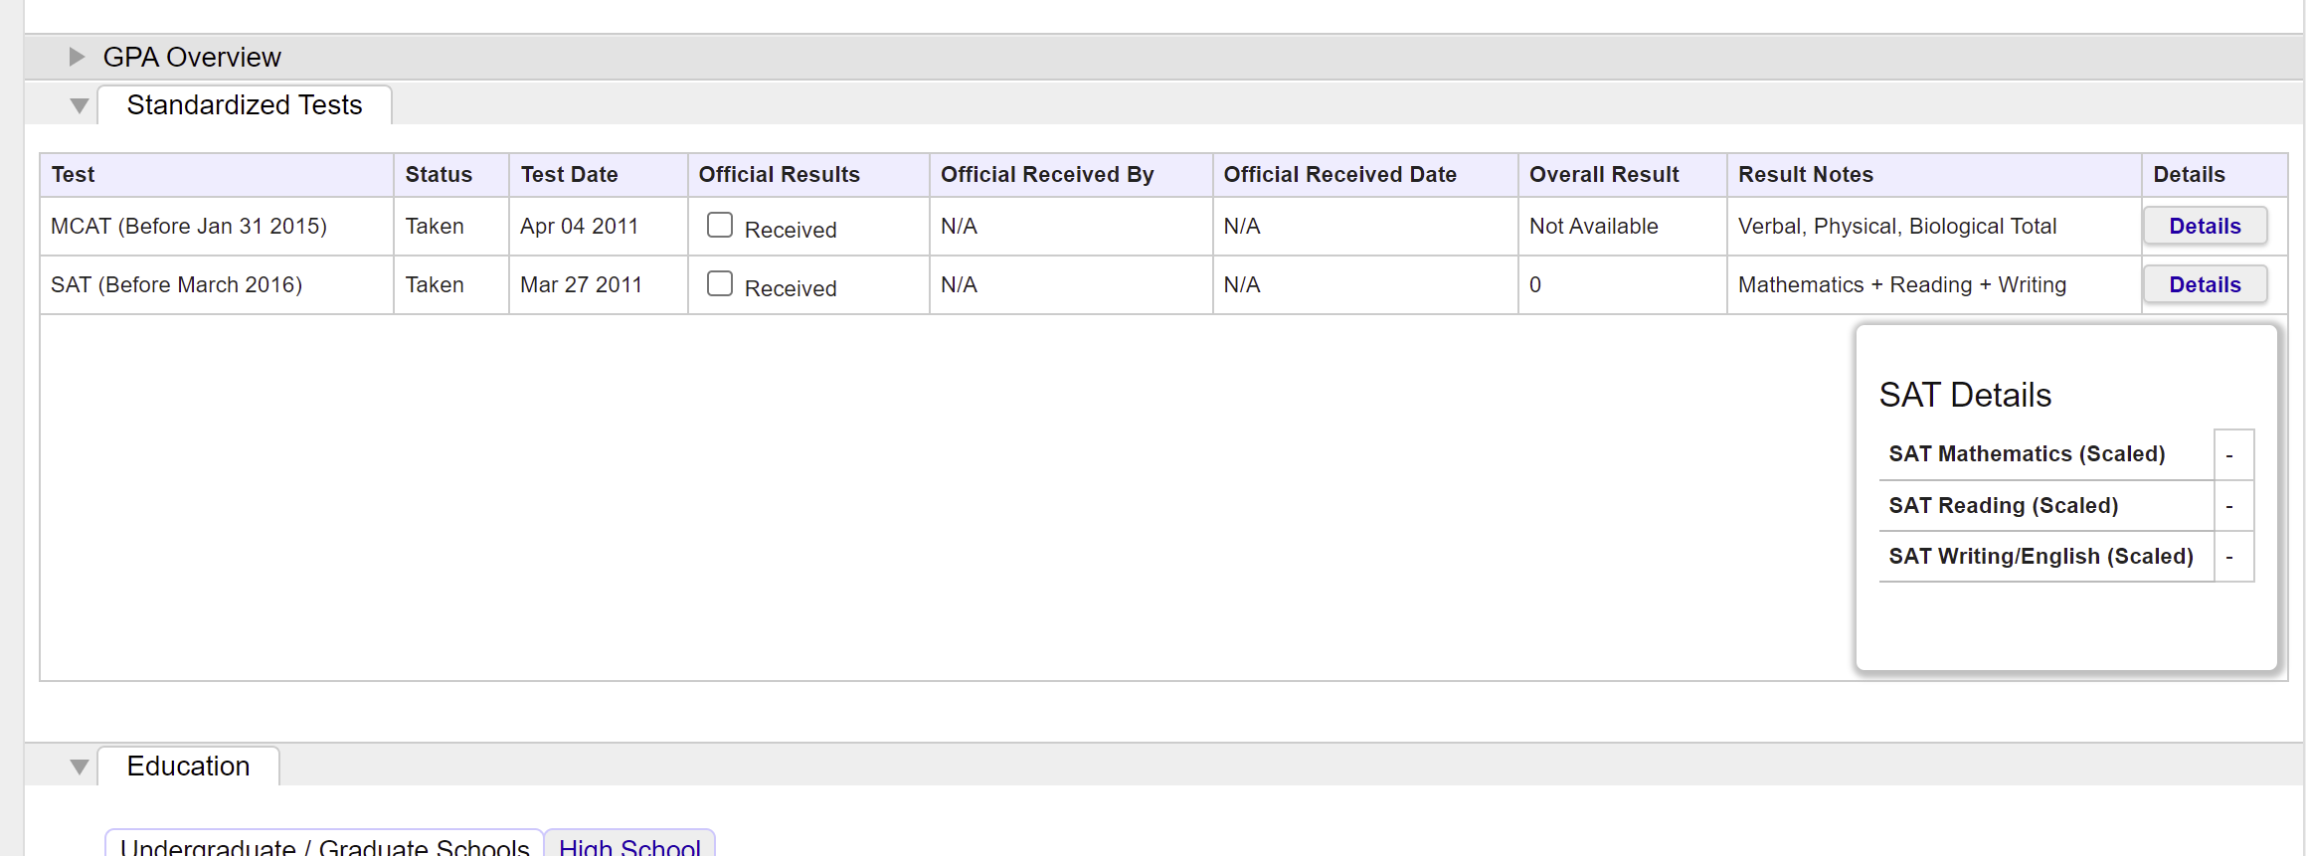
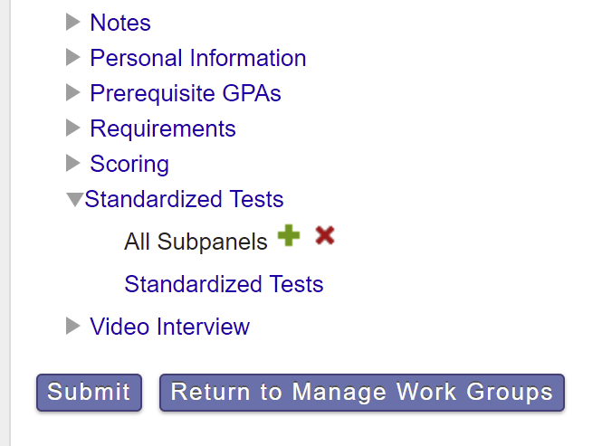
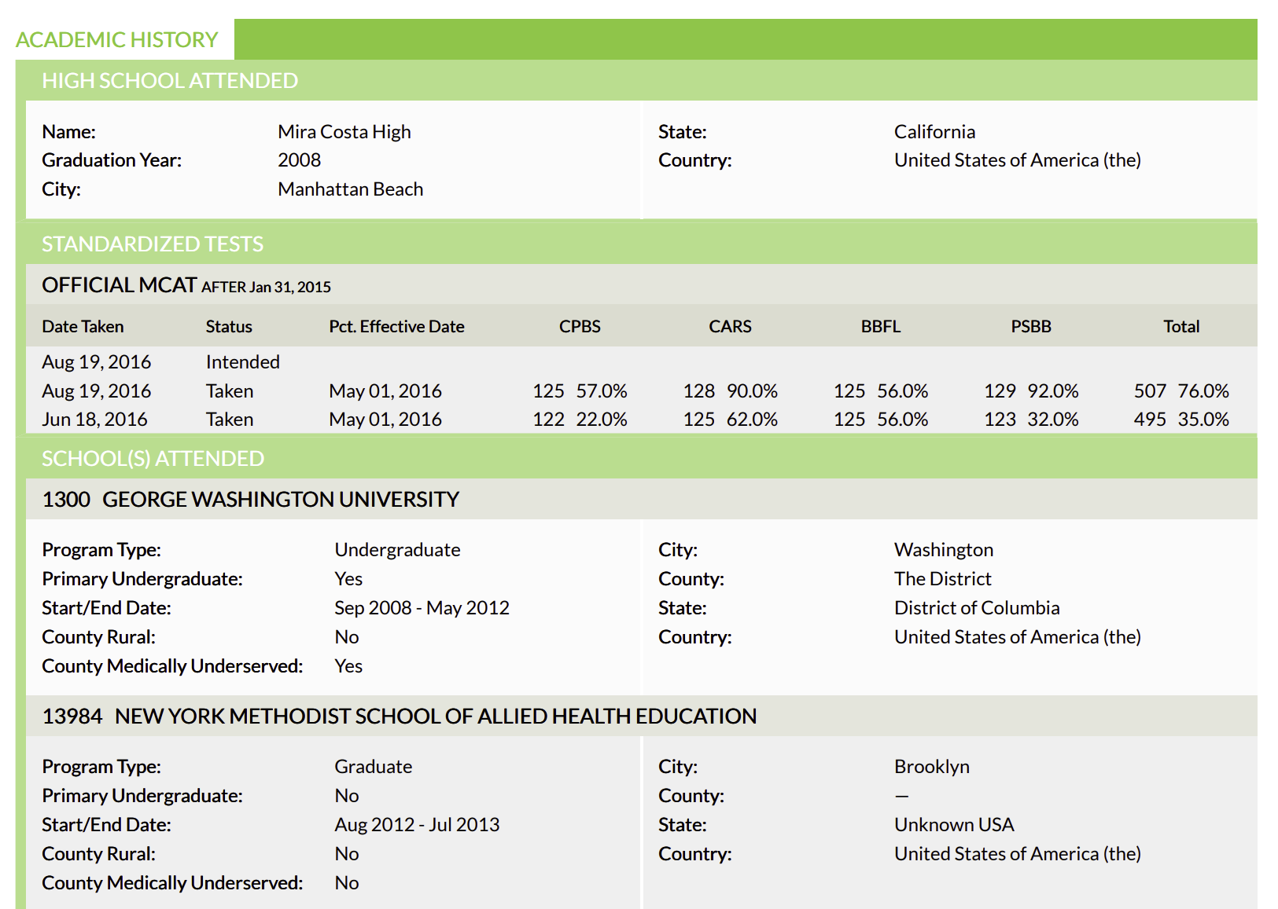
Better Test-Optional Reviews in WebAdMIT
SAT
ACT
GRE
MCAT
Etc…

Slide 14
2022-2023 Roadmap Overview

Slide 15
Key CAS / WebAdMIT Projects by Quarter
CAS & WebAdMIT Platform
2022
Q2
2022
Q3
2022
Q4
2023
Q1
Better Service International Students
IELTS Integration:
Automated data import/matching using IETLS APIs
Duolingo Integration:
Automated data import/matching using Duolingo APIs
Strengthen CAS Data Integration
Scheduled SFTP Delivery (Data):
Non-IT integration option for Slate, TargetX, etc.
Scheduled SFTP Delivery (Docs):
Non-IT integration option for Slate, TargetX, etc.
Additional Features:
Continue to make CAS easy to integrate with other Liaison and non-Liaison products
Additional Features:
Continue to make CAS easy to integrate with other Liaison and non-Liaison products
Create Upgraded Mobile-First CAS UX
Program Search & Dashboard:
User testing & optimization for mobile devices
Colleges & Transcripts:
Most complex workflows in CAS, including coursework entry
Program Materials/Q4:
Upgrade UX for questions, documents, etc.
Evaluations & Other:
Eval requests + all remaining screens for a pilot CAS in April 2023
Support Test-Optional Admissions
Standardized Tests:
Allow each test type to be permissioned separately & reflected on PDF
Custom Questions:
Allow each custom question block (CAS-level) to be permissioned separately and shown/hidden as needed
Test-Optional in Config:
Support school-driven preferences for test score collection in Config Portal & App Portal directly

Slide 16
Spotlight – A Mobile-First UX

Slide 17
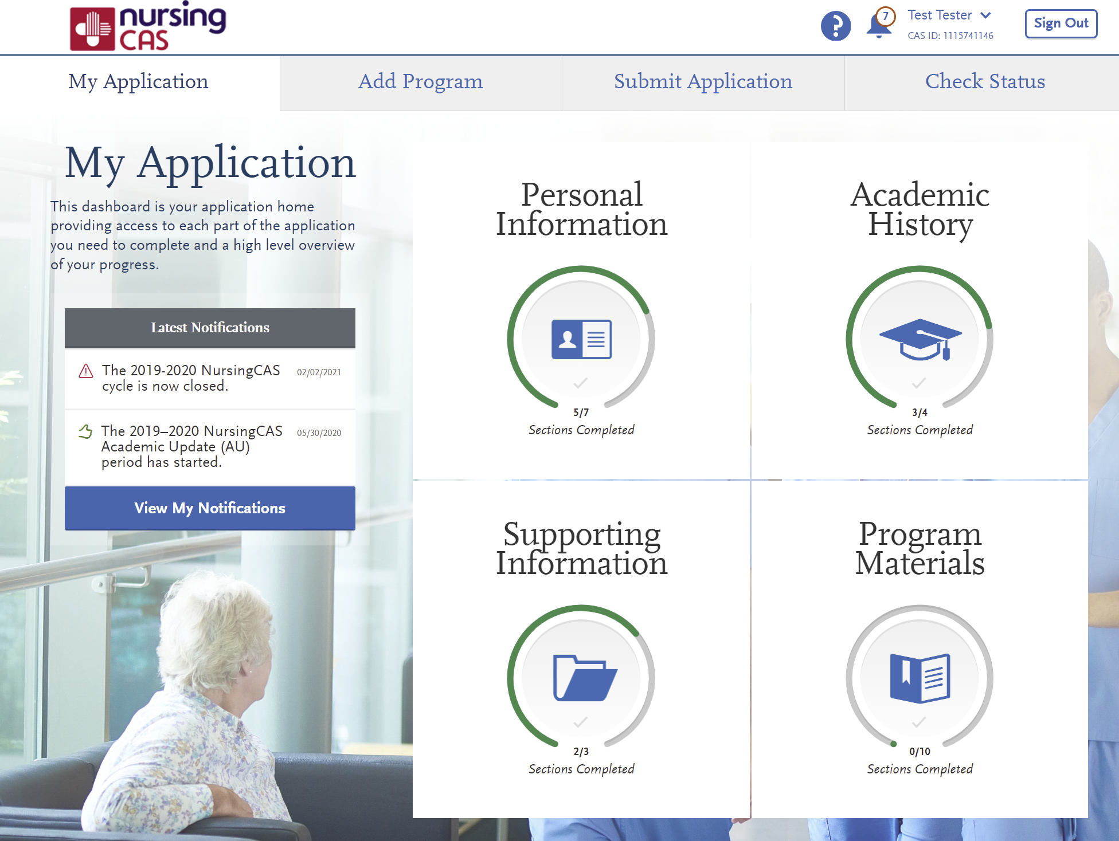
CAS Mobile Device Usage
In 2022, 30% of all CAS applicants
completed part or all of their application on a mobile device
CAS has always provided applicants with a
leading-edge experience – and we’re
re-investing to continue that leadership

Slide 18
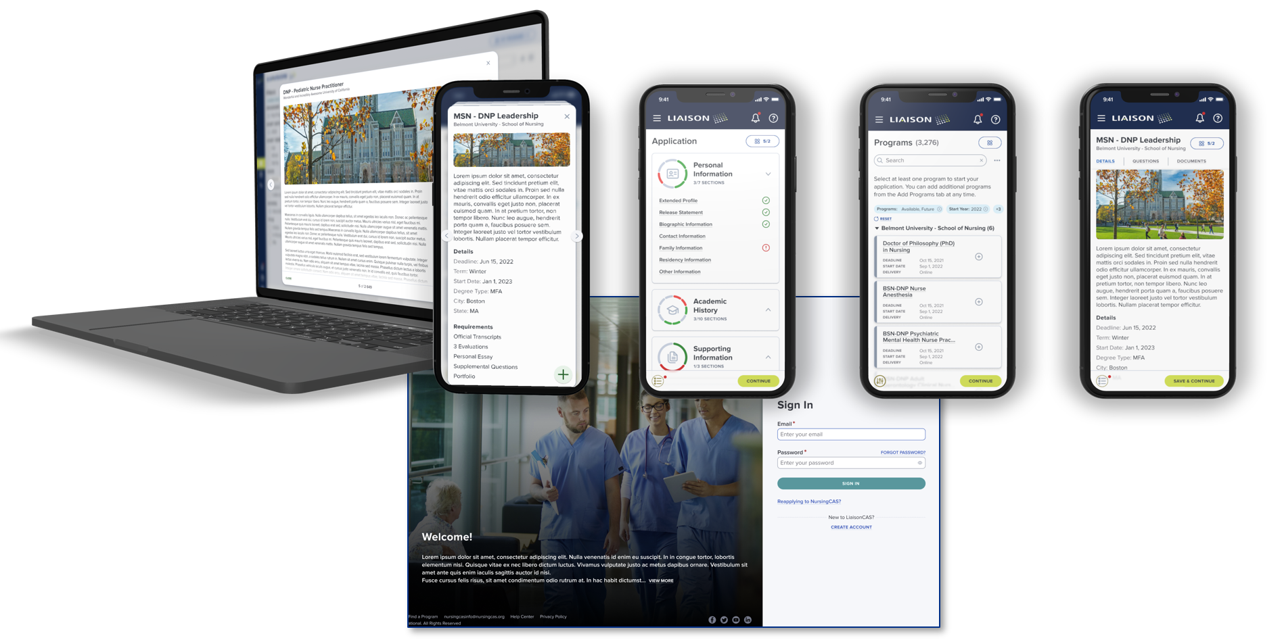
A Mobile-First CAS UX

Slide 19
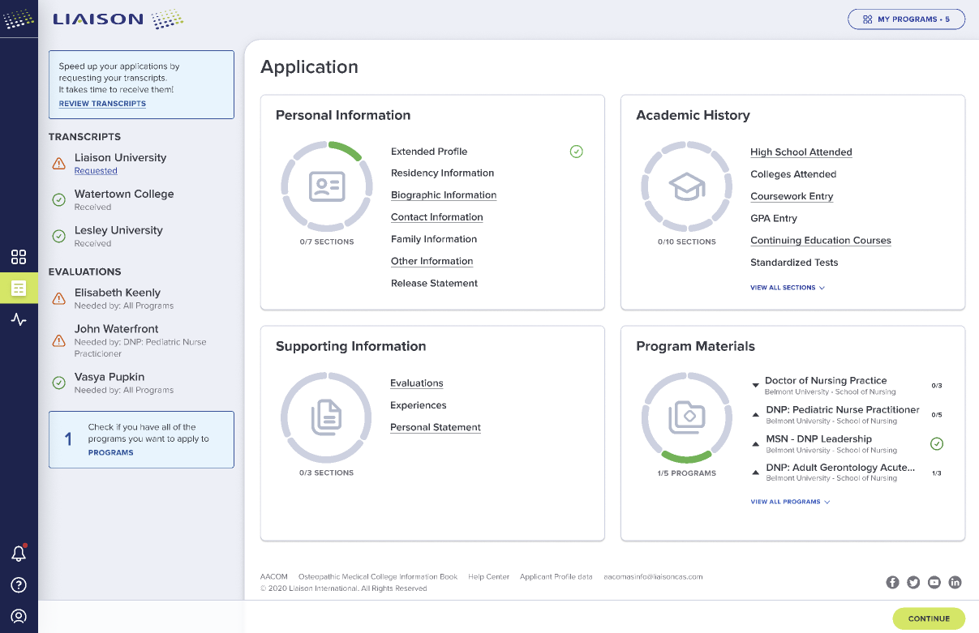
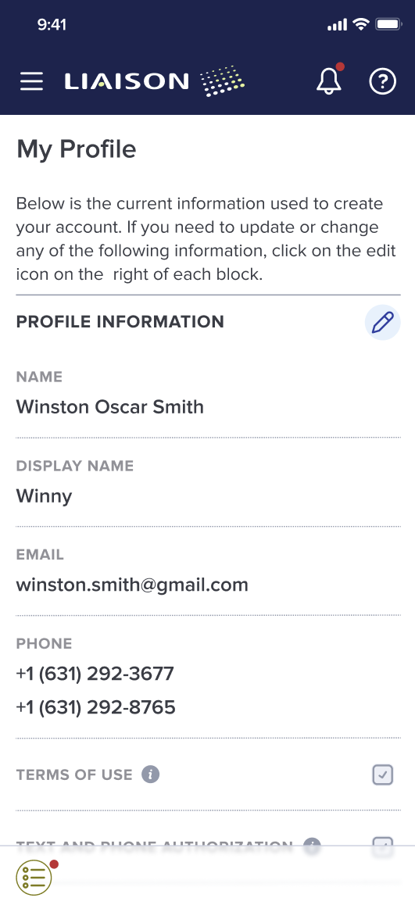
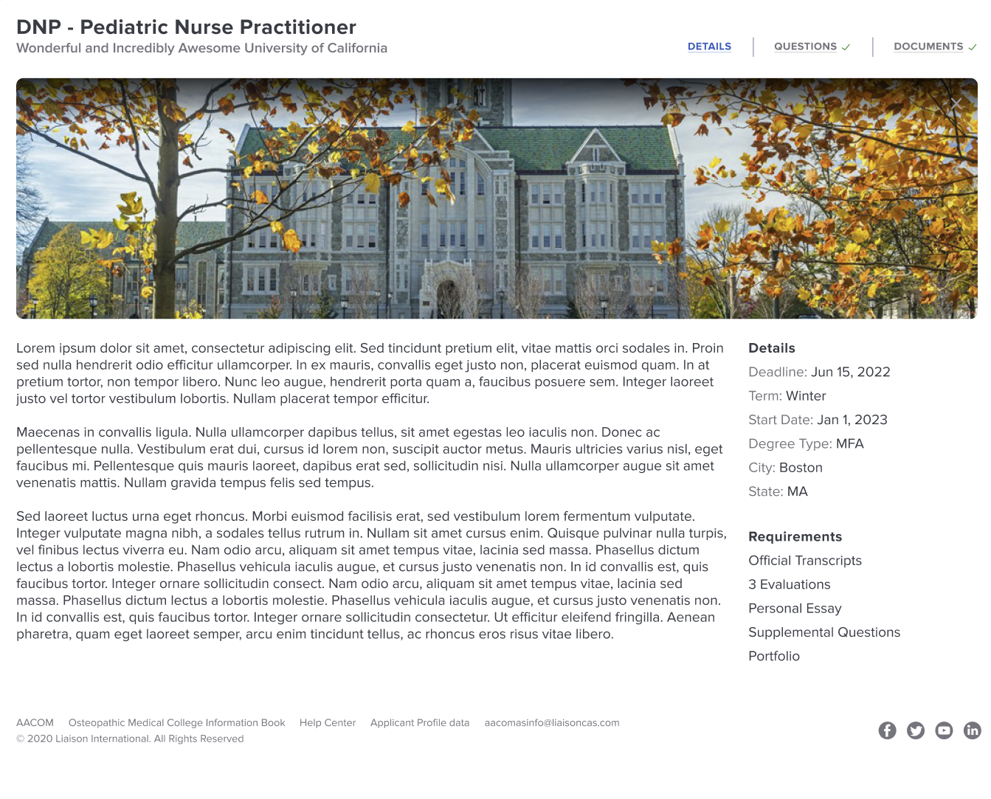
Additional Design Concepts

Slide 20

Timeline & Process
Project began in early 2022 and is in active development
Ongoing interactive user feedback sessions with real students will continue for the next 6 months
Goal: Pilot new mobile-first UX for CAS with the 2023-2024 cycle launches, beginning in Spring 2023

Slide 21
Final Thoughts - Why CAS?
“We’ve seen a 44% increase in our class size, and we saw a 50% increase in applications just one month after launching CAS. Our new, modern application experience was a direct contributor to this increase in completed applications.” – BusinessCAS Participating School
“The result of automating document management was “like moving from the Stone Age to an iPhone.” – UniCAS Partner
“It wouldn’t work for us to have multiple systems that required ongoing support from computer services. I had to have a tool that could be managed by my unit and CAS was it.” – GradCAS Participating School
“[With CAS], the different departments don’t have to create paper files. Now they can look at a rubric or an assignment and all weigh in from the comfort of their homes. We’re building a strong foundation for the future to handle larger application volume and allow for growth.” – UniCAS Partner
“The CAS technology is nimble and agile and those daunting piles of papers are long gone.” – PSYCAS Participating School

Slide 22
Q & A

Slide 23
Thank You
Mike Margitich
Liaison International
mmargitich@liaisonedu.com

