Slide 1


Slide 2
Return on Investment: How to Show that Going to College is Still Worth It?
Dr. Neil Scott
11:15 a.m. – 12:00 p.m.

Slide 3


Agenda
Understand the Narrative
Personalize the Message
Focus on Outcomes
Remove Barriers
Push Back on the Narrative

Slide 4

Alabama Community College System

Slide 5


Alabama Community College System

Slide 6
What do we mean when we say, “College isn’t for everyone?”

Slide 7

Understand the Narrative
Higher Entry Level Wages
Rising Cost of Higher Education
Student Loan Debt
Colleges are “Out of Touch”
Uncertainty of Career Goals
Success of High-Profile Drop-Outs

Slide 8

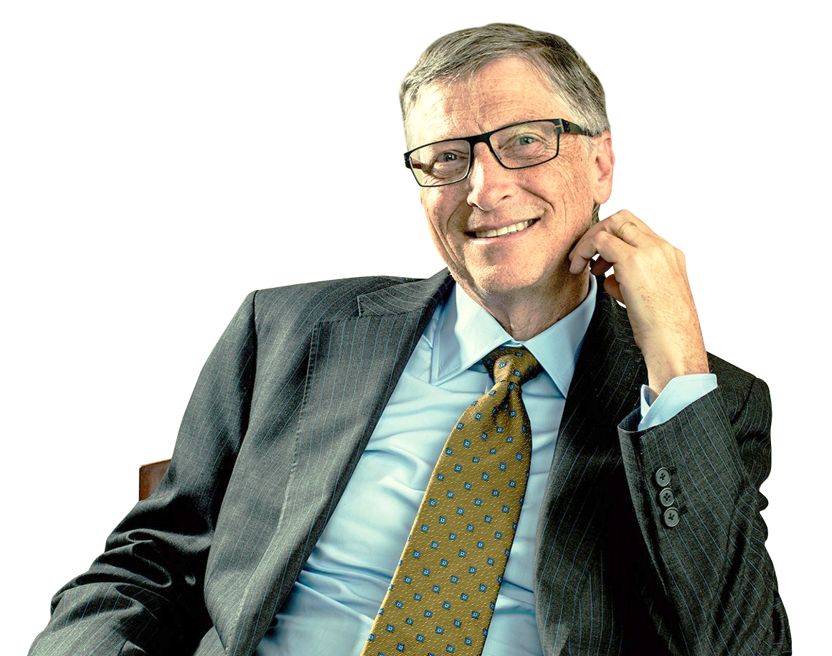
Understand the Narrative

Slide 9
Personalize the Message
Fill the top of the funnel with marketing and promotion, but TARGET the middle
Don’t confuse promotion with recruiting
Identify a method of prioritizing students, so you can focus your attention on the right ones
Use the tools you have to show genuine interest, tell personal stories, and maintain steady interaction
“The right message, to the right student, at the right time”

Slide 10
Focus on Outcomes
Use stories in your marketing and in your recruiting
  Alumni Success
  Business/Industry Needs
Reinforce stories with data on website, PURLs, and print
  Bureau of Labor Statistics
  Workforce Analytics (EMSI, Burning Glass)
  Average Wages by Program
If possible, emphasize immediate outcomes and focus on recent graduates
Create opportunities for prospective students to hear these stories first hand

Slide 11

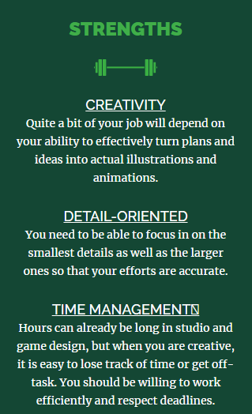
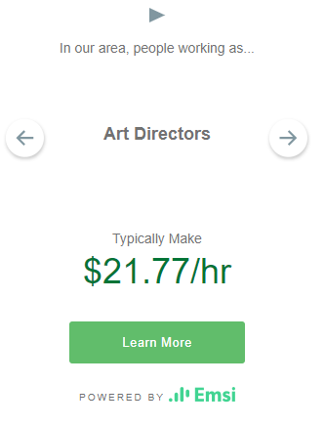
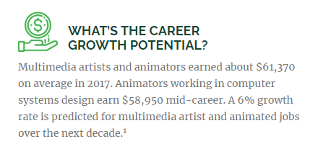
Focus on Outcomes

Slide 12
Remove Barriers
What items are currently required for admission, registration?
  Are these items necessary?
  Can students easily submit them?
Do students have to be in person to register, take placement tests, or complete other steps to enroll?
What personal barriers might a student face?
Lay out a plan for the student, but don’t overwhelm them
SHOW students that your college is for them

Slide 13
Remove Barriers
Many of your students are already questioning whether they should attend college
Don’t give them more reasons
to walk away

Slide 14
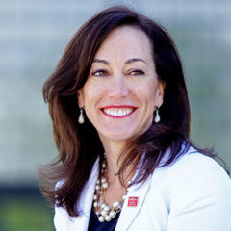
Push Back on the Narrative
“I’ve been told that being a university president is the hardest job in the world. One of the things that makes it hard is what people say about higher ed. People say ‘Yeah…it’s getting expensive. It’s out of touch.’ And here’s the one I really don’t like. ‘And, you know, college isn’t really for everyone.’
Is that what you tell your kids?
I know that’s not what the rich people are telling their kids. You know how I know that? Because some of them are going to jail…for spending $500,000 to get their kids in the side-door of those other schools.”
Janine Davidson, PhD
President of Metropolitan State University-Denver

Slide 15
Push Back on the Narrative
Every chance you get, push the value of higher education
College graduates experience:
  Over $ 1 Million more lifetime earnings
  Since 2010, 95% of all new jobs went to workers with at least some college education.
  Better health and life expectancy
  Nearly 5 times less likely to go to jail
  More likely to pay into the system than take from it
  Lower unemployment
  Greater personal and professional mobility
Every adult student has a story that reinforces the value of higher education

Slide 16
Q & A

Slide 17
Thank You!
Dr. Neil Scott
Alabama Community College System
Neil.scott@accs.edu

