Slide 1


#experienceliaison
©2022 Proprietary and Confidential

Slide 2


KRISTI KOOYMAN
Client Success Manager

Slide 3
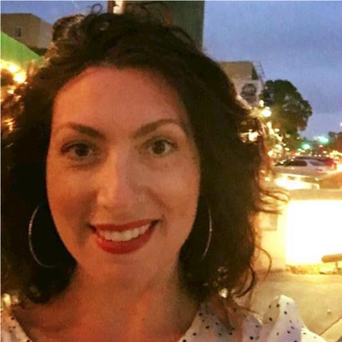
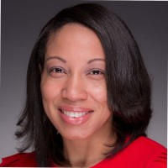
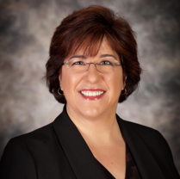



Grant Recipients
2021 Recipient
2022 Recipients
AnnMarie Puleo
Melissa Redmond-Burch
Dr. Caterina Bristol
Director of the Advisement Center
Registrar
Assistant Provost & Dean of Harold Lloyd Murphy Graduate School
Notes:
2021 Recipient:
AnnMarie Puleo, Director of the Advisement Center
Western Connecticut State University
2022 Recipients:
Christine Ball, Director of Enrollment Services
Augusta Technical College
Dr. Caterina Bristol, Assistant Provost & Dean of Harold Lloyd Murphy Graduate School
Alabama State University

Slide 4
SASHA PETERSON
Chief Innovation Officer

Slide 5
Nancy Zimpher, Ph.D.
Senior Fellow, National Association of System Heads,
Chancellor Emeritus, The State University of New York

Slide 6


Slide 7


Slide 8
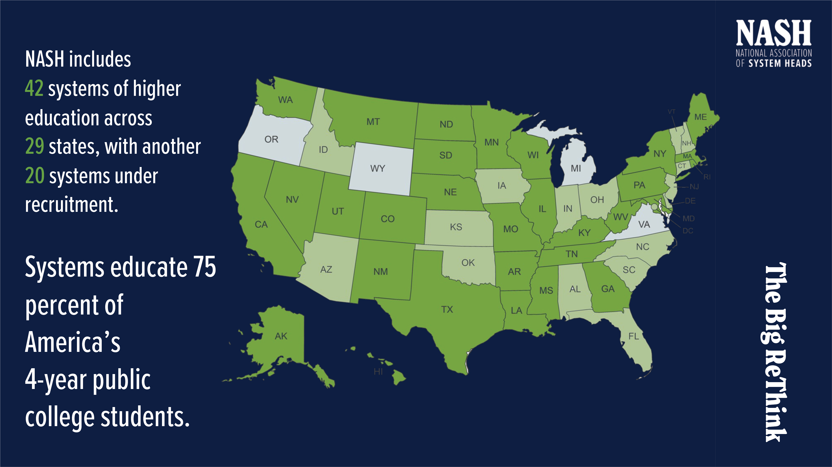

Slide 9


Slide 10


Slide 11


Slide 12


Slide 13


Slide 14
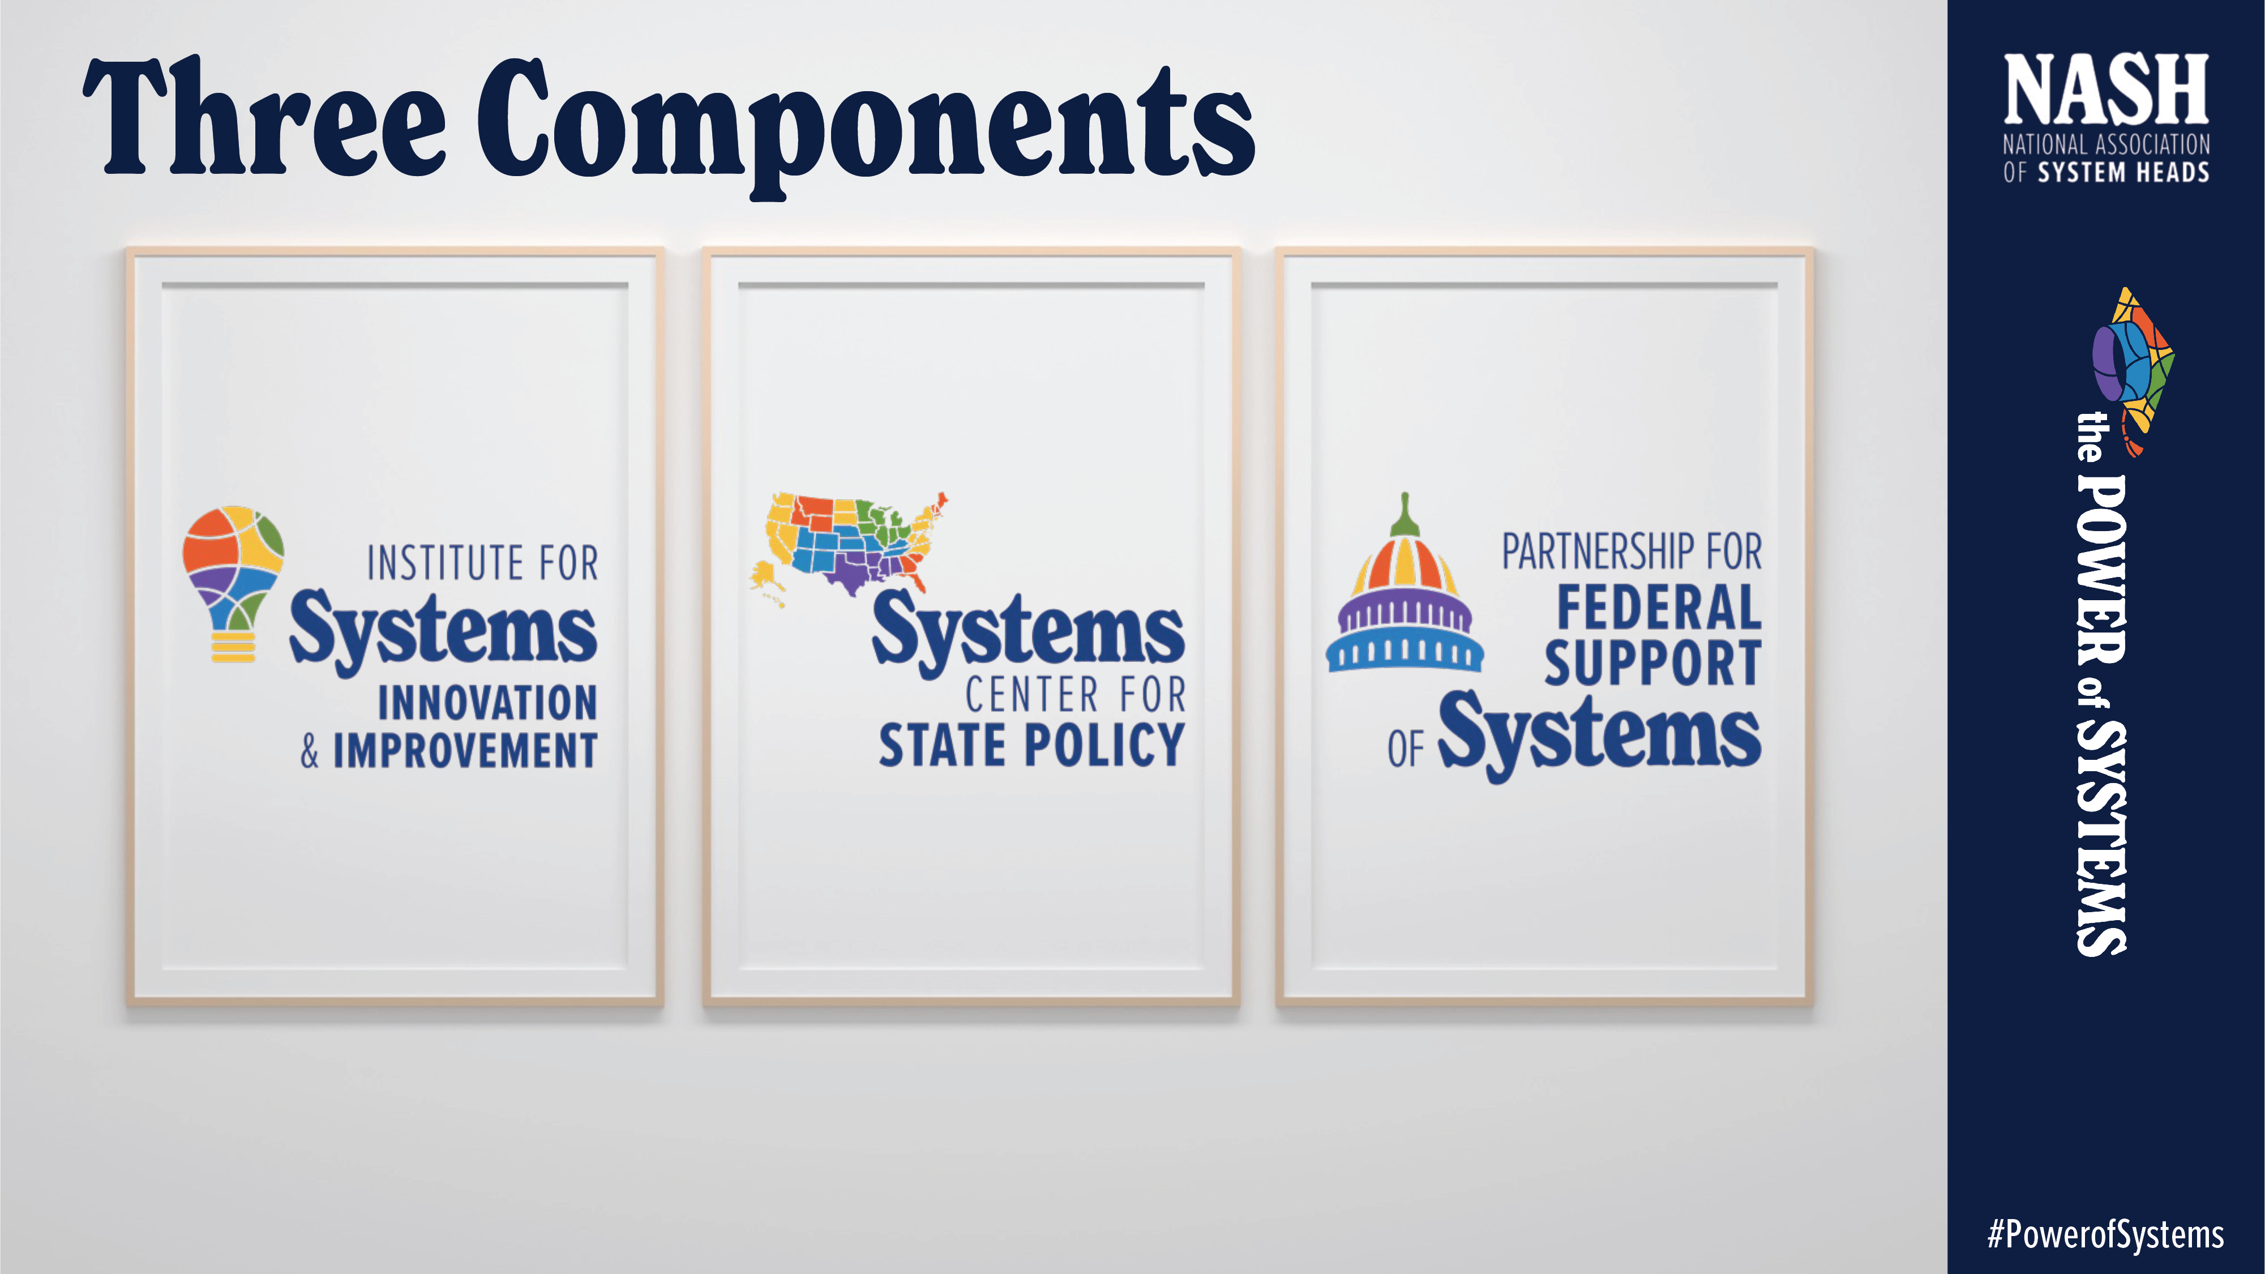

Slide 15


Slide 16


Slide 17


Slide 18


Slide 19


Slide 20
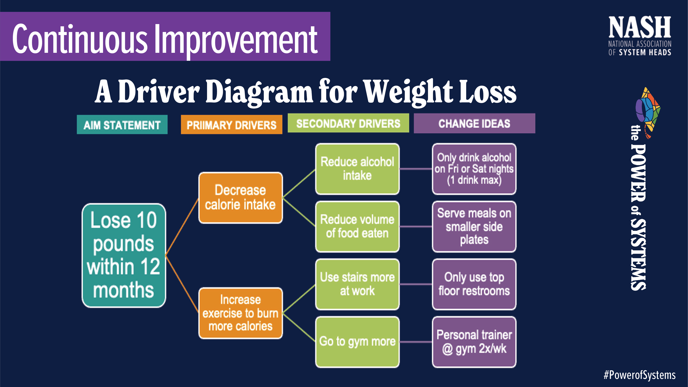

Slide 21


Slide 22


Slide 23
#experienceliaison
©2022 Proprietary and Confidential

Slide 24
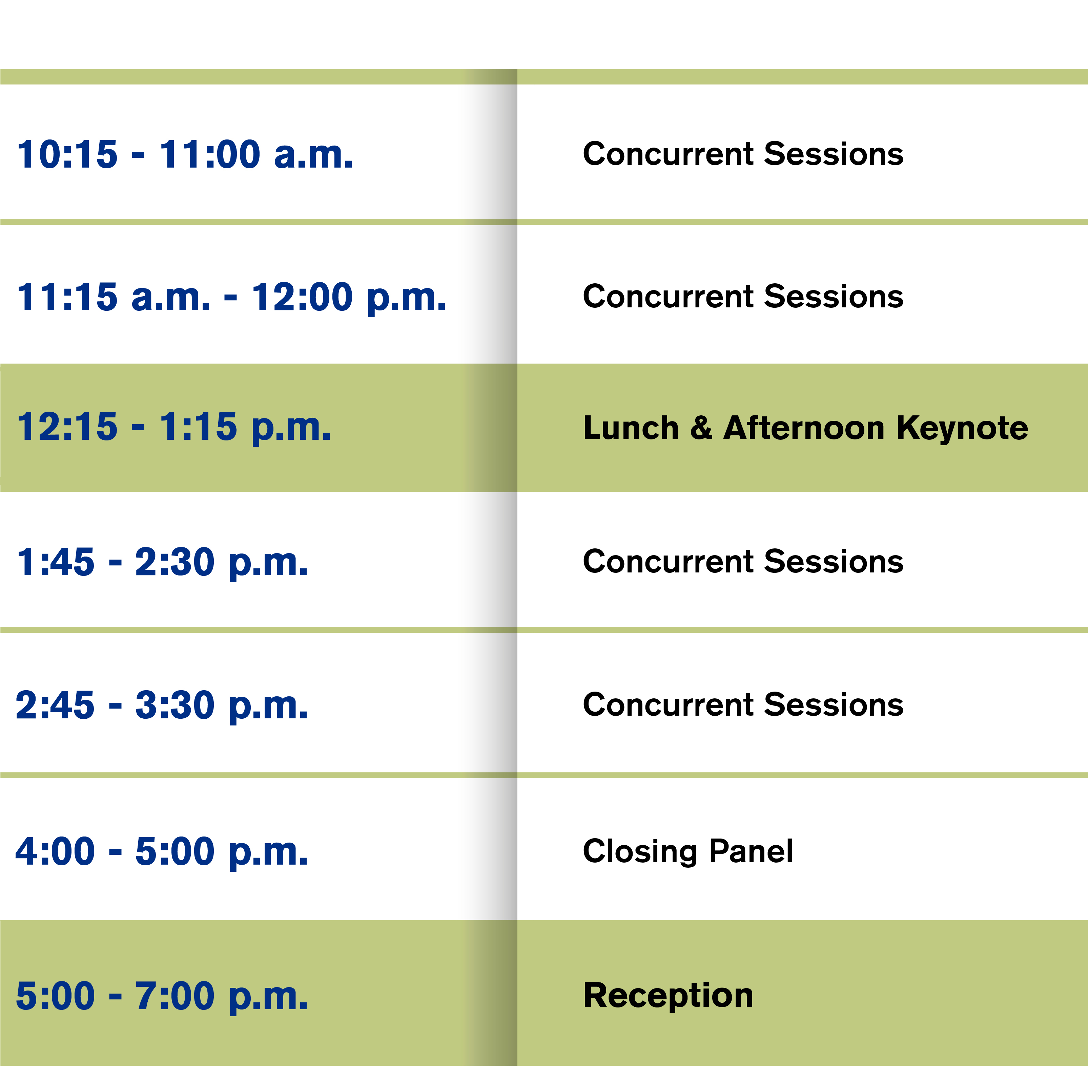
Schedule

