Slide 2
Product Roadmap: Othot, Analytics by Liaison, TargetX Insights
Robert DiMaggio - VP, Data Products

Slide 3
Presenter
Robert DiMaggio
VP, Data Products
Notes:
Who am I
Story – why you should listen to me
Never worked at a school
Understanding/wisdom, decision making, outcomes

Slide 4
Understanding image

Slide 5
Generalized Framework For Understanding
DIKW(D) Framework
E.M Awad and H.M. Ghaziri. Knowledge Management

Slide 6
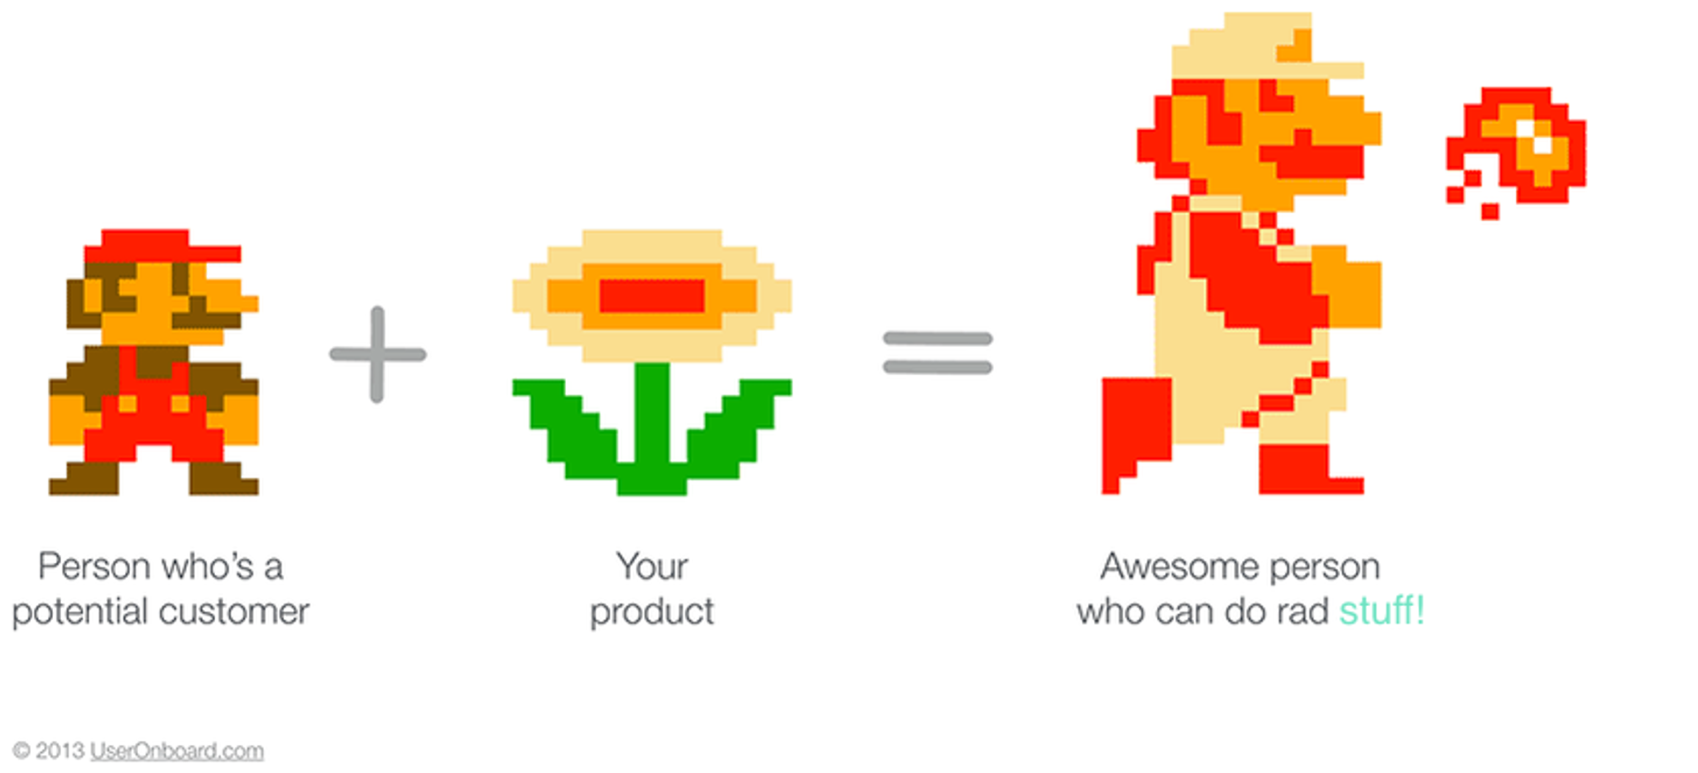
Level You Up

Slide 7
Level You Up

Slide 8
Generalized Framework For Understanding
DIKW(D) Framework
E.M Awad and H.M. Ghaziri. Knowledge Management

Slide 9
Our Clients
Manager
Recruiters/ Counselors/ Officers/
Analysts
VP
Director

Slide 10
What We Hear
Want to grow but can’t
Declining enrollment
Declining applications
Yield is declining
Missing net tuition revenue (NTR) targets
The same old approaches aren’t working
Marketing is getting less effective
Don’t have enough time to engage each student
Waste too much time managing admissions processes
Financially not competitive in the market
Struggling with retention
Decreasing and stretched staff

Slide 11
It’s Also an Analytics Maturity Pyramid
DIKW(D) Framework
E.M Awad and H.M. Ghaziri. Knowledge Management

Slide 12
Our Data and Analytics Product Lines
Intelligent Names

Slide 13
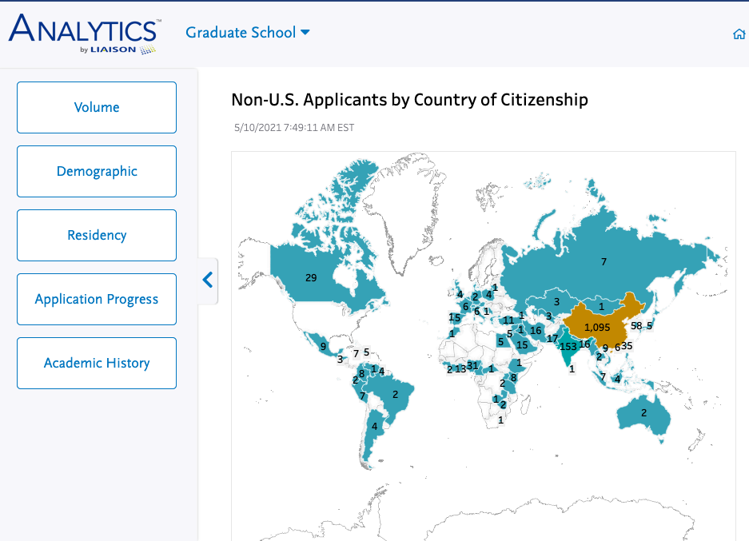
What is Analytics by Liaison?
What is Analytics by Liaison?
Dashboards to spot trends and shape your class for CAS customers
Why use Analytics?
Admissions and Enrollment Management: provides actionable data to make decisions on class shape and size
Presidents, Provosts, and Deans: to understand high-level enrollment and trends easily
Institutional Research: easily extract data to satisfy state and national survey requests and assist with analysis of outcomes data for annual reports

Slide 14
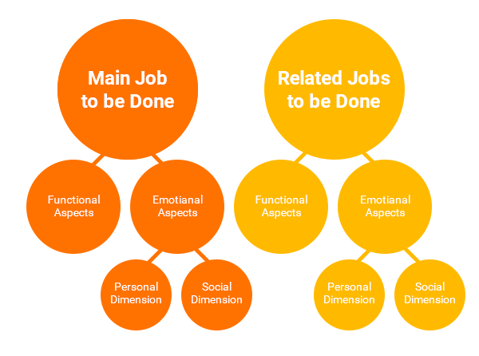
Analytics Roadmap
Visual Analytics Decommissioning
New Dashboards using Jobs to be Done Framework

Slide 15
Generalized Framework For Understanding
DIKW(D) Framework
E.M Awad and H.M. Ghaziri. Knowledge Management

Slide 16
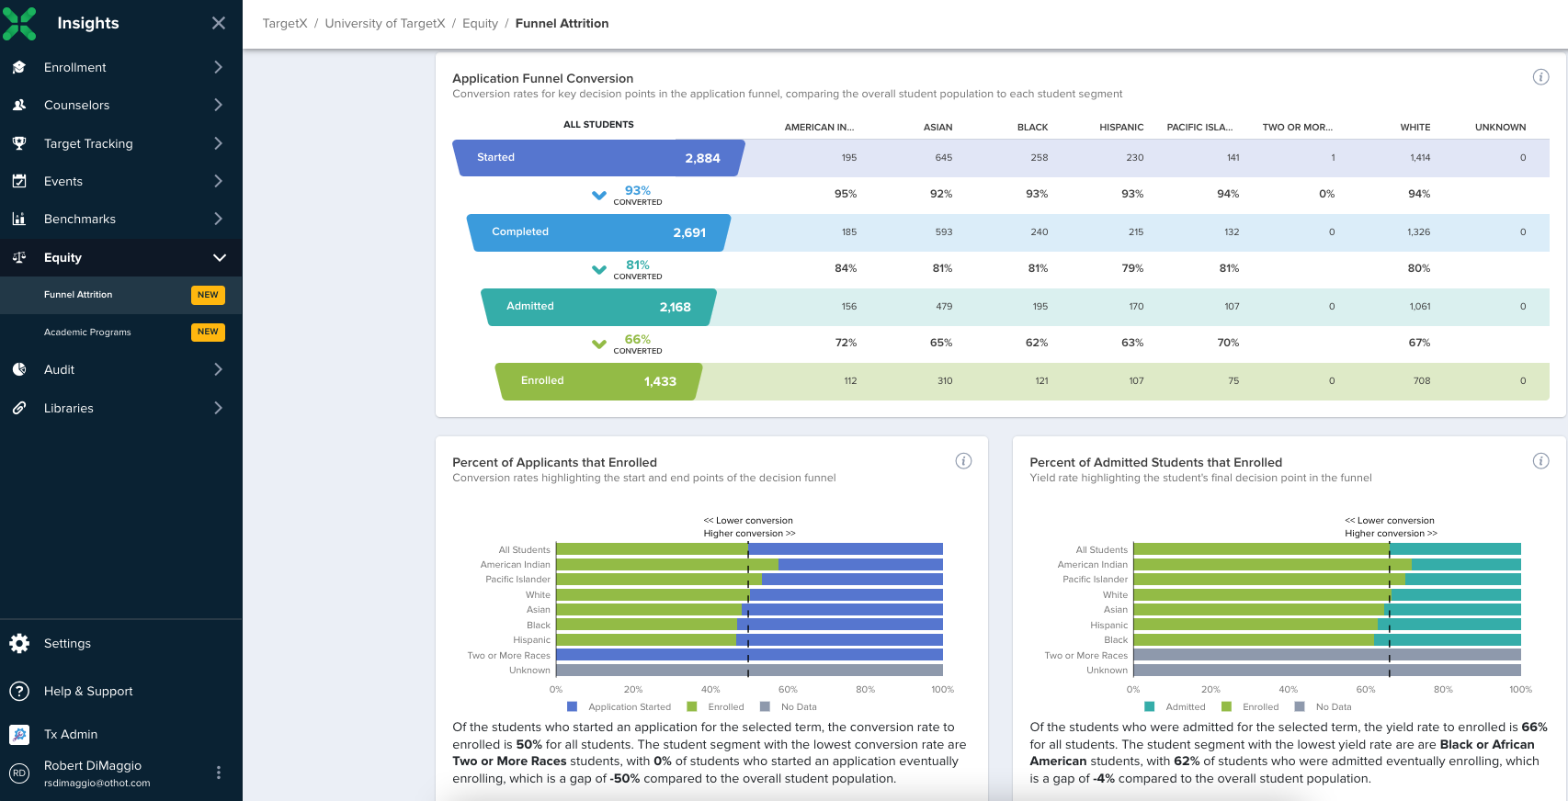
What is TargetX Insights?
What is TX Insights?
Dashboards to spot trends and shape your class for TargetX, EMP, or Slate customers
Why use TX Insights?
It tells the story of what is happening with admissions using targeted dashboards to diagnose recruitment issues

Slide 17
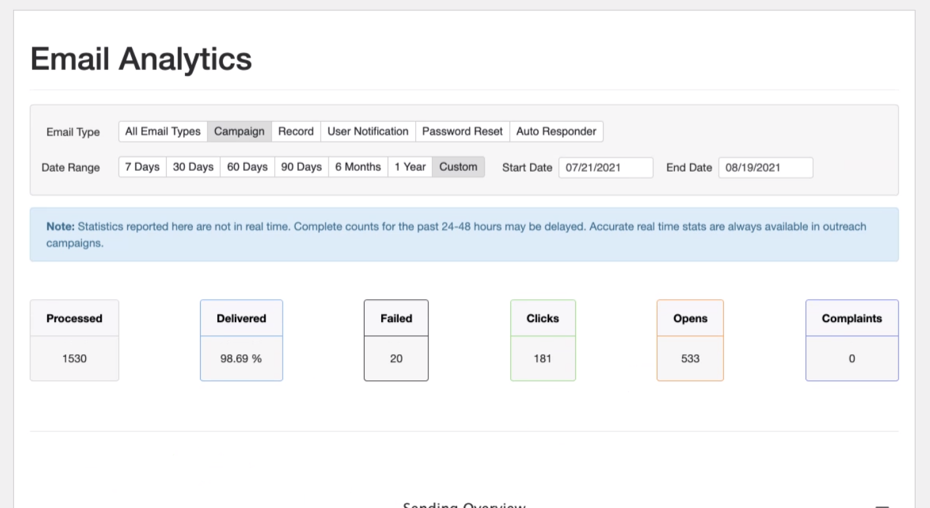
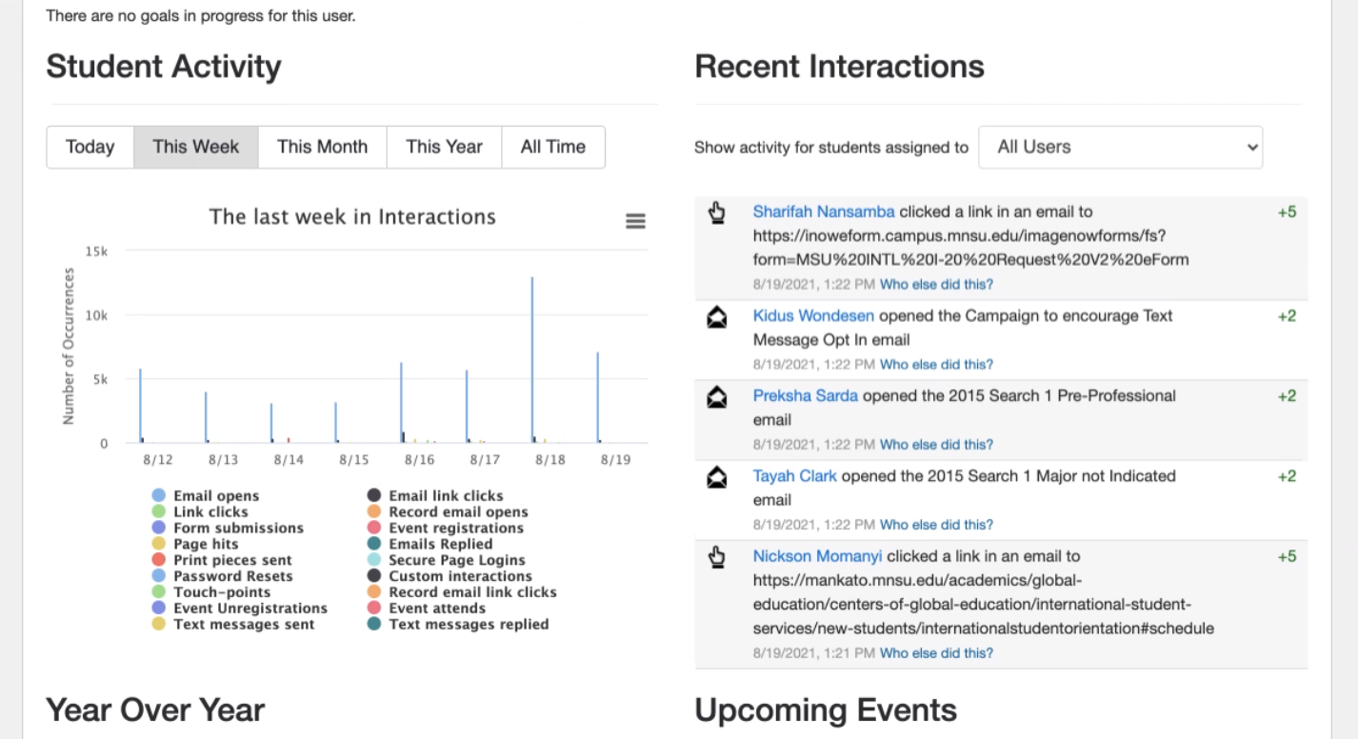
Insights Roadmap
Marketing Dashboards

Slide 18
Generalized Framework For Understanding
DIKW(D) Framework
E.M Awad and H.M. Ghaziri. Knowledge Management

Slide 19
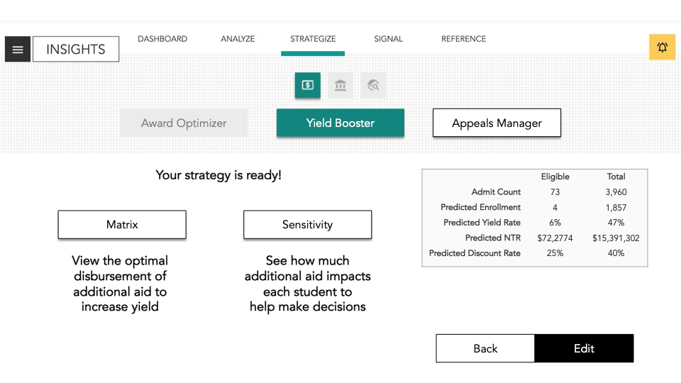
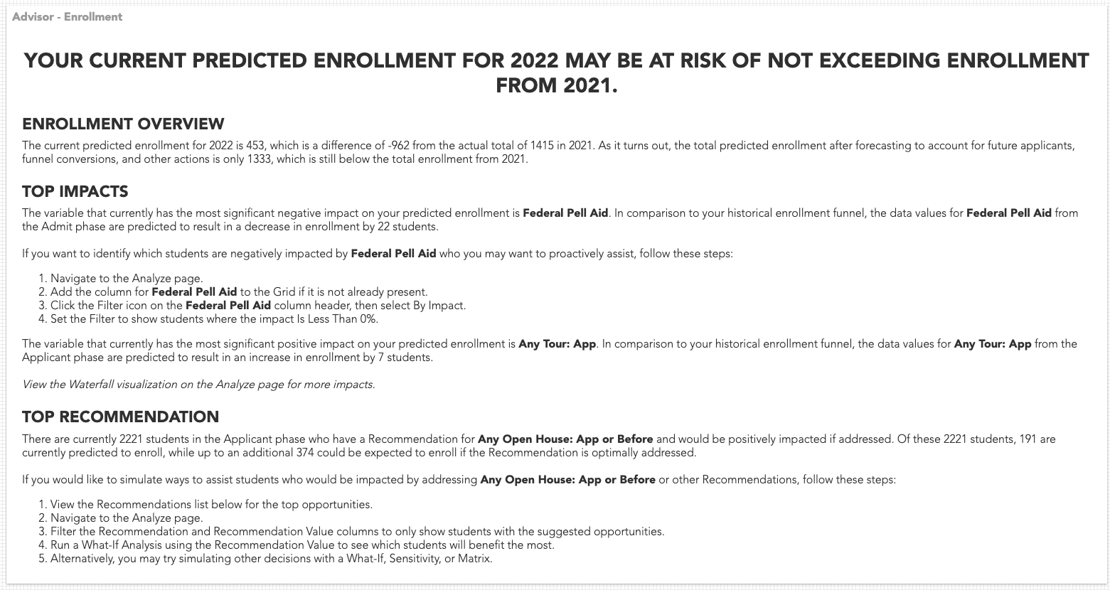
What is Othot?
What is Othot?
A data science platform focused on predicting recruitment and student success outcomes and showing staff specifically what they can do to improve those student outcomes
Why use Othot?
To improve yield, NTR, and marketing and recruiter efficiency with the most advanced analytics
Be able to make informed decisions on knowing what the outcome will be before making the investment

Slide 20
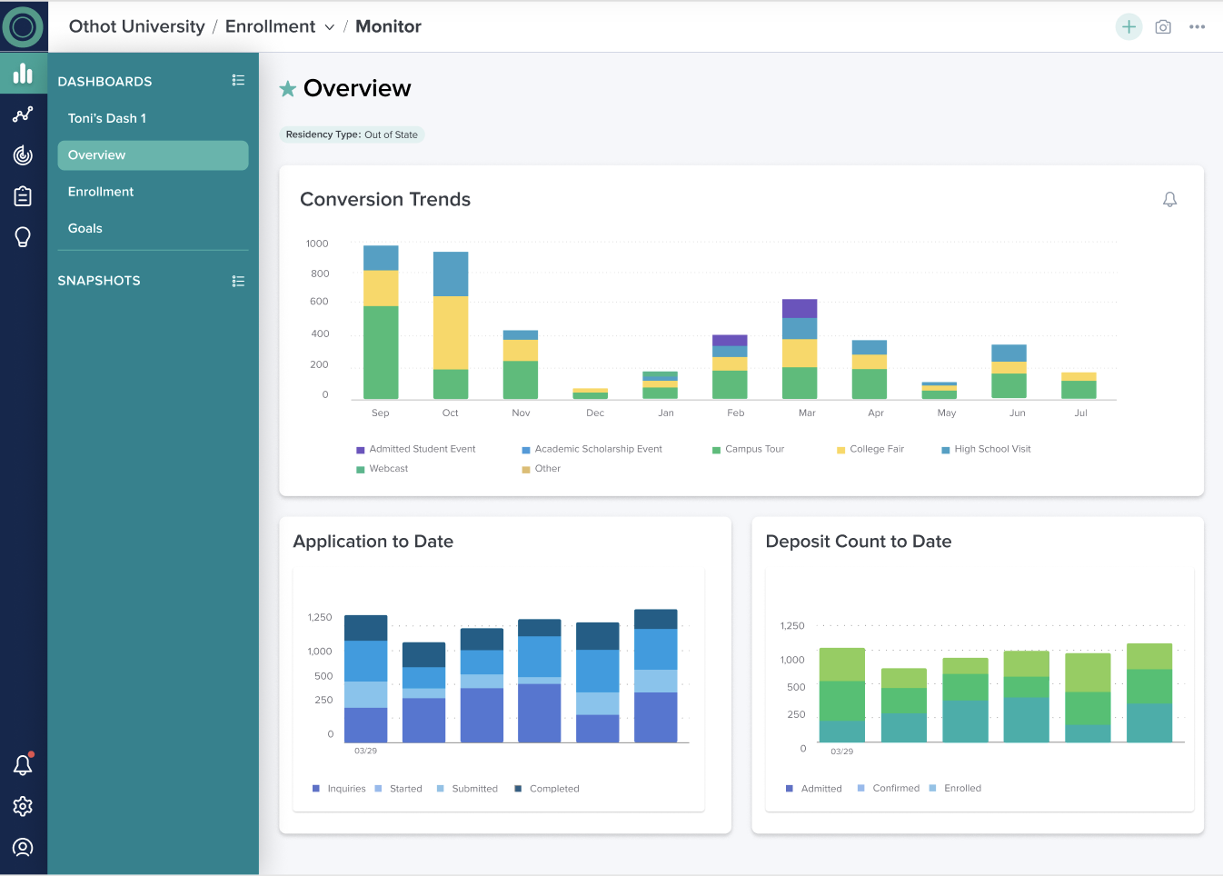
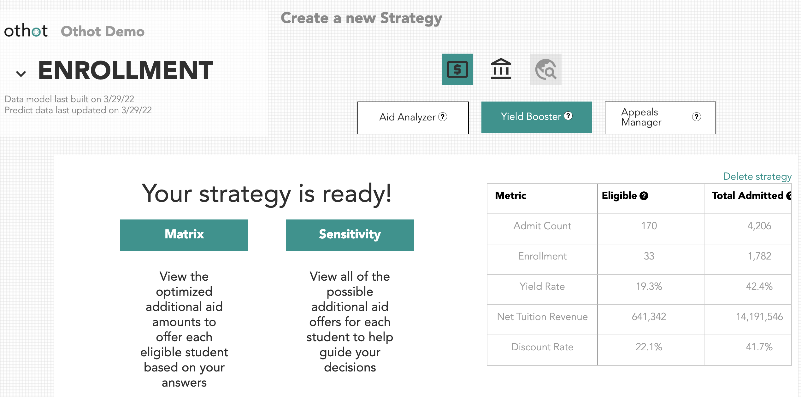
Othot Roadmap
More Strategies
UX Revamp

Slide 21
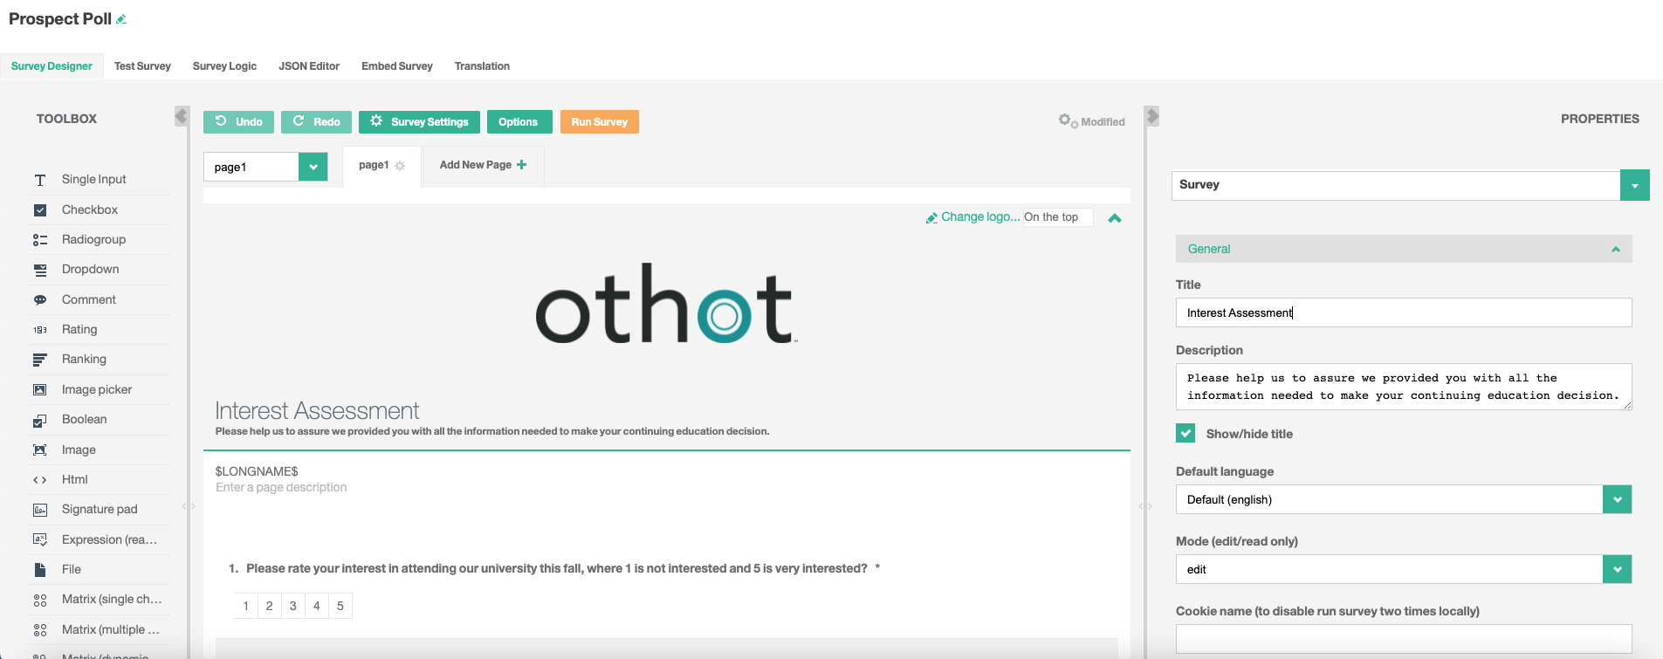
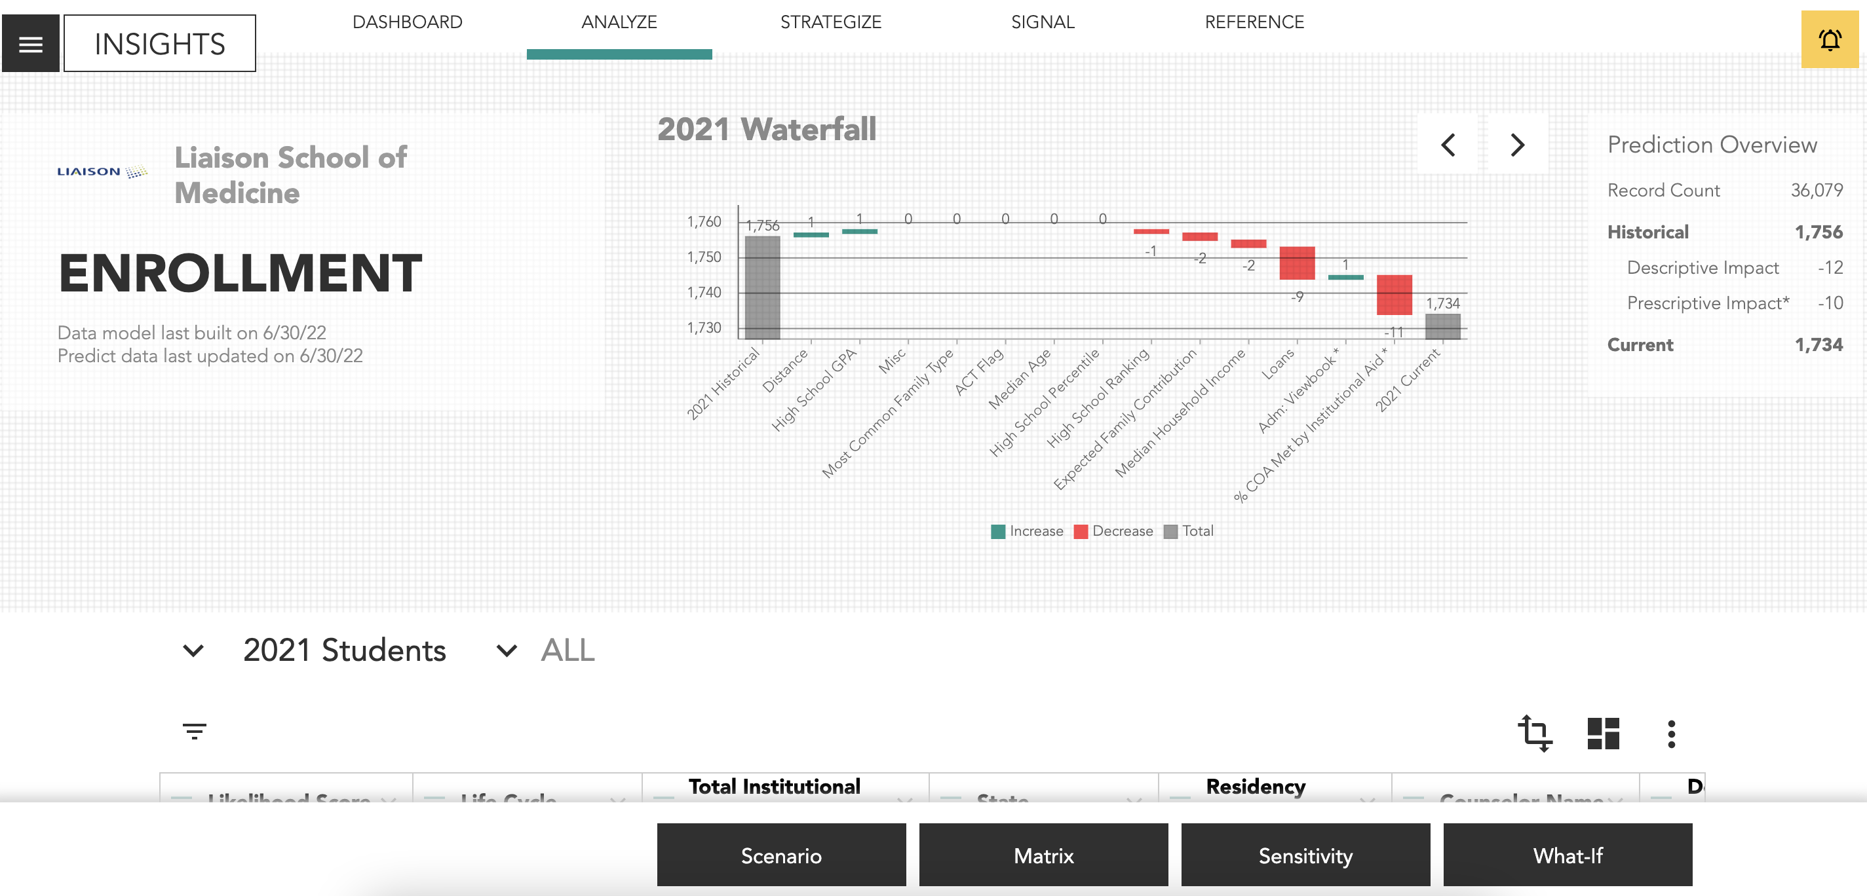
Othot Roadmap
Survey
Grad Admissions

Slide 22
Generalized Framework For Understanding
DIKW(D) Framework
E.M Awad and H.M. Ghaziri. Knowledge Management

Slide 23
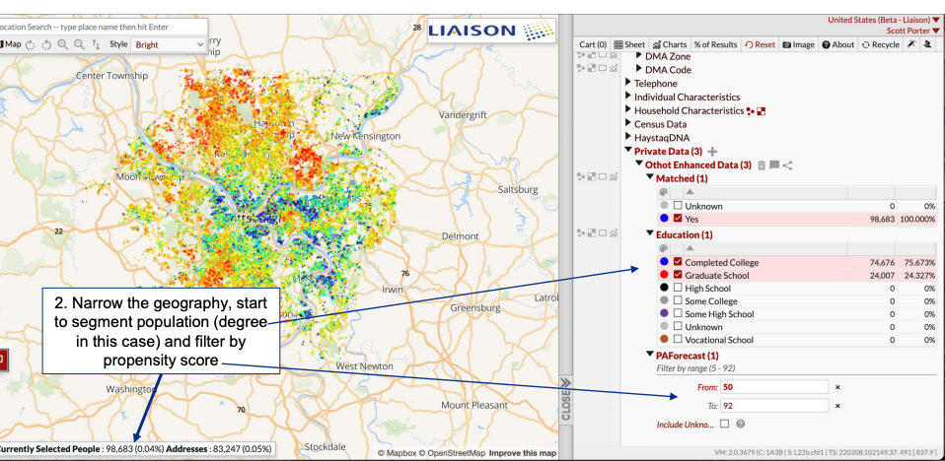
What is Intelligent Names?
What is Intelligent Names?
A new data science powered source of leads for graduate, community college, online, and continuing ed. programs
Why use Intelligent Names?
To get access to a new set of adults that have a high propensity for seeking education
To have a deeper understanding of who each lead is before a school even engages with them

Slide 24
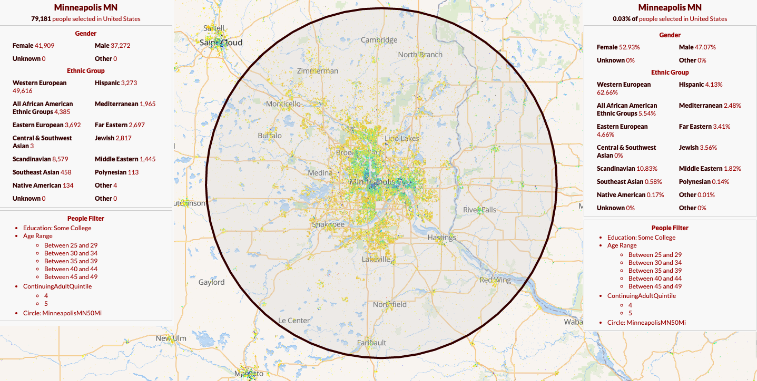
Who’s in the neighborhood?

Slide 25
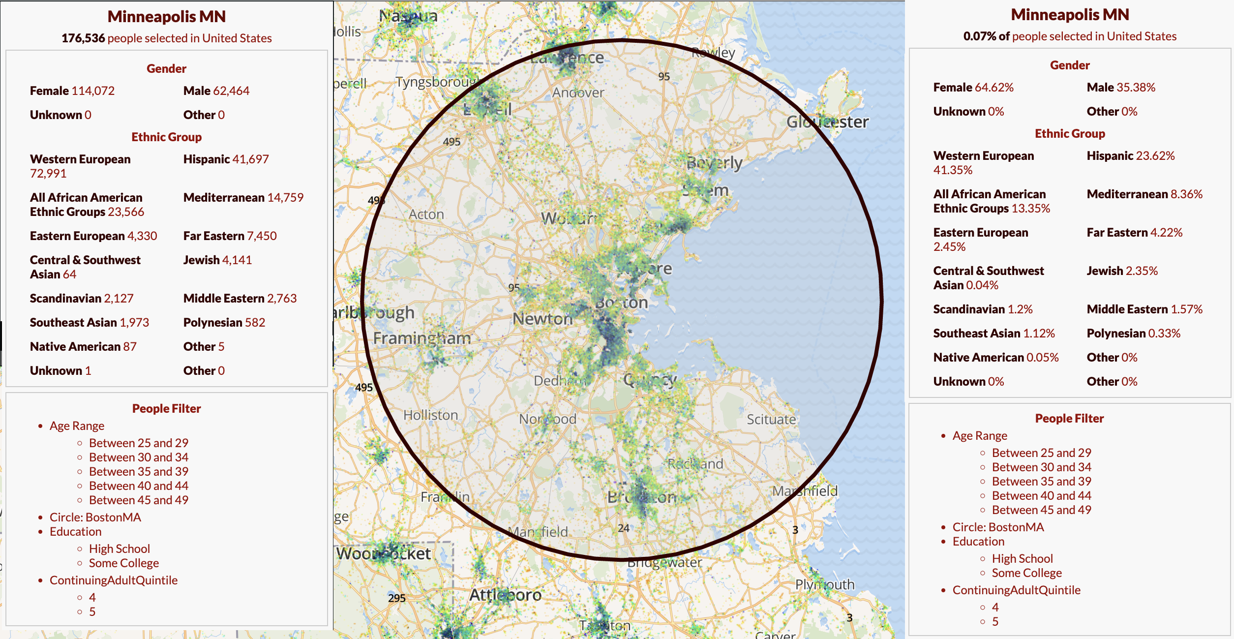
Who’s in the neighborhood?

Slide 26
Intelligent Names Roadmap
Graduate
Intelligent Names
Intelligent Append
Undergraduate
Intelligent Names (Adult Learners)
Intelligent Append
Intelligent Parent Names
Intelligent Stop out/Dropouts
Community College
Intelligent Names
Intelligent Append
Intelligent Parent Names
Continuing Ed
Intelligent Names
Intelligent Append

Slide 27
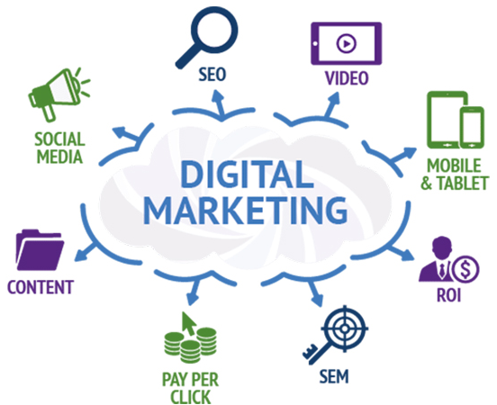
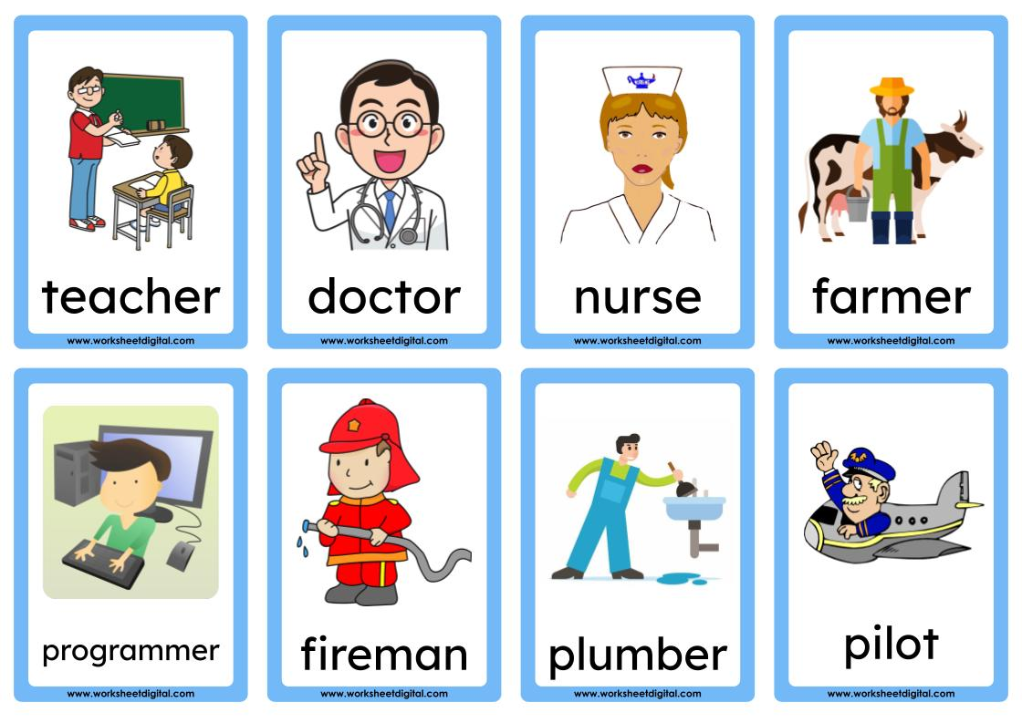
And More!
Education and Occupation History

Slide 28
Generalized Framework For Understanding
DIKW(D) Framework
Intelligent Names
E.M Awad and H.M. Ghaziri. Knowledge Management

Slide 29
Give You Analytics Superpowers
Pa
You
Liaison
Liaison Client

Slide 30
Our Data and Analytics Product Lines
To monitor how admissions is performing
To meet your enrollment, revenue, and equity goals
Intelligent Names
To find and engage with prospects in a more effective way
To show you the story of what is happening with your admissions (and soon retention)

Slide 31
Q & A

Slide 32
Thank You
Robert DiMaggio
Liaison International
rdimaggio@liaisonedu.com

