Slide 2
EMP Rewind 2022
Shane Mallen 7/28/2022

Slide 3
Agenda
Legalities & Security
Engaging Communications
Exports and Integrations

Slide 4
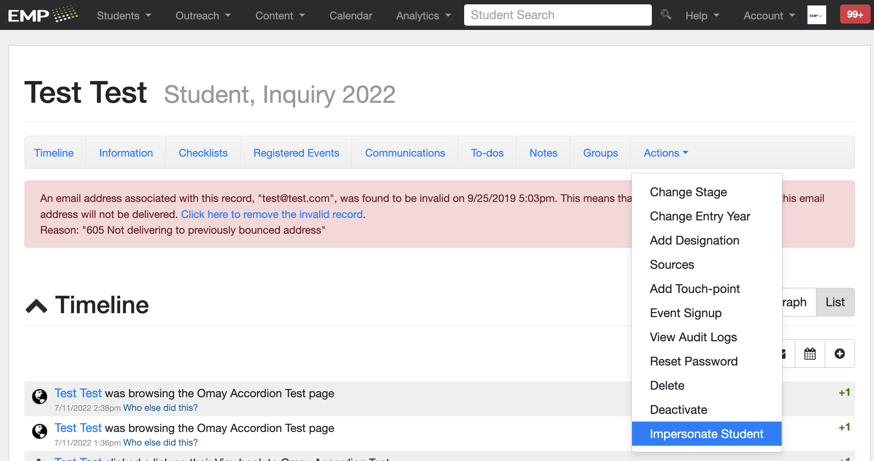
Legalities & Security
Student Impersonation
Users (internal and external) can preview existing test records’ PURLs without having to remember a number of passwords.
Users can assist their student in any action within their PURL.
Track PURL Logins in Groups
Notes:
Also made updates to ADA compliance and security features

Slide 5
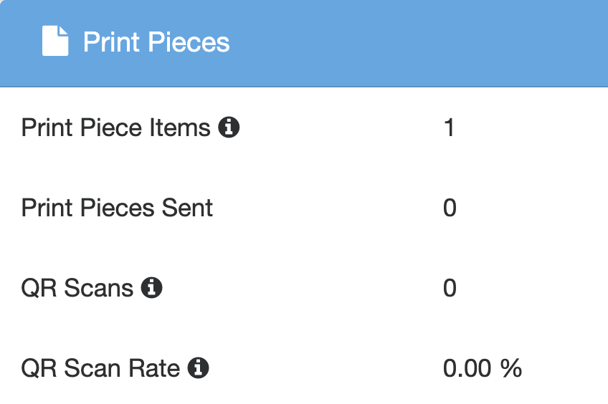
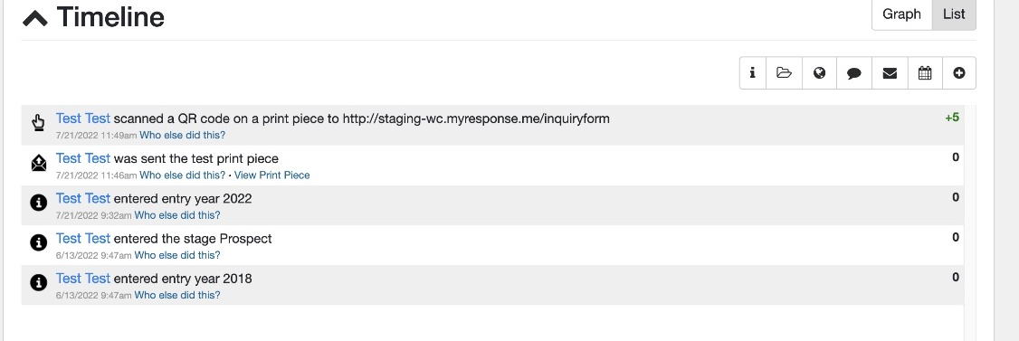
Engaging Communications
Intelligent Print
Dynamic trackable QR codes
Drive and track mobile device engagement and conversions from any personalized mail.
Personalized PDFs for International Students
Send International students Viewbooks through e-mail
On-demand Print Blast

Slide 6
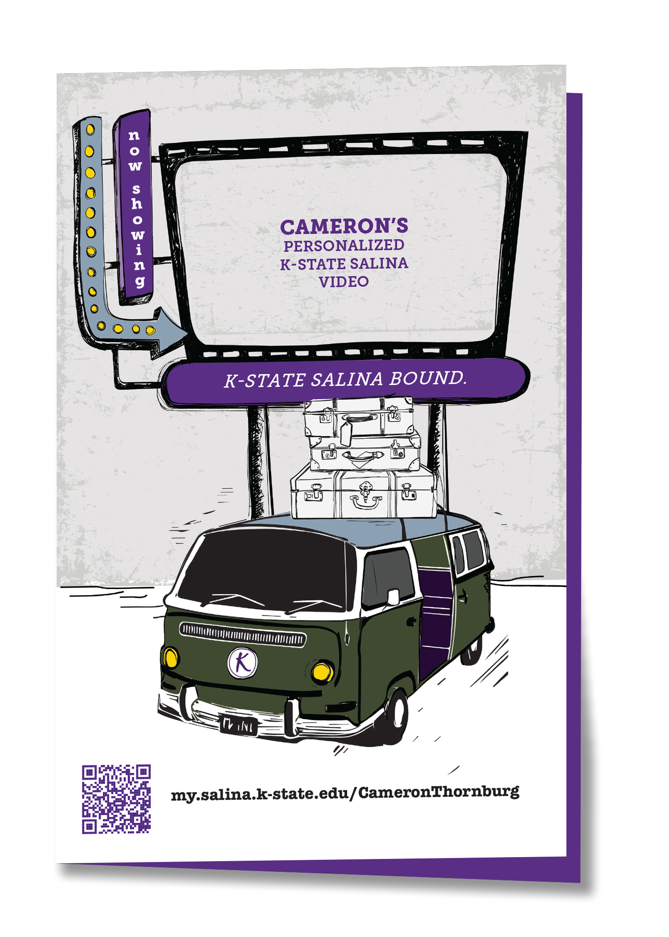
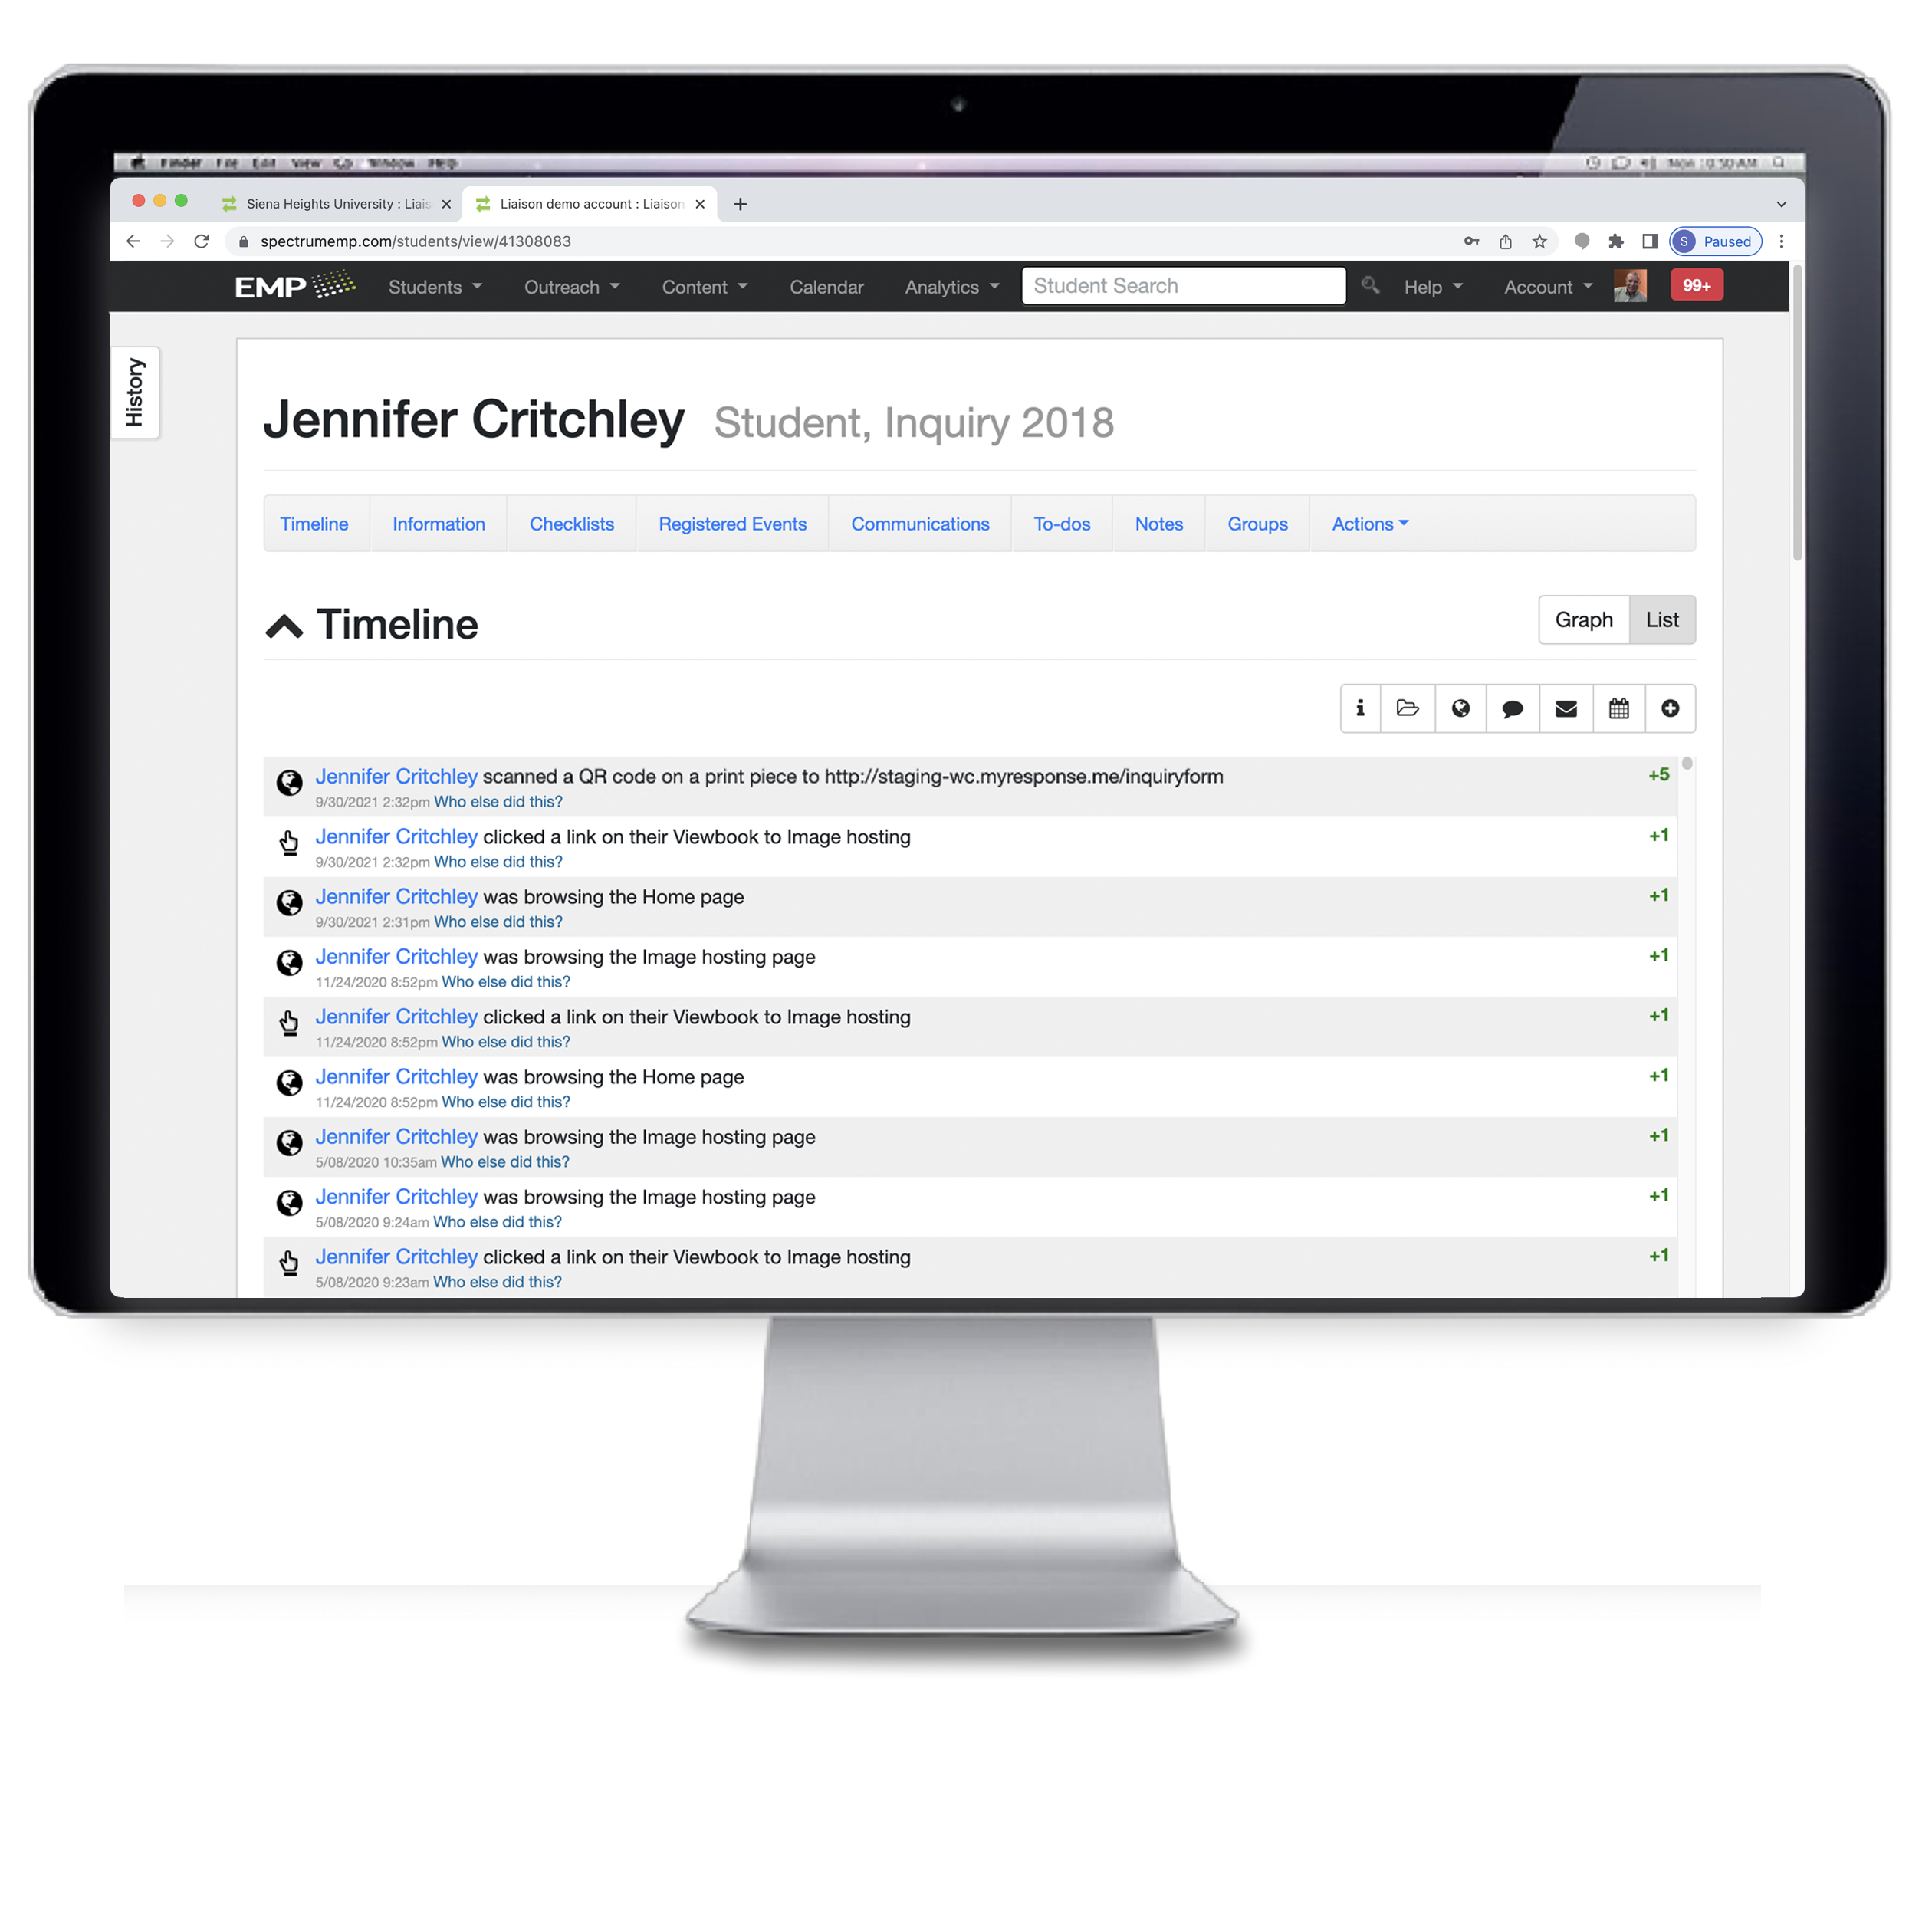
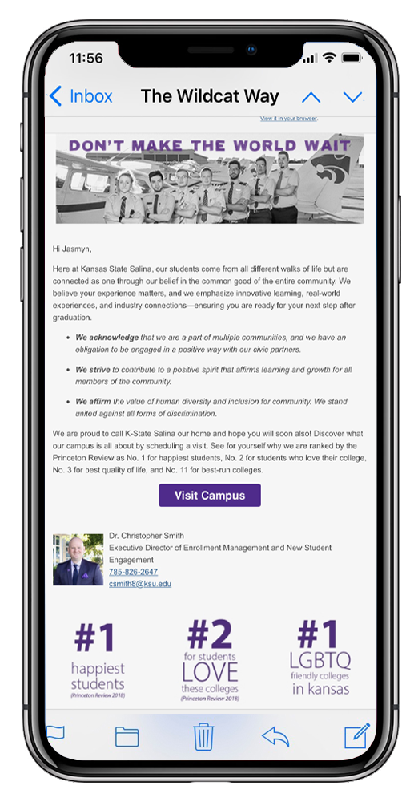
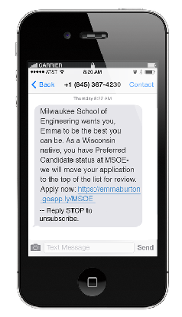
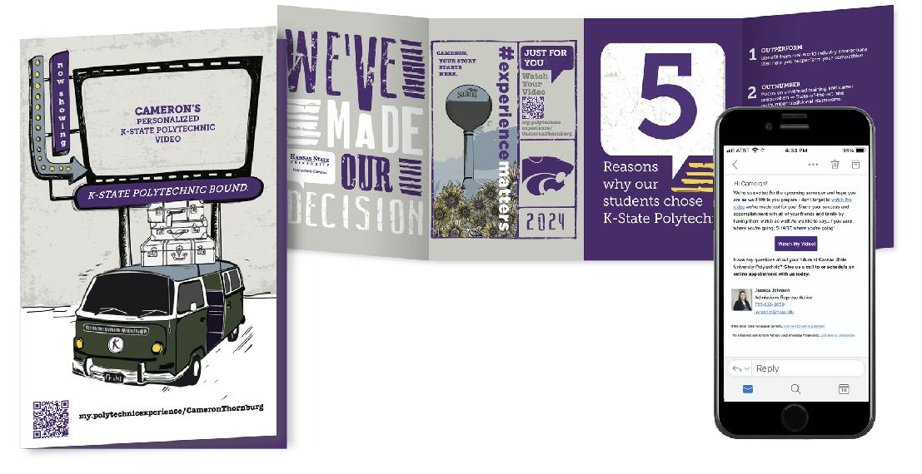
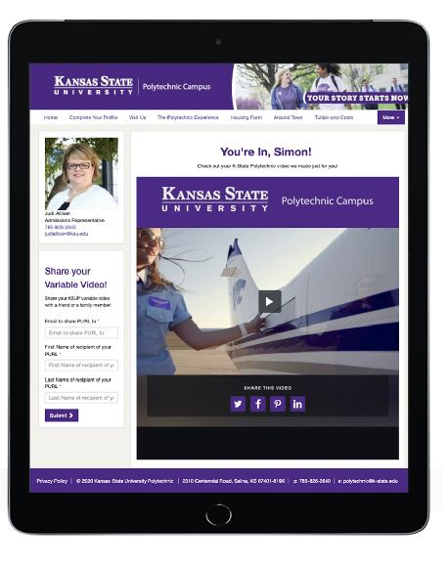
Engaging Communications
intelligent QR codes
Connect var print to digital
Hyper-personalized
Tracked Interactions
Interaction can trigger other campaigns
Validates print

Slide 7
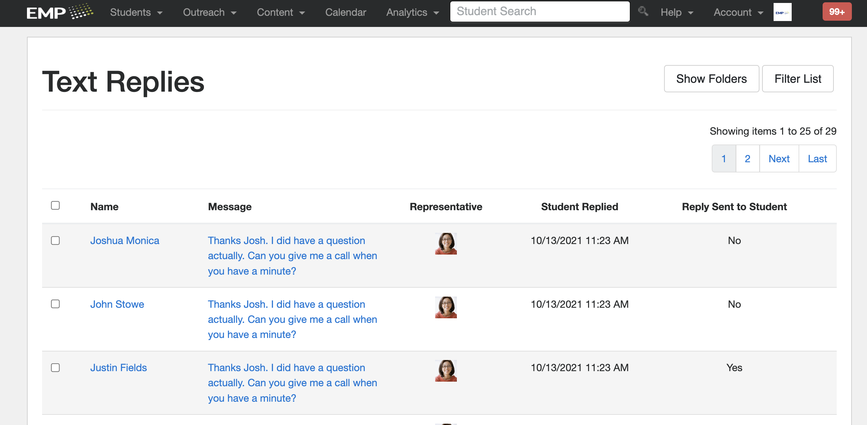
Engaging Communications
“Spam Trap” Monitoring
Search lists are automatically monitored for known “spam traps” or dormant emails,
SMS Conversations
Using a centralized inbox in their EMP account, clients can read and reply to all SMS messages with their students inside EMP.
Notes:
Spam Trap- Increasing inbox placement, engagement, and reputation.
On demand print blast- Previously, this process would take 24+ hours to get print pieces out the door.

Slide 8
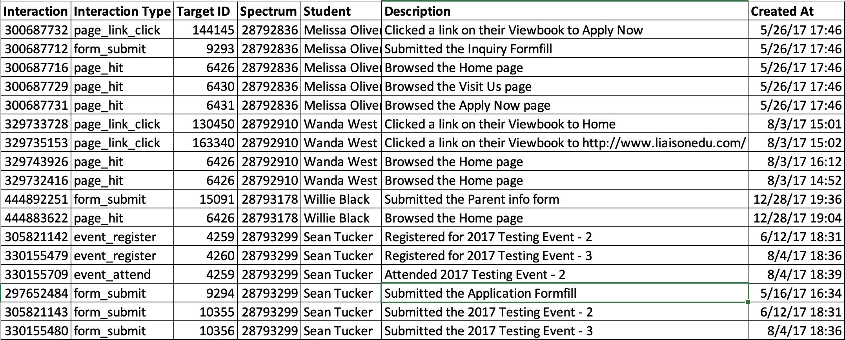
Exports and Integrations
Auto-export every campaign interaction
This feature exports selected students’ interaction history with the system.
Auto-populate field options in Imports
EMP can now auto-populates options for fields when importing files
Notes:
Students interact with our system in many ways: email opens, email link clicks, PURL page visits, QR code scans, etc.

Slide 9
Exports and Integrations
TargetX Recruit
TargetX Insights
Othot
Insights

Slide 10
Q & A

Slide 11
Thank You
Shane Mallen
Liaison
shane.Mallen@liaisonedu.com

