Slide 1


Slide 2
Casting a Wider Net:
Reeling in the Right Solutions to Expand Your Applicant Pool
David Cotter & Kristin McAuliffe
Boston University

Slide 3


Agenda
Boston University and Liaison
Graduate enrollment challenges
Four common objectives and the tools we use to get there
Discussion

Slide 4

Private research institution in Boston, MA
36,104 total undergraduate and graduate enrollment
10,646 international students
17,875 graduate and professional students
400+ graduate and professional programs
4
©2020 Proprietary and Confidential

Slide 5
Boston University and Liaison
Long standing relationship
Collaborative spirit
Multiple tools
  Various National CAS
  UniCAS
  Enrollment Marketing Platform (EMP)
  Slideroom

Slide 6




Graduate Enrollment Challenges
Crowded
Expensive
Political
Exhausting
How do we keep up with the competition? Where are the students? How do we differentiate? Should we go online? Ugh, they have a program now, too?
How much can our students borrow? Is it worth all this money? You have a full scholarship somewhere else? What's the interest rate on Grad PLUS now?
What policies are impacting our students? Can international students get here? Do you have your COVID vaccine? Where can I find all this information?
Do we have additional mental health resources for our students? Can we get a day off? Can we go off video? How do we support our students better?

Slide 7
Four Common Enrollment Objectives
Increasing the number of qualified applicants
Managing communication
Improving the application review process
Increasing yield and preventing melt

Slide 8
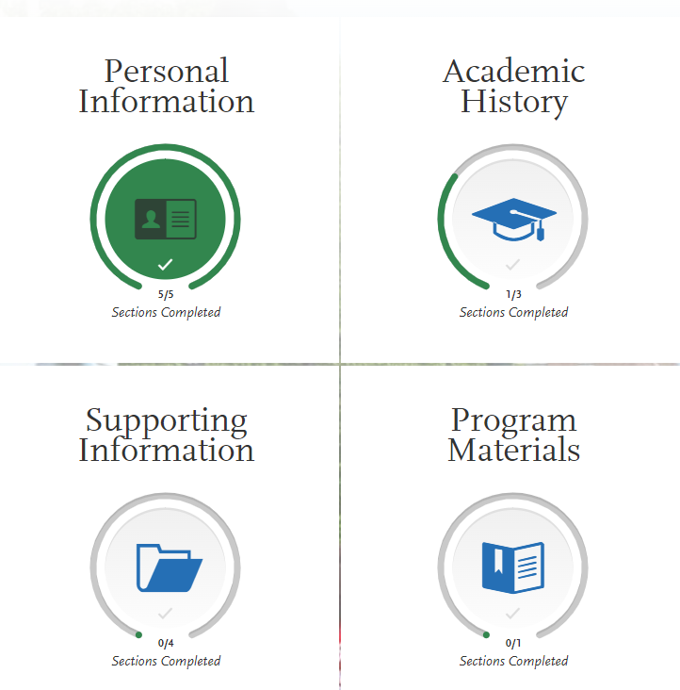
Increasing the Number of Qualified Applicants
Simplify the Application
What requirements do you REALLY need?
Reduce duplicate questions and documents
Ensure program names are clear and easy to understand
Utilize application fee waivers

Slide 9
Prospect / Lead
Tool: EMP
Inquiry
Tool: EMP
Program-specific
Calls-to-action
Drive-to-apply
Brand awareness
Themes
Themes
Submitted Application
Tool: WebAdMIT
Themes
Operational
Process-driven
Set expectations
Accept
Tool: EMP
Themes
Yield
Financial aid
Drive-to-deposit
Accepted Offer
Tool: EMP
Themes
Preparing for grad school
Relocation tips
Registration
Maintain their interest
Introduction to graduate study
General advice
Managing Communication
Events
Started Application
Tool: EMP
Themes
Submit your application
Deadline reminders
Program-specific
Waitlist
Tool: EMP
Themes
Maintain interest without too much excitement

Slide 10
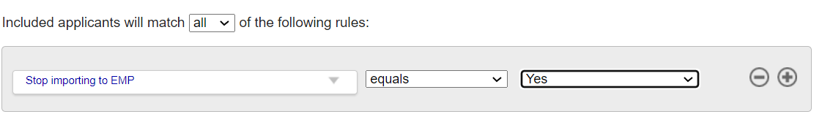
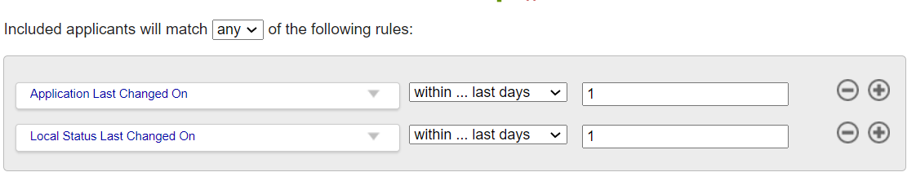
Managing Communication
Which tool is right when?
EMP: recruitment communication, general announcements, deadline blasts, event invites, yield, melt
WebAdMIT: application specifics and operations (missing materials, process notifications)
How do EMP & WebAdMIT work together?
Create EMP stages to match your WebAdMIT coding and local statuses
Use custom fields and recently updated identifiers to filter your export out of WebAdMIT

Slide 11


Managing Communication
Identifying Application Updates and Changes
Use lists to find recent updates (daily + weekends)
Use requirements as a checklist
Follow up as each item is received
Before Submission
From Submission to Decision
Post-Acceptance

Slide 12
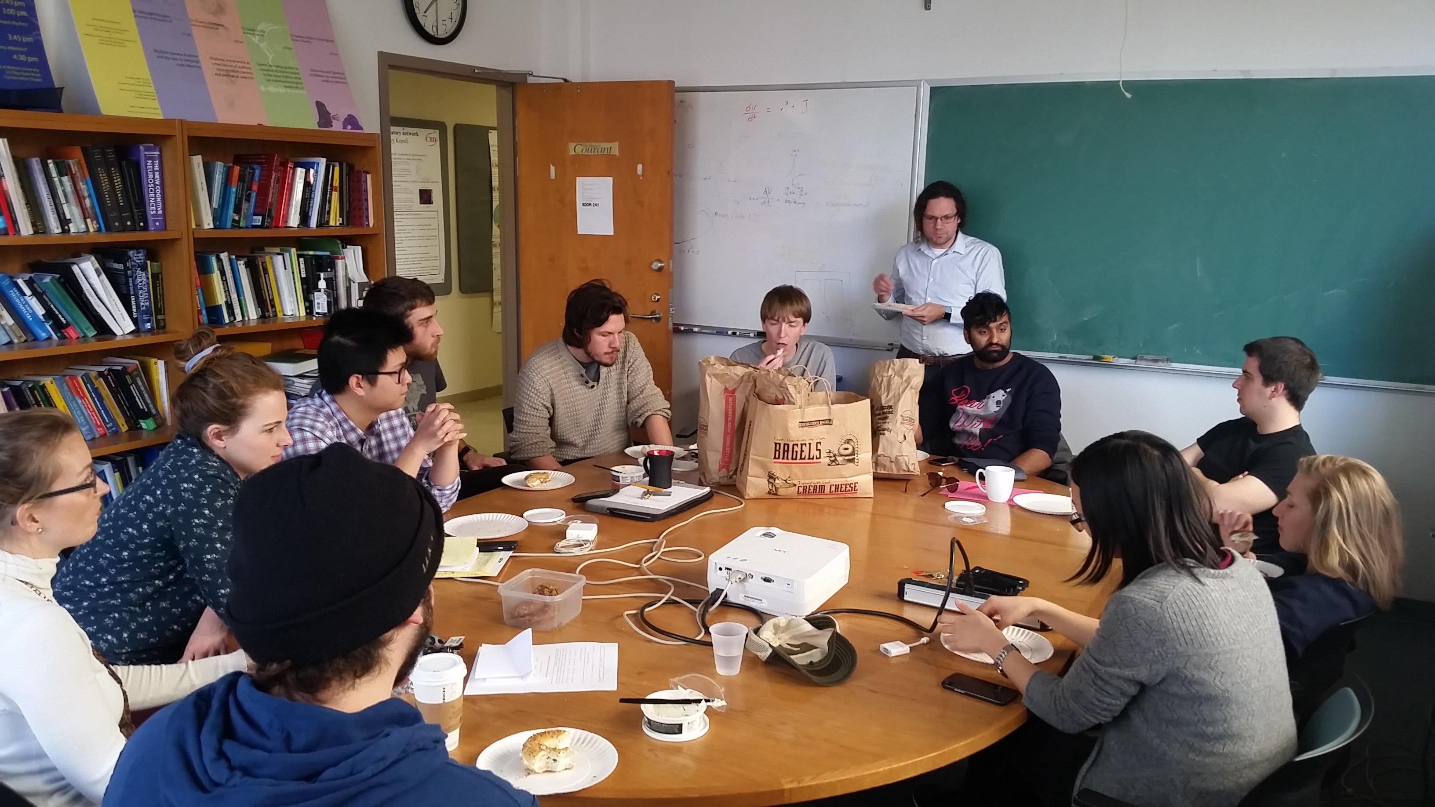
Improving the Application Review Process
Faculty Training (WebAdMIT)
  Create a fake application
Utilize the deadline dates for tracking in the Assignments tool
Create lists to determine when review is complete
Establish a standard rubric
  The smaller the range, the less room for bias

Slide 13
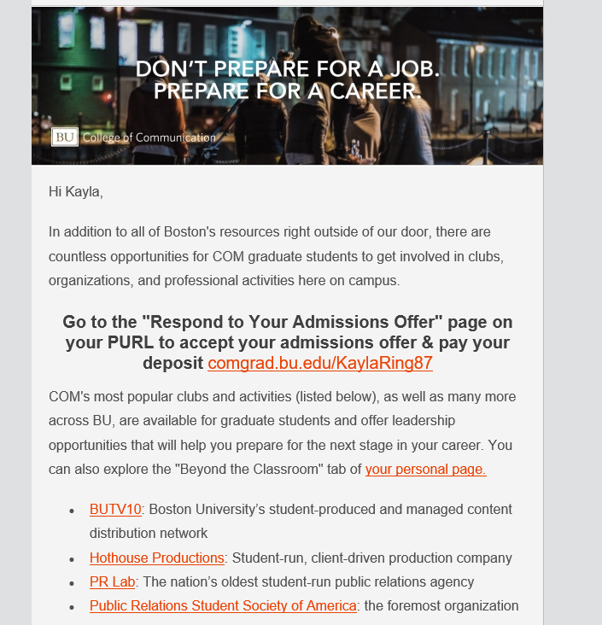

Increasing Yield & Preventing Melt
EMP Nurture Campaigns
Print Pieces
Stay in touch with your accepted students.
Combine reminders with content to build excitement.
Utilize accepted student packets, SWAG, and other print components. Involve students, faculty, and alumni.

Slide 14
Q & A

Slide 15
Thank You
David Cotter
Boston University
dfcotter@bu.edu
Kristin McAuliffe
Boston University
kchebra@bu.edu

