Slide 1


Slide 2
CAS and Letters by Liaison Rewind
Katie Wedgewood / July 28, 2022 / 1:45 p.m.

Slide 3


Agenda
Release Notes process
Review updates to the CAS applications (June 2021 to now)
Review updates to Letters by Liaison (June 2021 to now)

Slide 4


Speaker
Katie Wedgewood
Knowledge Strategist

Slide 5
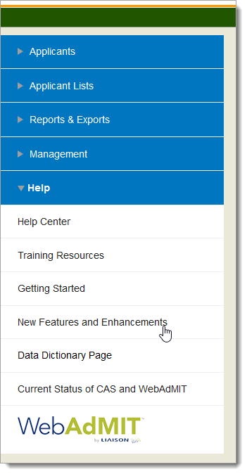
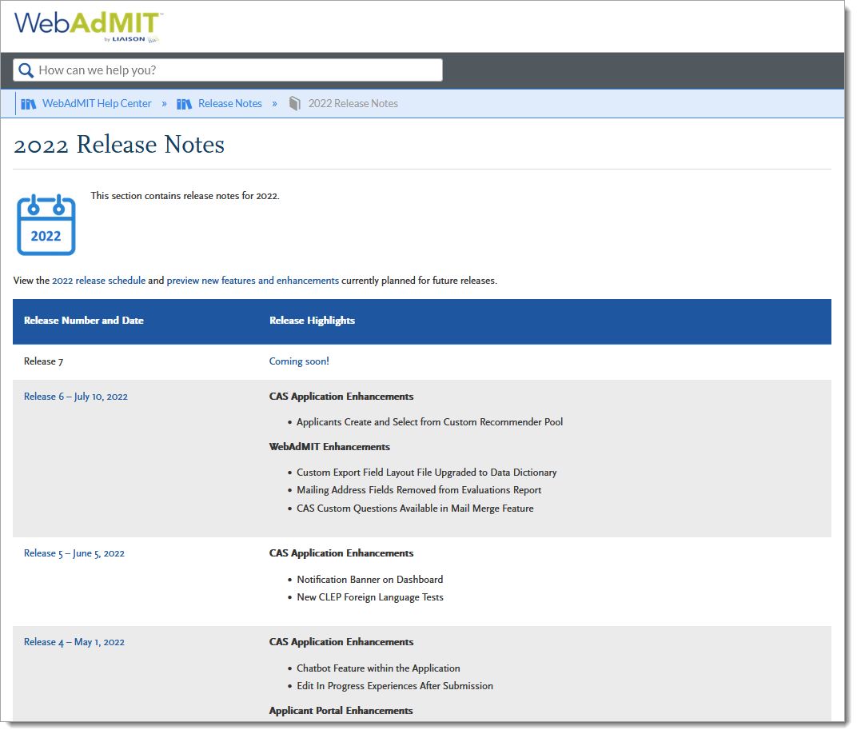
Release Notes Process
Notes:
https://help.liaisonedu.com/WebAdMIT_Help_Center/Release_Notes
Screenshot of Release Notes link in WA help center?
Shout out to Product

Slide 6
CAS Enhancements for Everyone

Slide 7
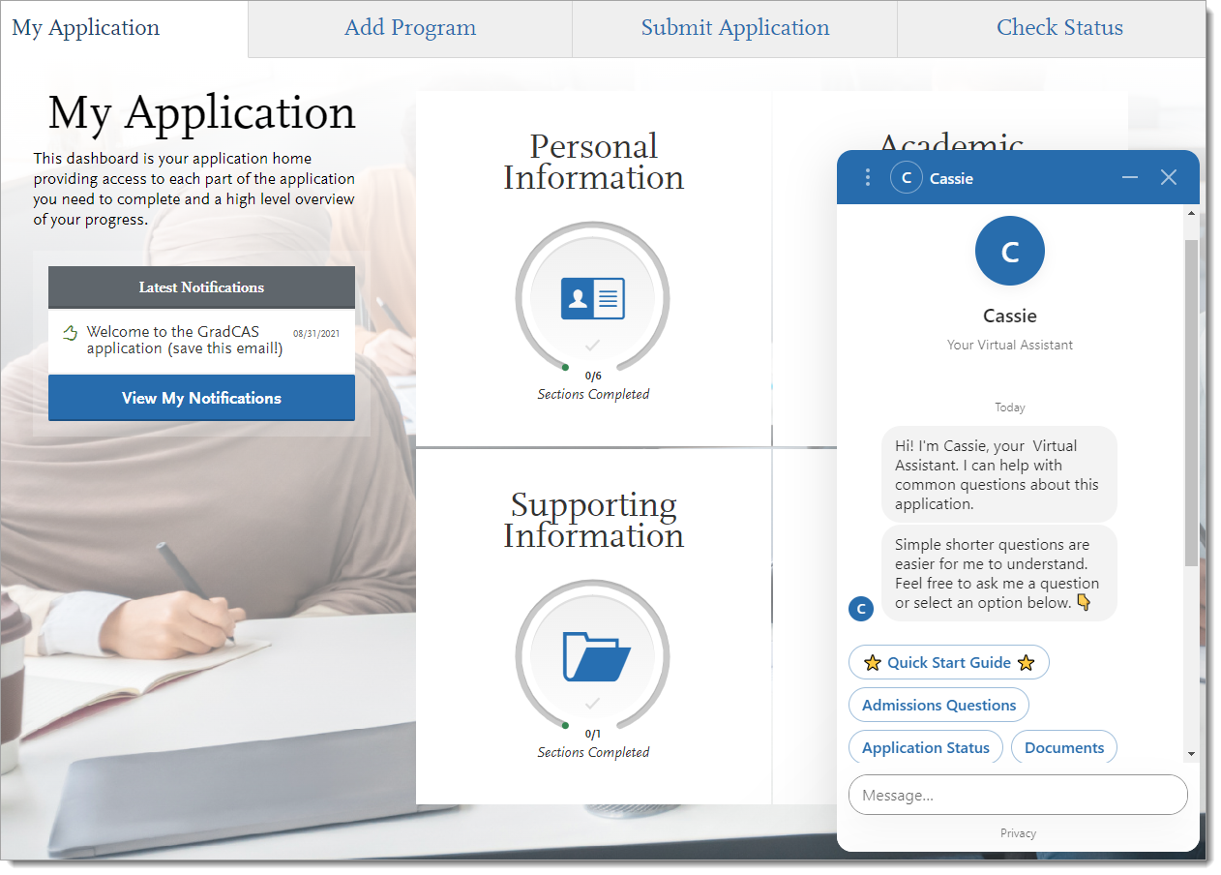
Chatbot Feature within the Application
Notes:
https://help.liaisonedu.com/Release_Notes/2022_Release_Notes/Release_04

Slide 8
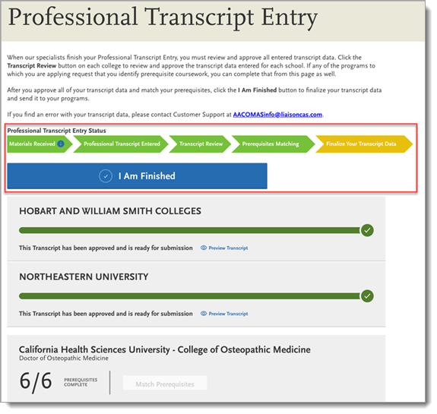
Professional Transcript Entry (PTE) Updates
Notes:
https://help.liaisonedu.com/Release_Notes/2021_Release_Notes/Release_07
https://help.liaisonedu.com/Release_Notes/2022_Release_Notes/Release_04
New Professional Transcript Entry (PTE) Status: Applicants occasionally forget to approve their Professional Transcript Entry (PTE). This enhancement adds a new final status, Finalize Your Transcript Data, to the PTE workflow in the application and enlarges the size of the I Am Finished button. These changes increase the call-to-action to the applicant to review and finalize their PTE.
Professional Transcript Entry (PTE) Reminder Email

Slide 9
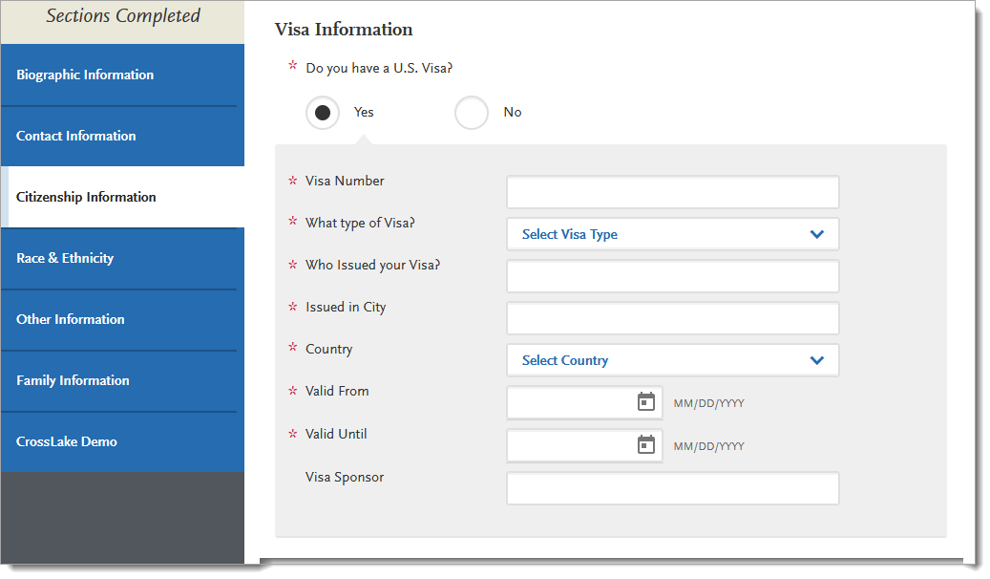
Citizenship and Residency Information Editable After Submission
Notes:
https://help.liaisonedu.com/Release_Notes/2021_Release_Notes/Release_11
Under the Citizenship Information section, applicants who do not list themselves as a US citizen can now update their citizenship and residency statuses after submitting their application. Non-US citizens have been able to edit their visa information since 2018's Releases 25 & 26.

Slide 10
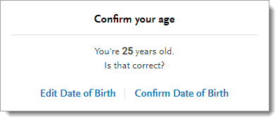
Validate Date of Birth with Age
Notes:
https://help.liaisonedu.com/Release_Notes/2022_Release_Notes/Release_01
A new confirmation window that automatically calculates an applicant’s age appears once an applicant enters their date of birth. This enhancement provides an additional point of review for applicants to confirm that their entered age is correct.

Slide 11
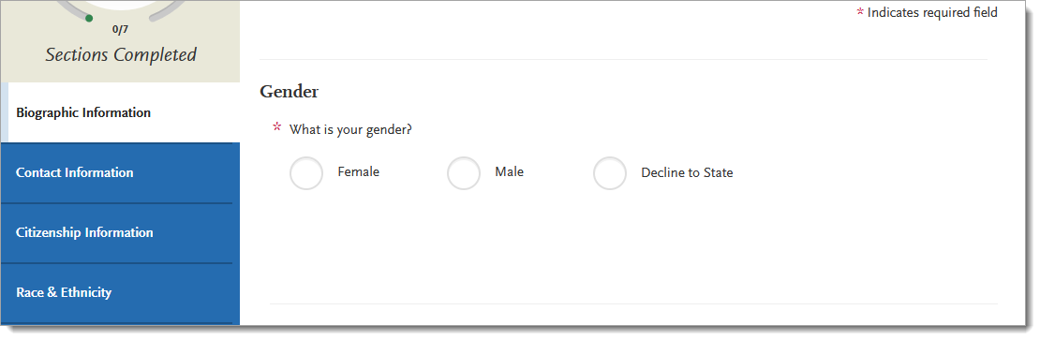
Gender/Sex Question Updates
Notes:
https://help.liaisonedu.com/Release_Notes/2021_Release_Notes/Release_05 Full Application PDF Lists CAS-specific Gender/Sex Question Label
Each CAS has a unique label for the Gender/Sex question block. Previously, the full application PDF used the default Sex or Gender label. This enhancement updates the full application PDF in both the Applicant Portal and WebAdMIT so that the correct CAS label is listed
https://help.liaisonedu.com/Release_Notes/2022_Release_Notes/Release_02 Gender/Sex Answer Values Reordered
The Gender/Sex answer values are now alphabetized:
Female
Male
Decline to State (if available in the CAS)

Slide 12
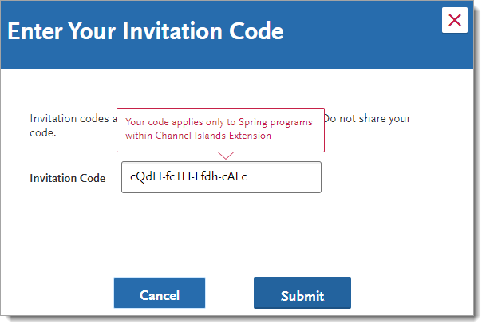
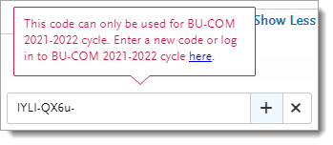
Invitation Codes and Coupon Code Updates
Notes:
https://help.liaisonedu.com/Release_Notes/2021_Release_Notes/Release_05 Term-specific Invitation Codes
Invitation codes are individual deadline extensions that programs offer directly to applicants. Invitation codes can be used for any program within an organization. This enhancement restricts invitation codes to specific terms for a program with an organization. For example, if the invitation code is limited to Fall programs, then an applicant cannot use the invitation code to apply to a Winter or Spring program at that institution. This allows you to better manage which programs an applicant can use invitation codes for.
https://help.liaisonedu.com/Release_Notes/2021_Release_Notes/Release_11 Improved Error Message for Coupon and Invitation Codes
Some CASs offer coupon codes, which offset the application fee, and invitation codes, which are individual program deadline extensions. Both codes are unique to a CAS and cycle. If an applicant tries to apply a coupon or invitation code to the incorrect CAS and/or cycle, they receive an error message. With this enhancement, the error message now clarifies that the applicant must use the code in the correct CAS and cycle.

Slide 13
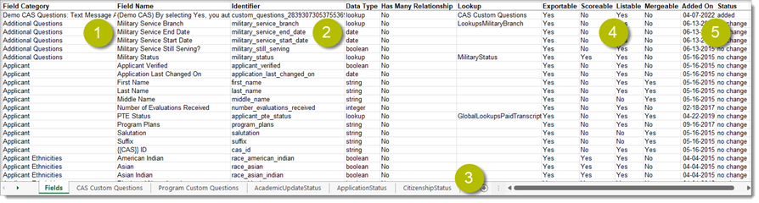
Lookup Table Updates
Notes:
https://help.liaisonedu.com/Release_Notes/2021_Release_Notes/Release_08
https://help.liaisonedu.com/Release_Notes/2022_Release_Notes/Release_02
Might be able to combine this with the Release Notes Process slide?
Annual Fall Lookup Updates (2021)
Annual Spring 2022 Lookup Updates
Many fields in the Applicant Portal contain predefined answer values that applicants can select. For example, the Country and County fields both have predefined answer values. These values are contained in shared “lookup tables.” With this release, the second of two semi-annual updates to these lookup tables has been implemented. Review the Shared Lookup Table Updates for Fall 2021 to learn what changes are new in the Applicant Portal and WebAdMIT. Note that the changes in WebAdMIT are scheduled to be released later this week; review the Timeline for more information.

Slide 14
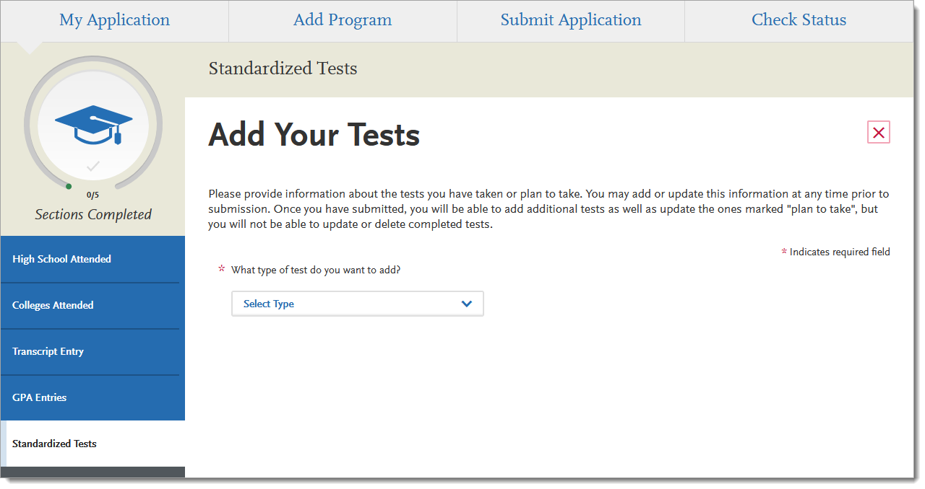
IB and CLEP Test Updates
Notes:
https://help.liaisonedu.com/Release_Notes/2021_Release_Notes/Release_11 New International Baccalaureate (IB) Mathematics Tests
Four math tests are now available in the International Baccalaureate (IB):
Mathematics: analysis and approaches SL
Mathematics: analysis and approaches HL
Mathematics: applications and interpretation SL
Mathematics: applications and interpretation HL
https://help.liaisonedu.com/Release_Notes/2022_Release_Notes/Release_05 New CLEP Foreign Language Tests
Five foreign language tests are now available in CLEP:
French Level II
German Level II
Spanish Level II
Spanish with Writing I
Spanish with Writing II
Additionally, the following tests are renamed:
French Language renamed to French Level I
German Language renamed to German Level I
Spanish Language renamed to Spanish Level I

Slide 15
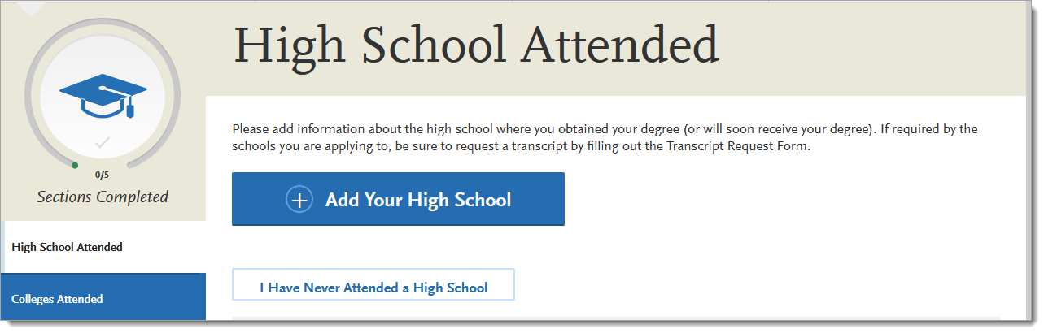
Separate Graduation Status Question Block from High School Attended Tile
Notes:
https://help.liaisonedu.com/Release_Notes/2022_Release_Notes/Release_01
CASs that ask for detailed information in the High School Attended section are no longer required to include the Graduate Status question. This enhancement allows CASs to separate High School Attended data from Graduation Status data.

Slide 16
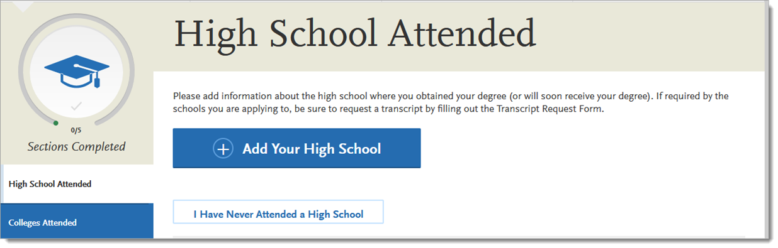
Exclude High School Attended and Other Sections from Reapplication Process
Notes:
https://help.liaisonedu.com/Release_Notes/2021_Release_Notes/Release_05
When CASs use the reapplication process, certain sections of the application can be carried forward into the new cycle. However, as not all data can be carried forward, this enhancement excludes the following sections from the reapplication process:
A-G Matching
Fall Redirection
General Education
High School Attended
High School Coursework
Spring/Winter Redirection

Slide 17
CAS Enhancements for Select CASs

Slide 18
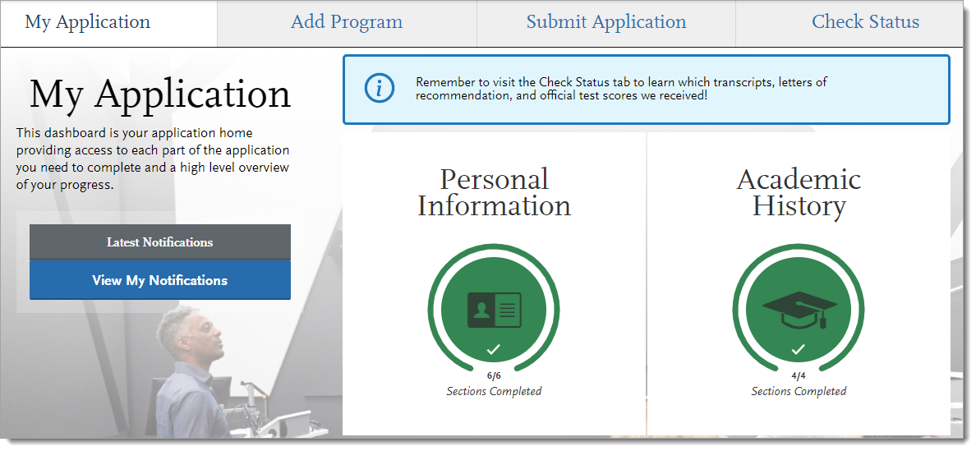
Notification Banner on Dashboard
Notes:
https://help.liaisonedu.com/Release_Notes/2022_Release_Notes/Release_05
A new notification banner is available for the application dashboard. CASs can choose to include up to three messages, including links, to rotate in the banner. Each time an applicant visits or refreshes the dashboard page, the banner progresses to the next message in its rotation. This enhancement allows CASs to share best tips and tricks with applicants as they complete their applications.
Applicant Portal
The notification banner appears in blue above the application quadrants (i.e., sections).

Slide 19
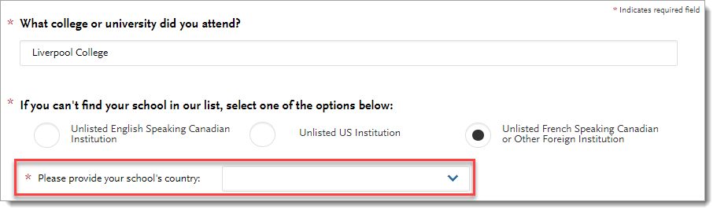
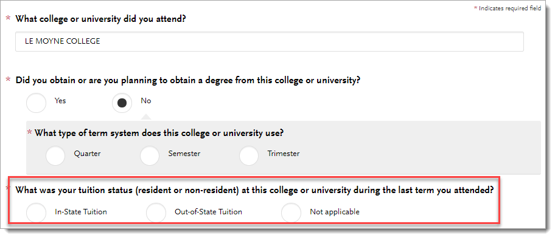
Colleges Attended Updates
Notes:
https://help.liaisonedu.com/Release_Notes/2021_Release_Notes/Release_05
Country Field for Manually Entered Foreign Institutions
College In-State or Out-of-State Tuition Status
When applicants report their colleges attended and select from the standard college code list, additional data about the college is also recorded, including the college state and country. However, when an applicant manually enters a college that is not included in the standard college code list, they cannot provide additional college data. By default, when an applicant selects:
Unlisted English Speaking Canadian Institution, Canada is automatically selected as the country.
Unlisted US Institution, United States is automatically selected as the country.
Unlisted French Speaking Canadian or Other Foreign Institution, there is no default country selected.
With this enhancement, when an applicant selects Unlisted French Speaking Canadian or Other Foreign Institution, a new required field for the college’s country is listed. This allows you to collect country data more easily for manually entered colleges.
Applicant Portal
When applicants report a foreign institution, they must now select the college’s country.
When applicants enter their colleges attended, they can now identify if they paid in-state or out-of-state tuition for each college or university. This can help you understand an applicant’s residency during their academic career.
This enhancement can be used in both the new and old Colleges Attended workflow. Additionally, the question is required, including whether the applicant selects a default college or university or manually enters one.
Applicant Portal
After an applicant enters their colleges attended, they must complete the required question, What was your tuition status (resident or non-resident) at this college or university during the last term you attended?. The available answers are:
In-State Tuition
Out-of-State Tuition
Not applicable

Slide 20
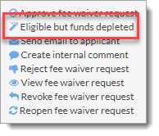
Fee Waiver Eligible Status
Notes:
https://help.liaisonedu.com/Release_Notes/2021_Release_Notes/Release_05
If an applicant is eligible for a fee waiver but the fee waiver fund is depleted, then applicants can be alerted that they qualified for the fee waiver even though they could not be awarded one. This enhancement allows you and associations to view if applicants met the CAS fee waiver requirements in case it impacts your admissions process.
Applicant Portal
If an applicant qualifies for a fee waiver, they will receive an email noting their qualification and the depleted funds. Applicants can then continue to submit and pay for their applications.

Slide 21
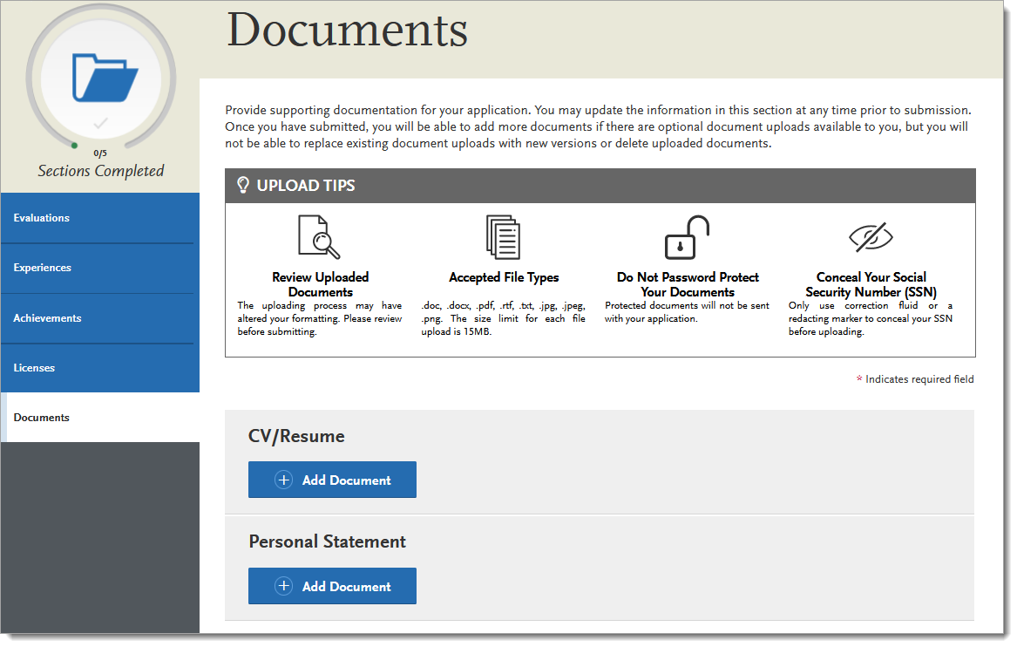
Show or Hide Required Documents in Supporting Information Section
Notes:
https://help.liaisonedu.com/Release_Notes/2021_Release_Notes/Release_06
Some CASs want to require applicants to upload certain document types depending on their answers to Extended Profile questions. For example, if an applicant earned a medical degree at a foreign institution, they must upload a copy of their foreign transcript or credential evaluation. Additionally, CASs want applicants to upload these documents in the Supporting Information section so that the documents are available to every program the applicant applies to.
The Document type visibility feature now supports showing and hiding required documents. Previously, only optional documents could be configured this way.
CASs can choose which optional and required documents will appear or be hidden in the Supporting Information section based on an applicant’s response to Extended Profile questions.

Slide 22
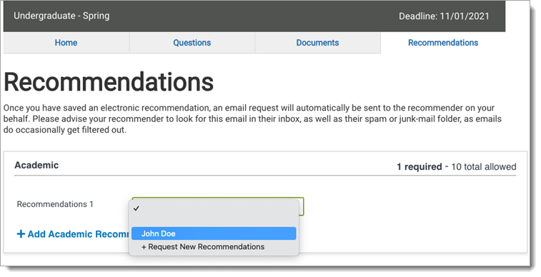
Applicants Create and Select from Custom Recommender Pool
Notes:
https://help.liaisonedu.com/Release_Notes/2022_Release_Notes/Release_06
For CASs that collect program-level recommendations (i.e., evaluations, references), applicants can now enter a recommender’s information once and then select them for any programs that they apply to. This enhancement alleviates the applicant burden of entering recommender information for every program and speeds up the application process.
CASs should also use the Reuse Evaluations feature with this enhancement to achieve maximum recommender and applicant efficiency.
Applicant Portal
When applicants navigate to the Recommendations section of the Program Materials quadrant, they can now select a recommender from the drop-down or add a new recommender to their pool.

Slide 23
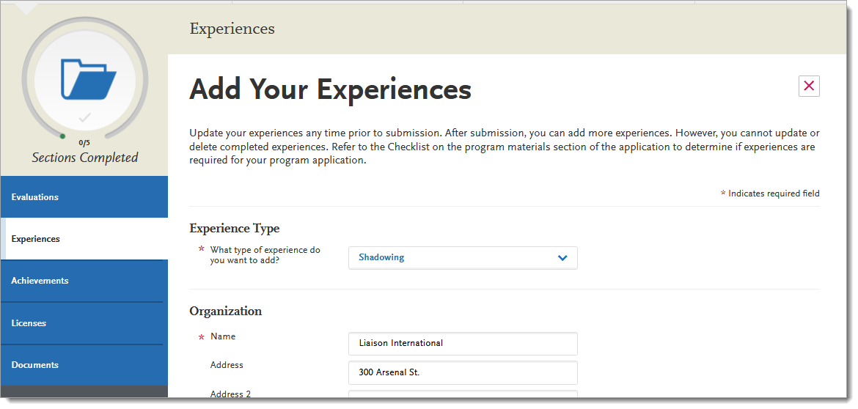
Edit In Progress Experiences After Submission
Notes:
https://help.liaisonedu.com/Release_Notes/2022_Release_Notes/Release_04
When applicants enter details of experiences, such as shadowing hours, volunteer work, or health care experience, and submit their application to a program, they cannot edit previously entered experiences. With this enhancement, applicants can edit in progress experiences (i.e., experiences that do not have an end date). This allows applicants to update experiences throughout a cycle and provide those details to their programs.
Applicant Portal
Applicants can edit in progress experiences after they submit their application. Once they save their changes, their information is automatically sent to programs.
If they edit an in progress experience, add an end date, and save their changes, they will not be able to edit the experience moving forward, as it no longer qualifies as an in progress experience.

Slide 24
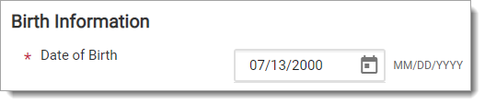
Date of Birth Only Listed in Birth Information
Notes:
https://help.liaisonedu.com/Release_Notes/2021_Release_Notes/Release_05
The standard Birth Information question block requires applicants to enter their date of birth, country, city, state/province, and county of birth. With this enhancement, a new standard Birth Information question block is available and only requires applicants to report their date of birth. This reduces barriers for applicants who wish to apply, as they may be unwilling or unable to supply birth information.
Applicant Portal
Applicants are only required to report their date of birth. The date of birth validation still exists, which warns applicants if they identify that they are younger than 13 or older than 70 years old.

Slide 25
CAS Application
Reference Guides

Slide 26
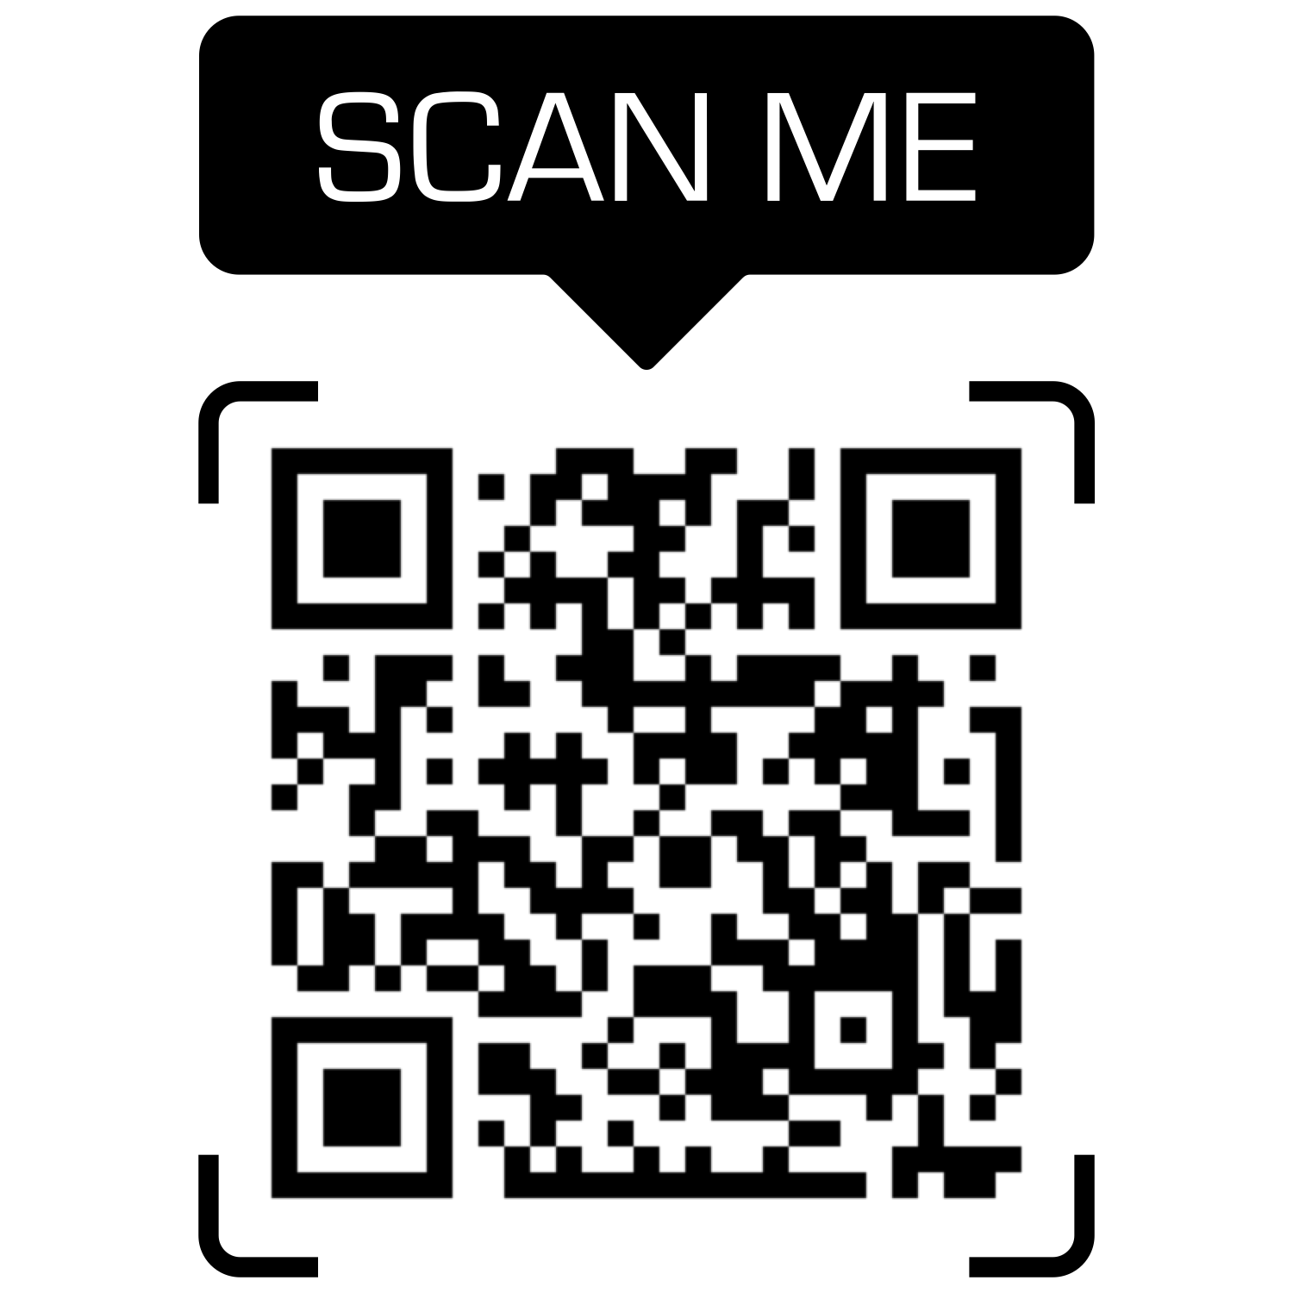
Reference Guides
Notes:
https://help.liaisonedu.com/Release_Notes/2021_Release_Notes/Release_06

Slide 27
Letters by Liaison Enhancements

Slide 28
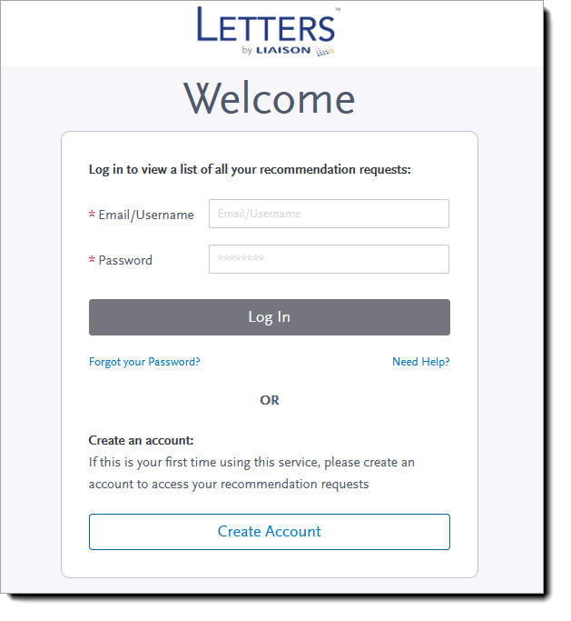
Enhancements to Likert Skale, Browser Support, and Login Page
Notes:
https://help.liaisonedu.com/Release_Notes/2021_Release_Notes/Release_08
https://help.liaisonedu.com/Release_Notes/2021_Release_Notes/Release_06
Enhancements Made to Likert Scale and Browser Support
Footer Added to Login Page
Letters by Liaison Quick Start Guide and FAQs

Slide 29
Q & A

Slide 30
Thank You
Katie Wedgewood
Liaison
training@liaisonedu.com

