Slide 1

Notes:
Alexis Start

Slide 2
Be Honest:
Why Do You Care About Data?
Alexis Tshudy & Jeff Morgan
Notes:
Alexis
Welcome & thanks for choosing our session

Slide 3


Why do you care who we are?
Alexis Tshudy
Jeff Morgan
Data Curator
8+ years @ Othot
Product Manager
4+ years @ Othot
Notes:
Alexis
First of all – both Jeff and I are part of the Othot team here at Liaison.
Quick intro to Othot
Alexis Intro
Jeff Intro

Slide 4
How is this presentation going to help you?
Reframe what it means to use data to make decisions as real people,
not computers
Increase your confidence in proposing creative new ideas to leadership
Gain some immediately useful (and honest) ways to use data to propel your career in Strategic Enrollment Management
Notes:
Alexis
We chose this topic because we’re well aware of the hype around using data and analytics in their many forms, like AI and Machine Learning, not only in Strategic Enrollment Management but in virtually every facet of our personal and professional lives.
And if we’re being honest with ourselves, as Othot and Liaison, we’re marketing and pushing messaging around adoption of analytical tools as much as anybody.
BUT today, we’re going to attempt to flip the narrative on this subject. Instead of talking exclusively about the promise and future of analytics in higher education, we’re going to talk about YOU.
And hopefully by the end of this session, you’ll walk away with these three things as a result of being honest about your relationship with data.

Slide 5
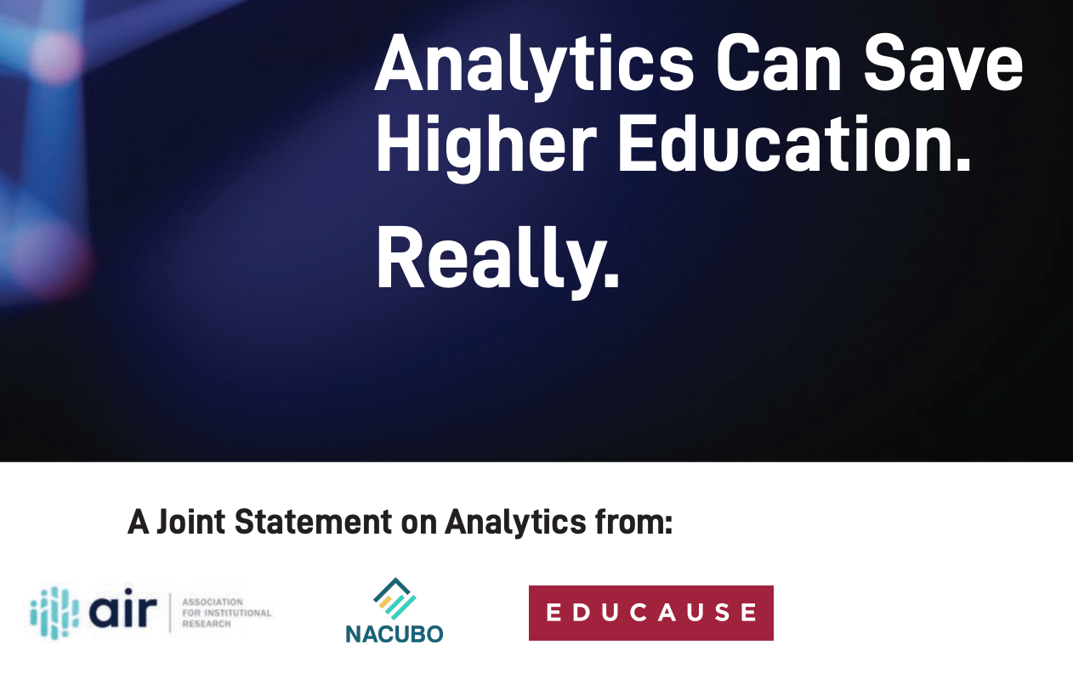
“Change with Analytics”
From the 2019 Joint Statement from AIR/Educause/NACUBO:
“Analytics is the use of data, statistical analysis, and explanatory and predictive models to gain insight and act on complex issues.”
“Data analytics initiatives are most effective when they target clear, measurable outcomes…”
Source - https://changewithanalytics.com/statement/
Notes:
Jeff first slide:
Let’s start with some of the hype!
If we can get a show of hands, how many people have seen or heard about this joint statement?
Whether you’re just hearing about it or knew already, would anybody like to share their reaction to the headline of “Analytics Can Save Higher Education. Really”?
*IF NO ONE DOES*
Pretty serious sounding right? It implies there’s a demise of higher education that’s in an unstoppable downward plunge. This was also before the pandemic. If they only knew what was coming…
So before we move on, take a few seconds read the contents of this slide to yourselves one more time.

Slide 6
Why do you care about data?
Notes:
Now I want to ask this group the question directly: Why do you care about data at your institution? Who would like to give an answer?
*PAUSE AND TAKE ANSWERS*
Some common answers would include:
- advancing institutional goals
- improving quality and efficiency
- strengthening student outcomes
- to enhance teaching, learning and advising
Those are all examples taken directly from the joint statement we just saw.

Slide 7
Are you being totally honest right now?
Notes:
Now let me ask again. Are you being totally honest right now with your answer?
*PAUSE*
Before I move on, I want to be clear that all of those things we just said are noble and valid reasons to adopt analytics. But thinking about doing so in those terms might not set you up for success and get you what you really want. Here's why...

Slide 8
One honest reason
“…a large portion of consumerism is designed to achieve the same thing…
people are seeking to impress each other,
or they are seeking to impress themselves.”
Sutherland, Rory. Alchemy. London: WH Allen, 2019
Notes:
The rest of this presentation is going to explore the main idea behind this quote. And we’ll do so within the lens of using data for strategic enrollment management decisions.
*READ QUOTE*
Obviously, “consumerism” isn’t a perfect fit for describing your work. So let’s replace “consumerism” with “the adoption of advanced analytics” in this sentence and you might already be starting to realize some underlying motivations.
Let me give an example: doesn’t it feel really good when you put together some crazy spreadsheet with formulas that only you could reverse engineer? And doesn’t it feel even better to show that spreadsheet to your boss and then confidently say “I made this and here’s what I think we should do as a result of my thorough analysis.”
Before we leave this slide, just take a moment to think about that feeling of impressing someone you work with, no matter what it was or how you did it. *PAUSE*

Slide 9

How do you impress people with data?
OUTCOMES
LOGIC
“It is better to be vaguely right than exactly wrong.”
Read, Carveth. Logic, deductive and inductive (1898), p. 351
Notes:
So now that we know we have an innate psychological reasoning for using data to impress others, how do you do actually do it?
Do you need to be an analyst, statistician, or data scientist? Sure, it would help, but even then, there are varying degrees of expertise for the people who already have those titles. Not all of them are exceptional at it.
So, here’s the first dirty little secret that is going to sound crazy at first: most people actually value LOGIC over OUTCOMES
Can I get a show of hands of anyone who hears that and immediately disagrees with it based on their experience? *PAUSE*
Now, I fully realize how blasphemous that might sound in higher education. Especially as someone who helps build a product that people like yourselves EXPECT to drive outcomes.
After all, there was a quote in the Change with Analytics joint statement: “Data analytics initiatives are most effective when they target clear, measurable outcomes…”
But before you leave the room, give me a chance to unpack this idea with you using some tangible examples.

Slide 10
Think about it…
Good Logic
Bad Outcome
Good Logic
Good Outcome
LOGIC
Bad Logic
Bad Outcome
Bad Logic
Good Outcome
O U T C O M E S
Notes:
For our example, let’s use an extremely common annual scenario in strategic enrollment management: assessing and updating our financial aid packaging strategy.
The most common example of “bad logic” would be saying “it’s just the way we’ve always done it.” Or another you’ve probably seen happen are incremental $1k increases in cells where you didn’t yield as high as you thought you should have last year.
Whereas, “good logic” almost always involves bringing in statisticians, data scientists, potentially institutional research, and of course consultants and software vendors who specialize in it.
Assessing outcomes is the easy part. Did you hit your enrollment goal? Did you get the class shape you wanted? Did you get the NTR you were expecting?
The truth is those good or bad outcomes are possible regardless of the approach and depth of logic that was deployed.
But remember, we want to impress people with our decision making abilities.
So, let me ask you: how would you expect each of those possible combinations to be perceived by others? Anyone want to share? *SOLICIT ANSWERS*

Slide 11
How others will react to your decisions
Good Logic
Bad Outcome
Good Logic
Good Outcome
LOGIC
Forgiving
Patient
Impressed
Elated
Furious
Retaliatory
Incredulous
Contented
Bad Logic
Bad Outcome
Bad Logic
Good Outcome
O U T C O M E S
Notes:
Each of these combinations results in different reactions.
The GOOD/GOOD and BAD/BAD quadrants are the obvious ones. You can really impress people and get promoted, or everyone can think you’re incapable of doing the job.
But look at the difference between Good Logic/Bad Outcome and Bad Logic/Good Outcome.
For bad logic/good outcome: It’s harder to believe that the enrollment and NTR results will be sustainable with “bad” or low levels of logic where you just didn’t change anything; even despite the good outcome.
Whereas seemingly deep logic that just didn’t go as planned often ends up being perceived as justifiable, explainable, or a “learning experience.” Someone might even say that you can take these results as new data inputs and user them to improve for next year.
Now, I know that not every situation may result in these perceptions, especially depending on who you’re working with, but these are what you can probably expect in most cases.
So, if we can agree that “good logic” alone is more likely to impress people than a “good outcome” on its own, the next question we might ask is: where do good ideas come from?
Sounds like a good job for data right? *PAUSE*

Slide 12

Where do “good” ideas come from?
Most new and truly groundbreaking ideas
have little to no historical data collected
to support them.
(…but you just said I need logic from data to support my new ideas?!?)
INSTINCT
The only way to collect the data from new ideas is to try them.
DATA
Notes:
Ehhhhhh maybe, but probably not. As it turns out, a truly new idea generally doesn’t have a lot of data to support it.
That’s why they’re ”new” ideas, right?
For something that is legitimately a new idea, you’re going to have to just try it in order to get the data that supports it. You may find that there were some proxies that led you to the ideas, but what you definitely don't have with a new idea is any outcome data because it's never been done before.
So this is where come to a crossroads. I’ve probably put your brain in a pickle.
I just said you need good logic to support your decisions, but you’re probably not going to have the data to support it.
How does that make any sense? Maybe it doesn't have to make sense.

Slide 13
Hacks
secrets for improving your relationship with data… and maybe your boss(es)
Notes:
Alexis
If our goal is to impress people with GOOD LOGIC (and hopefully good outcomes...) There as few things we can do to re-orient the way we think about and use analytics and data to support our new ideas.

Slide 14
Hack #1: Don’t depend on data for ideas
DO THIS INSTEAD
Good answers…
Bad answers…
Before you start a data project, ask yourself:
”What action will
I take once
I have the answers?”
Reference specific resources
Convey clear goals
Have situational reasons for needing to be addressed
Sound specific but aren’t
Ambivalent towards the
end-game
Not tied to a problem anyone currently has
Notes:
Alexis
The first is to stop depending on data for ideas. So often we hear "I'll know what to do once I see the data".
Instead of relying on data to come up with ideas, start with hypotheses, and in particular, ask your self "What action will I take once I have the answers?"
You can see on the slide what makes a good "answer" to this question – Being specific, with clear goals, and tying it to a current issue that you want to solve.
And focusing on a specific, well defined target and how YOU can influence students, will drive the types of data you'll need to collect and the type of analysis you might construct to support your shiny new idea.
Two examples of "good" answers to this question might be:
“I’ll decide which students to offer additional scholarships to in order to be more likely to get 25 additional students to reach our enrollment goal.”
”I’ll offer 50 out of state students a substantial travel voucher to encourage them to visit campus.”
Right off the bat, we're impressing our teams and our bosses with a FOUNDATION of good logic that shows we know what we want to do and how we're going to approach this problem.
And once we know what action we want to take we can tailor our analysis and the insights we use to gather the support necessary to implement our idea.

Slide 15
Hack #2: Don’t expect surprises
DO THIS INSTEAD
M.L. Models can…
M.L. Models cannot…
Ask yourself the dumb questions and be honest about the answers
Tell you what is true of the data
Be automated/make tasks and decisions easier
Predict something they’ve never seen before
Notes:
Alexis
The second way we want to start re-thinking about the use of advanced analytics is that you shouldn’t EXPECT surprises from your advanced analytics models. Now, that's not to that the models wont pick up on some cool and ~interesting~ insights about certain populations that we didn’t know about before, because it does and it can.
Machine learning models and process much more information that our human brains about the relationship between all of the hundreds of variables that its given; but at a high level, machine learning models learn from historic data to make predictions about the future. That means that machine learning models can (and will) tell you what is TRUE about your current population.
As part of the implementation process at Othot, we go through a model validation with each of our customers where we surface some key insights about what is important in the models and what variables are having an impact on predictions. We start those meetings off with a disclaimer, that this IS AND SHOULD be what you already know to be true. If the models are telling you what you already know - that’s a GOOD thing. It means the model is working.
To bring this back to what Jeff said a few slides ago, "The only way to collect the data from new ideas is to try them." The models you build today arent magically going to give you all of the answers you need to support new hypotheses and ideas that its never seen in the data before. Don't be afraid to use the psychological reasons that "the data" might not be twisted to support to develop and push for those new ideas.
Here's an example: ***
So in presenting your new ideas, it very well may be both things coming together, both insights from the models about what is currently true about students AS WELL AS something that YOU know to be true, but may not be captured in the data or the models.

Slide 16
Hack #3: Don’t data dump your analysis
DO THIS INSTEAD
Insights should be…
Insights should not…
"Increase the team’s exposure to insights – not data"
Relevant to current objectives
Actionable
Visualized and summarized
Overwhelm
Require significant explanation
Notes:
Alexis
Okay, so as we start to come back around full circle... we want to IMPRESS people right? You know what's NOT impressive? An hour long meeting staring at a screenshare of an excel sheet that has numbers so small that you have to get so close to your screen that you end up with only half of your face showing up in your webcam.
This "hack" is all about getting your team acclimated to your new idea and your approach so that things AREN’T a surprise at the end of the year, but without "dumping" a bunch of data on them and expecting them to follow everything you’ve been working so hard on.
Instead, we want you to anticipate the answers to the "logical" questions you might be asked about your new ideas, and think about how you can answer those with simple, bite-sized pieces of content. You don’t always need a LOT of supporting data analysis. You need just enough to show that you have "good logic" supporting your idea. Hit them with the 2-3 INSIGHTS that they'll actually REMEMBER and find ACTIONABLE.
What makes this even better is that when we can distill this down into smaller, more impactful insights, that means that we can sprinkle these throughout regular meetings with the team and build support from the team or our bosses throughout the semester or throughout the year so that when it comes time to get the green light, everyone is on board.

Slide 17
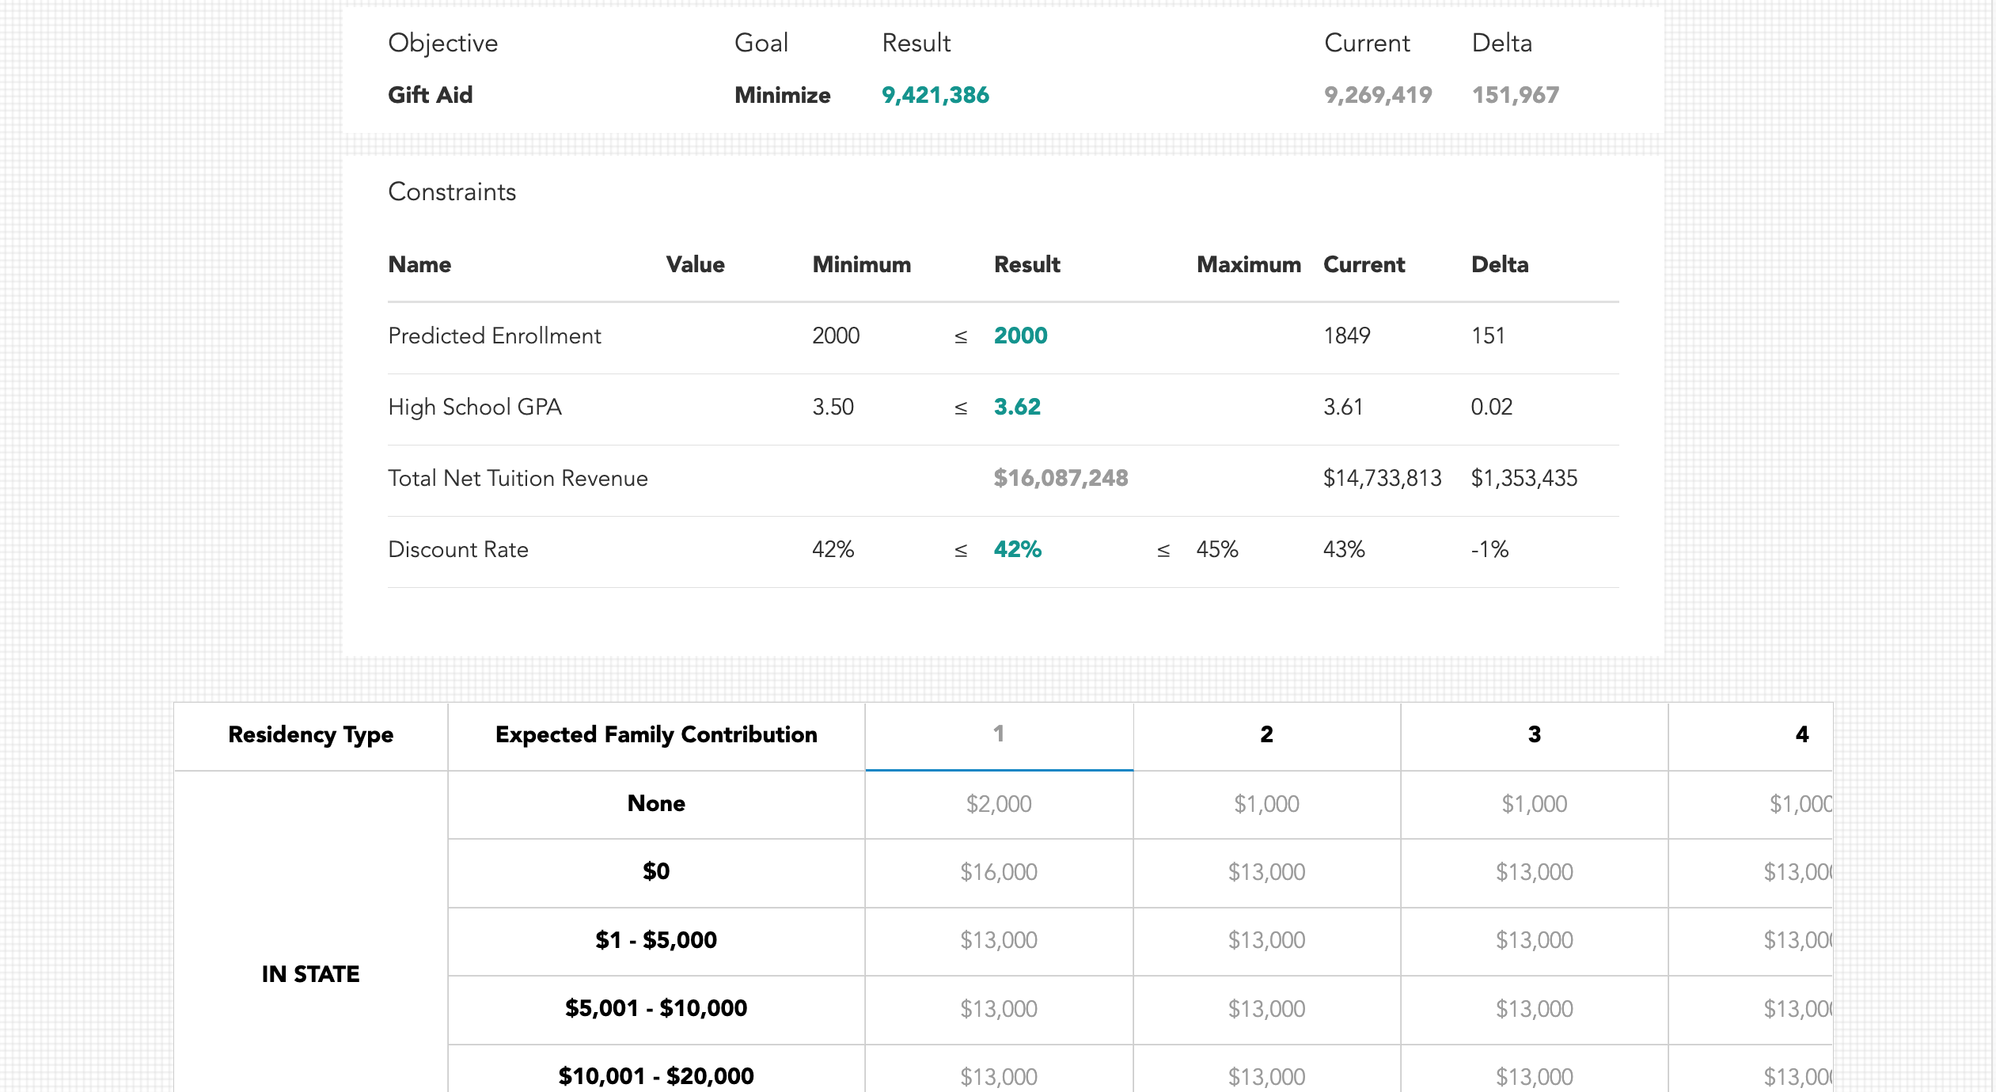
Hack #4: Don’t be afraid to use a little magic
DO THIS INSTEAD
Very impressive:
Back up your ideas with more advanced analytics
Notes:
Alexis
So, let's say we've come up with a great idea about how we want to change our financial aid strategy... we've build some models with that in mind... and we know that we need to be able to show our colleagues/our bosses, that we've used "GOOD" logic to IMPRESS THEM and garner support for our idea through INSIGHTS (not data dumps). How do we do that? With a little magic.
There are some pretty cool advanced analytics tools on the market (hint hint: Othot) with some pretty magical functionality (hint hint: Matrix Optimization, Sensitivity, Strategize), that can help you get to those insights to support your logic. Now again, we aren't relying on these tools to "tell us the answer" or "come up with the idea", but when we have an idea we can use those tools to back up the idea we have with logic by simulating what "might" happen if implemented to support the decision to ultimately implement it.
***Jeff example of OWU***
We worked with a school this past year who came to us with a hypothesis in mind for a new financial aid strategy, but they didn’t have the confidence to implement it. More specifically, they thought it was possible to increase enrollment by increasing gift aid to students with higher need while decreasing merit only scholarships to students without any financial need to make up for it. Probably sounds familiar, right?
So between our Partner Success team and the use of our platform, we simulated multiple packing strategies that did just that but to different degrees. The model said it was possible and the school went with the most aggressive option. The quote from the president was “why not swing for the fences and be happy if we hit a triple?”
Fast forward to deposit deadline day and it was clear that enrollment dramatically increased because of the aid strategy, but the discount rate was a little higher than they’d expected and hoped for which meant lower NTR than expected too. At first, they were somewhat disappointed with the outcome. They had high expectations that were almost, but not fully met. But now this summer and we’re working with them again on the upcoming year’s aid strategy and guess what: THEY AREN’T CHANGING IT.
Why? Because the logic that supported their decision to enact the aid strategy, even if the outcome wasn’t perfect, was really strong. Not only that, but the VP of Enrollment at this school just took a job as a President at another college.
We obviously weren’t there for the interviews, but it’s likely that they mentioned significantly turning around their enrollment decline in one year and the logic that went into the decision. Very impressive, right?
So to reiterate, the IDEA for this approach did NOT come from ”data” or a “model.” It was an intuition that was hard to get anyone to buy into without some serious logic behind it in order to support it. Could they have tried it without simulating the strategy first? Absolutely. Were they going to? No. It just took a little “magic” to increase their confidence in making a bold decision.

Slide 18


Hacks
Let the action you want to take drive your analysis
Ask yourself the dumb questions and be honest about the answers
Focus on sharing insights
Use a little magic
Notes:
Alexis
Wrap it up.

Slide 19
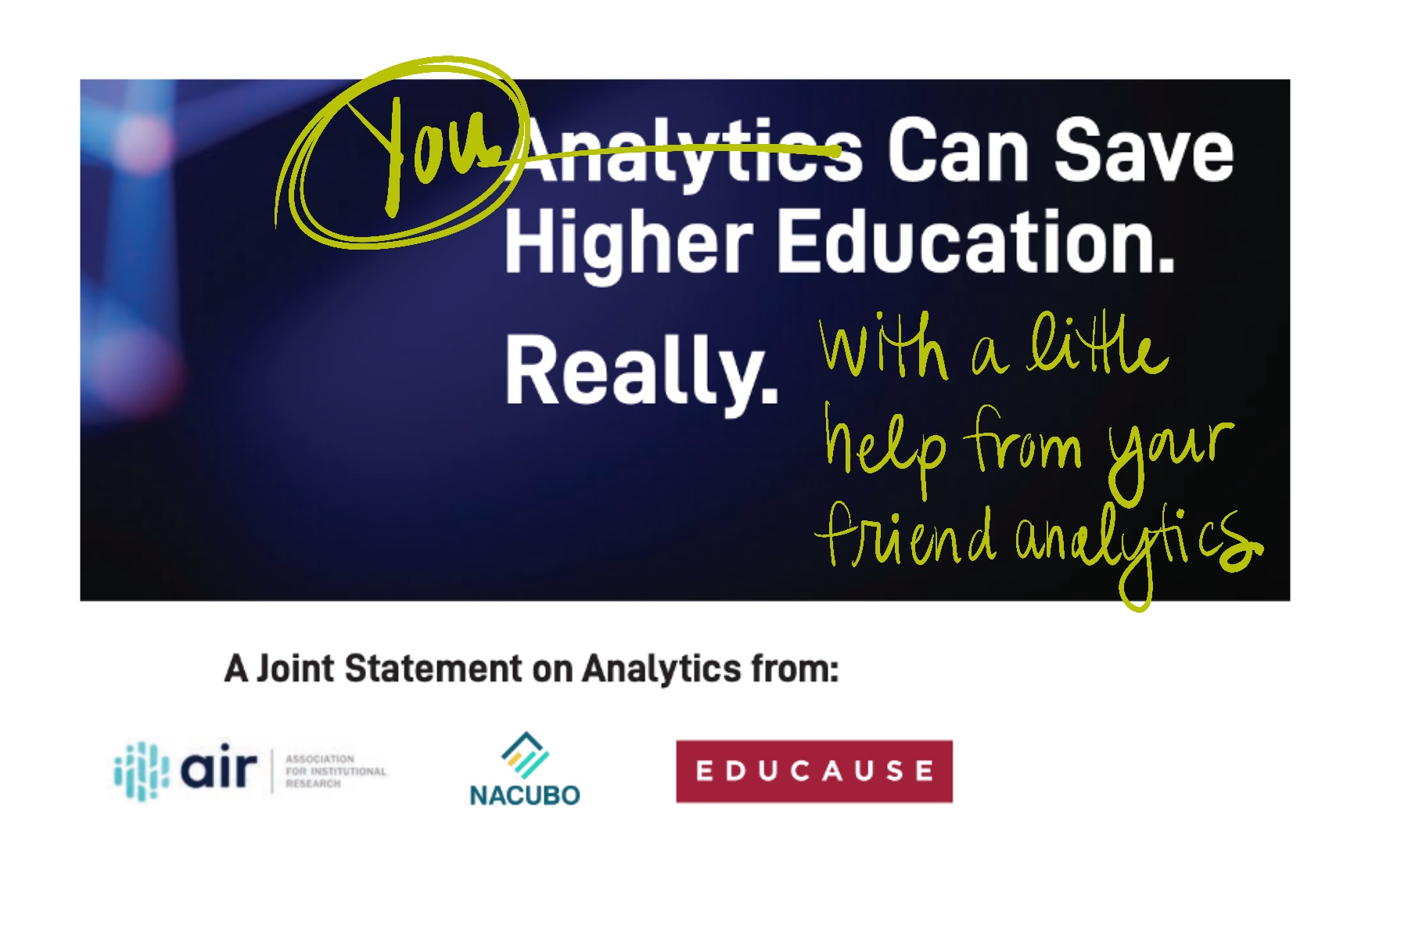
How do you feel about data now?
Notes:
Jeff:
Let’s come back to where we started: the joint statement that was intended to light the fire under strategic enrollment management leaders to start using analytics immediately.
It was written to make you feel like you couldn’t possibly do your job without analytics. Is that really want you want from analytics? To save your industry… from yourself?
The issue with this statement is that it’s not analytics who is responsible for coming up with ideas and actually making decisions. Those are still jobs for PEOPLE and probably should stay that way in higher education.
But this statement is exactly why people have the wrong idea of analytics and can set themselves up for disappointment. If analytics were really doing everything to save higher education, you as a leader in strategic enrollment management are just a passenger, and not impressing anybody.
In reality, analytics on its own won’t impress anybody. What it does is help you support your own ideas and decisions, which in turn improves the perception of your work amongst the people you need to continuously impress.

Slide 20
Q & A

Slide 21
Thank You
Alexis Tshudy
Othot/Liaison Intl.
atshudy@liaisonedu.com
Jeff Morgan
Othot/Liaison Intl.
jmorgan@liaisonedu.com

