Slide 1


Slide 2
Are you speaking student?
Aligning data and communications to serve students, schools, and your organization.
Jessica O’Keefe ADEA

Slide 3

Objectives
Understand how jargon or “internal speak” affects your students and your data.
Identify how using a Customer Relationship Management (CRM) software such as EMP can be mutually beneficial for the organization and the student.
Analyze current strategies and design new strategies using EMP to increase potential applications.

Slide 4


Slide 5
Effective Communication
Audience Specific
Timely
Relevant

Slide 6


Slide 7
Can You Clearly Identify Your Self?
Advisor/ guidance counselor
Career changer
Gap/ transitional year student
High school student
Not listed
Post baccalaureate student
Student at a community college
Student at a four-year university

Slide 8
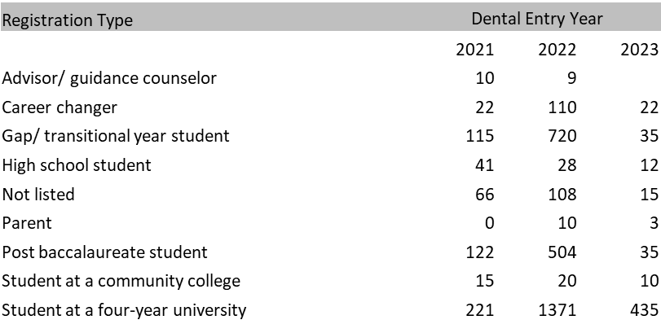
Virtual Event 2021 Data
Not Listed Sample:
College Graduate
Completed four years of College/undergraduate degree
Current Applicant
Dental school applicant
Masters Graduate
Masters in Public Health Graduate
Nontraditional student

Slide 9
Please select the category that best describes you: *
Prospective Dental Student
Advisor or School Counselor
Parent or Guardian or Guest

Slide 10
Virtual Event 2021 Data
Not Listed Sample:
College Graduate
Completed four years of College/undergraduate degree
Current Applicant
Dental school applicant
Masters Graduate
Masters in Public Health Graduate
Nontraditional student

Slide 11
Virtual Event 2022 Data
Registration Type | Count
Advisor or School Counselor | 99
Parent or Guardian | 124
Prospective Dental Student | 6004
Advisory Type | Count
4 year College/University Advisor | 24
Community College Advisor | 1
High School Counselor | 14
Middle School/ Junior High Advisor | 1
Pre Health Advisor | 58
Prospective Dental Student | Count
College Student | 2354
High school/ secondary school student | 534
Internationally Educated Dentist | 2390
Not currently enrolled or have already completed my degree | 728

Slide 12
Virtual Event 2022 Data
High school/ Secondary School Student
High School Graduation Year | Count
2021 | 10
2022 | 189
2023 | 177
2024 | 104
2025 | 42
2026 | 1
Grand Total | 523

Slide 13
Virtual Event 2022 Data
College Students
 | Dental School Entry Year
College Graduation Year | 2022 | 2023 | 2024 | 2025 | 2026 | 2027 | 2028 | 2030 | Grand Total
2021 | 18 | 63 | 8 | 2 |  | 1 |  |  | 92
2022 | 33 | 442 | 66 | 8 | 1 | 1 |  |  | 551
2023 | 11 | 630 | 208 | 31 | 3 | 1 |  |  | 884
2024 | 14 | 6 | 261 | 109 | 12 | 1 | 1 | 1 | 405
Grand Total | 76 | 1141 | 543 | 150 | 16 | 4 | 1 | 1 | 1932

Slide 14
Effective Communication
Audience Specific
Prospective Dental Student
Advisor or School Counselor
Parent or Guardian or Guest
Timely
  Correctly Identify Dental Entry Year
Relevant
  Develop Content to meet their needs

Slide 15

What Is Next?

Slide 16
Q & A

