Slide 1


Slide 2
Admissions by Design:
Using Quantitative Analysis to Create Qualitative Campaigns
Linda Quimby
Keith Mock
11:15 a.m.- 12:00 p.m

Slide 3

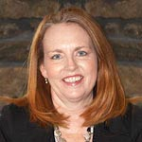



Introductions
Linda Quimby
Keith Mock, Ed.D
Vice President for Enrollment
Associate VP,
Enrollment Management Solutions
Notes:
.

Slide 4


Agenda
Introductions
National Enrollment Landscape
Impact to Recruitment
Othot Solutions
Campaign ready integration with EMP
Q and A
Conclusion

Slide 5
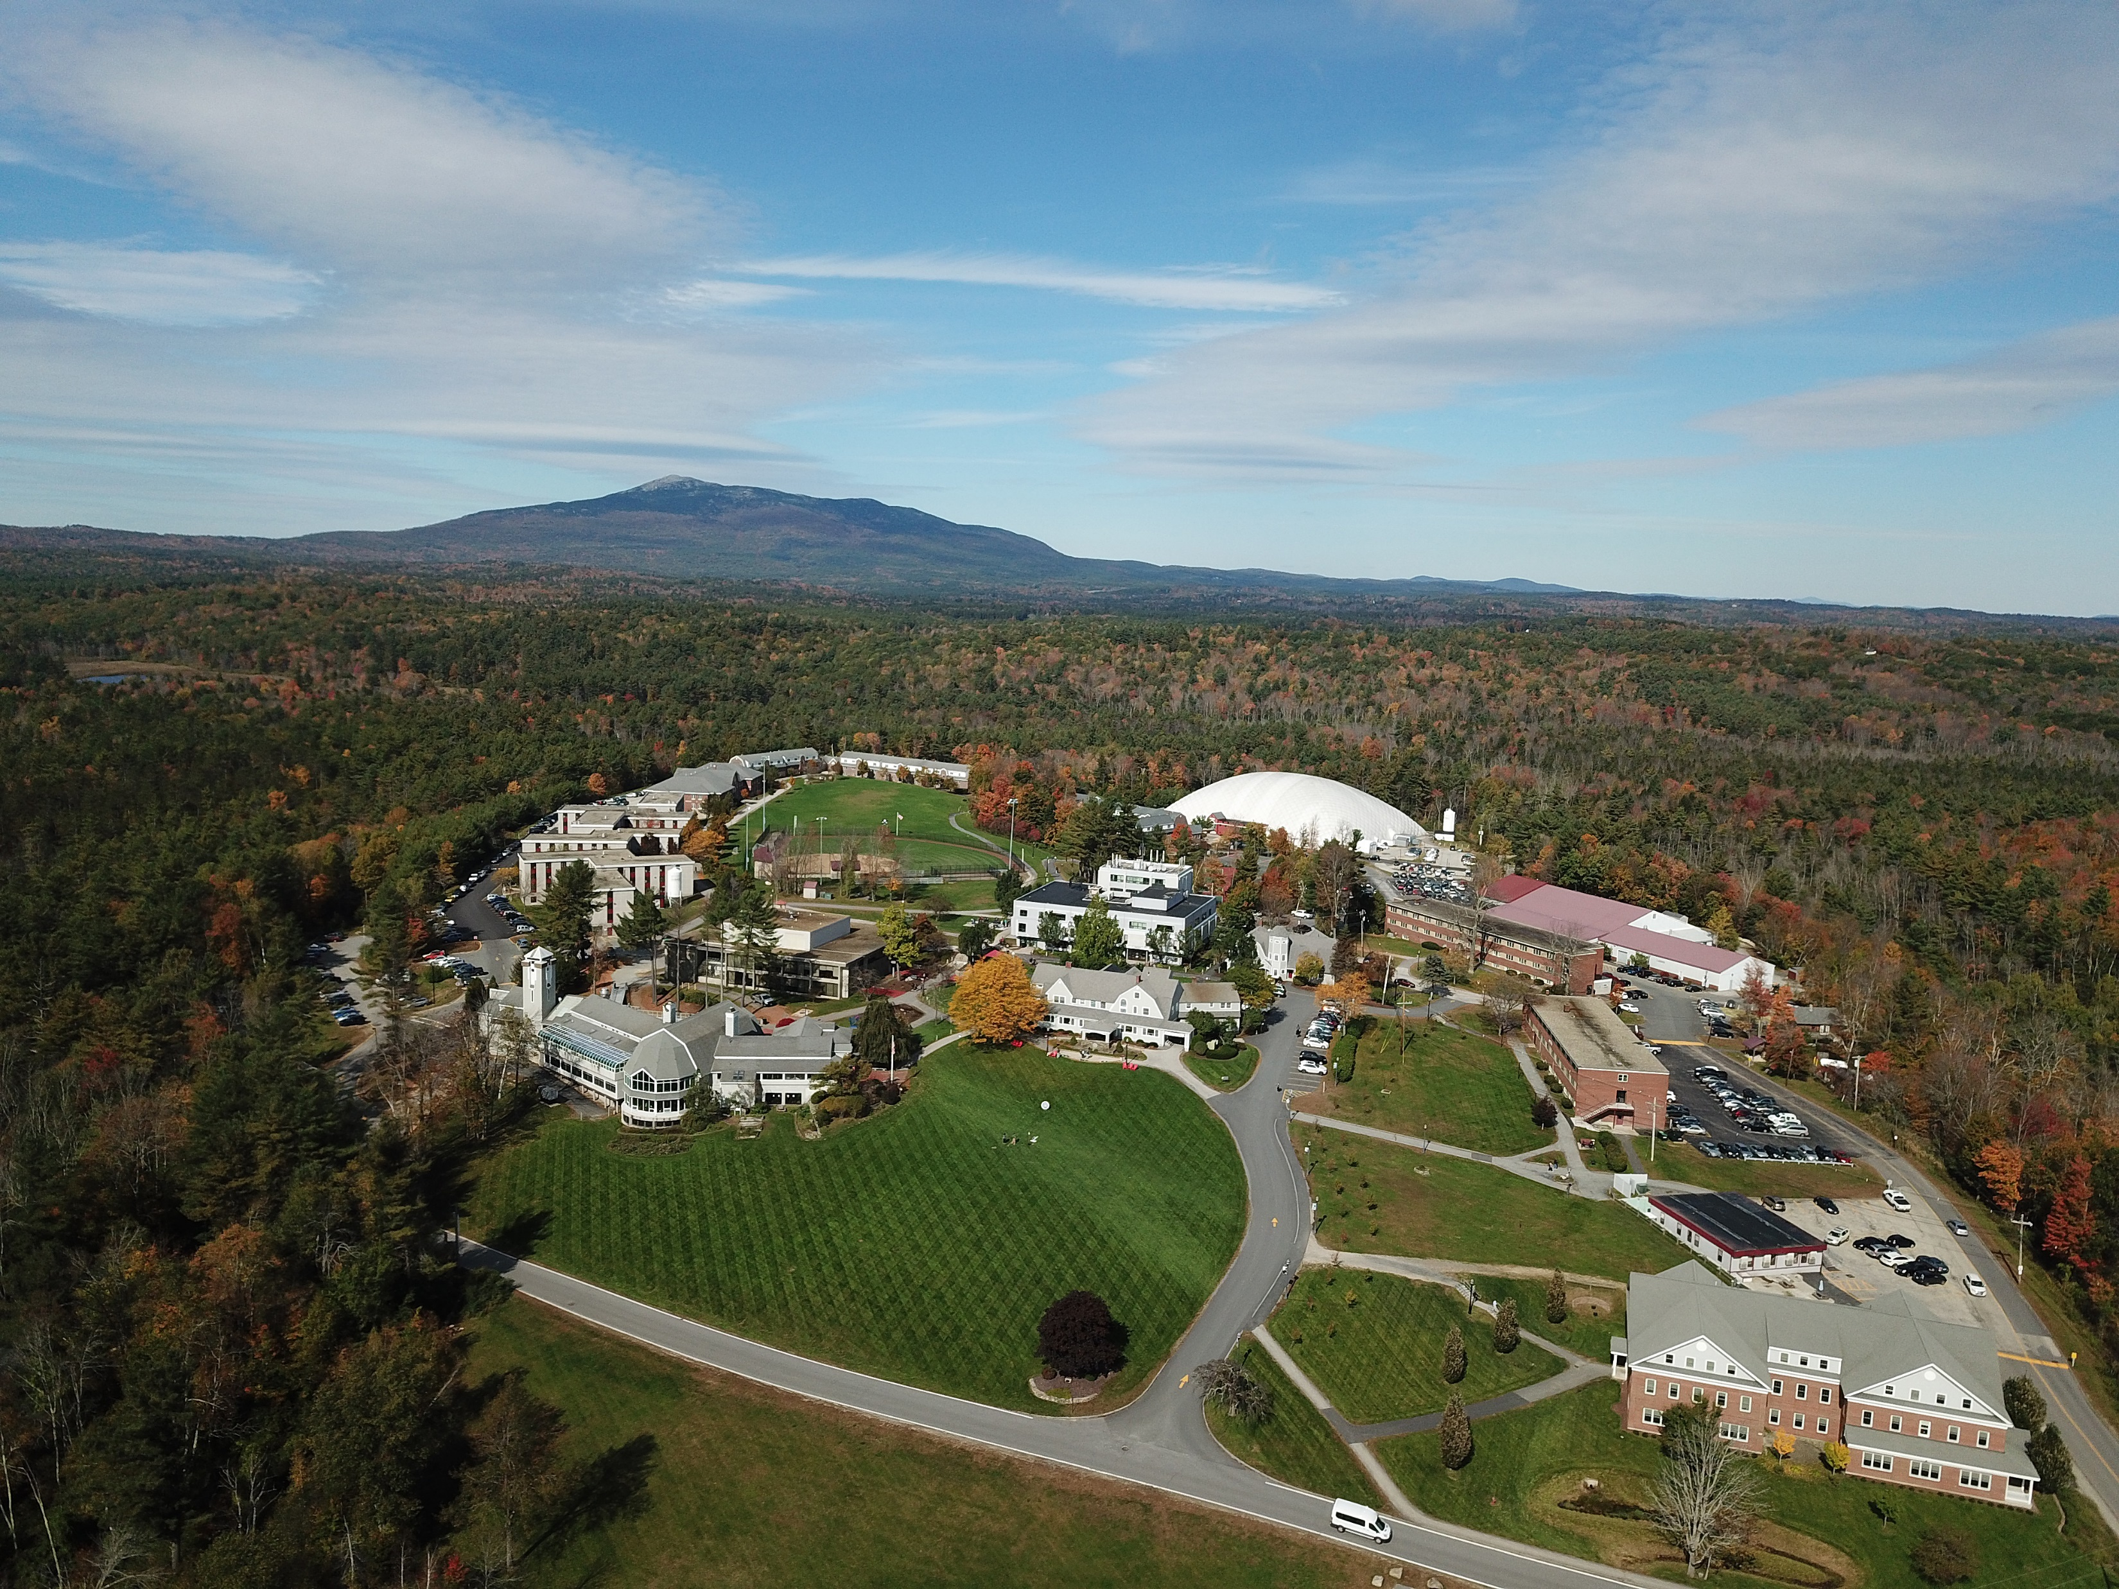

Main Campus located in Rindge, N.H with Academic Centers in Manchester & Lebanon, N.H. & Goodyear, AZ.
1,800: Total undergraduate and graduate enrollment
500 Graduate students
Online Graduate Degrees Offered: M.B.A., M.Ed., M.S.A. & M.S.N.
Specialized master/doctoral programs: MPAS, MEPN & DPT
5
©2020 Proprietary and Confidential

Slide 6
National Enrollment Landscape: The Impact of Disruption and Turbulence
Decreasing population of high school graduates in select geographic regions
Lingering pandemic related impacts: Testing, academic readiness, mental health concerns, delayed return to in person visitation
Prospective students applying to an increasing number of institutions
Changing profile of high school graduates
Competitors aren’t just higher education institutions: Bootcamps, employer training programs, workforce incentives
Academic profile stronger: Masking grade inflation, erosion of students at the lower end of the academic profile
FAFSA filing declines – new -9%, renewals down 12%
Community Colleges
Enrollment teams asked to do more with less
Great resignation

Slide 7
Impacts to Recruitment
Historical data unreliable…or is it?
Gains made in the margins. Institutions themselves are changing.
Broad data metrics insufficient
Data tools insufficient to harness the micro data in our CRM
Geo demographic data holds promise
Not a “set it and forget it” environment. Turbulence continues demanding constant look at the “here and now”
Tight budgets demand data to support recruitment decisions
Personalized, targeted, timely recruitment demands greater data analytic capability
Look to talent from vendor partners to provide skills and knowledge we cannot hire.

Slide 8
FPU – History and Culture
Partnered with Spectrum Creative Solutions
Othot Prescriptions Begin
Partnered with Othot
Began creating a culture reliant on segmentation
Reliance on leveraging segmentation; Data optimization
Fall 2022 (Projected)
January 2022
2021
2015
Spring 2011

Slide 9
Paradigm Flipped
Remember that you do not recruit students when they understand you. You begin to recruit students when they feel that you understand them.

Slide 10




Breaking Down Advanced Analytics
How can we
make it happen?
VALUE
Commercial
Leaders:
What will
happen?
Prescriptive
Analytics
Why did
it happen?
Predictive
Analytics
What
happened?
Diagnostic
Analytics
Descriptive
Analytics
Hindsight
Insight
Foresight
Gartner Analytics Value Escalator
www.gartner.com
DIFFICULTY
Notes:
Before we talk about our solution specifically, let’s give you some context.
As consumers, we have all experienced the power of AI.
When Amazon tells you the next book to buy, or Netflix tells you what show you should binge on next — that is the power of AI and ML.
These systems look at your past behavior, and that of people like you, and then begin connecting the dots to help you take the next step.
We do a little more than that.
Most of what you’ve experienced stops at the predictive stage – which is already on the upper right side of the quadrant.
We take this to the next level and not only tell you what will happen…. We help you guide it to getting there.

Slide 11




The Value of the Liaison Prescriptive Analytics and Partnership
!
Proactively identify issues
Empower users with information
Gain a deeper understanding of the individual
Make decisions confidently, with strong data backing
Access dedicated success teams and resources

Slide 12
A Current Scenario
Using Othot, we can tackle most any question, providing a “What-if” analysis to guide our efforts.
What is going on at your place?
Need more NARPs?
Need more students from a particular geographic area (or school)?
Need more students in a specific major?
Want to find out what is holding your students back from enrolling?

Slide 13
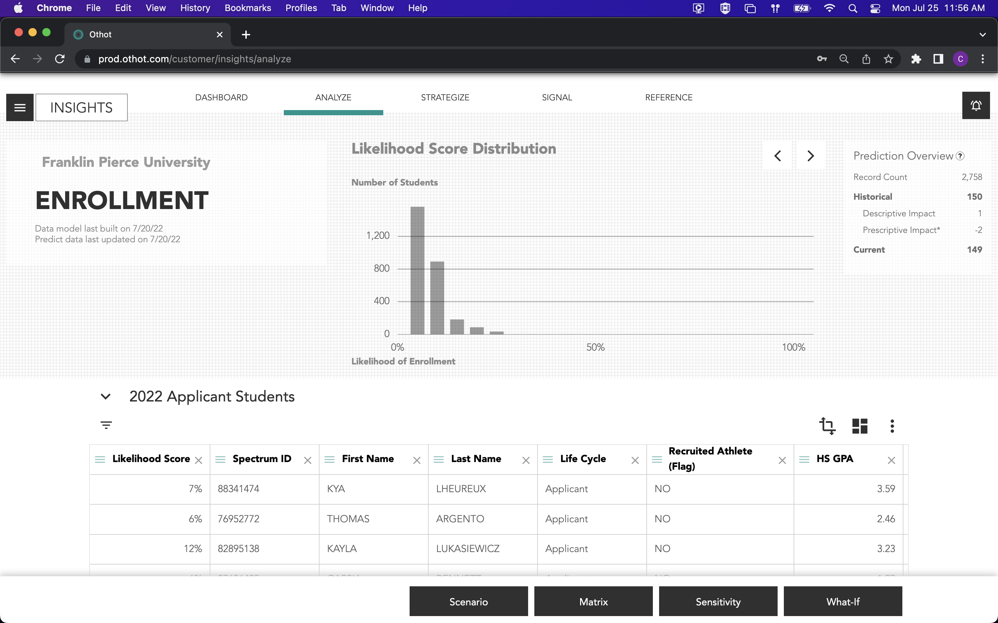
We need more NARPs!
Talk about the need for non athletes – Curt’s slides
Notes:
This is the main Analyze page when logging in. On this page you’ll see a few things:
Chart at top center
Prediction Overview in the top right
Grid at bottom
ALL information presented is tied to student population you are filtered on – in this case: 2022 Applicants

Slide 14
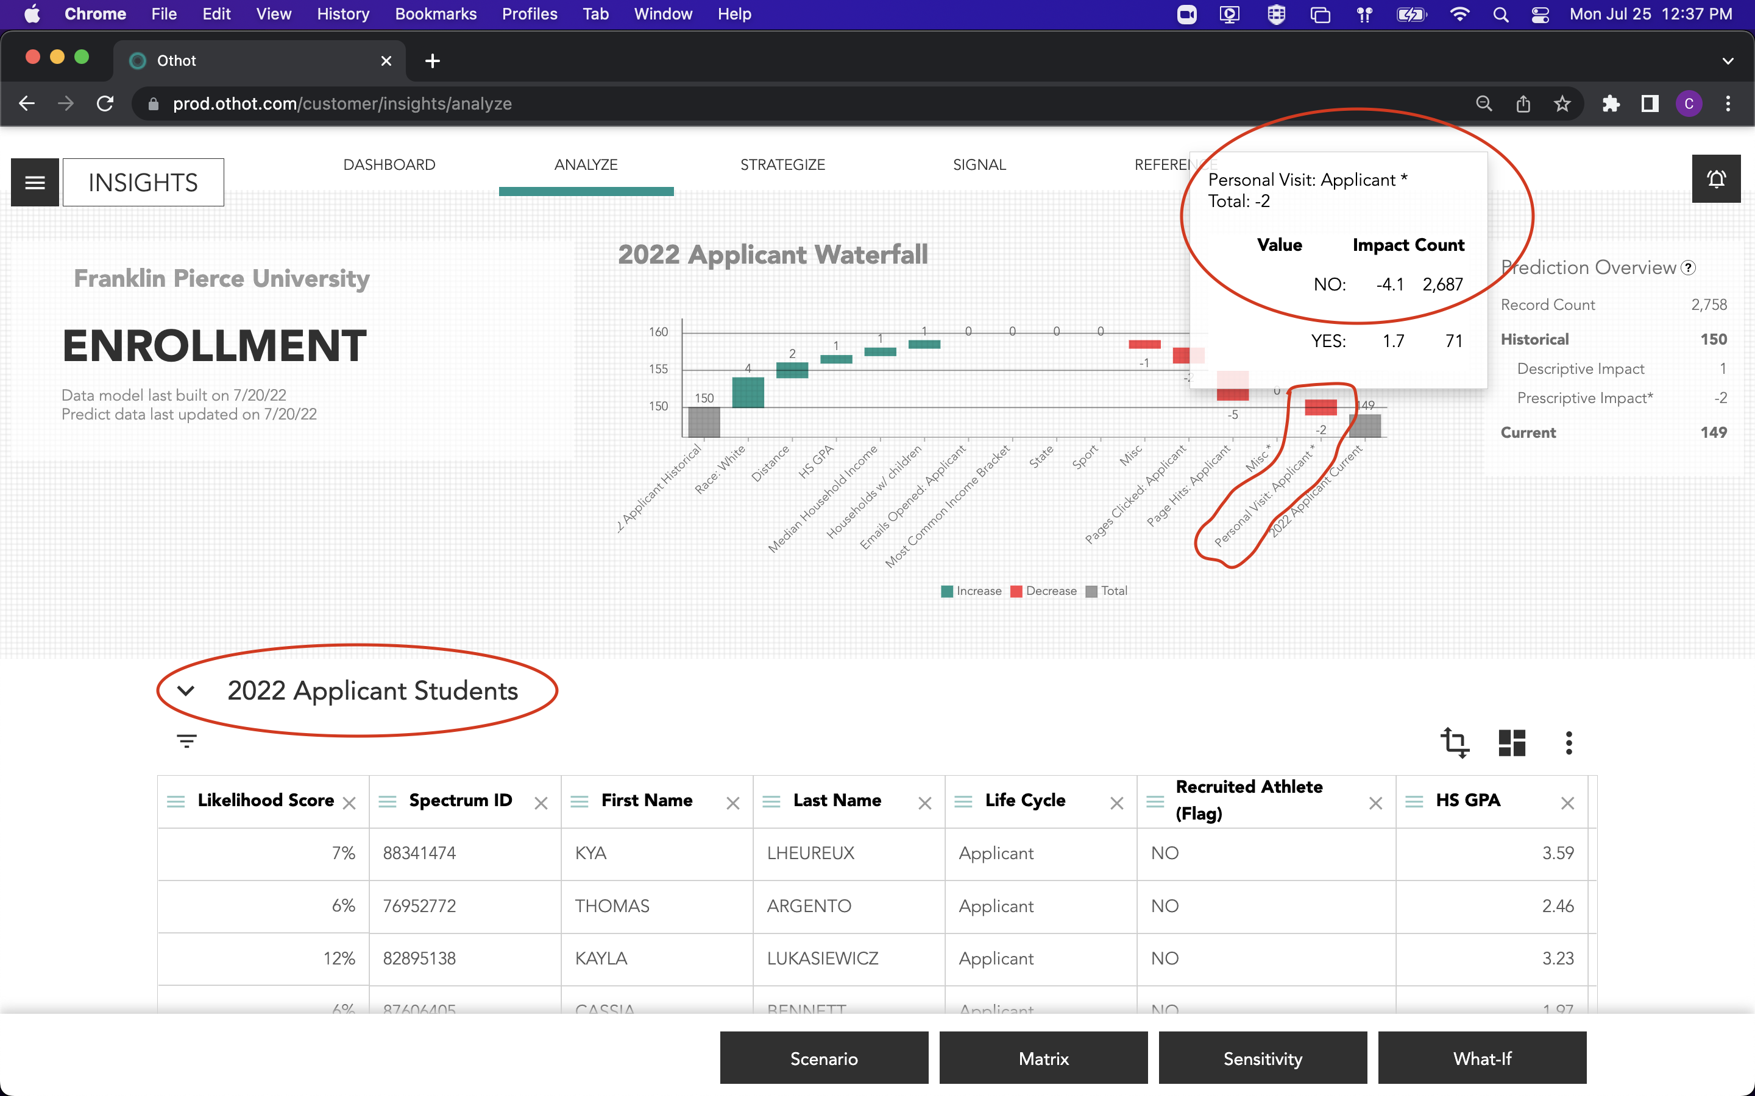
We need more NARPs!
Talk about the need for non athletes – Curt’s slides
Notes:
USE CASE – Drive Visits during Applicant Phase
What you see here is the “Waterfall” chart which depicts actionable items that not only have the most importance to student enrollment in the respective population, but also the relative weighted impact of each variable.
In this case, the information is filtered on any student who has/had an application of file at one time for Fall 2022. In the ”Waterfall,” the variable in focus is, “Personal Visit: Applicant” which is defined as students who have or have not partaken in a campus visit during or before the Applicant phase. Here, we see that of the 2,758 total records in this population (seen as top figure in Prediction Overview box), 2,687 student HAVE NOT visited to which it is negatively impacting their likelihood score by (-4.1%) on average.

Slide 15
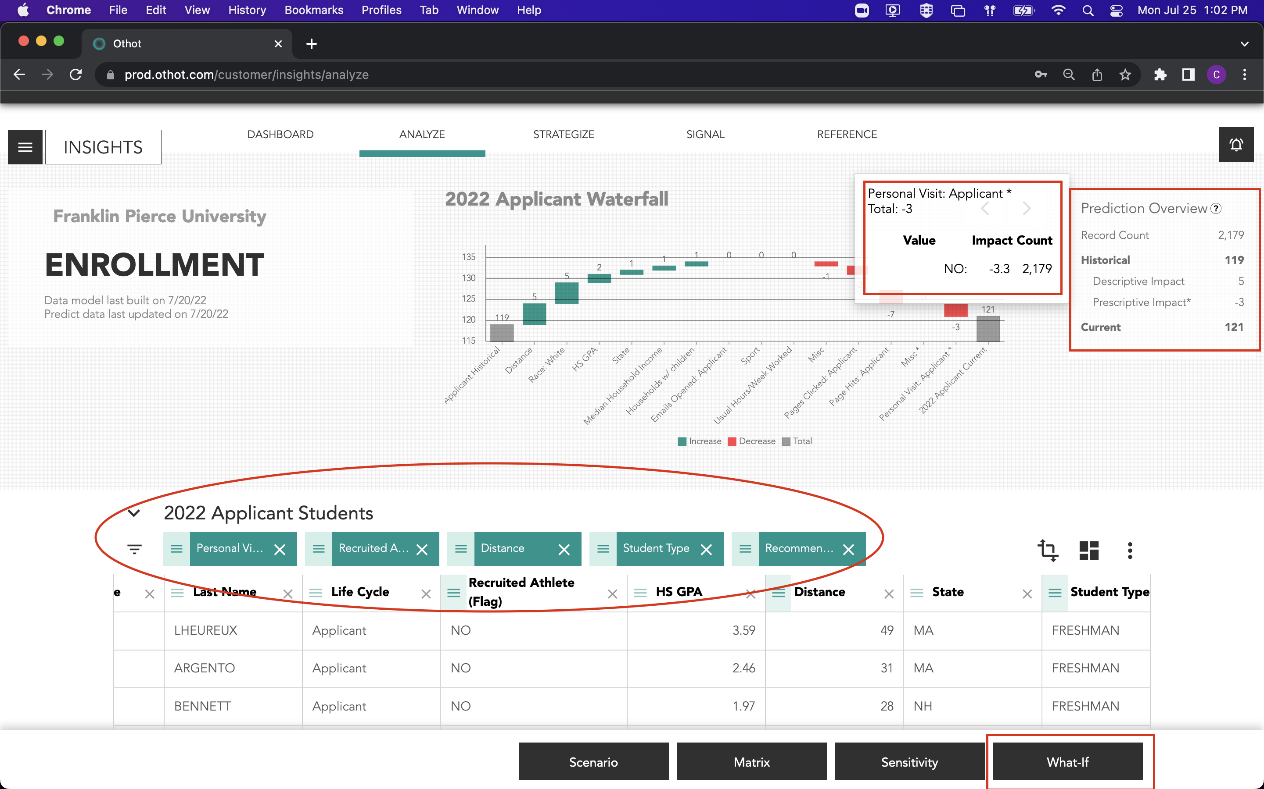
We need more NARPs!
Freshman
Non-Athlete
Not visited
Within 150 mi
Top Rec is visit
Notes:
So, by filtering on the HAVE NOT visited group, we can simulate “What-If” they DID visit?
The filters shown here consist of the following: Freshman, Non-Athletes, who’s top actionable Recommendation is “Personal Visit: Applicant,” who HAS NOT visited, and that lives within a 150-mile radius to FPU (as the crow flies).
As you can see, this has brought the total record count down from 2500+ to 2,179 students, of which, only 121 are predicted to enroll, and ONLY two student increase in enrollment from historical years. From the waterfall, you can also see the related negative impact of not having visited campus.
Once you have subpopulation of students you are content with, we would simulate the actionable variable by clicking on a “What-If,” in the box at the bottom right.

Slide 16
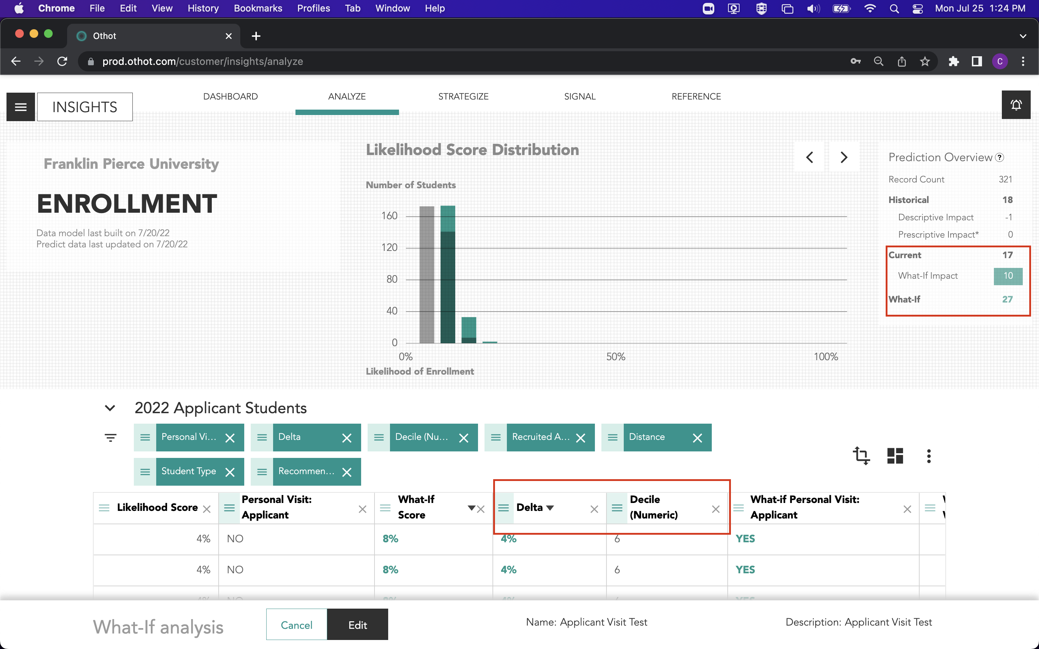
We need more NARPs!
Talk about the need for non athletes – Curt’s slides
Notes:
With two additional filters, “Delta” greater than 3% (which is the average in that column), and “Decile” less than 7 (where Othot defines Decile on a 1-10 scale, 1 being most likely to enroll and 10 is least likely),one could whittle down the population from 2100+ to just over 300 and go from enrolling 17 students to 27. There can be even more filtering from here.
This example only scratches the surface at how granular data can be analyzed about a student population or even individual. Data can be produced daily and can therefore be presented in real-time during each login.

Slide 17
Human Creativity Required
How will you operationalize the prescription?
Notes:
Linda to provide examples of how she has used EMP in the past
Junior quick visit day/Quick app
Rhodes College providing travel vouchers
Othot answers the ‘High Impact Question’ of what it will take to get this student to enroll…
Give the recruiter the info that they need to recruit the student. - COA, Visit, Financial aid, Parent involvement

Slide 18


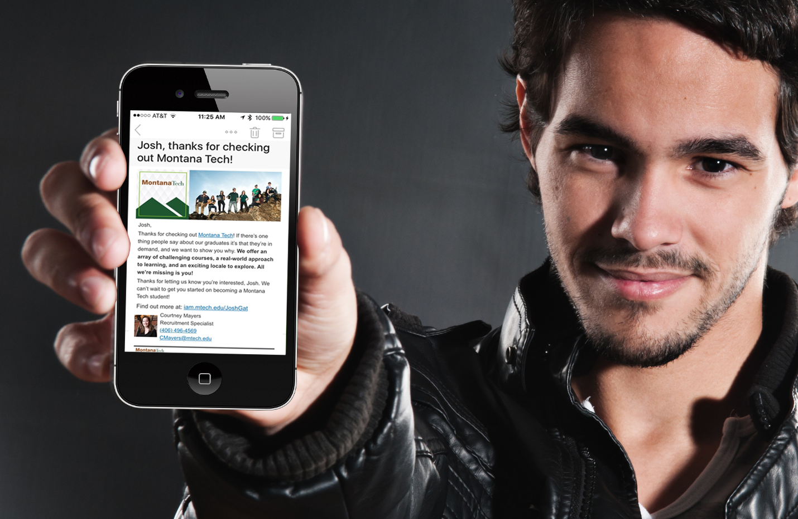

The Four Pillars of Communication
4 Keys to Success
Immediate
Relevant
Automated
Trackable
Notes:
Omnichannel and informed

Slide 19

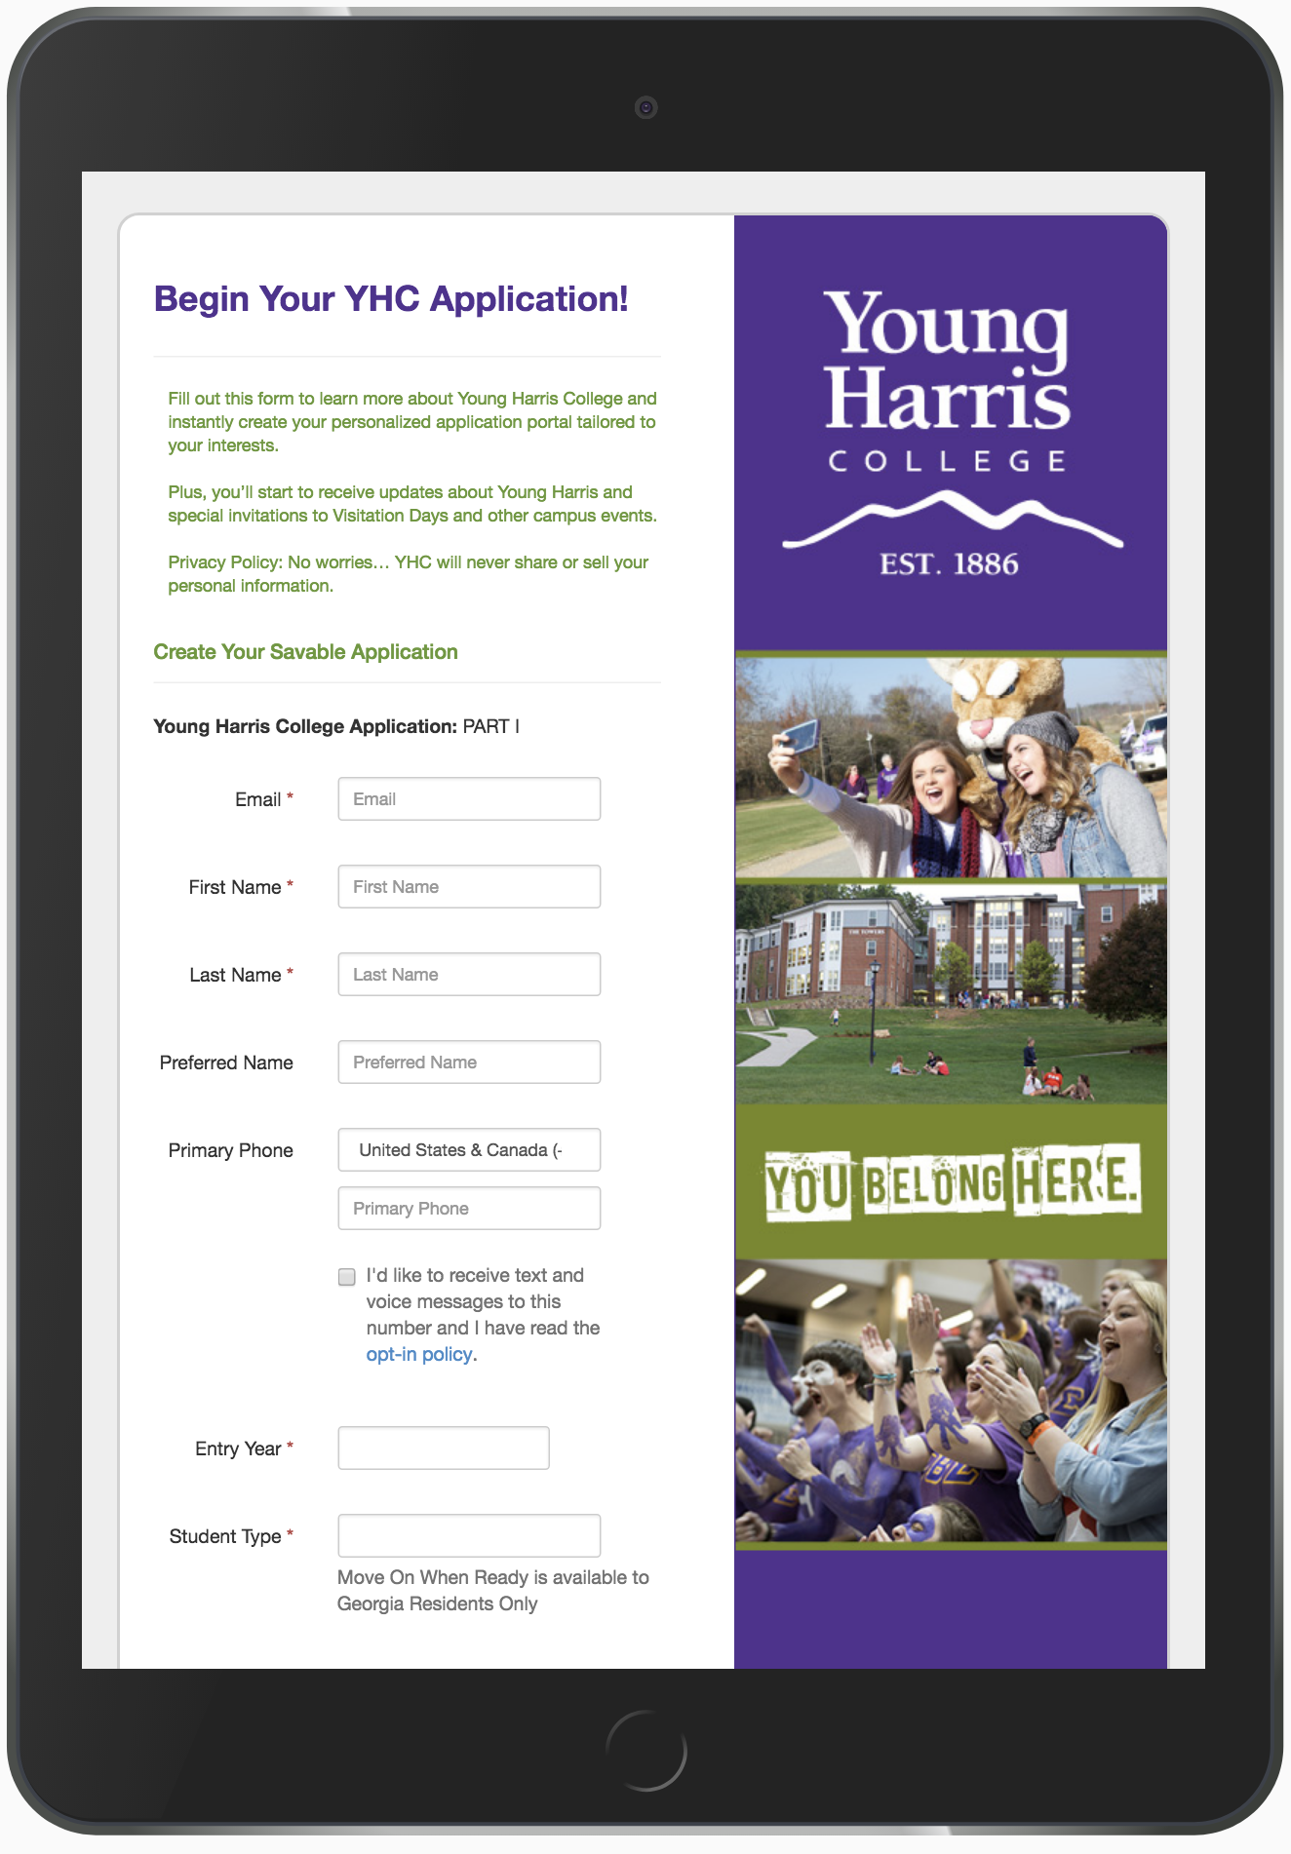
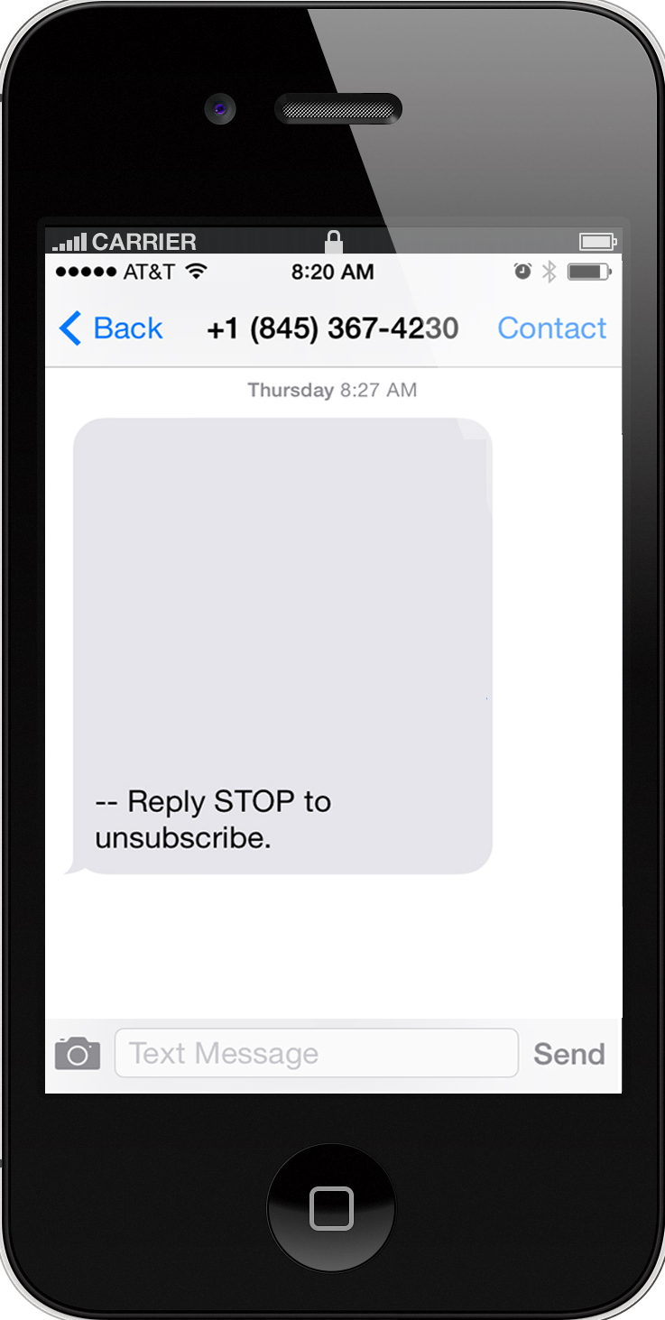

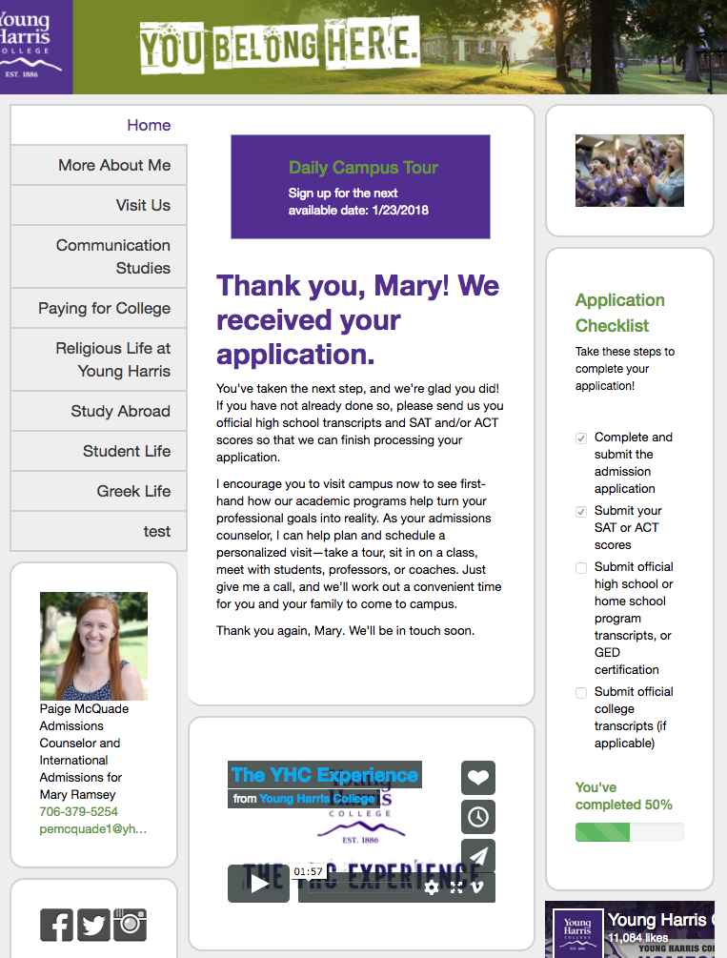





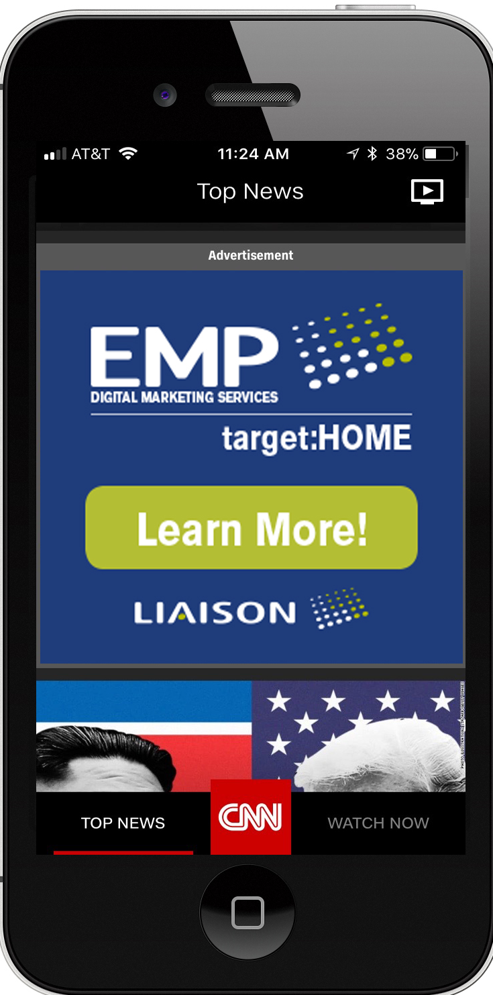

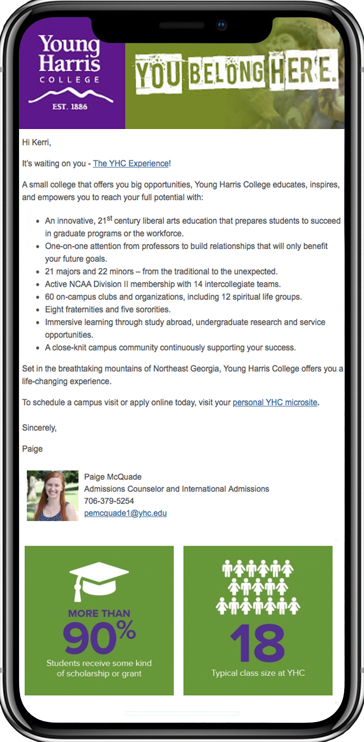





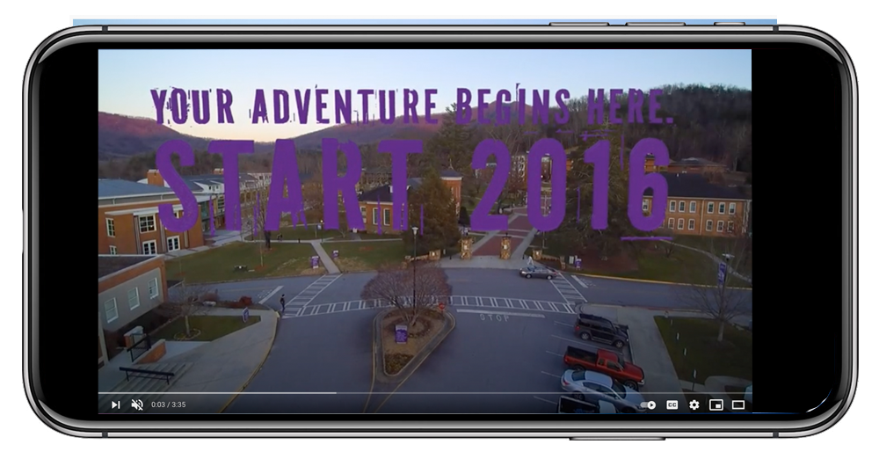




True Omni-Channel Marketing
Mobile Marketing
Hi Kerri,
Our next Open House is Saturday October 12.
Sighup at:
www.discover.yhc.edu/KerriRamsey
Email
Single message; multiple channels.
Integrated data drives personalized messages.
Messages evolve based on prescriptive models driven by student interactions and updated data.
Prescriptive model empowers staff to engage with the right students at the right time, with the right message.
Snapchat
Facebook
Personalized Microsites
Texting
It’s not just one
email, It’s a combination
of all interactions.
Variable Print
Events
Twitter
Prospect
Digital Marketing
Rep Interactions
tiktok
Pinterest
Youtube
Notes:
seamlessly delivering a single message across a wide variety of engagement with a targeted, personalized message for every single prospect and their families.
True Data integration allows for a seamless personalized experience through the entire enrollment funnel.
Tracking every interaction, allows Prescriptive modeling to automatically evolve messaging to ensures your outreach is always consistent, relevant and effective.
Engages your staff to empower them to know who to engage with and more importantly, what exactly to say.

Slide 20
Data-Led Decision Making

Slide 21
Q & A

Slide 22
Thank You
Linda Quimby
Franklin Pierce University
Qiumbyl@franklinpierce.edu
Keith Mock
Liaison International
kmock@liaisonedu.com

