Slide 1


Slide 2
A Climber’s Guide:
How to Scale the Demographic Cliff
July 28, 2022
Chris Lucier
Director of Partner Success, Othot by Liaison

Slide 3


Speaker
Christopher Lucier
Director of Partner Relationships

Slide 4


Agenda
The Situation
Research Methodology
Data & Insights
How to Scale the Cliff
Q&A
Notes:
Lea, can you please add the overlay to this image so that it is not as much of a contrast with the cover slides?

Slide 5
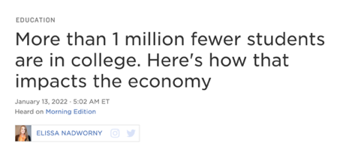
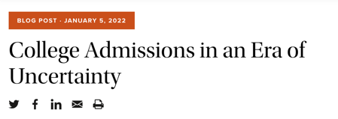
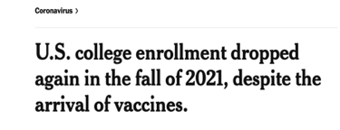
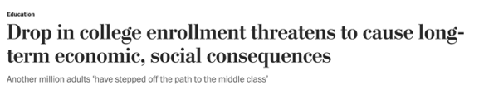
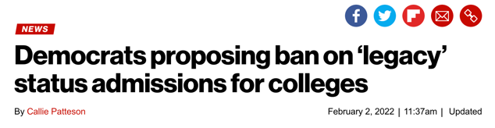
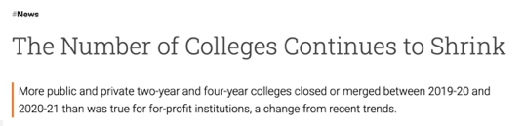
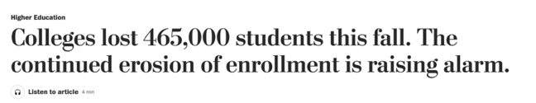

Enrollment Landscape

Slide 6
Our Research Methodology
Institution-specific forecasts based on high-school graduates in geographic market area
Source data:
Blend of Grawe and WICHE forecasts
Publicly data of geographic markets
Sample size: 454 institutions
Notes:
Old content:
Leaders can use findings to reconsider and adjust their recruitment and retention strategies.
Geographic variation in the forecast number of high school graduates can be used by institutions to project and plan for future enrollments.
This information should be viewed from where they recruit.
Andy and Patty to dialogue the slides

Slide 7
Key Findings
Forecasts vary considerably, even for institutions located in the same state or even city
Institutions best positioned are those with recruitment that is:
  Highly concentrated in a single state or group of states with relatively positive expected growth of high-school students, or
  Highly dispersed across many states and regions
Notes:
Forecasts vary considerably, even for institutions located in the same state or even city. BECAUSE INSTITUTIONS LOCATED IN THE SAME STATE/CITY MAY HAVE VERY DIFFERENT GEOGRAPHIC RECRUITMENT MARKETS
Use example of u of Chicago, and u of Illinois –Chicago
Not surprising because they have very different recruitment areas
Institutions best positioned…
Highly concentrated… ON THE OTHER HAND, INSTITUTIONS WITH HIGHLY CONCENTRATED RECRUITMENT IN A STATE WITH A LARGE DECLINE IN NUMBER OF HIGH-SCHOOL GRADUATES IS GOING TO STRUGGLE.
Highly dispersed… THIS GROUP OF INSTITUTIONS ALSO HAS THE ADVANTAGE THAT THEY CAN MORE EASILY SHIFT RECRUITMENT INTO STATES THAT ARE LESS IMPACTED BY DEMOGRAPHIC CLIFF

Slide 8
Key Findings
Institutions that are aware of their market prospects have an opportunity to position themselves for success in the face of decline by:
  Refine and/or redirect recruitment and marketing tactics and strategies and/or
  Increasing focus on retention
Throughout, optimizing resources – get the biggest bang for the buck
THE TIME IS NOW!
Notes:
Forecasts vary considerably, even for institutions located in the same state or even city. BECAUSE INSTITUTIONS LOCATED IN THE SAME STATE/CITY MAY HAVE VERY DIFFERENT GEOGRAPHIC RECRUITMENT MARKETS
Use example of u of Chicago, and u of Illinois –Chicago
Not surprising because they have very different recruitment areas
Institutions best positioned…
Highly concentrated… ON THE OTHER HAND, INSTITUTIONS WITH HIGHLY CONCENTRATED RECRUITMENT IN A STATE WITH A LARGE DECLINE IN NUMBER OF HIGH-SCHOOL GRADUATES IS GOING TO STRUGGLE.
Highly dispersed… THIS GROUP OF INSTITUTIONS ALSO HAS THE ADVANTAGE THAT THEY CAN MORE EASILY SHIFT RECRUITMENT INTO STATES THAT ARE LESS IMPACTED BY DEMOGRAPHIC CLIFF

Slide 9
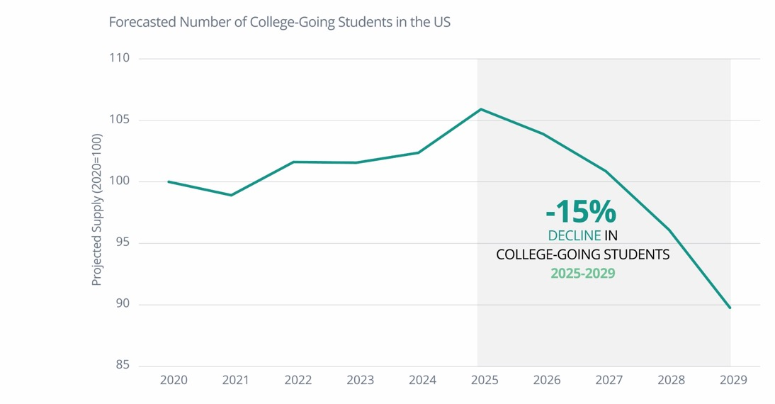
The Demographic Cliff is Coming
Notes:
Birth rates and other demographics are amplifying today’s complexities
The data from Nathan Grawe and WICHE show:
Demographics are working against colleges and universities
There are not enough students to fill beds.
Unique views of the combine data help institutions understand where their admission markets stand
COVID-19 has accelerated the trends

Slide 10
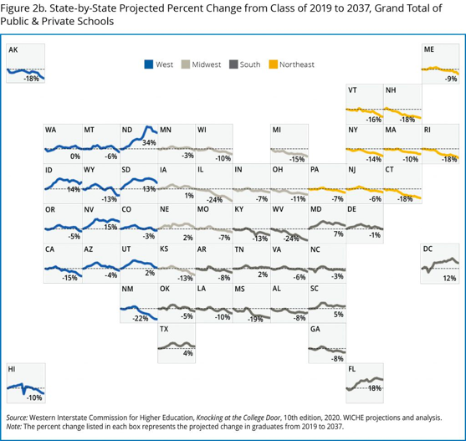
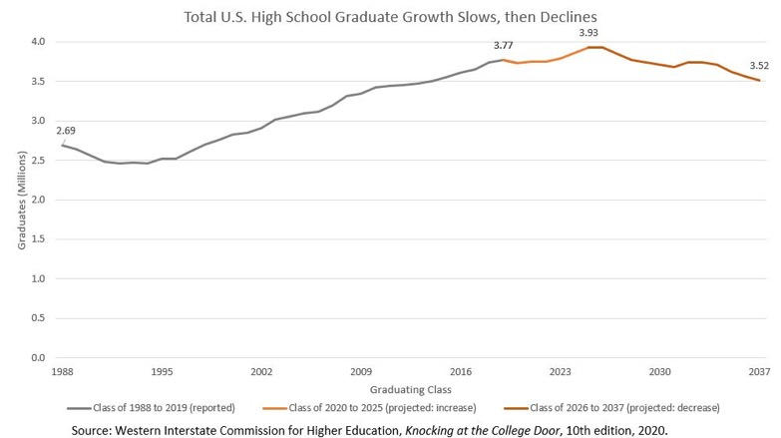
And Will Not Get Better
Notes:
At Othot we have built an advanced analytics SaaS platform that guides colleges and universities to make informed decisions throughout the entire student to alumni lifecycle by better understanding each individual.

Slide 11
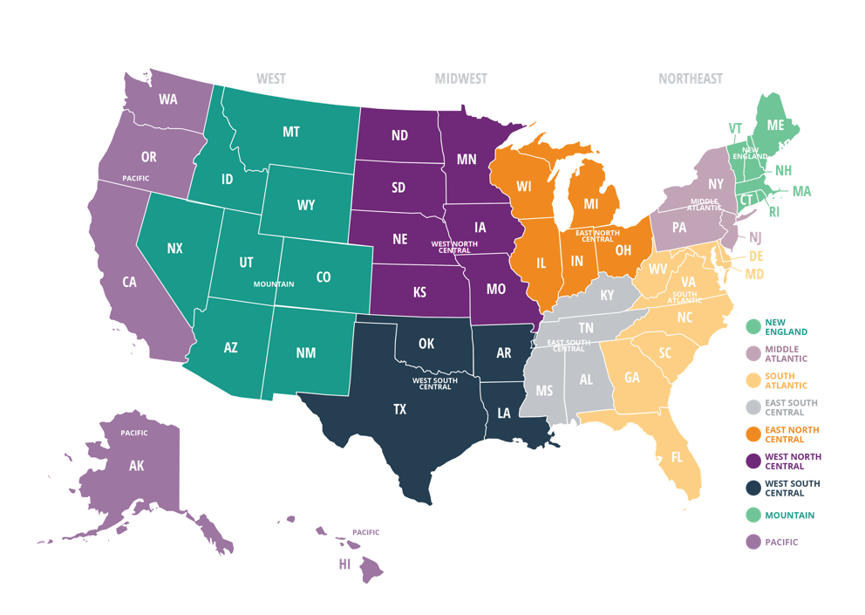
Census Regions and Divisions of the United States

Slide 12
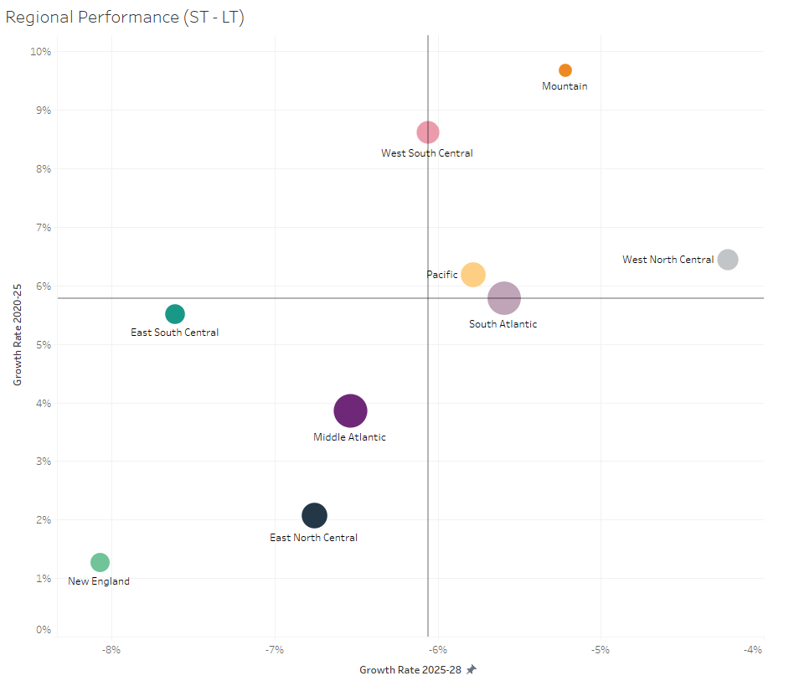
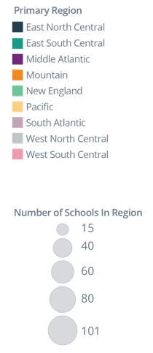
Different Regions Will Experience Different Market Growth Rates
Projected growth rates vary materially by region, both in the near term, 2020–25 (vertical axis), and following the enrollment cliff, 2025–28 (horizontal axis).

Slide 13
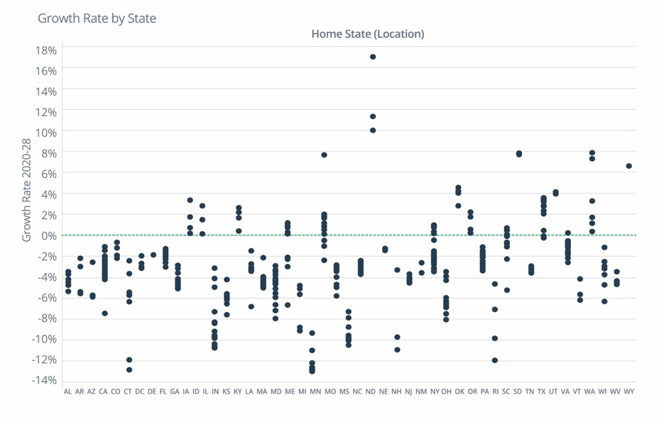
Forecasts Vary Within and Across States
The projected decline is typically discussed from a national perspective leaving many with the impression of a shared fate.
A deeper look at the data shows a different reality — the declines will be profoundly uneven, varying across and within states.
The future of enrollment will not be felt equally by all schools.
Implication: Even within states, market growth rates vary significantly, institution-by-institution
Notes:
The expected impact of the demographic shift varies considerably across institutions, even among institutions in the same state.
Overall, 80% of the institutions are projected to see negative growth rates.

Slide 14
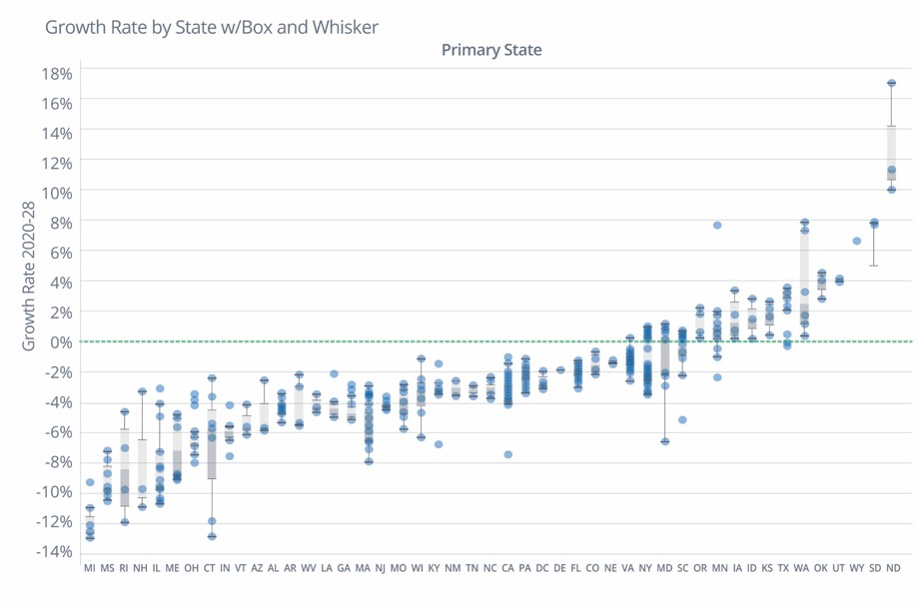
Forecasts Vary Within and Across States
Notes:
73% (I THOUGHT THIS WAS 80% (perhaps institutions)) of the states have a mean growth rate at or below zero.
Most of the states projected to grow significantly have relatively small populations and therefore cannot offset or replace the aggregate losses in other states.

Slide 15
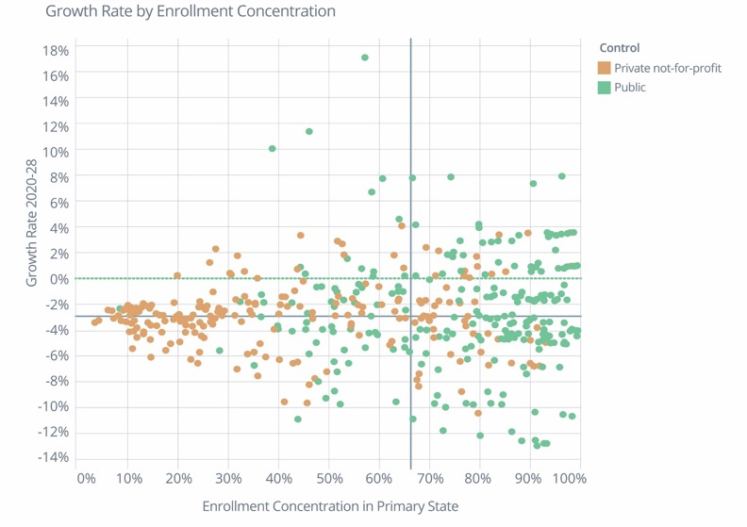
Geomarket Concentration: Friend or Foe?
Enrollments at schools recruiting mostly in a single state are driven by the number of high-school graduates in that state.
Some of these will benefit from growth rates higher than the nation’s, while others will be pulled down by below average growth rates.
Institutions that already have a presence in several states are better able to shift enrollment efforts across these states than institutions that do not.
Implication: there will be less variance in market growth for institutions that have a geographically diversified recruitment strategy.
Notes:
If an institution’s recruitment is highly concentrated in a single state (right hand side of graph), their market moving forward is going to be highly dependent on demographics in that state:
If that state has positive demographic outlook, the institution has a positive outlook
But, if that state has negative demographic outlook, that is bad news for the institution
Note the dispersion of growth rates on the rhs of graph
On the other hand, institutions with recruitment that is more dispersed across a large number of states, are less reliant on projections for any individual state. These institutions also have the advantage that they can more easily shift their recruitment into states projected to see growth
For many public institutions, where they are and where they recruit are the same. For that reason, there is more variance in growth rates across public institutions than across private institutions, which tend to have more diversified recruitment markets.

Slide 16
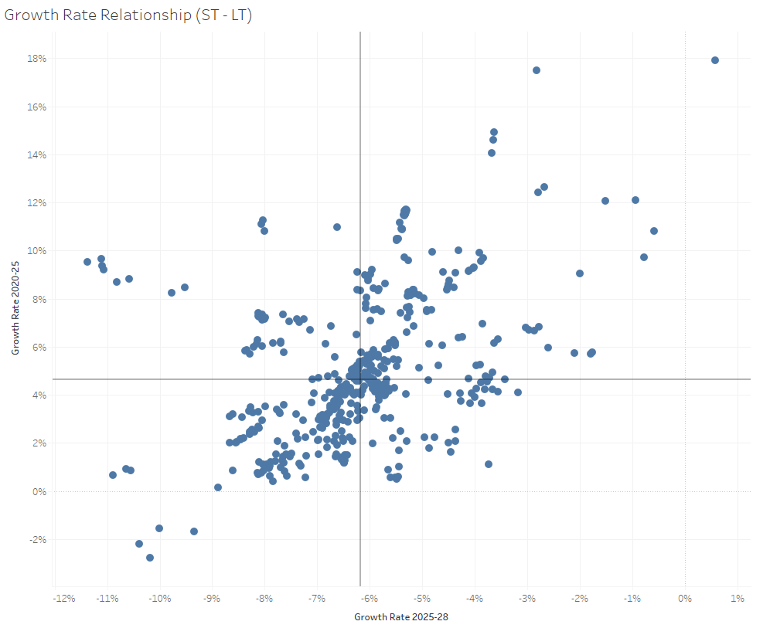
Drive Strategy Based on Market Growth Rates Before and After the Peak
Appropriate strategies to move forward depend not only on longer-term projections over the decade but on the timing of growth and decline.
Where a school falls in this graph highlights how critical it is to diversify the recruiting strategy as well as the urgency to change.
Implication: Opportunities to reorient
recruitment depend on projected growth in the near-term (2020-25) as well as projected declines thereafter (2025-28).

Slide 17
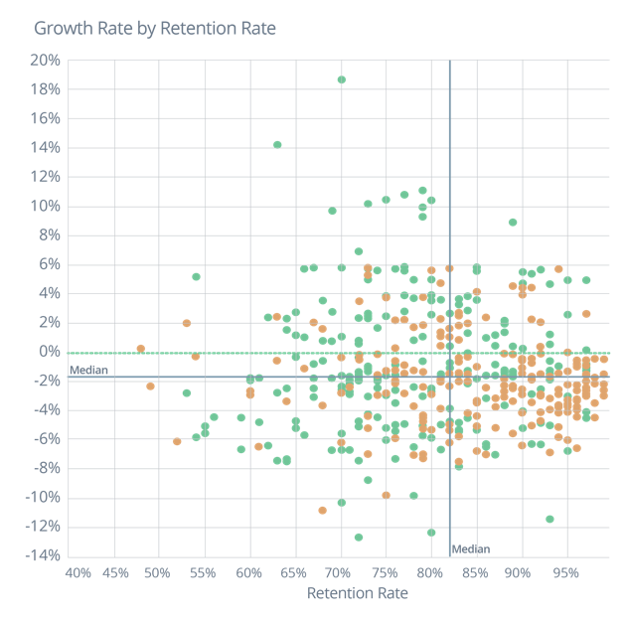
Retention Strategy Must Be an Important Part of Overall Strategy
In addition to recruitment strategy refinement, a school can diversity or fortify its enrollment position by retaining a larger portion of those students who do enroll. Perhaps counterintuitively, this opportunity is
Implication: For many institutions, improving retention rates is good strategy for maintaining overall enrollments in the face of declining numbers of new students.

Slide 18
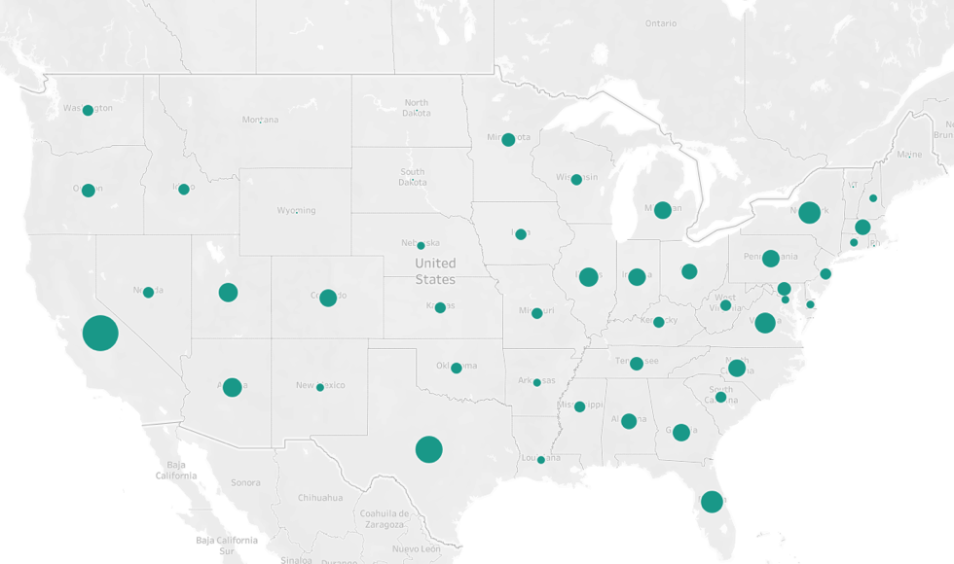
The Impact of National Schools –
The Big Get Bigger, Because They Can
“U-M, MSU thrive, while Michigan regional universities scramble for students”
Size of dot is proportionate to the number of national schools in that state.
Notes:
National Schools (those that recruit with a national footprint, have significant recruiting resources and rank high on national rankings) are expected to maintain their current enrollment size, regardless of the market declines. As such, these 162 schools will further reduce the number of high school graduates available for other schools to recruit.

Slide 19
How to Futureproof

Slide 20
Projected Market Area Growth in the 2020’s
The number of traditional college-age students in Sample University’s current market area is projected to see 3.9% growth in the short term (2020-25), followed by decline of 6.0% in the latter half of the decade (2025-28).

Slide 21



Predictive and Prescriptive Analytics
How can we
make it happen?
VALUE
Commercial
Leaders:
What will
happen?
Prescriptive
Analytics
Why did
it happen?
Predictive
Analytics
What
happened?
Diagnostic
Analytics
Descriptive
Analytics
Hindsight
Insight
Foresight
Gartner Analytics Value Escalator
www.gartner.com
DIFFICULTY
21

Slide 22
Advanced Analytics Strategies for Futureproofing Your Institution
Increase yield rates within your existing geographic footprint:
Identify first and second next actions to maximize the probability of each specific student to enroll based on student behavior – i.e., financial awards, relationship activities (high school or campus visits, calls, etc.), marketing programs (status, programs, etc.)
Understand the price sensitivity of each prospect and award necessary to maximize enrollment at your goal NTR
Develop new recruiting geographies to find “best-fit” students:
Are you, in fact, maximizing opportunities in your feeder markets?
Identify locations and new recruitment efforts to identify students in those regions
Know which marketing and recruitment tactic will have the biggest impact on a student applying and enrolling
Increase retention/ persistence rates to be in the top quartile of your cohort/competing schools:
Determine the likelihood of a student to persist, before and after they step onto campus
Identify which interventions are most likely to improve retention of each specific student
While optimizing recruitment, marketing, financial aid, and student success resources

Slide 23
Q & A

Slide 24

Thank You
Chris Lucier
clucier@liaisonedu.com

