Slide 1


Slide 2
A Clear Call to Action: Equity, Access, and Innovation in Admissions Today
Kristin Tichenor, Ed. D | Vice President for Enrollment, Wentworth Institute of Technology
David Poole | Research Director, EngineeringCAS, Liaison
2:45 p.m. – 3:30 p.m.

Slide 3
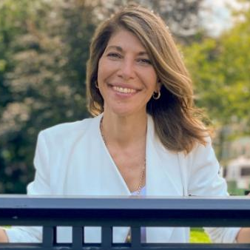



Panelists
Kristin Tichenor, Ed.D.
David Poole
Vice President for Enrollment
Research Director

Slide 4

Summer Relaxation
Notes:
We’re glad you joined us for the session
Summer has arrived
Record heat waves
Everyone is calm, right?

Slide 5

Summer Reality
Notes:
We’re glad you joined us for the session
Summer has arrived
Record heat waves
Everyone is calm, right?

Slide 6
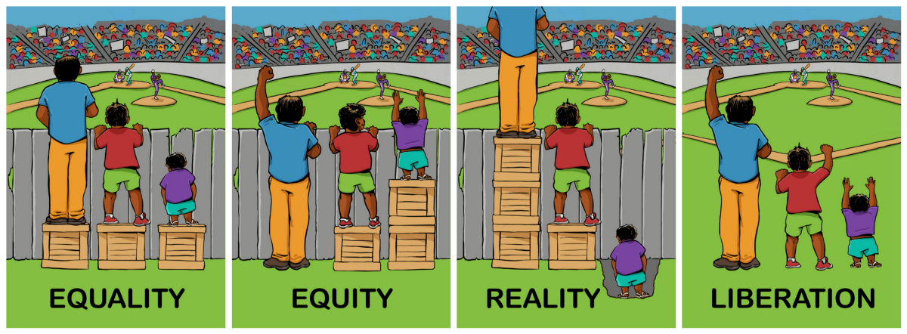
What are we working for…
Notes:
Diversity – differences/similarities (age, culture, disability, ethnicity, gender, race, etc.)
Inclusion – a sense of belonging, feeling valued, supportive environment and commitment
More than an initiative but it must be an organizational imperative
Outreach – early pipeline development (examples)
Collaboration with discipline-specific organizations (examples)
Chief Diversity Officers
Campus Climate Efforts
Retention efforts
Institutional History revisited and appropriate action

Slide 7

Global Disruptor
Notes:
Enrollment Woes
Total undergraduate enrollment has dropped by nearly 1.4 million — or 9.4 percent — during the pandemic
National Student Clearinghouse Research Center indicated that 662,000 fewer students enrolled in undergraduate programs in spring 2022 than a year earlier, a decline of 4.7 percent. Spring 2022 showed slight increase
Graduate and professional student enrollment, which had been a bright spot during the pandemic, also declined 1 percent from last year.
International enrollment woes
Future trends not hopeful – a survey of Spring 2022 graduates as reported by Inside Higher Ed:
Only 47% of all high school seniors plan on attending a four-year college
The percentage of Latino students who want to go to college dropped from 79 percent to 71 percent.
The percentage of Black students who want to go to college dropped from 79 percent to 72 percent.
However Graduate Enrollment among students of color increased the most — among Latinx students, there was a 20.4% year-over-year increase; among Black or African American students, a 16% increase; and among American Indian and Alaska Native students, an 8.8% increase.
Across all institutions, the report found, business, biological and agricultural sciences, and health sciences saw the greatest increases, while engineering fields saw the greatest declines in enrollment.

Slide 8


Global Disruptor
Notes:
Holistic Admission
Re-evaluating the process (removal of standardized tests like the SAT or GRE) accelerated
Factors for success

Slide 9

Impact on Enrollment Management
Notes:
Holistic Admission
Re-evaluating the process (removal of standardized tests like the SAT or GRE) accelerated
Factors for success

Slide 10

Innovate with People and Technology
Notes:
Holistic Admission
Re-evaluating the process (removal of standardized tests like the SAT or GRE) accelerated
Factors for success

Slide 11
Q & A

Slide 12
Thank You
Kristin Tichenor, Ed.D.
Vice President for Enrollment
Wentworth Institute of Technology
tichenork@wit.edu
David Poole
Research Director, EngineeringCAS
Liaison International
dpoole@liaisonedu.com

